Slide 1
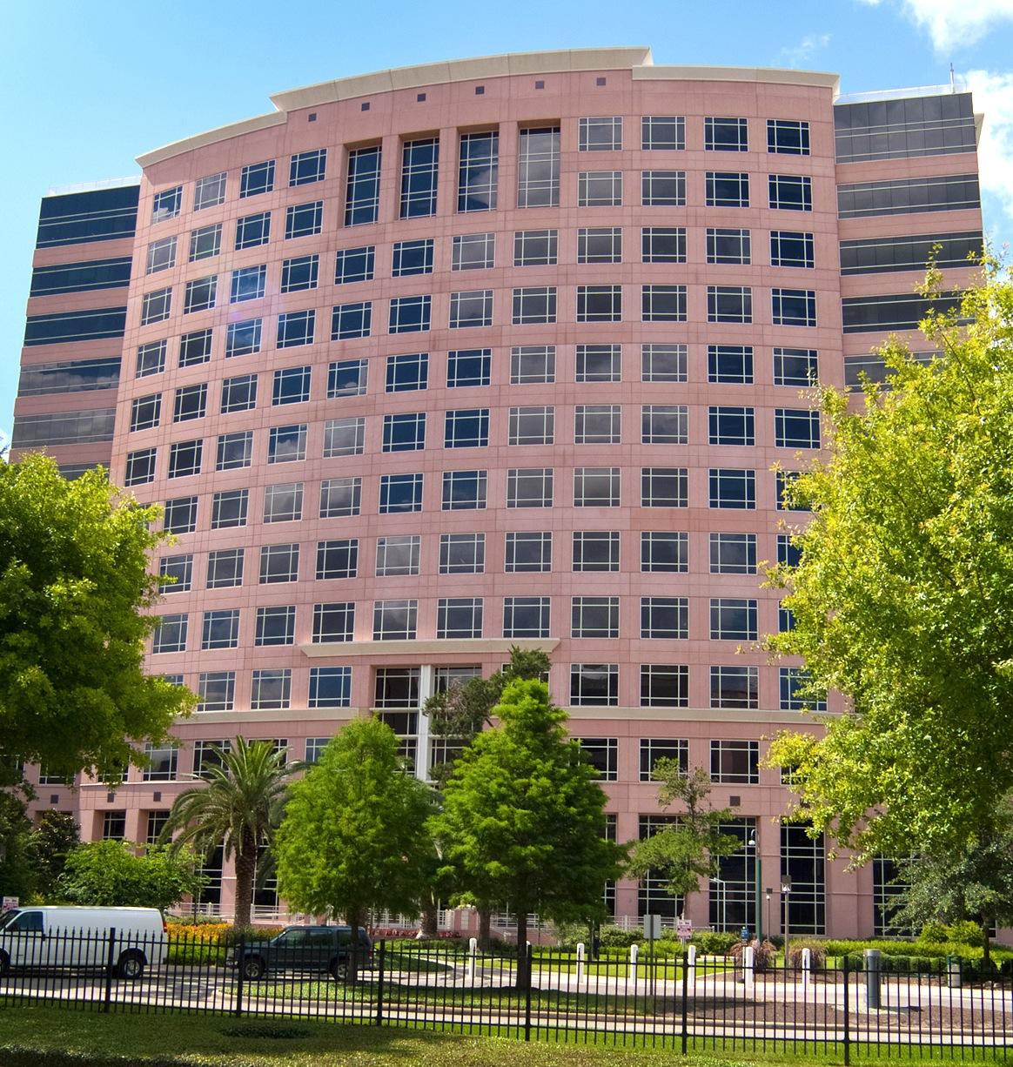
FERPA BASIC TRAINING SLIDES
Content Provided By:
Barbara Holthaus
U.T. System Administration
Office of General Counsel
April 2015

Slide 2
WHAT IS FERPA?
It is a Federal law: the Family Educational Rights and Privacy Act, and federal regulations - (34 CFR Part 99).
It gives right to students enrolled at an educational institution to:
Inspect, review and request amendments to errors in their ‟Education Records”; and
Give their consent before their Education Records are used or disclosed unless a specific FERPA exception applies.
FERPA contains specific exceptions which allow the institution to use or disclose an Education Record without the students’ consent.
Slide 2

Slide 3
WHAT DO I HAVE TO KNOW ABOUT FERPA?
FERPA is a federal law. All educational institutions that fail to have policies and procedures to ensure FERPA compliance can be audited and/or subject to legal action by the US Department of Education. In extreme cases they can lose all federal funding.
Slide 3

Slide 4
WHAT DO I HAVE TO
KNOW ABOUT FERPA?
(Continued)
Regents Rule 50702 and UTS 183 require MD Anderson to:
Adopt policies and procedures that ensure that all faculty and staff can comply with the UT System-wide Policy on FERPA;
Provide all employees with awareness training about those policies and procedures;
Provide specialized and in-depth training to offices and employees as required; and
Make sure that all contracts that involve third party access to FERPA Data have FERPA compliant language.
Slide 4

Slide 5
GOALS FOR THIS TRAINING
Familiarize you about the kinds of records and information you are likely to encounter here at MD Anderson that are subject to FERPA.
Help you to understand the rules that apply to using or disclosing records subject to FERPA.
Learn where to get help if you need to access a record that may be subject to FERPA or receive a request to provide someone with a record that may be subject to FERPA.
Slide 5

Slide 6
INFORMATION SUBJECT
TO FERPA
EDUCATION RECORDS
• ‟Education Records” are defined by FERPA as any records which…
– contain information directly related to a student who is, or was in attendance at an educational at an institution; and
– are maintained by the institution, or by a party acting for institution.
Slide 6

Slide 7
INFORMATION SUBJECT
TO FERPA (Continued)
EDUCATION RECORDS INCLUDE:
– ALL records in any format including: emails to, from, or about a student maintained by a faculty or staff member in a personal or private email account, test papers, essays, computer records, tracking information from a card swipe, film, photos, videos, audio tape, records of disciplinary hearings, application files of any individual enrolled or previously enrolled as a student.
– Personally Identifiable Information: Information obtained from Education Records that, alone or combined with other information, can be used to identify a student.
Slide 7

Slide 8
INFORMATION SUBJECT
TO FERPA
(Continued)
EDUCATION RECORDS INCLUDE:
– Employment records of students working in jobs designated as ‟work-study” positions.
– ‟Education Records” created or maintained by a third party that has a contract to provide a service that the institution could have performed internally.
EDUCATION RECORDS ARE EVERYWHERE!
Slide 8

Slide 9
EXAMPLES OF WHAT ARE
NOT ‟EDUCATION RECORDS”
– Information that is personally observed by a staff or faculty member;
– Records created and maintained by a law enforcement unit solely for law enforcement purposes;
– Employment records of individuals who are employed in a job that does not require student status and can be filled by any person;
– Medical records made and maintained about treatment provided to students by a health care provider including UT Health’s Student Health and Counseling Services;
Slide 9

Slide 10
EXAMPLES OF WHAT ARE
NOT ‟EDUCATION RECORDS”
(Continued)
– Application files of individuals who do not enroll as students;
– Financial information about a student’s parent or guardian;
– A record from which all Personally Identifiable Information has been removed such that the record cannot be used alone, or in combination with other information, to identify a student to whom the record pertains; and
– Records that only contain information about alumnus not connected with the alumnus’ attendance as a student.
• REMINDER:
MD Anderson is a public institution and a state agency. Almost every record you create or encounter in your employment here is likely to be considered a state record, even if it is not an Education Record subject to FERPA.
Slide 10

Slide 11
WHO IS A ‟STUDENT”
UNDER FERPA?
• Any individual who is or was ‟in attendance” at the institution.
• At UT System, ‟student” is defined as any individual enrolled in a course of study leading to a degree.
• At MD Anderson, this includes individuals enrolled in the School of Health Professions and the Pediatric Education and Creative Arts program (School Program).
• ‟Student” does not include an individual enrolled in community education classes, continuing education, and other similar programs.
Slide 11

Slide 12
PARENTS AND FERPA
• At the K-12 level, FERPA provides parents of students under the age of 18 the right to review their children’s Education Records and to give consent to access and to the release of the records in the absent of an exception.
• At the University level, this right transfers to the student, even if the student is under the age of 18 and/or the parent is paying the student’s tuition.
• This may not always sit well with some parents. The Registrar, the Privacy Officer, the Offices of Student Affairs and Legal Services all have experience and training to help a parent who is unhappy about the restrictions that FERPA places on their ability to obtain information about their children. If you encounter an unhappy parent, seek help from these resources.
Slide 12

Slide 13
WHO MUST COMPLY
WITH FERPA
All Workforce members (employees, trainees, contractors, and volunteers) who access or use ‟Education Records” of MDA Anderson students for any reason.
Slide 13

Slide 14
More About ‟FERPA” and FERPA DATA
• For purposes of this training, Education Records and Personally Identifiable Information is referred to as ‟FERPA DATA”.
• FERPA limits both the ‟Use” and ‟Disclosure” of FERPA Data:
– ‟Use” is any access to FERPA Data by (1) an MD Anderson Workforce member for any purpose; or (2) a third party pursuant to a FERPA compliant contract.
– ‟Disclosure” is the granting of access to FERPA Data to a third party outside of the institution.
• FERPA also applies to information disclosed verbally if the information was originally obtained from an Education Record (i.e., an employee reads a student transcript and then tells a reporter what grade the student received.)
Slide 14

Slide 15
FERPA’S STUDENT CONSENT
REQUIREMENTS
• An educational institution must obtain a student’s consent for the use or disclosure of his or her educational records UNLESS a specific statutory provision allows its use or disclosure without first obtaining consent.
• FERPA provides numerous exceptions to the consent requirement.
Slide 15

Slide 16
FERPA’S EXCEPTIONS
The ‟University Official” Exception
• The ‟University Official Exception” (also called ‟the School Official Exception”) is very broad and allows employees to perform their duties.
• The ‟University Official Exception” permits MD Anderson Workforce members to use and disclose an Education Record without student consent for any ‟legitimate educational purpose.”
– A legitimate educational purpose includes performance of any duty a University employee is required or permitted to perform as a University employee.
Slide 16

Slide 17
FERPA’S EXCEPTIONS
The ‟University Official” Exception (Continued)
– But the exception prohibits use or disclosure of the same record for any other purpose, including:
• any personal purpose, such as to defend yourself against a personal complaint, and
• disclosure to a third party, such as a law enforcement official or the media, even if the University Official believes the disclosure is required for the public good.
Slide 17

Slide 18
EXAMPLES OF OTHER FERPA EXCEPTIONS THAT ALLOW USE OR DISCLOSURE OF FERPA DATA WITHOUT STUDENT CONSENT
– To Federal or State authorities, including System Administration and the Board of Regents, authorized by law to audit or evaluate a state or federally funded education program, or to bring an enforcement action regarding an educational program.
– To another institution to which a student has applied for enrollment.
– To organizations conducting studies on behalf of educational institutions pursuant to a FERPA compliant agreement.
Slide 18

Slide 19
EXAMPLES OF OTHER FERPA EXCEPTIONS THAT ALLOW USE OR DISCLOSURE OF FERPA DATA WITHOUT STUDENT CONSENT (Continued)
– To comply with a valid judicial order or subpoena.
– In a health or safety emergency, but on a case by case basis to the extent determined by the institution to be required to address the emergency.
– Results of a disciplinary hearing in some specific circumstances.
– In connection with financial aid for which the student has applied or received, to determine eligibility, amount, conditions of aid, or enforce conditions and terms of aid received.
Slide 19

Slide 20
EXAMPLES OF OTHER FERPA EXCEPTIONS THAT ALLOW USE OR DISCLOSURE OF FERPA DATA WITHOUT STUDENT CONSENT (Continued)
– Disclosure of information on students legally required to register as a sex offender.
– If the data is ‟Directory Information” (i.e., name, address, email address, phone number, dates of attendance and other such directory information designated in MD Anderson’s FERPA policy.)
• HOWEVER, Directory Information may not be released without a student’s consent if a student has ‟opted out” of this exception.
Slide 20

Slide 21
EXAMPLES OF OTHER FERPA EXCEPTIONS THAT ALLOW USE OR DISCLOSURE OF FERPA DATA WITHOUT STUDENT CONSENT (Continued)
• MD Anderson’s FERPA policy and school catalog provide information as to how a student may ‟opt out.”
• An Opt Out remains in effect, even after the student leaves MD Anderson, until the student revokes it in writing.
NOTE: Normally only the Public Information Officer, or official trained and authorized to release information under the Directory Exception, should do so. This is because, in some cases, releasing Directory Information in a particular context may reveal Personally Identifiable Information about a student, which is a FERPA violation.
Slide 21

Slide 22
EXAMPLES OF OTHER FERPA EXCEPTIONS THAT ALLOW USE OR DISCLOSURE OF FERPA DATA WITHOUT STUDENT CONSENT (Continued)
– For example, a requestor asks for the Directory Information about all students who have a GPA under 2.5. If the school releases the requested Directory Information, this will reveal to the requestor that each of these students has a GPA of less than 2.5. That would be a FERPA violation.
THIS IS NOT AN EXHAUSTIVE LIST. SEEK HELP FROM THE SHP’S ASSOCIATE DIRECTOR OF ACADEMIC AND STUDENT AFFAIRS, SCHOOL PROGRAM’S MANAGER, OR LEGAL SERVICES BEFORE RELEASING ANY INFORMATION THAT MAY BE SUBJECT TO FERPA!
Slide 22

Slide 23
WHO MUST COMPLY
WITH FERPA?
• UT System Administration Offices and the Board of Regents: System officials can access an institution’s FERPA data under certain exceptions (i.e., to provide it to a third party under the Research or Audit exceptions, such as for Coordinating Board reporting.) All such data must be used and maintained by System or the Board only as permitted by FERPA, including entering into a FERPA compliant contract with the third party that restricts the third party’s subsequent Use and Disclosure the data.
• Contractors: MD Anderson can outsource the provision of services that involve third party access to, or creation, of FERPA Data to a contractor if the contract requires the vendor to comply with the institution’s requirements for maintaining all FERPA Data confidentially and securely.
Slide 23

Slide 24
CONTRACTS AND FERPA
• In contracting for services, you must first determine if the contract will or may involve outsourcing of MD Anderson’s FERPA Data to a contractor. This includes contracts where students are required to give their personal information directly to the contractor, who then maintains or processes it on behalf of MD Anderson.
• If a potential contract involves any outside access to FERPA Data, the contract must contain specific terms that require the contractor to comply with the institution’s specific FERPA compliant confidentiality and security requirements.
Slide 24

Slide 25
CONTRACTS AND FERPA (Continued)
• If you are not sure if FERPA Data will be involved in a contract you are working on, it is your obligation to find out.
• You can also get help from [Privacy Person at institution], [name of institution’s in-house legal officers] [or] the Office General Counsel at UT System if you are not sure if a contract involves FERPA data.
Slide 25

Slide 26
FERPA AND INFORMATION
SECURITY
• Unlike HIPAA and other Breach Notification Laws, FERPA is not a Security Rule. However, since FERPA requires MD Anderson to keep FERPA Data confidential, it must be maintained securely at all times.
• You must know, understand and follow MD Anderson’s general rules for handling and storing confidential data securely as to all FERPA Data that you use or maintain.
Slide 26

Slide 27
FERPA AND INFORMATION
SECURITY
(Continued)
• If you become aware that FERPA Data is subject to unauthorized access, you must report it immediately as a potential security incident to MD Anderson’s Information Security Offices so that the proper individuals can investigate and determine what MD Anderson’s duties are to respond to the incident, depending on the type of FERPA Data and the nature of the access that occurred.
• Under FERPA, most unauthorized access does not require provision of breach notices to affected students, but FERPA does require the access to be documented in the affected student’s records. Also, other breach notice laws may apply to certain FERPA data (i.e., if the FERPA data includes a student’s SSN.)
Slide 27

Slide 28
HOW DO I KEEP IT
ALL STRAIGHT?
• You don’t have to be a FERPA expert on your first day! This training is provided to make you aware of the fact that FERPA Data is everywhere and some of the information accessible in your new position may be subject to FERPA.
• The general rule of thumb is that as long as you are only accessing and sharing information as needed to do your job, you are probably complying with FERPA since the University Official Exception allows any Workforce member to access any FERPA Data the member needs to perform an official duty.
• If you are involved in sharing University records or information with others, you need to be aware that some of it, including emails that you send and receive may contain FERPA Data. You must understand your department’s or office’s policies and procedures for using and sharing FERPA Data.
Slide 28

Slide 29
HOW DO I KEEP IT
ALL STRAIGHT?
(Continued)
• If you aren’t 100% sure what to do, get help! If you receive a subpoena, Texas Public Information Request, litigation hold, or some other request for records that you are not specifically trained to respond to: Get help. Ask your supervisor or contact Legal Services.
• Under UT System’s FERPA rules, MD Anderson will provide more extensive training to employees who are likely to have routine access to FERPA and the specific requirements they will need to follow.
– If you work in an office such as Student Affairs, or Information Technology, Information Security that handles a high volume of FERPA Data, you will probably be learning a lot more about FERPA in the future.
– If you are involved in contracts, you probably will, too.
– If you think you need training and you haven’t gotten it - ask!
Slide 29

Slide 30
WHAT IF I THINK I (OR SOMEONE ELSE) MAY HAVE VIOLATED FERPA?
Don’t panic!
Tell your supervisor immediately.
Make sure that the proper report is made to the School of Health Profession’s Associate Director of Academic and Student Affairs at (713) 745-1205 or the School Program’s Manager, as appropriate, and Information Security.
Cooperate - help your department or office figure out what went wrong so it can fix any problems, (including ineffective policies), so there isn’t a next time!
Slide 30

Slide 31
FINAL THOUGHTS
Remember that FERPA Data is everywhere!
MD Anderson’s policies on FERPA are at [insert websites for the Handbook of Operating Procedures and other FERPA policies at the institution].
The persons at MD Anderson who can answer questions about FERPA or this training are the:
School of Health Profession’s Associate Director of Academic and Student Affairs, Brandon Hernandez, at (713) 745-1205 or bhernandez2@mdanderson.org; and
School Program’s Manager, Daniel Smith, at
(713) 792-7681 or dlsmith4@mdanderson.org
Slide 31

Slide 32
FINAL THOUGHTS
(Continued)
The UT System Privacy Coordinator in the Office of General Counsel, Barbara Holthaus, bholthaus@utsystem.edu, is also available to advise institutions on interpreting and understanding FERPA.
The federal regulations on FERPA are at http://www2.ed.gov/policy/gen/guid/fpco/pdf/2012-final-regs.pdf
Regents Rule 50702 is at http://www.utsystem.edu/board-of-regents/rules/50702-confidentiality-and-security-education-records-subject-family-education
UTS 183 on FERPA is at http://www.utsystem.edu/board-of-regents/policy-library/policies/uts183-maintenance-education-records-subject-family-educati
When in doubt about FERPA, ask somebody!
Slide 32

