Slide 1
UT Systems Kenneth I. Shine MD Academy of Health Science Education 2024 Innovations In Health Science Education Meeting
Award & New Member Induction Ceremony

Slide 2
Celebrating our 20th Year! Recognitions and Acknowledgments
Thanks to all of the contributors to the meeting
Recognizing Grantees
Innovations Finalists
Poster Awards
Induction of New Members

Slide 3
Behind the Scenes
Unsung Heros:
UTMB Office of Education Development
D’Anne Dewitt Kimberly Turner
Elizabeth Freeman Chelsea Tippit
Texas Medical Association
Nicole Abbott
Dr Len Cleary
Dr Bridgett Piernik – Yoder
Dr Alison Ownby
Dr Karen Szauter
Ms Luann Berger

Slide 4
Thank You Dr Len Cleary!

Slide 5
Program was Successful Because of You
Presentations included:
Workshops 11
Discussion sessions 5
Short presentations 14
Collaborations 2
Oral Abstracts 24
Posters 69

Slide 6
Grants & Innovation Awards
Dr. Jose Cavazos, MD PhD

Slide 7
Recognition of the Committee
Joseph Albanesi Joya Chandra Nora Gimpel Virginia Niebuhr
Kay Oyajobi Craig Rubin Christine Baker Lisa Elferink
Deanna Grimes Annette Occhialini Bela Patel Susan Ruppert
Alexander Bishop Robert Esterl Carin Hagberg Mary O’Keefe
Evan Pivalizza Era Buck Moshtagh Farokhi Ruth Levine
Gayle Olson Omid Rahimi Jose E. Cavazos (Chair)

Slide 8
2024 Grant Awardees
Developing the Master Adaptive Learner: Coaching with Standardized Clinical Feedback
Andrea Cooley, DO, FACOS Co-Investigator: Derek Holbrook, EdD. UT Tyler SOM
Operationalizing App-Based Formative Feedback in Obstetrics and Gynecology Training to Establish Procedural Competency Benchmarks
R. Nicholas Burns, MD, FACOG Co-Investigator(s):Stephanie Chang, MD, Emily Lin, MD UT Southwestern SOM
Expansion of Cardiothoracic Surgery Debate-Style Journal Club to a Global Community of Learners and Educators
Mara B. Antonoff, MD, FACS Co-Investigator: Robert Hetz, MD UT MD Anderson Cancer Center
Increasing Health Equity Competencies through Implementation of a 10-Week Student-informed Summer Intensive Fellowship
Jemima John, PhD, MPH Shreela Sharma UT Health Houston SPH
The Hunter's House: A Virtual Reality Memory Palace for Surgical Education
Joshua A. Roshal, MD University of Texas–Medical Branch

Slide 9
Dr. Judith Drew Innovation in Health Science Education Award

Slide 10
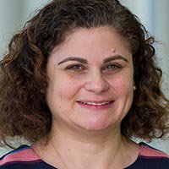
Dr. Judith Drew Innovations Award Finalist
Toxidrome-apalooza
Adriane De la Cruz, MD, PhD
Assistant Professor of Psychiatry
UT Southwestern
3rd

Slide 11
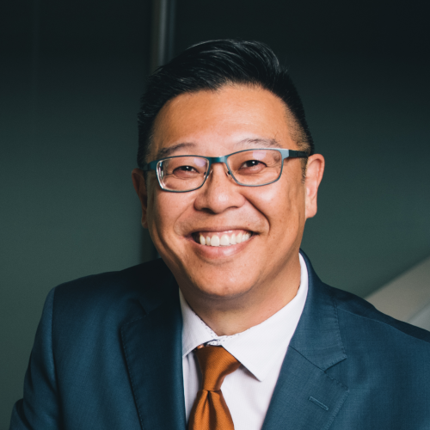
Dr. Judith Drew Innovations Award Finalist
Interprofessional Integration Curriculum
John C. Luk, MD
Assistant Dean for Interprofessional Integration
UT-Austin Dell Med
2nd

Slide 12
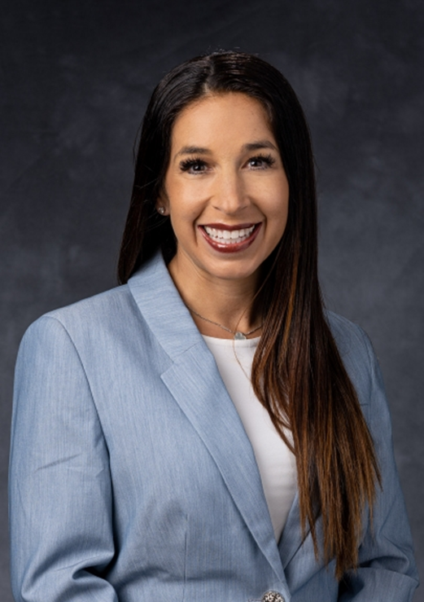
Dr. Judith Drew Innovations Award Finalist
Cardiothoracic Surgery Debate-Style Journal Club: Application of Evidence to Real-World Patients
Mara B. Antonoff, MD, FACS
Associate Professor of Thoracic & Cardiovascular Surgery
Co-Investigator: Robert Hetz, MD
Assistant Professor of Thoracic & Cardiovascular Surgery
UT MD Anderson Cancer Center
1st

Slide 13
Poster Awards

Slide 14
Poster Judges
LuAnn Wilkerson
Michael Ainsworth
Jeffrey Levin
Peggy Hsieh
Gary Rosenfeld
Dorothy Sendelbach
Patti Olusola
Donna Morris
Annette Occhialini
Evan G Pivalizza
Janine Prange-Kiel
Linda Rounds
Andrew E Springer
Holly West
Lisa Elferink
Saadia Faiz
Rekha Kar
John Luk
Melanie McEwen
Darlene F Metter

Slide 15
Poster Awards
36 poster presenters submitted their presentations for consideration
Pre-scoring based on poster
Final score at the meeting for Q& A

Slide 16
Students / Trainee Awards

Slide 17
UTMB Food Pantry “The Picnic Basket” Student Usage Outcomes
Beth Hawkins
Rebekah Brown
Shayna Edwards
Emma Tumilty, PhD
University of Texas Medical Branch at Galveston
Honorable Mention

Slide 18
Enhancing Health Literacy in CHFC3 Patients - A quality initiative: The Impact of Educational Binders on Heart Failure Management
Jessica Cox
Hannah Yu
Shayan Ravanassa
Elliot Hernandez
Martha Diaz,
Elizabeth Davis, MD,
Marysuna Wilkerson, MD
University of Texas Medical Branch;
Honorable Mention

Slide 19
Words Matter: Examination of language use in a case of pediatric obesity
Briana Pottinger
Jacee McCoy
Anna Matuk,
Michelle Barrat,
Emma Omoruyi,
McGovern Medical School UTHealth Houston
Honorable Mention

Slide 20
Apples to Oranges: Comparing the Quality of Pre-Med Resources on TikTok and YouTube
James Chen
Yasamin Rastgar,
Amy Wang ,
Brandon Lopez
University of Texas Medical Branch

Slide 21
Impostor Syndrome and its Associated Factors
James Yan, BS, UTHSCSA;
Kanapa Kornsawad, MD: UTHSCSA;
Aesha Aboueisha, MD: UTHSCSA;
Maria Woodward, MD, MS:
Ami Shah, MD: Rush University;
Adrienne Mann, MD: University of Colorado
Tyra Fainstad, MD: University of Colorado

Slide 22
The Power of Storytelling: A Novel Curriculum Strategy to Re-engage Physician Interns, Residents, and Fellows in the Art of Medicine
Johnna Wellesley, University of Texas Medical Branch
Ava McGuire, University of Texas at Austin
Aleena Asaria, University of Texas at Austin,
Carolyn S. Phillips, University of Texas at Austin,
Tyler Jorgensen, Dell Medical School at University of Texas at Austin

Slide 23
Poster Awards

Slide 24
The Art of Nursing Used to Enhance Therapeutic Communication
Elesha Roberts
The University of Texas at Austin
Honorable Mention

Slide 25
Impact of Psychiatric Pharmacist-led Psychopharmacology Didactics for Psychiatry Residents
Nina Vadiei
The University of Texas at Austin
Tawny Smith
Dell Medical School
Honorable Mention

Slide 26
Building Physician Educators: The Pediatric Academic Medicine Summer Preceptorship Program
Alayna Garcia
Mason Stevens
Autumn Atkinson
McGovern Medical School at UTHealth Houston
Honorable Mention

Slide 27
Curricular Integration of Population Health through Interprofessional Community Engagement
Young Veronica
The University of Texas at Austin;
Justin Pedigo, PharmD, BCPS,
The University of Texas at Austin and University of Texas Health Sciences Center at San Antonio

Slide 28
Using an Adaptive Approach to Integrating Health System Science and Community Service into Medical Education Curricula
Hani Serag
Sarah Siddiqui
Premal Patel
Kathleen Everling
Norman M. Farr
Farah Kudrath
Misha Syed
University of Texas Medical Branch

Slide 29
Simulators to Improve Confidence in Performing Joint Injections
Vijaya Murthy
Rohan Willis
University of Texas Medical Branch
Szauter K

Slide 30
Advancing Interprofessional Competencies in Senior Medical and Nursing Students: A Large-Scale Mock Paging Activity
Amy Gonzalez
Sidra Qureshi
Rebeka Watson Cambell
Shatoi King
University of Texas Medical Branch
Szauter K

Slide 31
People’s Choice Award !!
Application of Just Culture Principles and Best Practices for Effective Research Mentorship of Undergraduates
Daniel Ghaly, BS, The University of Texas at Austin, College of Natural Sciences
Maria Ghaly, The University of Texas, Osier Laboratory
Sanjana Poonuru, The University of Texas, College of Natural Sciences;
Zeal Pathak, The University of Texas, College of Natural Sciences;
Nico Osier, The University of Texas, School of Nursing

Slide 32
People’s Choice Award !!
Outcomes of a Multi-year Biomedical Research Program for High School Students: The Voelcker Biomedical Research Academy
Irene Chaps, Ph.D., UT Health San Antonio;
Kristen La Porte, UTHSA;
Adriana Avendano, UTHSA;
Olga Coronado, UTHSA;
Francis Lam, UTHSA;
DePass Anthony, Consulting;
Linda McManus, UTHSA;
Andrea Giuffrida, UTHSA, Western University of Health Sciences

Slide 33
Induction of New Members

Slide 34
Membership Committee
With Gratitude to the following Membership Committee Volunteer Reviewers
Judith Aronson (UTMB) Angela Mihalic (UTSouthwestern)
Gregory Botz (MDACC) Biff Palmer (UTSouthwestern)
Maximilian Buja (UTHSCH) Linda Rounds (UTMB)
William Clarke (UTHSCSA) Leonel Vela (UTRGV)
Sandra Hanneman (UTHSCH) John Vineeth (UTHSCH)
Peter Hu (MDACC) Dihua Yu (MDACC)
Gerald Ledlow (UT Tyler HSC)

Slide 35
Ammar M. Ahmed MD
The University of Texas at Austin

Slide 36
Swathi Arur Ph.D
The University of Texas MD Anderson Cancer Center

Slide 37
Saadia A. Faiz MD
The University of Texas MD Anderson Cancer Center

Slide 38
Deepu Varughese George PhD, LMFT
The University of Texas Rio Grande Valley

Slide 39
Philip E. Greilich MD, MSc
The University of Texas Southwestern Medical Center

Slide 40
Melinda Hermanns PHD, RN, PMH-BC, CNE, PN/FCN, ANEF, ACUE
The University of Texas at Tyler Health Science Center

Slide 41
Awdhesh Kalia PhD
The University of Texas MD Anderson Cancer Center

Slide 42
Rekha Kar PhD
The University of Texas Health Science Center at San Antonio

Slide 43
Janine Prange-Kiel Ph.D.
The University of Texas Southwestern Medical Center

Slide 44
Alan Rampy DO, PhD, FCA
The University of Texas at Austin

Slide 45
E. Steve Roach MD
The University of Texas at Austin

Slide 46
Andrew Everett Springer DrPH
The University of Texas Health Science Center at Houston

Slide 47
Jennifer Swails MD,FACP
The University of Texas Health Science Center at Houston

Slide 48
Misha F. Syed MD, MEHP
The University of Texas Medical Branch at Galveston

Slide 49
Thank you for attending the 2024 Innovations Meeting
Safe travels !
Start thinking about what you can share next year

