Slide 1

BUILDING THE BRIDGE
Excellence through Innovation, Education & Financial Stewardship
Improving The Effectiveness of Cleaning Patient Rooms

Slide 2
THE TEAM
Team Members
      CS&E Participant Doramarie Arocha
      CS&E Participant Ron Burke
      Team Member David Townson
      Team Member Elizabeth Thomas
      Facilitator Pat Griffith
Sponsor(s)
      M.D. Dr. James Luby

Slide 3
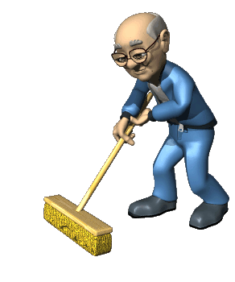

IMPROVING THE EFFECTIVENESS OF CLEANING PATIENT ROOMS

Slide 4
What We Are Trying to Accomplish?
AIM STATEMENT
Improve The Effectiveness of Cleaning Patient Rooms at UT Southwestern University Hospitals. We will improve the cleaning process outcomes by measuring adequate cleaning of the 17 high touch areas from the initial baseline from 69% to 95% by the end of the 4th Qtr. 2011.

Slide 5
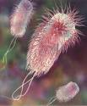


OBJECTIVE:
To Evaluate the Effectiveness of cleaning patient rooms to help eliminate clinically important nosocomial pathogens in each contaminated hospital room.

Slide 6


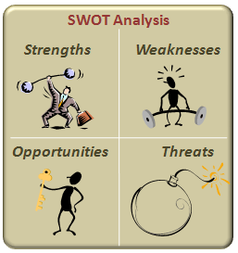
QUALITY TOOLS
Brainstorming
Process Mapping
SWOT
Checklists
Charts – Data measurement, collection & analysis
Survey of Environmental Services Staff

Slide 7
Effectiveness of Cleaning
SUPPLIERS
Environmental Services Infection Prevention Nursing Infections/Diseases Patient Rooms
PROCESSES
Patient Admit Notification of patient discharge from unit. (15 min. prior) Mark 17 high touch areas in patient room with Fluorescent Marking Gel | Environmental Services cleans the room Inspection team notified within 5 minutes | Rooms checked with UV light to determine how effectively the rooms were cleaned Immediate feedback to ES | Record results in the iPod mobile device | Data will be transferred to a database Summary & Graphs will be created based on data collected
CUSTOMER
Patient Family Hospital
INPUTS
ATP Fluorescent Marking Gel Applicators (DAZO) UV light iPod Cleaning Supplies Family Patients
OUTPUT
Obtain Monthly/Quarterly reports that will provide trend analysis | Benchmark against hospital baseline & other hospitals nationwide | Improve patient satisfaction Help reduce infection rates

Slide 8
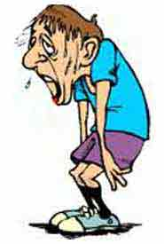

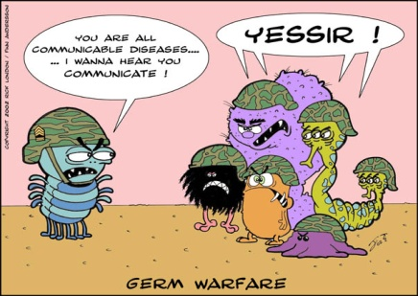
SWOT ANALYSIS
STRENGTHS Adequate time to clean room (certain locations/time of day). Adequate supplies needed for the job (EPA registered disinfectants) Quick response to failures Policies and Procedures in place Environmental monitoring of cleaning activities to determine effectiveness. Now have accurate methods of determining room cleanliness. | WEAKNESSES High employee turnover Inadequate training Lack of enthusiasm Failure to meet the standard for cleaning patient rooms Rushing to complete task Cleaning schedule Cutting corners due to time constraints and workload Not enough versatile workers
OPPORTUNITIES Re-train employees Preceptor for new employees Daily evaluation of cleanliness When personnel need more time, it should be documented and improvements made. Facilitate realistic goal settings for turnaround time Increase staff Regular cleaning schedules Outline effective cleaning methods Re-evaluate policies and procedures Increase education/In-services Include Infection Prevention as a partner. | THREATS Increase infection rates Increase hospital stay for patients Increase cost for patient & hospital Cross contamination between patients & employees Increase risk of outbreaks Employee turnover rates increased

Slide 9
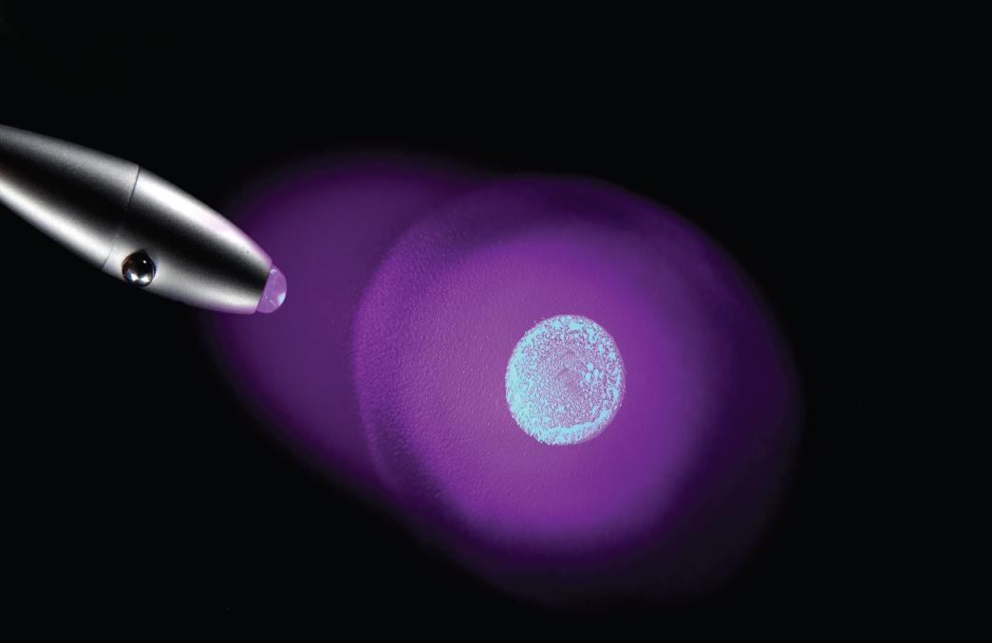
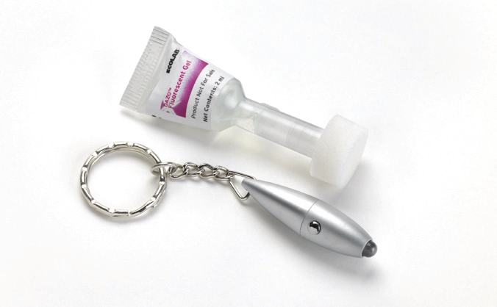
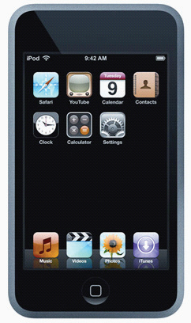
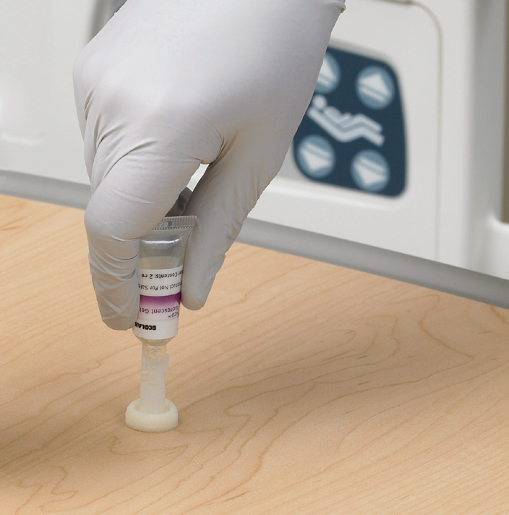
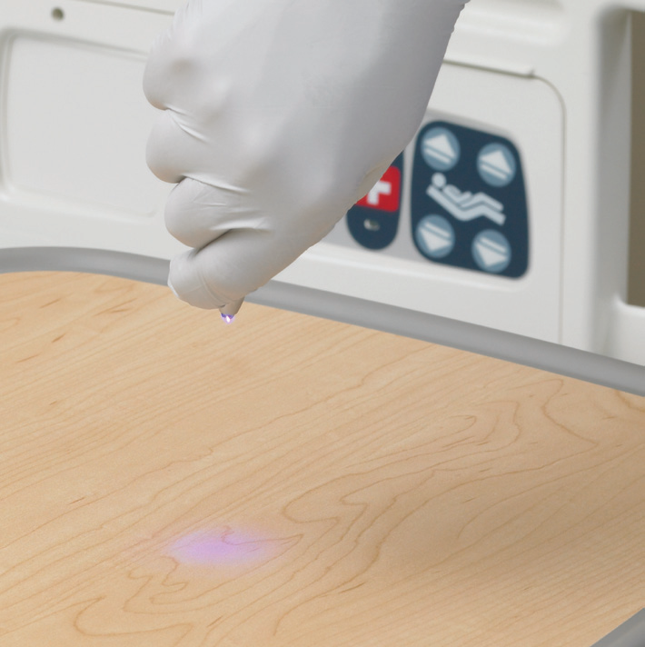
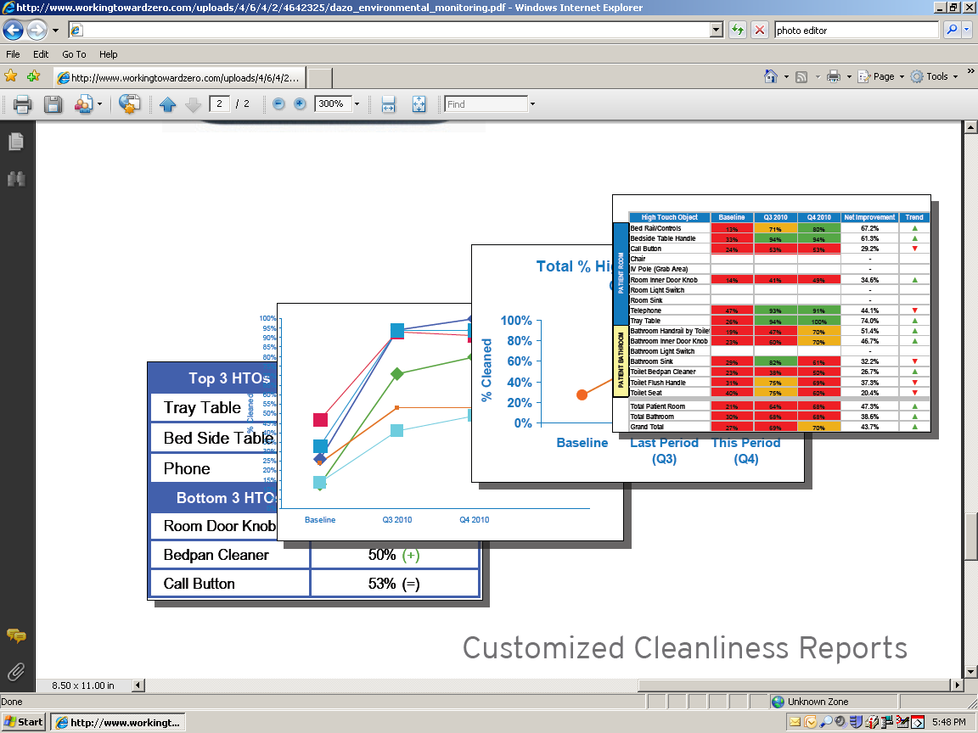
DAZO MONITORING SYSTEM
Notes:
Components of the process

Slide 10
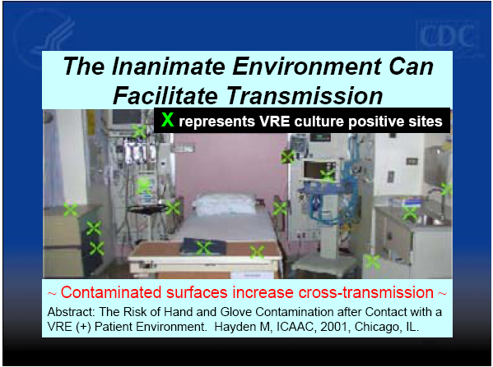

Notes:
VRE can survive on environmental surfaces for several days.
This slide shows a typical ICU room that had been cleaned and made ready for a patient. To test the effectiveness of cleaning procedures, investigators at a hospital in Chicago took cultures of several sites in the room to see if VRE was present. Everywhere you see a green X on the slide was a site where VRE was cultured from.
This really drives home the message on the importance of doing a good job with routine cleaning.
. . . share stories of MRSA outbreaks . . .

Slide 11
 | Progress & Trend Report Percent High Touch Object Cleaned
 | High Touch Objects | Baseline | Q2 2011 | Q3 2011 | Net Improvement (Over Baseline)
Patient Room | Bed Rail/Controls | 68% | 84% | 88% | 20%
 | Bedside Table Handle | 77% | 89% | 95% | 17%
 | Call Button | 59% | 64% | 82% | 23%
 | Chair | 60% | 71% | 49% | (11 %)
 | IV Pole | 63% | 70% | 61% | (2 %)
 | Room Inner Door Knob | 59% | 52% | 71% | 13%
 | Room Light Switch | 71% | 47% | 64% | (7 %)
 | Room Sink | 80% | 96% | 89% | 9%
 | Telephone | 67% | 73% | 78% | 11%
 | Tray Table | 88% | 86% | 93% | 5%
Patient Bathroom | Bathroom Handrail by Toilet | 59% | 56% | 81% | 22%
 | Bathroom Inner Door knob | 60% | 41% | 73% | 12%
 | Bathroom Light Switch | 59% | 54% | 66% | 7%
 | Bathroom Sink | 85% | 90% | 90% | 5%
 | Toilet Bedpan Cleaner | 57% | 60% | 81% | 24%
 | Toilet Flush Handle | 77% | 77% | 88% | 12%
 | Toilet Seat | 87% | 90% | 94% | 7%
Total | Total Patient Bathroom | 69% | 65% | 81% | 12%
 | Total Patient Room | 69% | 73% | 77% | 8%
 | Grand Total | 69% | 70% | 79% | 10%
 | n= (# of objects evaluated) | 1187 | 1254 | 1233
 | <70
 | 70% - 80%
 | >80%

Slide 14
Quarter | Bed Rail/Control | Bedside Table | Call Button | Chair | IV Pole | Room Inner Door | Room Light Switch | Room Sink | Telephone | Tray Table
Baseline (n=698) | 68% | 77% | 59% | 60% | 63% | 59% | 71% | 80% | 67% | 88%
Q2 2011 (n=772) | 84% | 89% | 64% | 71% | 70% | 52% | 47% | 96% | 73% | 86%
Q3 2011 (n=744) | 88% | 95% | 82% | 49% | 61% | 71% | 64% | 89% | 78% | 93%

Slide 15
Quarter | Bathroom Handrail | Bathroom Inner Door | Bathroom Light | Bathroom Sink | Toilet Bedpan | Toilet Flush | Toilet Seat
Baseline (n=489) | 59% | 60% | 59% | 85% | 57% | 77% | 87%
Q2 2011 (n=482) | 56% | 41% | 54% | 90% | 60% | 77% | 90%
Q3 2011 (n=489) | 81% | 73% | 66% | 90% | 81% | 88% | 94%

Slide 16
UTSW– QUARTER 3 Results
EnCompass™ Monitoring Program
Thoroughness of Disinfection Cleaning
Focus Areas
Top 3 HTO’s | % Cleaned
Toilet Seat | 90%
Tray Table | 89%
Room Sink | 89%
Bottom 3 HTO’s | % Cleaned
Bathroom Inner Door Knob | 58%
Bathroom Light Switch | 59%
Room Light Switch | 60%

Slide 17
SUMMARY
Healthcare-associated infections (HAIs) remain among one of the leading causes of death in the United States. There are 1.7 million HAIs reported annually, which cause approximately 99,000 deaths.
The goal of infection prevention is to eradicate the risk of patients acquiring infections from employees and their environment.
Environmental services play a significant role in providing proper healthcare to patients. Suboptimal cleaning can serve as a source for the transmission of microorganisms to patients.
Although, approximately $900 million is spent annually by hospitals in the United States on cleaning solutions, disinfection of rooms is below optimal.
Implementation will include providing educational services to housekeeping and utilizing marking methods, disinfection of patient rooms.
It is crucial for hospitals to utilize programs that increase the adequacy of disinfection. In order to optimize disinfection, collaboration between the infection control team and environmental services is necessary.
This process will be ongoing and our target will continue to be 95%.

Slide 18

