Slide 1
Quantum Leap
Project Management
Donna Thomas
Director, Project Management
Planview Training
March 2017

Slide 2
Agenda
Quantum Leap PMO Mission, Vision, Goals
Agile Decision Process & Lifecycles
Planview Key Capabilities
Planview Navigation Basics
Planview Demonstration
Status Reporting Schedule
PMO Digital Collaboration Site
Planview Support Contacts
Next Steps & Questions

Slide 3
Quantum Leap Project Management
Vision
Establish a Quantum Leap Project Management Office (PMO) that incorporates UT System’s Operating Concept, Agile Decision Process, and Team of Teams.
Mission
Build a best in class Program and Project Management (PPM) organization and culture to successfully deliver Quantum Leap initiatives and transformational work that provides value to the state of Texas and our faculty, students, and institutions

Slide 4
Project Management Goals
Build a system wide capability to successfully identify and complete transformational work that provides value to our institutions, faculty, and students
Provide centralized oversight, coordination, and reporting across all Quantum Leaps
Provide project management support to UT System departmental and institution project managers working on Quantum Leap initiatives
Increase transparency and collaboration across UT System and Institutions by supporting a digital collaboration site and enterprise project management reporting system
Foster communication among project team members and project stakeholders across institutions to ensure successful delivery of Quantum Leap initiatives.
Incorporate a Lessons Learned Library showcasing previous projects to give project managers access to valuable resource information on projects of similar size and complexity.

Slide 5
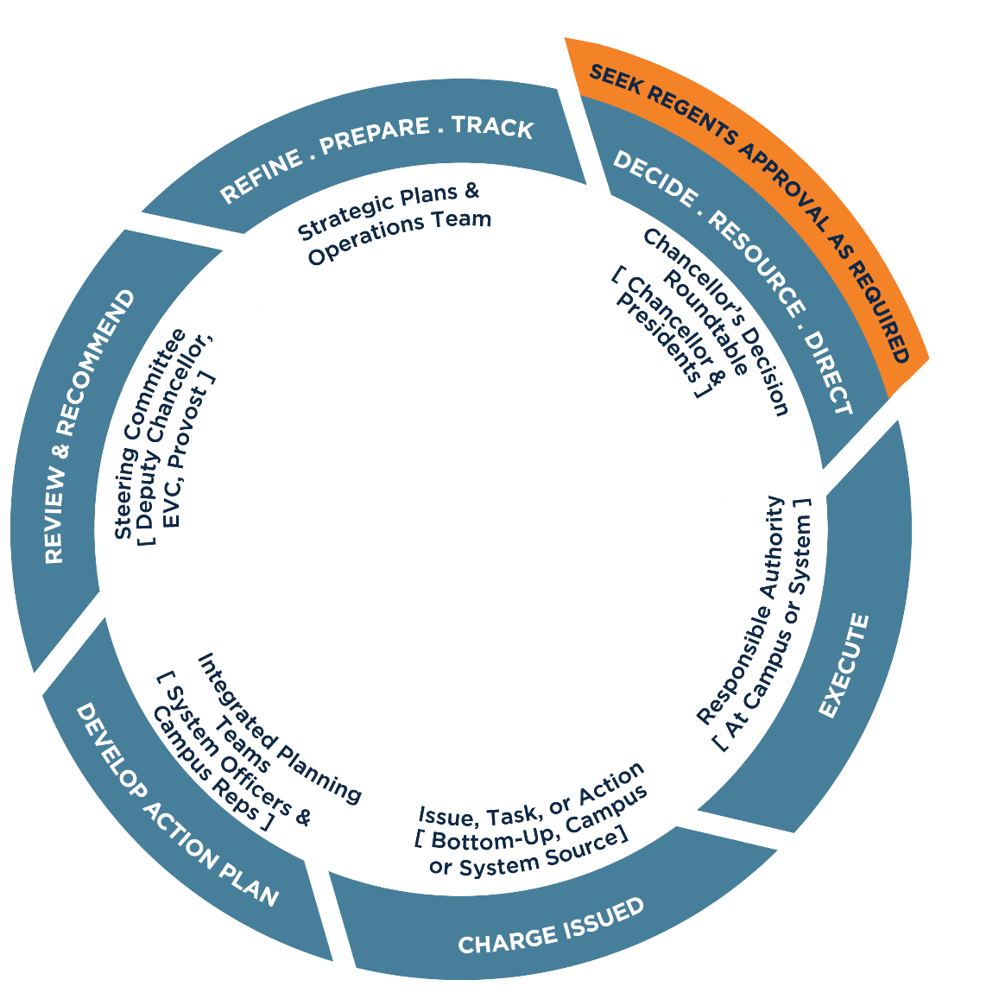
Agile Decision Process & Lifecycles
Detailed Planning
Refine Action Plan to include detailed:
Scope, Schedule, Budget
Gate 2 Approval:
Project Approved for Detailed Planning by:
DC, EVC, Steering Committee with
Campus Representatives
Final Review
Present Final Project Action Plan
Receive and process recommendations
Baseline approved budget and schedule in Planview tool
Program & Project Lifecycle
Gate 3 Approval:
Project Approved for Execution by:
Chancellor and Presidents
Review
Present preliminary Project Action Plan
Receive and process recommendations
Execute Final Project Plan
Adapt as needed to changing conditions
Follow Change Request Process
Report Status, Risks, and Issues
Develop Project Action Plan*
Includes high-level:
Scope
Schedule
Budget
*Allows projects to start without
QL Concept Document approval
Create QL Concept Document
Defines Program and includes:
Vision
Goals
Objectives
Benefits
List of proposed projects
Gate 1 Approval:
Program Defined and Approved by DC & EVC
Reviewed by Steering Committee with Campus Representatives, Chancellor and Presidents

Slide 6
Planview Key Capabilities
Single-data source to all Quantum Leap programs and projects
Quick access to projects specific to your institution
Transparent, timely status reporting
Knowledge of resource participation by institution
Summarized program and project financial data
Knowing when outcomes (value and benefits) are being delivered and at risk

Slide 7
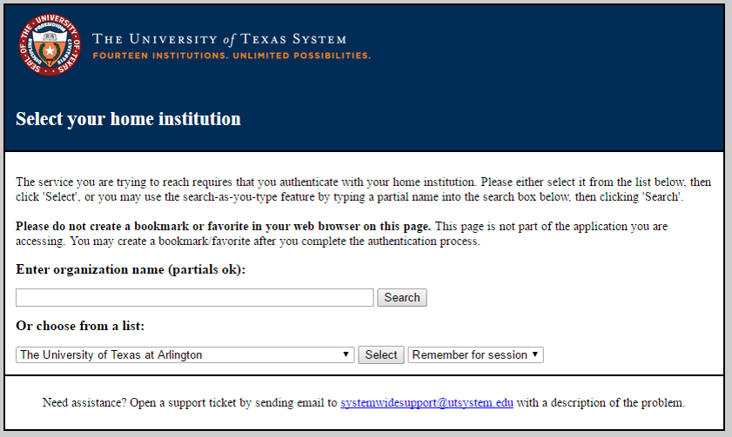
Planview Demo – Login
URL: https://utsystem.pvcloud.com/planview/login/body.asp
Internet Explorer or Chrome are the recommended browsers
Single Sign On is supported and you must select your institution
Log in using user name and password that you use every day at work
Please bookmark or add URL to favorites for quick access!

Slide 8
Planview Navigation Basics
Menus
Portfolios
Ribbons & Tiles
Action Menus
Column Sets
Favorites
Search
Help
NOTE: Please see the “Planview Info User Quick Reference Guide (QRG)” for definitions and directions on how to navigate within Planview, and more detail on the Program and Project Tiles and Executive Reports.

Slide 9
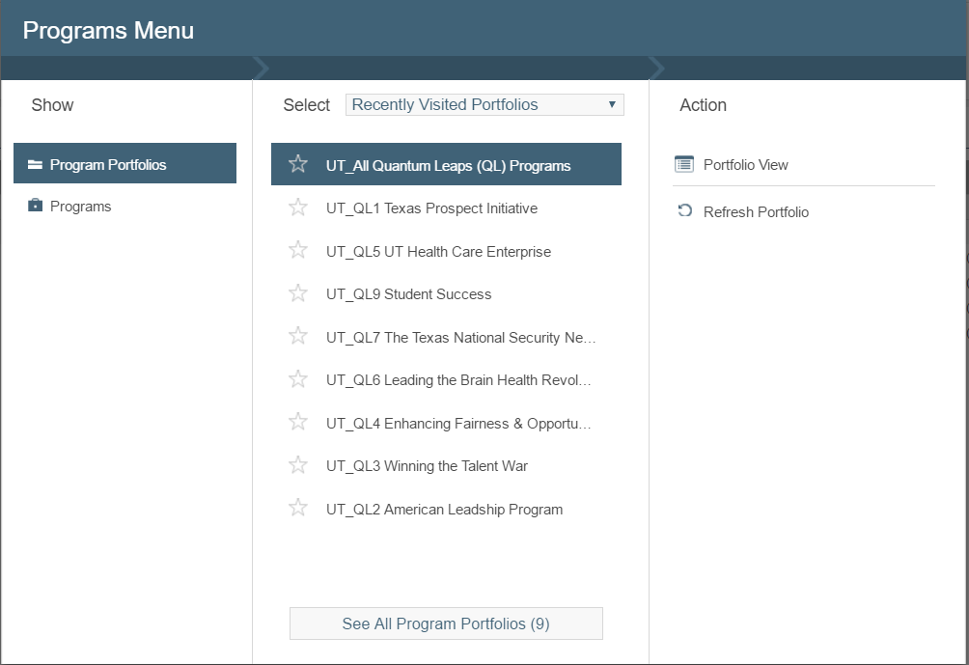
Programs Menu - Portfolios

Slide 10
Programs Menu - Ribbon & Tiles
Organized by Quantum Leaps
Program Dashboard
Easy way to see R/Y/G status for all QL programs and projects
Portfolio Manager
Easy way to see all project schedules rolled up for a QL program schedule and milestones
Program Status Portfolio Report
High level status, timeline, issues, and risks for selected program and their related projects
Program Financials Report
View of approved budget and actual expenses from Peoplesoft.
QL Staffing Report
Ability to view who is working on QL by staff level and institution
Access to high level information is provided for all programs and projects
More – Changes, Issues, Risks
Provides access to a Change, Issue, and Risk (CRI) Register summary for a portfolio of projects.

Slide 11
Projects Menu - Ribbon & Tiles
Organized by Institution
Portfolio Manager
Easy way to see % complete (for tasks not effort) for projects in a selected portfolio
Project Status Portfolio Report
Report that shows status, timeline, issues, and risks for projects in a selected portfolio
More – Changes, Issues, Risks
Provides access to a Change, Issue, and Risk (CRI) Register summary for projects in selected portfolio
Milestones Due this Period
Lists open milestones and highlights date variances for projects in a selected portfolio
Access to detail project information is granted to projects specific to your institution
Project Dashboard
Easy way to see R/Y/G status for projects in a selected portfolio

Slide 12
Outcomes Menu - Ribbons & Tiles
Capability is evolving as more Quantum Leaps finish the discovery phase
Custom reports are being built to support Quantum Leap Outcome Management process
Training will be provided as the outcomes are entered into the tool and outcome reports become available

Slide 13
Planview Support
For process and procedure support, please contact:
  All Institutions: Donna Thomas (dthomas@utsystem.edu)
  Health Institutions: Todd Sazenski (tsazenski@utystem.edu)
  Academic Institutions: Lashelle Inman (linman@ustystem.edu)
For technical tool support, please send an email to OSI_PMO@utsystem.edu

Slide 14
PMO Digital Collaboration Site
Provides
  Access to PMO templates and WIKI for processes and terminology
  QL Key Contacts, Training Material, and Project Status Reporting Schedule
  Platform to collaborate on cross-institution programs and projects
Access and Permissions
  Secure access to PMO and QL sub-sites’ unrestricted content
  PMO will facilitate the setup and maintain user access permissions
Support
  For Support directly related to the Quantum Leaps SharePoint site, please contact your designated PMO Contact or send an email to OSI_PMO@utsystem.edu
    Add new content areas / sections within a Quantum Leap Sub-site
    Change the layout of information on a Sub-site
    Add/Remove/Modify Permissions
    Receive training on using the SharePoint Site
  For Technical Support, please contact UT System’s Help Desk via email at HELP@utsystem.edu or via phone at 512-499-4357, extension 3.
OSI PMO Home Link: https://community.utsystem.edu/sites/osipmo/SitePages/Home.asp

Slide 15
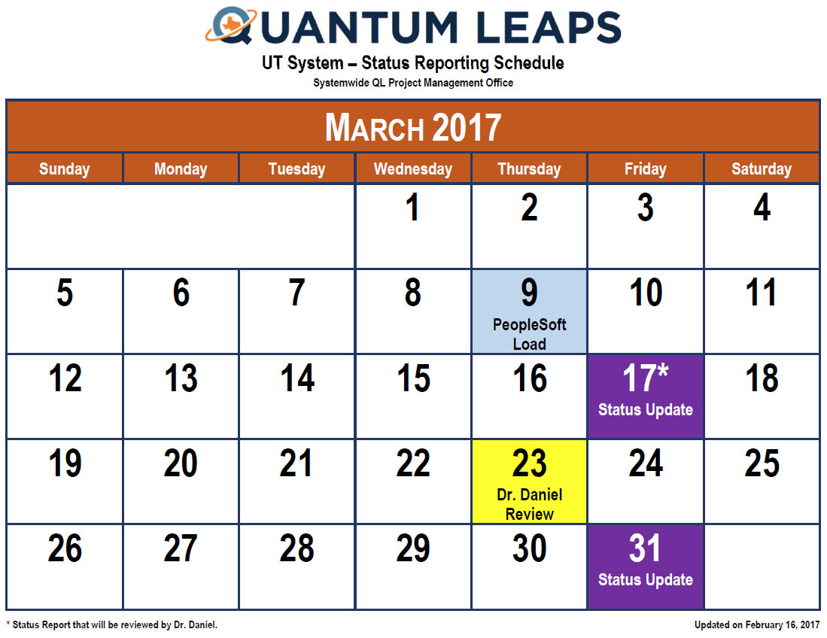
2017/2018 Calendar – Reporting Schedule
Financial data loaded 7th business day of each month
Status reports are due every 2 weeks
Monthly review with Deputy Chancellor, Dr. Daniel
Calendar available on PMO website
March is first Planview reporting period - quality is evolving!
https://community.utsystem.edu/sites/osipmo/Lists/Calendar/calendar.aspx

Slide 16
Next Steps
Provide access to PMO website
Distribute Program and Project Status reports first week of April
Schedule check-in meetings for next couple of months
Questions?

