Slide 1

University of Texas System
2017 UT SELECT Part D Overview

Slide 2
Overview of UT SELECT PART D
An Employer Sponsored Medicare Part D Plan
Enrollment and Eligibility
Medicare Part D Plan Key Points
Express Scripts Medicare – Benefit Overview
Prior Authorizations
Communications
Services Available to Members

Slide 3
Express Scripts Medicare PDP for UT SELECT
An employer-sponsored Medicare Part D prescription drug plan
Approved by the Centers for Medicare & Medicaid Services (CMS) and sponsored by a retiree group or a former employer (UT)
Participation is limited to qualified participants
The name of the plan will be: Express Scripts Medicare® (PDP) for UT SELECT, but will be referred to as UT SELECT Part D
The plan is subject to Federal program requirements. CMS is the oversight agency in place for the Medicare Part D program
Entitled to Medicare Part A and/or be enrolled in Part B
  Be at least 65 years old, on long term disability or have end-stage renal disease
A retiree (or dependent of the retiree) of the plan sponsor
A permanent resident of the United States or Puerto Rico
Eligibility
Criteria

Slide 4
Enrollment and Eligibility
This new plan will be effective January 1, 2017
Retirees who are currently Medicare-eligible will automatically be enrolled in this new plan
Current retirees under age 65 will automatically be enrolled in this new plan when they become Medicare-eligible
CMS does not allow members to be enrolled in two Medicare Part D plans. Therefore, members who have existing individual Medicare Part D plans will be automatically disenrolled from their plan when they are enrolled in the Express Scripts Medicare PDP through UT SELECT

Slide 5
Medicare Part D Plan Key Points
Retiree coverage will continue to be covered at 100%. Dependent coverage out-of-pocket premiums will not change as a result of the transition to the new UT SELECT Part D Plan
Members may qualify for “Extra Help” from the Federal government, via premium and copayment assistance. Contact Express-Scripts if you have questions
High-income earners may need to pay an additional Part D amount to the Federal government– this is known as D-IRMAA
  Members will receive a letter from the Social Security Administration if they are identified as needing to pay this extra amount
  Income Thresholds > $85,000 for individuals/$170,000 for married

Slide 6
Medicare Part D Plan Key Points
Drug coverage will remain similar to current plan coverage with minimal differences
While participants will see the different Medicare Part D drug payment stages in plan communications, participants will not experience a gap in coverage during the “donut hole”
Members may experience reduced copays for the remainder of the plan year when catastrophic levels of prescription payments are reached (>$4,950 out of pocket)
VA pharmacies are not included in the Med D network; however, members can choose to use their VA benefit instead of their Express Scripts Medicare benefit to cover medications with the VA network

Slide 7
Medicare Part D Drug Payment Stages
1
Deductible Stage: $100
Initial Coverage Limit Stage
2
3
There is NO Coverage Gap (Donut Hole)
4
Catastrophic Stage – members may pay less than the copay
5
Maximum Out of Pocket $6,850
 | Retail (31 Day Supply) | Retail (90 Day Supply) | Mail Order (Up to 90-Day Supply)
Generic | $10 | $30 | $20
Preferred Brand Drugs | $35 | $105 | $87.50
Non-Preferred Brand Drugs | $50 | $150 | $125
Notes:
As a Medicare Part D participant you will pay copays through all payment stages. In fact, you may actually pay less than the copay during the Catastrophic phase. Again, there is no “donut hole” to worry about.

Slide 8
Prior Authorizations
8
For certain drugs, members may need to get approval known as Prior Authorization, before the drug can be covered
Prior Authorization requirements may differ from the member’s current plan, as they now include CMS-approved programs
Express Scripts will transfer existing Prior Authorizations between the current plan and new EGWP plan for Medicare Part D medications
  Certain drugs may be covered as either a Medicare Part B or Medicare Part D drug depending on the reason they were prescribed. If members are taking any of these medications, they also will require a new Prior Authorization (also known as a coverage determination)
Members are responsible for initiating the Prior Authorization process and/or coverage review determination
    Reviews cannot be requested until January 1st

Slide 9
CMS Required Communications
Express-Scripts Pre-notification Letter
Pre-notification Letters were mailed on October 24, 2016
General information about the Medicare Part D plan that is sponsored by University of Texas System
  Includes a Benefit Overview to advise members of their 2017 cost sharing amounts
  Note: members do not have to take any action to enroll in this plan; they only need to take action if they want to opt-out of coverage
  If members choose not to participate, by opting-out of this prescription drug coverage, they will lose their retiree medical and prescription drug coverage from the University of Texas System

Slide 10
CMS Required Communication
Welcome Kit
Participants will receive their Welcome Kits around December 1, 2016.
If the enrollment information is incomplete or incorrect, ESI will mail a Request for Information letter to the member to obtain the correct information
If the member does not respond to the Request for Information letter within 45 days, the enrollment will be cancelled
Includes a new ID card which will replace the current card; for use starting January 2017
Note: Members under age 65, and not yet eligible for Medicare, are not yet eligible for this plan, and should continue to use their existing ID card.
Each individual member, per Medicare requirements, will receive a Part D ID Card
Also includes a formulary guide, pharmacy notice and a mail order form

Slide 11
Enhanced Explanation of Benefits
Members who utilize their prescription drug benefit will receive a monthly Explanation of Benefits (EOB) that summarizes all of the medication they filled the previous month
  Members First EOB will be mailed in February 2017
  This is a new feature that will help you track your prescription drug benefit utilization, not only monthly, but your yearly accumulation as well

Slide 12

Customer Service
Express Scripts Medicare Customer Service will be available as of October 1st, 2016
Available 24 hours a day, 7 days a week

Slide 13
Tips for Getting Started at Mail
To take advantage of Home Delivery
  Members should have at least a 14 day supply of medication on hand when ordering
  New prescriptions are usually delivered within 8 days and refills within 3-5 days after Express Scripts Medicare receives the order and shipping is always free
  Express Scripts Medicare offers an automatic refill program available to participants who utilize the Express Scripts Pharmacy
  Pharmacists are available 24 hours a day, 7 days a week to speak with members
  Members are notified of upcoming shipments over two weeks prior to the shipment date so that they can cancel or modify the order if necessary.

Slide 14
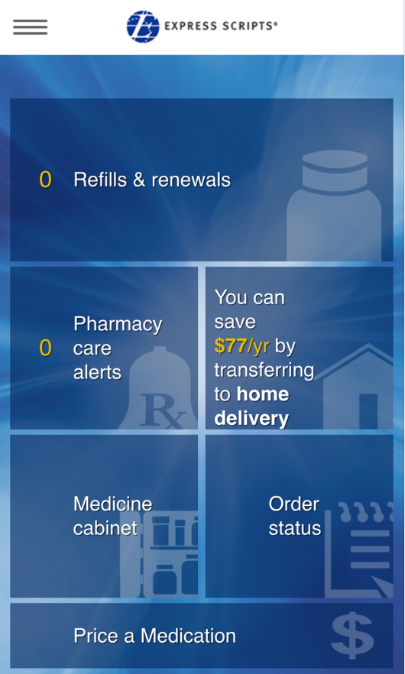
Smart Phone App
The Express Scripts Mobile App allows members to :
Use My Rx Choices
Check Medications on File
View Pharmacy Alerts
Order Refills and Renewals
Check on the Status of an Order
Locate a Pharmacy
Transfer Rx to Home Delivery
Access Information about a Medication

Slide 15
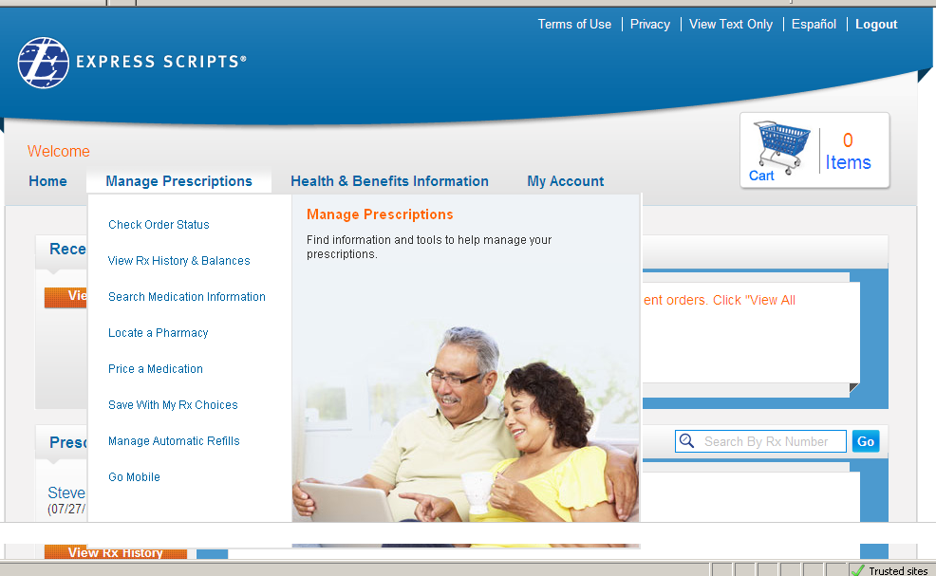
www.Express-Scripts.com
After January 1, 2017 members can access Express-Scripts award winning consumer website www.Express-Scripts.com allows members to manage their prescription benefit from the comfort of their own home
  Members can access: drug coverage and pricing information, home delivery order tracking, pharmacy locations and more

Slide 16




Express Scripts Web Site
Improved usability helps members get the most from their benefit plan
  My Rx Choices®
  Personalized Pharmacy Care Profiles
Online prescription management:
Refills, renewals and order status
Automatic Refills
Transfer to mail
Claims, balances and history
Locate a pharmacy
Preferences
Benefit education and management:
  Benefit highlights
  Pricing and coverage details
  Accessibility features

Slide 17
Questions
Call Express-Scripts at
(800) 860-7849

