Slide 1


Slide 2
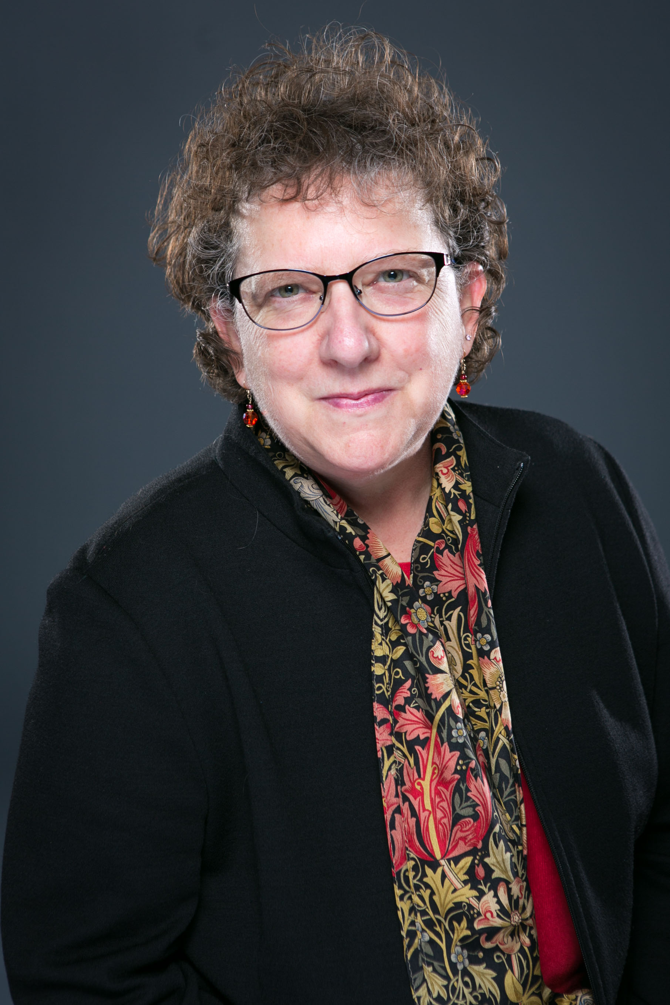
Welcome
Rebecca Karoff, PhD
Associate Vice Chancellor for Academic Affairs
The University of Texas System

Slide 3

Social Media
Tweet Us: #2022All-Texas
Follow Us on Twitter:
  @utsystem
  @TACC_News
  @PHITHETAKAPPA

Slide 4
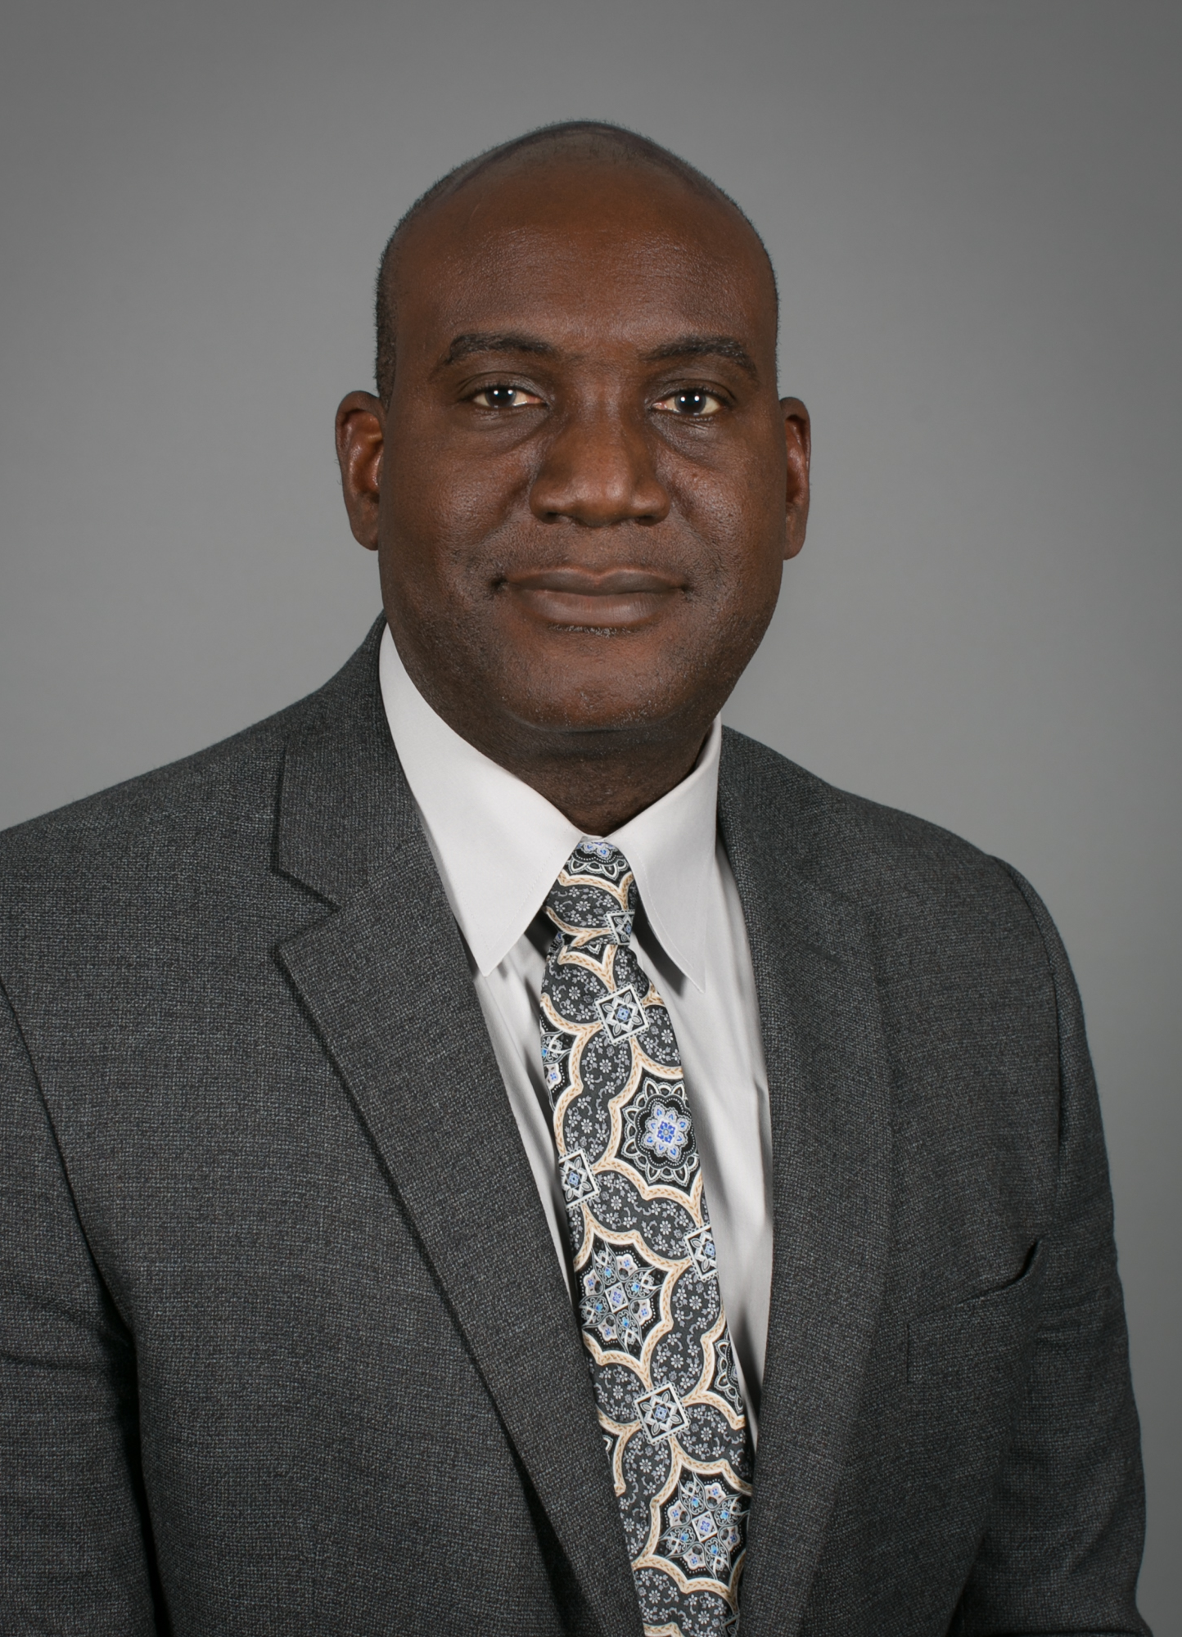
Keynote
Archie L. Holmes, Jr., PhD
Executive Vice Chancellor for Academic Affairs
The University of Texas System

Slide 5




















Thank You to Our Sponsors!
University of Houston - Downtown
Texas A&M International University
Texas A&M – Corpus Christi
UT San Antonio
UT Rio Grande Valley
Tarleton State University
Texas State University
Texas Tech University
UT Austin
UT Dallas
Lamar University
Huston-Tillotson University
St. Edward’s University
UT El Paso
UT Permian Basin
Texas A&M University – San Antonio
Houston Baptist University
Sam Houston State University
UT Arlington
UT Tyler

Slide 6
Panel of Sponsors
Group A
Group B
Group C
Group D
Moderator:
Dr. Christine Bailie
Moderator:
Dr. Cynthia Ferrell
Moderator:
Dr. Ashley Purgason
Moderator:
Dr. Colleen Swain
University of Houston - Downtown
Texas A&M International University
Texas A&M – Corpus Christi
UT San Antonio
UT Rio Grande Valley
Tarleton State University
Texas State University
Texas Tech University
UT Austin
UT Dallas
Lamar University
Huston-Tillotson University
St. Edward’s University
UT El Paso
UT Permian Basin
Texas A&M University – San Antonio
Houston Baptist University
Sam Houston State University
UT Arlington
UT Tyler

Slide 7
Recitation of 2022 All-Texas Academic Team
James Johnson
Alvin Community College
Amber Jordan
Alvin Community College
Kailyn Regier
Amarillo College
Osyris Padilla
Amarillo College
Joshua Pavez
Amarillo College
Brianna Ortega
Amarillo College
Laura Robinson
Austin Community College
Averi Muhr
Austin Community College
Darlene Ledesma
Austin Community College
Nathan Lu
Austin Community College
Ikechukwu Oranekwu
Austin Community College
Jennifer Ebert
Austin Community College
Vishal Manral
Austin Community College
Isabella Abreu Santos
Austin Community College
Oliver Kipp
Austin Community College
Larissa Roncador
Austin Community College
Jordan Huff
Austin Community College
William Hammel
Austin Community College
Amber Traylor
Austin Community College
Lemuel Chineyemba
Blinn College
Casey Prowell
Blinn College
Alexis Tijerina
Blinn College
Sherihan Jaouhari
Blinn College
Courtney Thomas
Blinn College
Stephen Chapa
Brazosport College
Glydel Padilla
Brazosport College
Jenna Kendrick
Cisco College
Jolie Pendeza
Cisco College
Diego Andrade
Coastal Bend College
Heritage Ogunmola
Coastal Bend College
Humberto Paiz
Coastal Bend College
Nahuel Suarez
Coastal Bend College
Muyiwa Adeyemi
College of the Mainland
Madalyn Bond
College of the Mainland
Callie Patterson
College of the Mainland
Crystal Reyes
College of the Mainland
Marina Kuziarova
Collin College
Elaine Pereira Da Silva
Collin College
Nicholas Stanley
Collin College
Jeremiah Christian Amparo
Collin College

Slide 8
Recitation of 2022 All-Texas Academic Team
Kelly Blankenship
Collin College
Khadija Ijaz
Collin College
Eunha Jung
Collin College
Kade Kapper
Collin College
Jeremy Lamonte
Collin College
Alexis Merker
Collin College
Tatiana Papadopoulos
Collin College
Sea Sehannie
Collin College
Maha Shaikh
Collin College
Shantel Thomas
Collin College
Deeksha Vivekanand
Collin College
Aleezah Athar
Collin College
Elizabeth Delcambre
Collin College
Rachel Dunlap
Collin College
Josiah Garner
Collin College
Madison Kelcher
Collin College
Sanai Lowe
Collin College
Paulo Ramirez
Collin College
Randall Sallings
Collin College
Edward Shteyn
Collin College
Ye Sung Sohn
Collin College
Sara Colley
Collin College
Michael Hamblin
Collin College
Aicha Diaba Diakite
Dallas College – Brookhaven Campus
Ly Doan
Dallas College – Brookhaven Campus
Rediet Kebede
Dallas College – Brookhaven Campus
Valentina Moran
Dallas College – Brookhaven Campus
Zainab Siddiqui
Dallas College – Brookhaven Campus
Kaitlyn Espinosa
Dallas College – Eastfield Campus
Lauren Espinosa
Dallas College – Eastfield Campus
Juliet Ibeke
Dallas College – Eastfield Campus
Vi Le
Dallas College – Eastfield Campus
Sindy Mancia
Dallas College – Eastfield Campus
Abram Pedroza
Dallas College – Eastfield Campus
Brisa Arroyo
Dallas College – El Centro Campus
Grace Olvera
Dallas College – Mountain View Campus
Ana Pereira
Dallas College – Mountain View Campus

Slide 9
Recitation of 2022 All-Texas Academic Team
Nicole Camarillo
Dallas College – North Lake Campus
Jordan Collins
Dallas College – North Lake Campus
Syed Hashim
Dallas College – North Lake Campus
Hamzah Ismail
Dallas College – North Lake Campus
Brandy Merrell
Dallas College – North Lake Campus
Thoa Nguyen
Dallas College – North Lake Campus
Dania Othman
Dallas College – North Lake Campus
Thuan Pham
Dallas College – North Lake Campus
Francisco Calvache Sosa
Dallas College – North Lake Campus
Bianca Biggs
Dallas College – Richland Campus
Katrina Carrizalez
Dallas College – Richland Campus
Morakoth Chev
Dallas College – Richland Campus
Jacob Marin
Dallas College – Richland Campus
Nizar Mouradi
Dallas College – Richland Campus
Noura Mouradi
Dallas College – Richland Campus
Herandy Perez-Pulido
Dallas College – Richland Campus
Ananiya Shenkut
Dallas College – Richland Campus
Gaganjit Sidhu
Dallas College – Richland Campus
Ruben Smith
Dallas College – Richland Campus
Rahel Tsegay
Dallas College – Richland Campus
Sara Alvarez
El Paso Community College
Andreas Buttner
El Paso Community College
Esmeralda Chavarria
El Paso Community College
Raymond Desantos
El Paso Community College
Antonio Garcia
El Paso Community College
Alberto Guillen
El Paso Community College
Christopher Rojas
El Paso Community College
Heather Garrett
Galveston College
Leah Hewitt
Galveston College
Raoul Simmons
Galveston College
Renard Simmons
Galveston College
Kyle Tan
Galveston College
Lisa Vitanza
Galveston College
Courtney Langfels
Grayson College
Mackenzie Hernandez
Hill College
Olga Haj
Houston Community College – Central Campus
Keila Rodriguez
Houston Community College – Central Campus
Hebah Chreidi
Houston Community College – Northwest Alief Hayes Campus
Sylvera Yeboah
Houston Community College – Northwest Alief Hayes Campus
Steve Ndung’u
Houston Community College – Northwest – Katy Campus

Slide 10
Recitation of 2022 All-Texas Academic Team
Ada Njoku
Houston Community College – Northwest – Katy Campus
Marcus Davis
Houston Community College – Northwest – Spring Branch Campus
Aboubacar Kone
Houston Community College – Northwest – Spring Branch Campus
Emily Burgos
Houston Community College – Southwest – Brays Oaks Campus
Leslie Leal
Howard College – Big Spring Campus
Jennifer Justis
Howard College – San Angelo Campus
Lina Boggus
Kilgore College – Main College
Kailyn Terry
Kilgore College – Main College
Chelsi Gore
Lamar State College - Orange
Sunday Stewart
Lamar State College - Orange
Dania Sanchez
Lamar State College – Port Arthur
Jaklyn Villareal
Laredo College
Liam Blakeway
Lone Star College – CyFair Campus
Lauren Parker
Lone Star College – CyFair Campus
Rebeca Cantu-Alvarez
Lone Star College – Kingwood Campus
Faith Plaisance
Lone Star College – Kingwood Campus
Tamarah Badin Arenas
Lone Star College – Montgomery Campus
Victor Giacoman
Lone Star College – Montgomery Campus
Mauricio Sanchez Mendoza
Lone Star College – Montgomery Campus
Ana Vergara Gonzalez
Lone Star College – Montgomery Campus
Shiza Rubab
Lone Star College – North Harris
Isabella Reyes
Lone Star College – Tomball Campus
Macey Uzzell
Lone Star College – Tomball Campus
Kelsey Roberson
Lone Star College – University Park Campus
Brooklyn Lopez
McLennan Community College
Catherine Scott
McLennan Community College
Mariam Athumani
Midland College
Parker Tew
Midland College
Roy Escobedo
Navarro College
Alena Sam
North Central Texas College – Corinth Campus
Ashley Isabelle
North Central Texas College – Flower Mound Campus
Jeri Housel
North Central Texas College – Gainesville Campus
Chimara Okeke
North Central Texas College – Gainesville Campus
Aaliyah Avellaneda
Northeast Texas Community College
John Rodriguez
Northeast Texas Community College
Jasmine Cortinas
Northwest Vista College – San Antonio Campus

Slide 11
Recitation of 2022 All-Texas Academic Team
Vanessa Morales
Northwest Vista College – San Antonio Campus
Isaac Valdez-Cervantes
Northwest Vista College – San Antonio Campus
Joseph Zuniga
Northwest Vista College – San Antonio Campus
Cheyenne Davis
Odessa College
David Jenkins
Odessa College
Phoenyx Ali
Palo Alto College – San Antonio Campus
Idolina Cadrona
Palo Alto College – San Antonio Campus
Luis Cuellar
Palo Alto College – San Antonio Campus
Nichole Hou
Palo Alto College – San Antonio Campus
Bianca Romo
Palo Alto College – San Antonio Campus
Edward Farias
Panola College
Abigail Pettibon
Paris Junior College – Greenville Campus
Carolina Berg
Paris Junior College – Main Campus
Kayla Garcia
Paris Junior College – Sulphur Springs Campus
Crystal Romero
Paris Junior College – Sulphur Springs Campus
Mizuki Noro
Ranger College
Morgan Blom
San Antonio College – Main Campus
Jeremiah Davis
San Antonio College – Main Campus
Constantine Ewan
San Jacinto College – Central Campus
Arya Jenkins
San Jacinto College – Central Campus
Marantha Boateng
San Jacinto College – North Campus
Gabriel Castaneda
San Jacinto College – North Campus
Valeria Flores
San Jacinto College – North Campus
Roxana Macal
San Jacinto College – North Campus
Christian White
San Jacinto College – North Campus
Elsie Bura
San Jacinto College – South Campus
Ashley Winslow
San Jacinto College – South Campus
Ramon Zubiate
South Plains College – Levelland Campus
Travis Brown
South Texas College – Pecan Campus
John Cluley
South Texas College – Pecan Campus
Lizbeth Coronado
South Texas College – Pecan Campus

Slide 12
Recitation of 2022 All-Texas Academic Team
Mario Garza
South Texas College – Pecan Campus
Mina Takada
South Texas College – Pecan Campus
Luis Constancio
Southwest Texas Junior College
Ashia McDonald
St. Philip’s College
Charles Okafor
Tarrant County College – Northeast Campus
Megan Stiffler
Tarrant County College – Northeast Campus
Courtney Beckum
Tarrant County College – Northwest Campus
Connor Cox
Tarrant County College – Northwest Campus
Lilia Vasquez Deras
Tarrant County College – Northwest Campus
Lilia Vasquez Deras
Tarrant County College – Northwest Campus
Onyinyechi Chiemela
Tarrant County College – South Campus
Jiwon Choi
Tarrant County College – South Campus
Maxine Gilhespy
Tarrant County College – South Campus
Nicholas Moore
Tarrant County College – South Campus
Rachel Moore
Tarrant County College – South Campus
Haely To
Tarrant County College – South Campus
Andrew Mwenduti
Tarrant County College – Southeast Campus
Angeli Rodriguez
Tarrant County College – Southeast Campus
Danna Foehser
Tarrant County College – TCC Connect Campus
Malana Herrera
Tarrant County College – TCC Connect Campus
Long Nguyen
Tarrant County College – TCC Connect Campus
Payal Rajawat
Tarrant County College – TCC Connect Campus
Ryan Wagner
Tarrant County College – TCC Connect Campus
Edwin Barrera
Tarrant County College - Trinity River Campus
Leksi Jarnagin
Tarrant County College - Trinity River Campus
Monserrat Soto
Tarrant County College - Trinity River Campus
Michael Thomas
Tarrant County College - Trinity River Campus
Terra Vickner
Tarrant County College - Trinity River
Veronicah Wangari
Tarrant County College - Trinity River Campus
Shadia Abdallah
Temple College
Micaela Hutcheson
Temple College
Diego Maldonado
Texarkana College
Tami Neinas
Texas State Technical College
Teresa Pruitt
Texas State Technical College

Slide 13
Recitation of 2022 All-Texas Academic Team
Alexis Bernal-Alvarez
Trinity Valley Community College
Jamie Holman
Trinity Valley Community College
Chiyelu Oyolu
Trinity Valley Community College
April McCullough
Trinity Valley Community College
Lexy Rhein
Trinity Valley Community College
Jordan Booth
Tyler Junior College
Preston Long
Tyler Junior College
Kristin Hoover
Tyler Junior College
Shelby Morgan
Tyler Junior College
Micah Leary
Tyler Junior College
Taylor Tracey
Tyler Junior College
Jessica Partida
Victoria College
Erika Batten
Weatherford College
Katie Fox
Weatherford College
Yung-Hsin Hsiao
Weatherford College
Joel Pratt
Weatherford College
Baylee Freeman
Western Texas College
Baylee Green
Western Texas College
Camryn Jansky
Wharton County Junior College
Brooke Thomas
Wharton County Junior College

Slide 14
Special Recognition
All-USA Academic Team Scholar & Coca-Cola New Century Transfer Scholar
Kyle Tan
Galveston College
Coca-Cola New Century Workforce Scholar
Felice Reyes
San Jacinto College

Slide 15
Coca-Cola All-Texas Academic Team
Gold Scholars
Silver Scholars
Bronze Scholars
Michael Hamblin
Collin College
Dania Sanchez
Lamar State College
Taylor Tracey
Tyler Junior College
Zainab Siddiqui
Dallas College
Isabella Reyes
Lamar State College
Kristin Hoover
Tyler Junior College
Jennifer Ebert
Austin Community College
Oliver Kipp
Austin Community College
Sunday Stewart
Lamar State College - Orange
Aaliyah Avellaneda
Northeast Texas Community College
David Jenkins
Odessa College
Ashley Winslow
San Jacinto College
Megan Stiffler
Tarrant County College
Micaela Hutcheson
Temple College
Micah Leary
Tyler Junior College

Slide 16
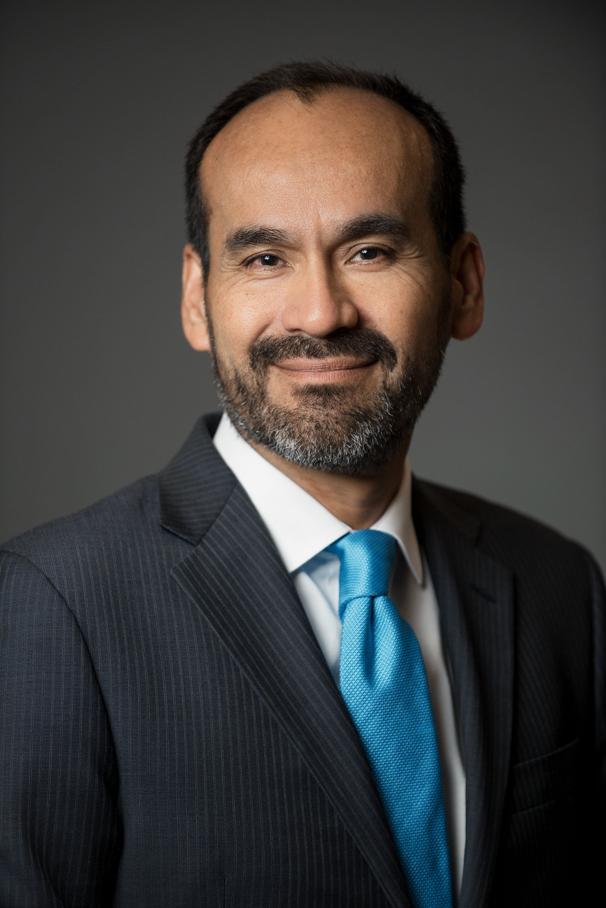
Closing Remarks
Jacob Fraire
President & CEO
Texas Association of Community Colleges

