Slide 1
University of Texas System
Women’s Leadership Development Workshop
Developing Future Women Leaders
Moderators: Susan Franzen and Tony Cucolo
UT System Administration
January 2019

Slide 2
Welcome!

Slide 3
We are all colleagues working a large and diverse organization.
But what is
“The University of Texas System”?
Texas¹⁴

Slide 4
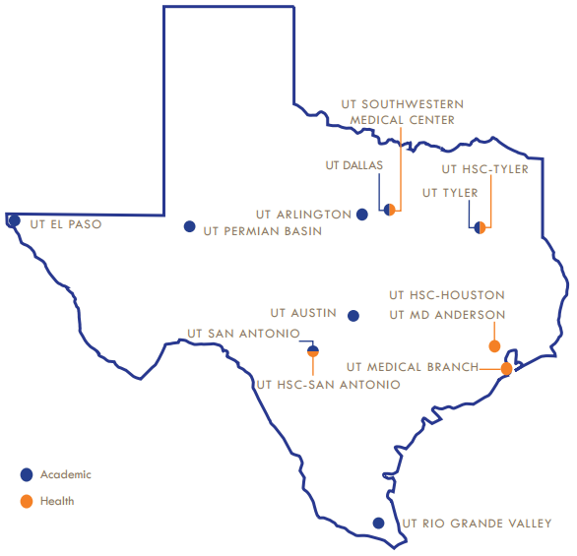

14 institutions
8 Academic Institutions, two with medical schools…
6 Health Institutions…
1 Administrative HQ
110,000 Employees
221,000 Students
9 million Patients seen per year
#3 in the world for patents granted
UT SYSTEM HQ
UT System HQ

Slide 5
Who you are, the 2019 Cohort…
60 selfless Sponsors from every institution…
  Professors, Chairs, and Deans
  A bevy of “Vices”: AVPs, VPs, and EVPs
  Chief Medical Officers, Chief Innovation Officers
62 Protégées, the future senior leaders of the academy, medicine – and athletics -- from every institution…
  Assistant, Associate and Interim Deans
  Assistant and Associate Professors and Chairs
  Assistant and Associate Directors and Managers
  …and a Head Coach

Slide 6
Purpose of the Workshop – the “why” you are here.
The problem to be addressed:
  Despite the gains made in the percentages of women among higher education graduates and faculty members, women remain underrepresented in U.S. medicine and academia's highest-level executive positions – women are underrepresented in the "C-suite." The University of Texas System is no exception, having generally lower numbers of women in top leadership positions in both the health and general academic components.
The desired outcome: build a “bench,” and set conditions to advance the best.
  Protégées leave the Sponsorship Workshop with new knowledge, skills and career planning ideas to accelerate their path to executive leadership and help them be even more ready for the next opportunity to advance.
  Sponsors will bolster their own knowledge and skills and enhance their relation with their protégée through shared experience – and be inspired to continue sponsoring protégées to top leadership positions at their institutions or elsewhere.

Slide 7
Why this concentrated effort at academic and medical campuses?
In the academic, medical academic, and health and medical cultures, individual achievement is the key to advancement.
Often, highly successful individuals receive limited leadership experience or formal development before they are selected to lead people and manage resources in fast-moving, rapidly changing environments.
They are expected to build teams, lead peers, establish a positive organizational climate, routinely make timely and difficult decisions about people and resources, and effectively communicate to diverse stakeholders and audiences across a variety of means.
This type of leadership requires preparation and a specific development effort.
This workshop is one of those sustained efforts.

Slide 8
History matters:
A thanks to our Founders present.

Slide 9
Let’s go!

Slide 10
Leadership “Primer”
Enterprise Vision
Empathy
Intellectual Curiosity
Key Traits and Skills of Successful Leaders
Courage
Selflessness
Humility

Slide 11
“Leadership is the process of influencing people by providing purpose, direction, and motivation to accomplish the mission and improve the organization.”

Slide 12
“Leadership is the process of influencing people by providing purpose, direction, and motivation to accomplish the mission and improve the organization.”

Slide 13
Now, let’s ask ourselves…
What do you want to get out of the next two days together?
What do you wish for others?
What are you willing to do to ensure that you and others get what you want/need from this conference?

Slide 14
University of Texas System
Women’s Leadership Development Workshop
Developing Future Women Leaders
Moderators: Susan Franzen and Tony Cucolo
UT System Administration
January 2019

Slide 15
Main Points: The Sponsorship Imperative
Women don’t need to be “fixed” – fix the system
Unconscious biases need to be addressed
Sponsors: Power, Advancement, Public
Sponsors stick their neck out; mentors operate behind the scenes

Slide 16

Main Points: DiSC Revelations and Application
We are all a combination of styles. By understanding your style and the styles of others, you increase your understanding of the behaviors and motivations, improve effective communication, and effectively address conflict.

Slide 17
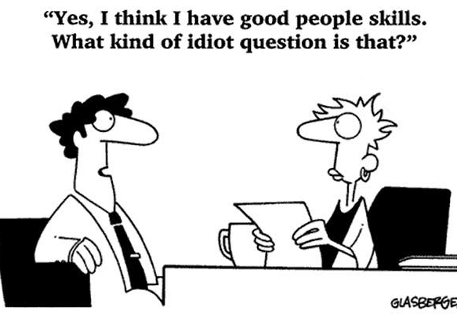
Main Points: Leading with Emotional Intelligence
EQ or EI (emotional intelligence) is a greater predictor of success than IQ.
Emotional intelligence is about self-awareness and self- management plus social awareness and relationship management. You can improve your emotional intelligence, or EQ through practice.

Slide 18

Main Points: Self-Promotion, Gaining Visibility, Executive Presence
There are many techniques you can practice on your own with your cell phone/apps
Lower voices command more authority
Use your power voice
Walk confidently
What you do as a leader is amplified
Gesture appropriately

Slide 19

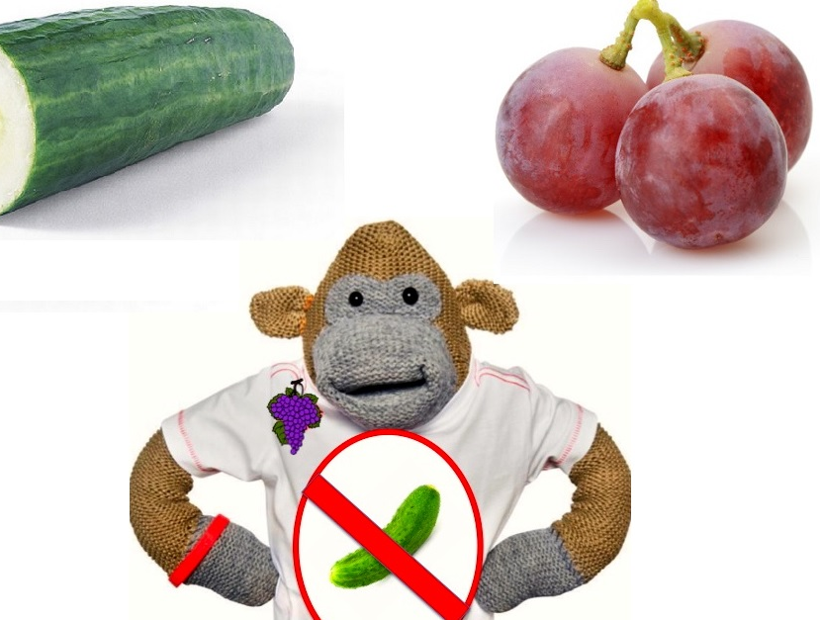
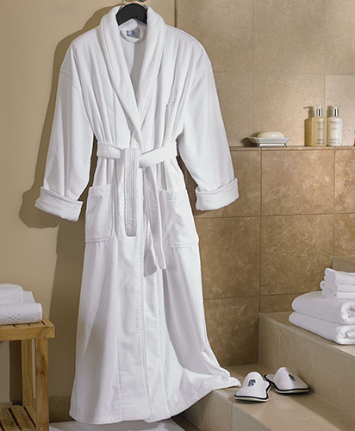
Main Points:
Negotiation Skills
Don't accept the cucumber when there are grapes!
ASK!
ASK!
ASK!
Men apply to positions where they meet 60% of the qualifications – women only apply when they meet 95 percent!
Be willing to walk away... what's your backup?
When negotiating...
  Understand the power of anchoring
  Do your research
  Ask questions
  Be aware of the impact of emotions

Slide 20
Main Points: What I Look for When Hiring Leaders
Skills
Attitudes
Capability/Potential
Everything you do is an audition
Promote your uniqueness

Slide 21
Main Points: Passion or Emotion? Effective Communication Skills for Leaders
Win the battle of the narratives
Tell the truth well
Memorable, shareable, repeatable communications
Create a rhythm of communication
Communicate with empathy

Slide 22
Wrap Up and Farewell
Did you get what you wanted/needed from the past two days?
Do you think others did?
What's next for you? Your institution?

