Slide 1
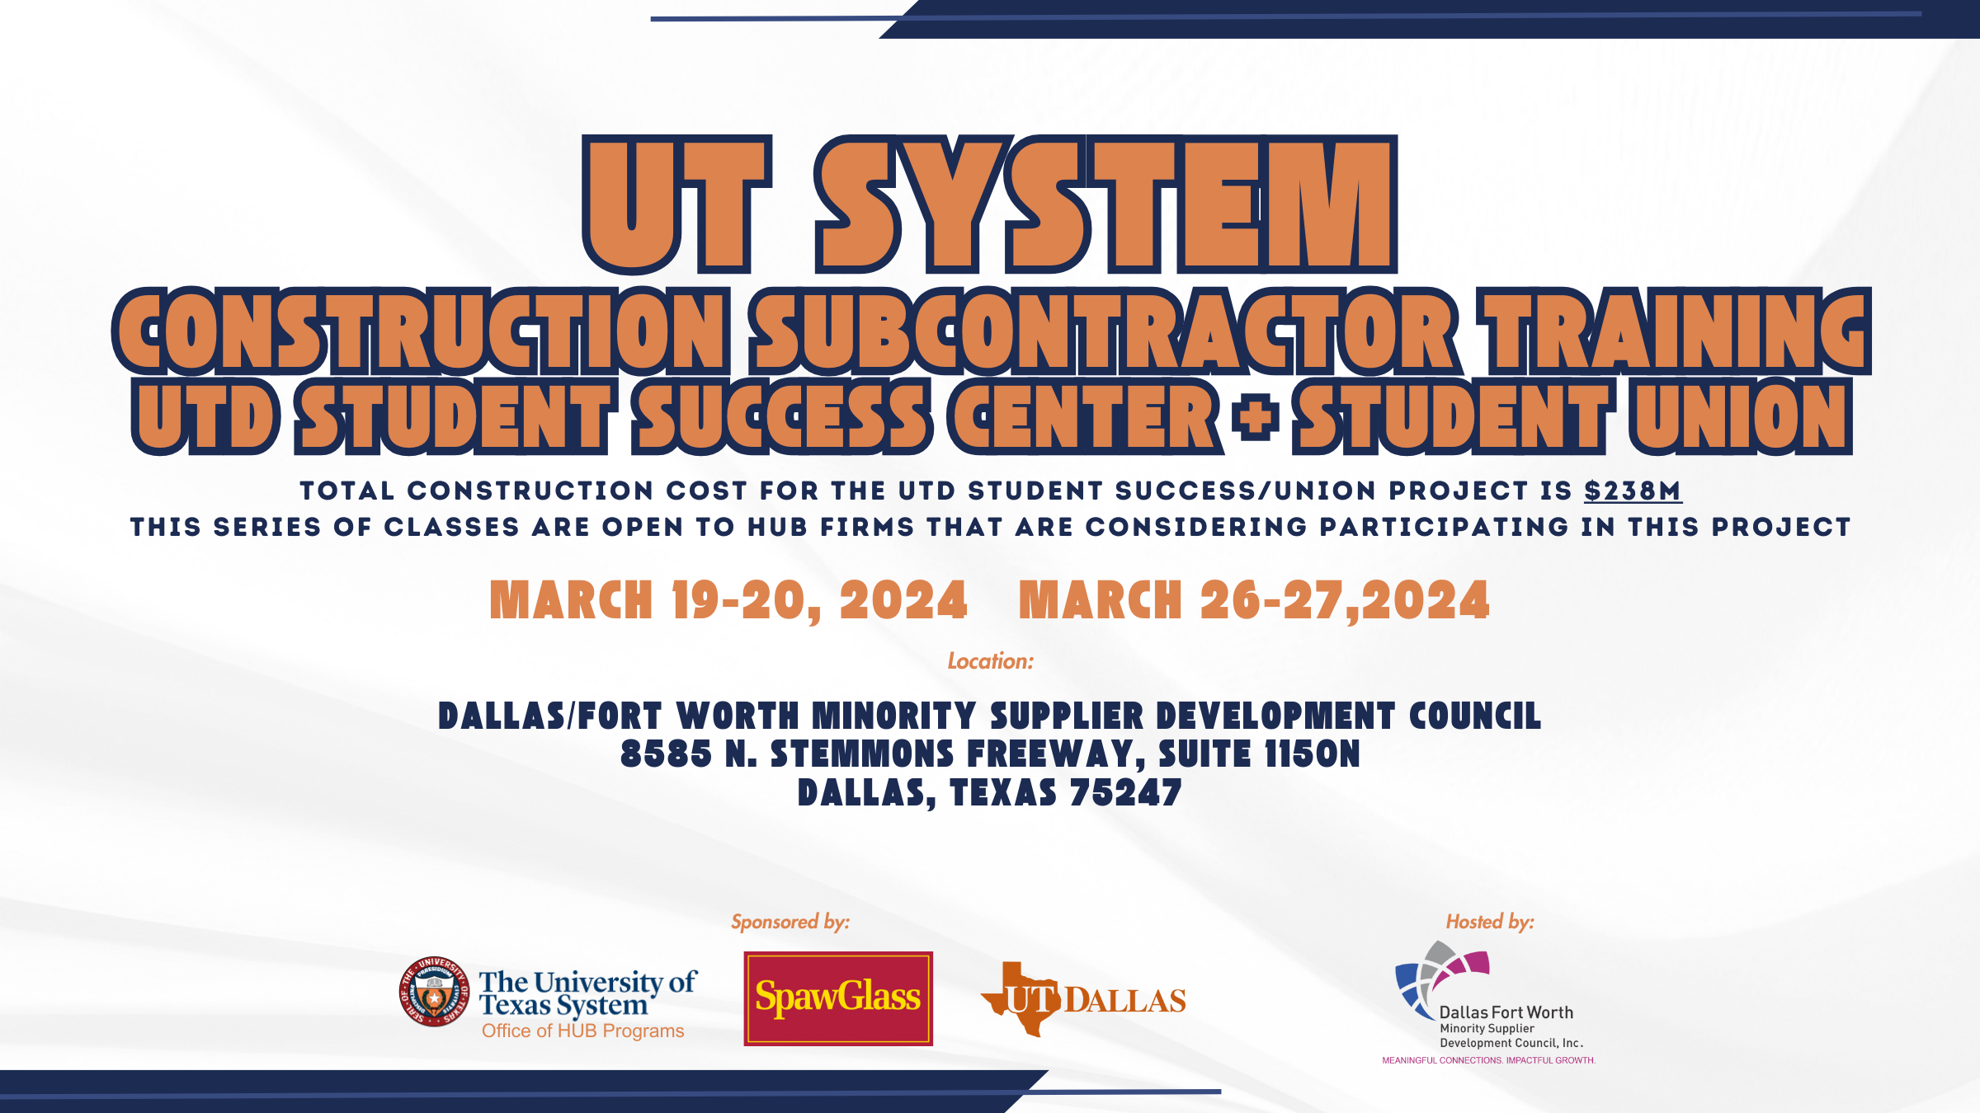

Slide 2
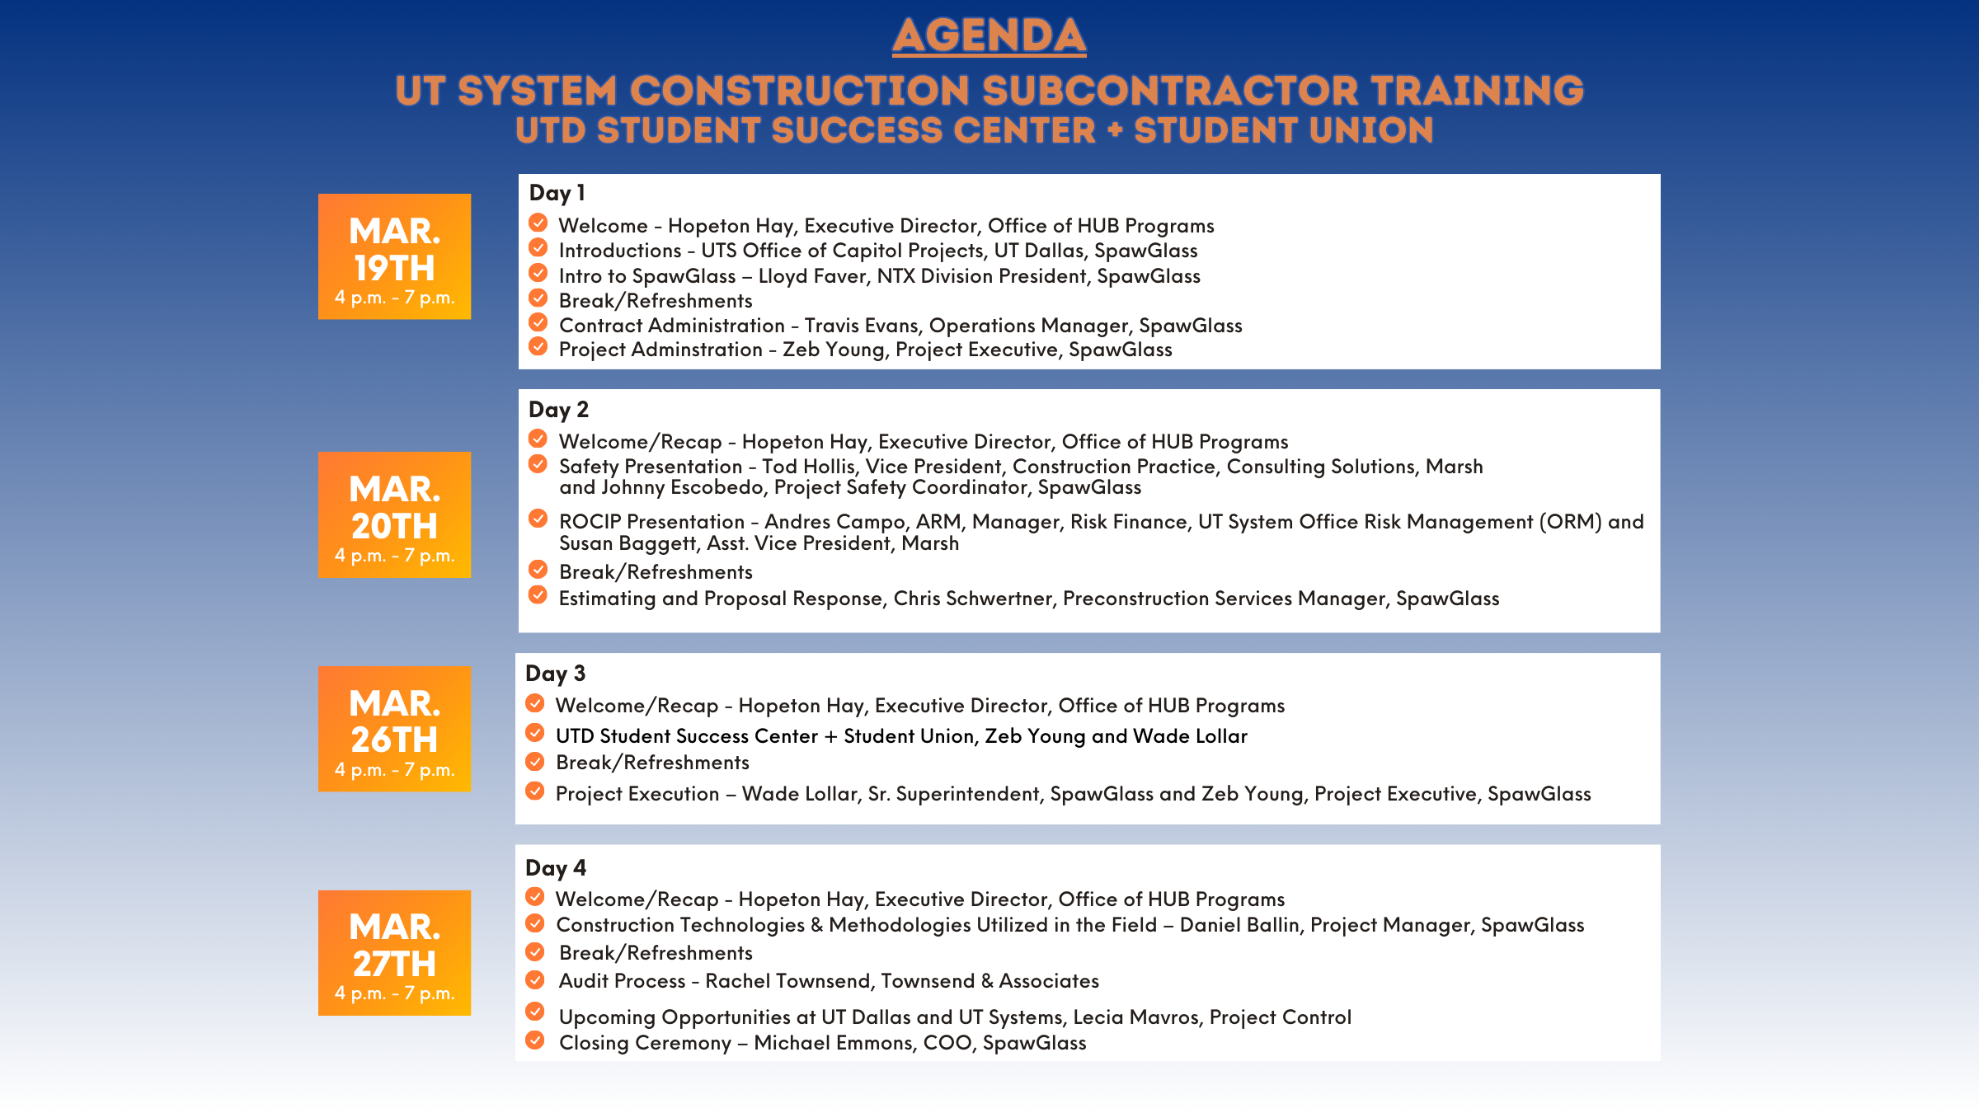

Slide 3
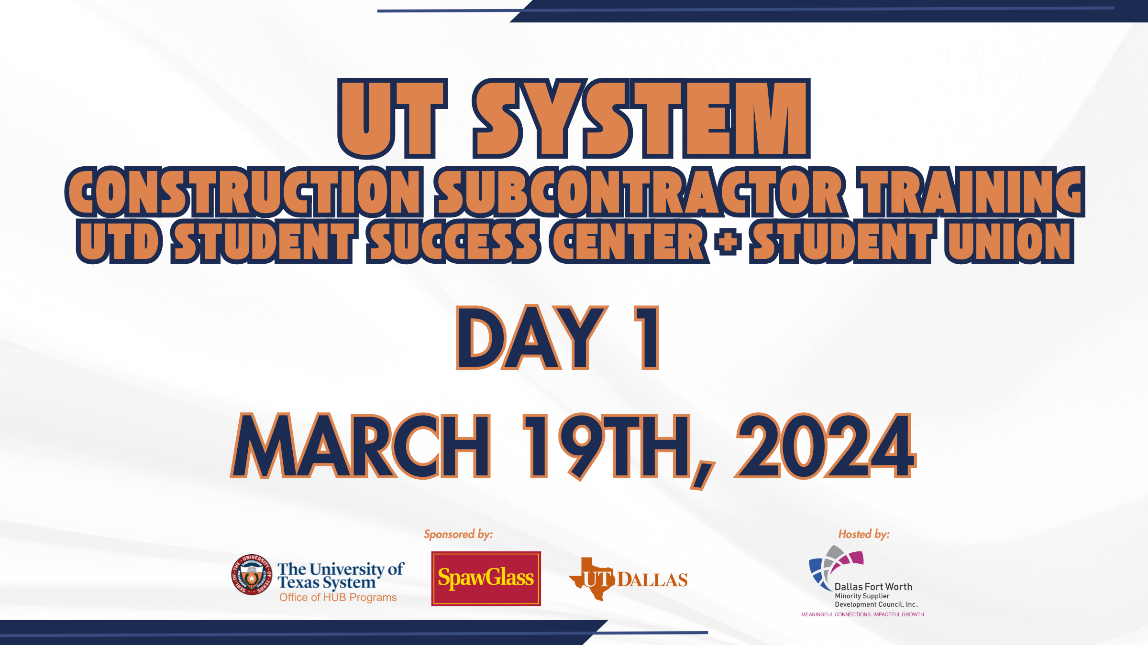

Slide 4
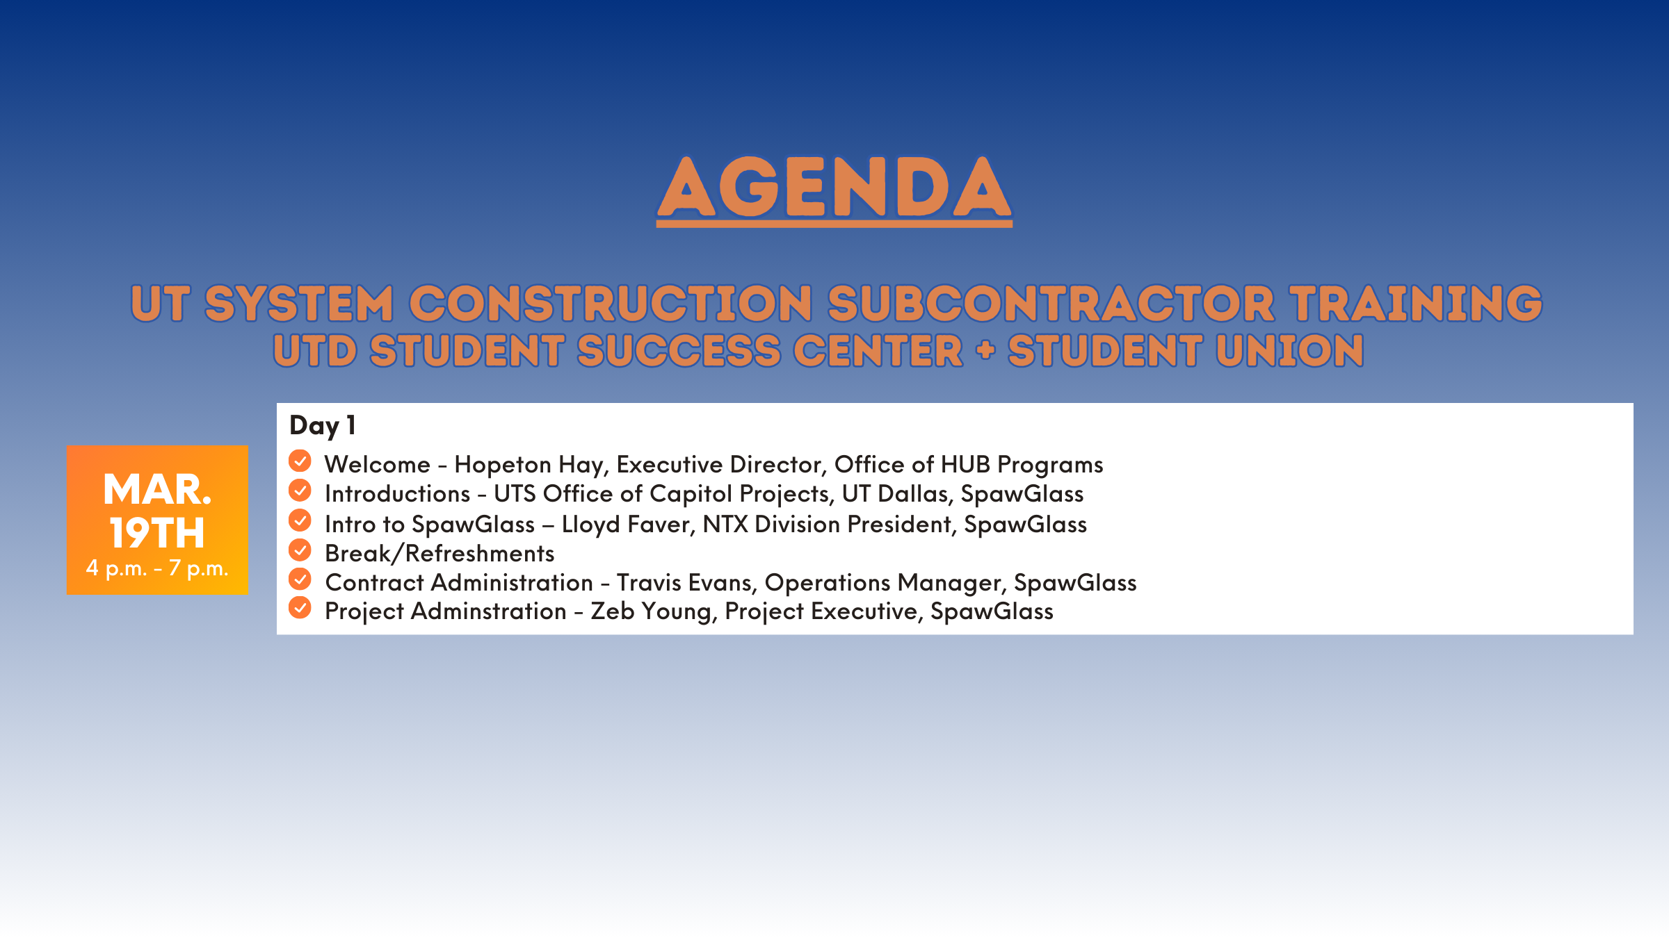

Slide 5


Introduction to
SpawGlass

Slide 6

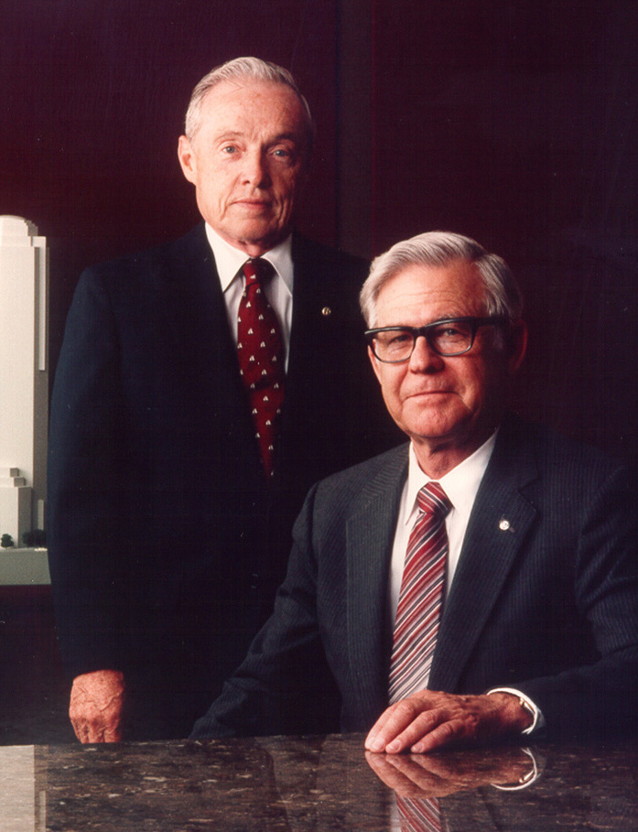

About SpawGlass
SpawGlass was founded in 1953 by Louis Spaw and Frank Glass and built on three fundamental values: honor, honesty and hard work.
Our success and growth over the years can be credited to those founding values, which still guide us today.

Slide 7
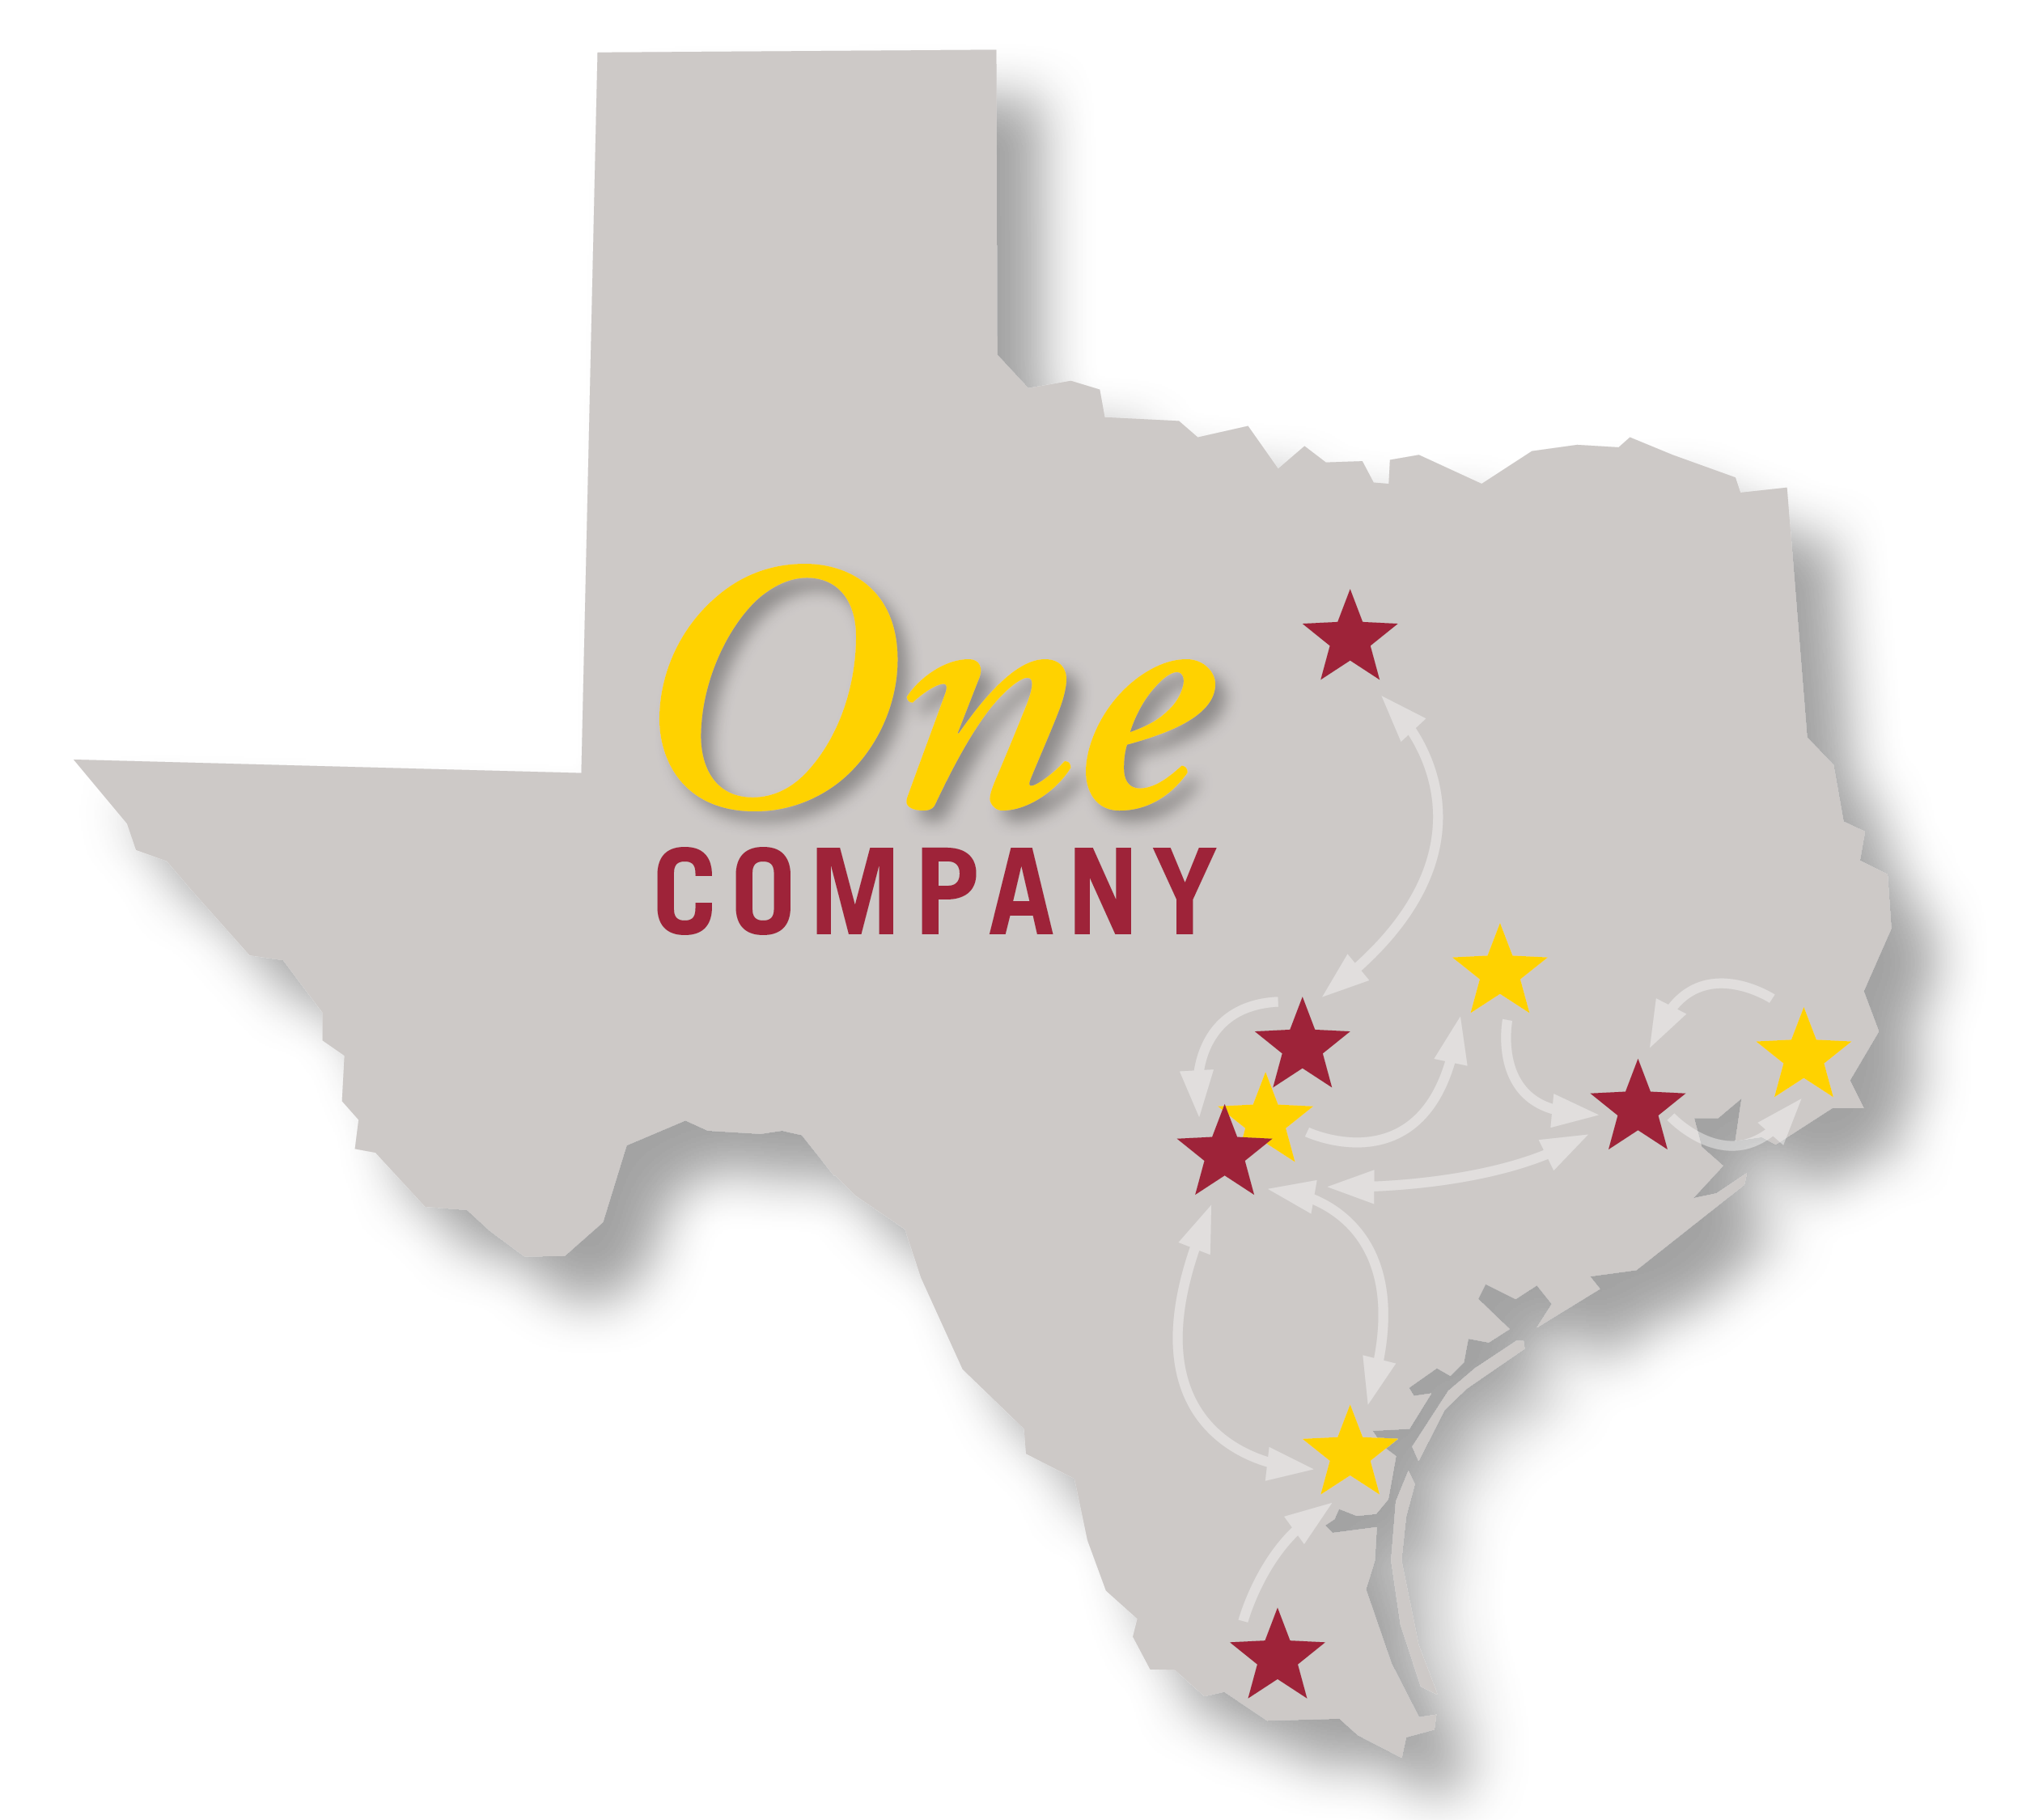
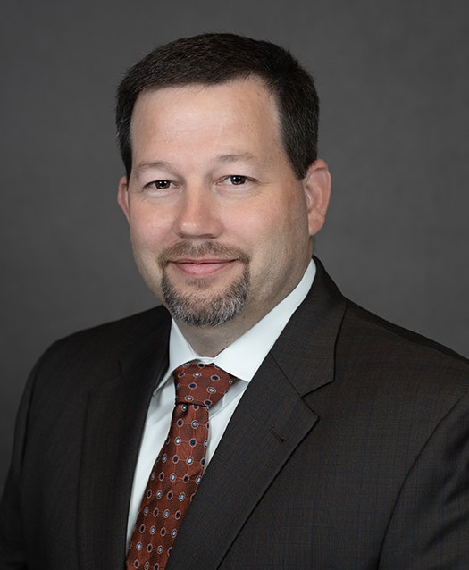
BY THE NUMBERS
9
locations throughout Texas
$900m+
Average total annual revenue
720
Team members
71
Years building
in Texas
100%
Employee-owned
Lloyd Faver
President, North Texas Division
817-288-0890
Lloyd.Faver@SpawGlass.com
Notes:
Add Lloyd Faver’s headshot, title and contact information
Add Eric Kennedy’s headshot and contact information

Slide 8
Markets We Serve
Athletic
Aviation
Campus Housing
Civil
Corporate
Government
Healthcare
Higher Education
Hospitality
Life Sciences
Light Industrial
Parking Garages
Performing Arts
Religious
Restoration
Retail
Senior Living
Transportation
Notes:
Markets We Serve
Higher Education
Transportation
Healthcare
Aviation
(List others)

Slide 9

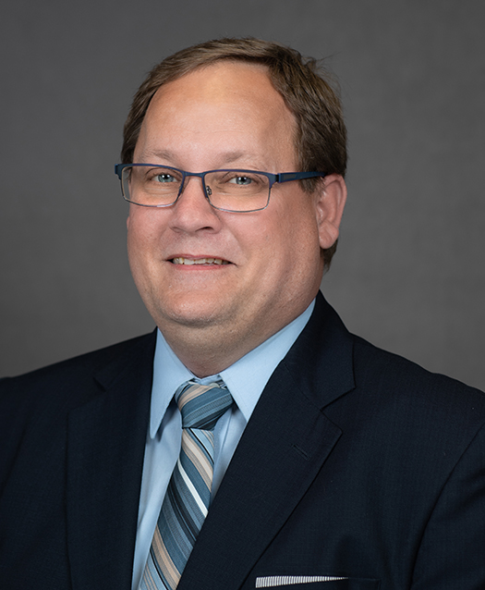
Building Services
Small projects ranging from
$500 to $2,000,000
Jake Pack
Building Services Manager
817-288-0890
Jake.Pack@SpawGlass.com
  Great way to get to know us
  and how we do business!

Slide 10
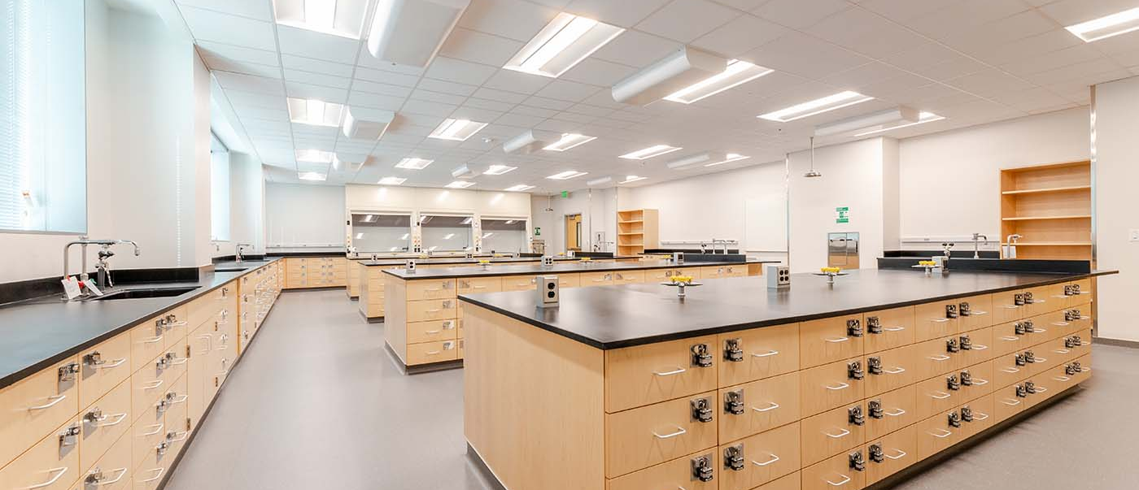
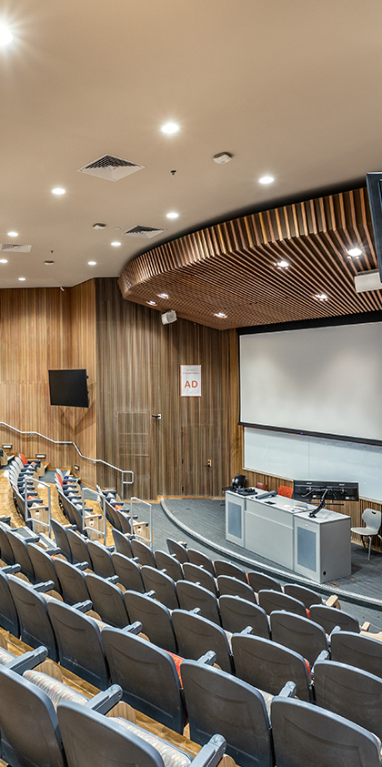
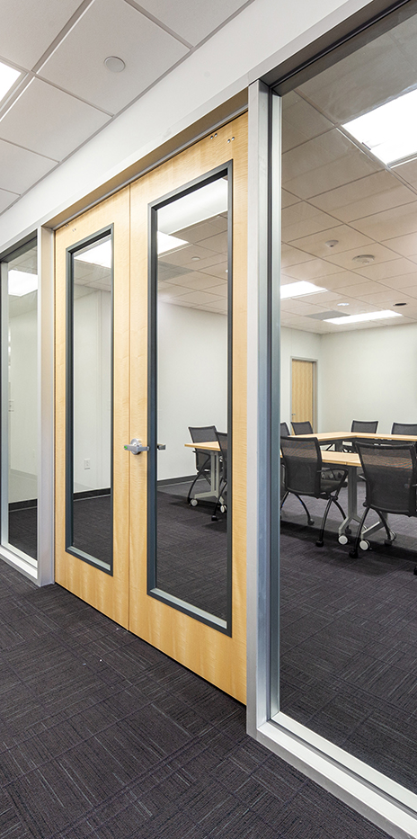
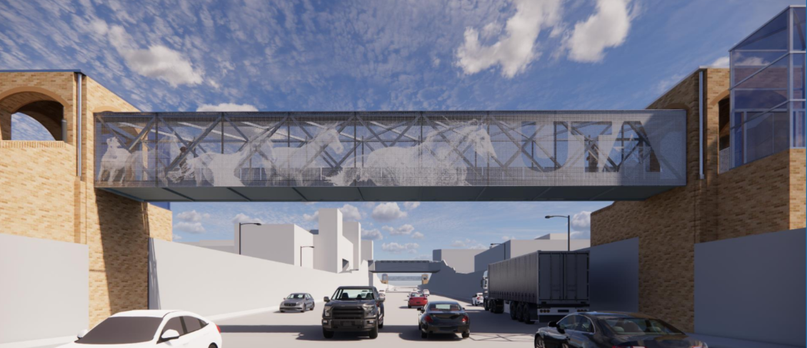
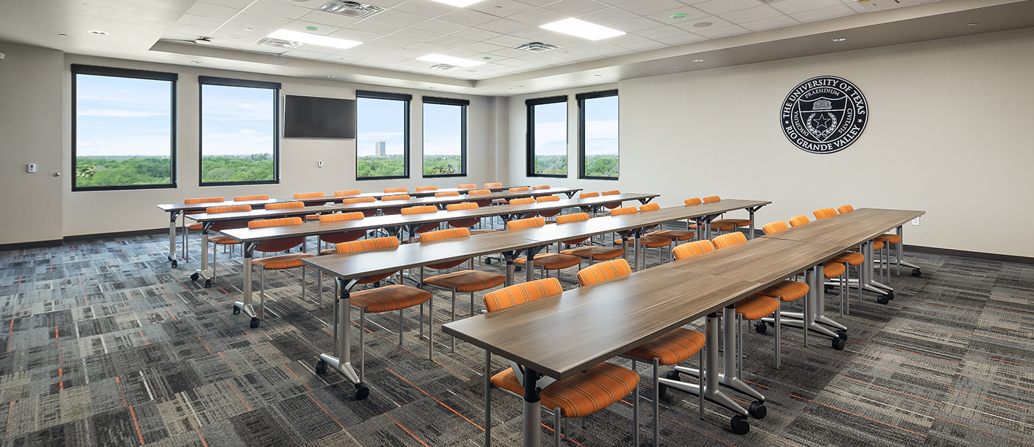
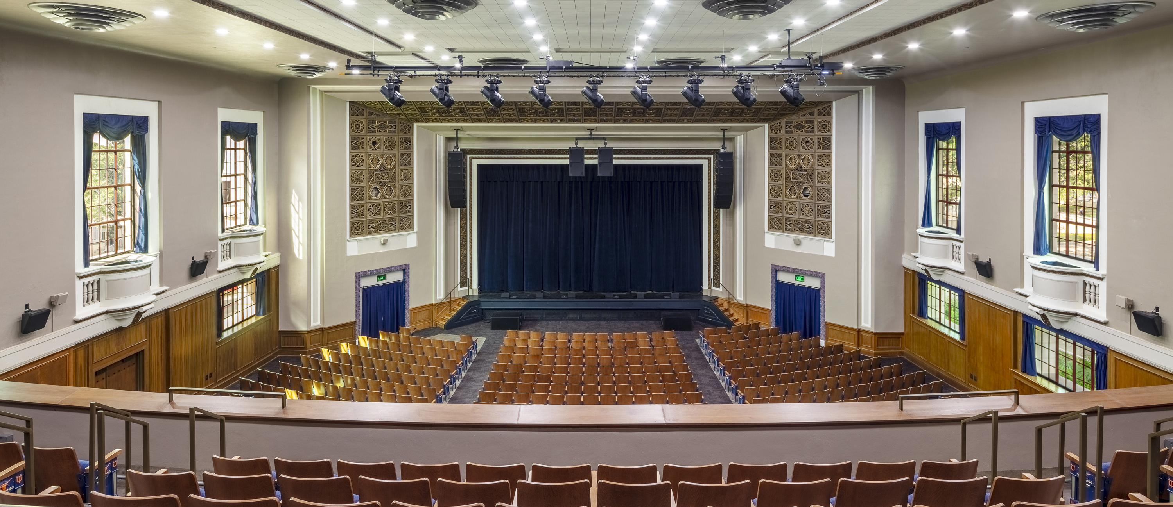
Serving The University Of Texas
Since
1979!
153 projects | $1.3B+ contract amount | 11 campuses
Notes:
SpawGlass and The University of Texas System
153 projects
Over $1.3 billion in construction
6 different campuses

Slide 11
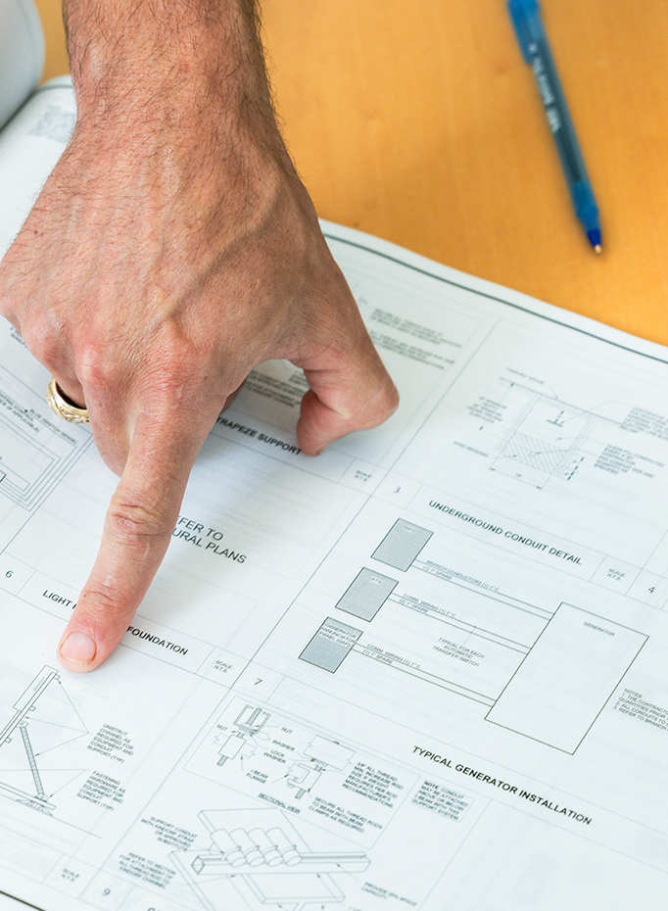
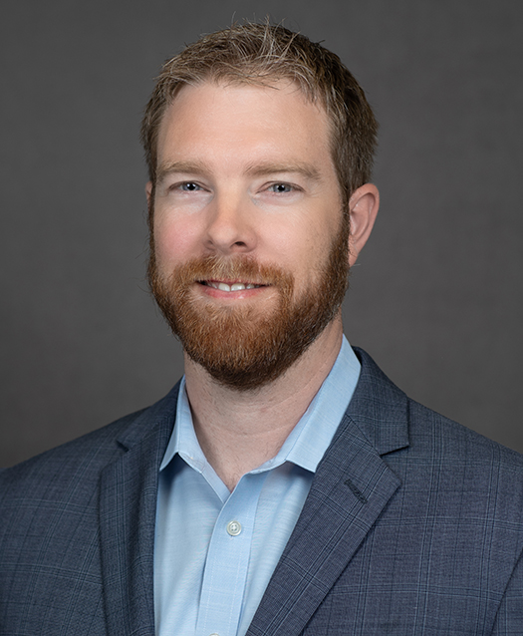
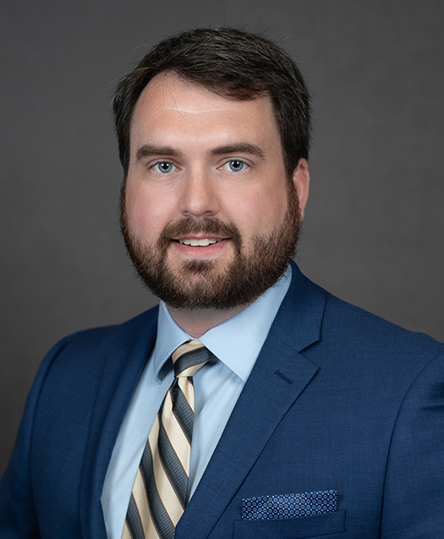
    Find Your Scope
    Right size for you or team
    Understand how to do business under
    State of Texas procurement
Chris Schwertner
Preconstruction Services Manager
210-875-9562
Chris.Schwertner@SpawGlass.com
Zeb Young
Project Executive
817-682-5818
Zeb.Young@SpawGlass.com

Slide 12
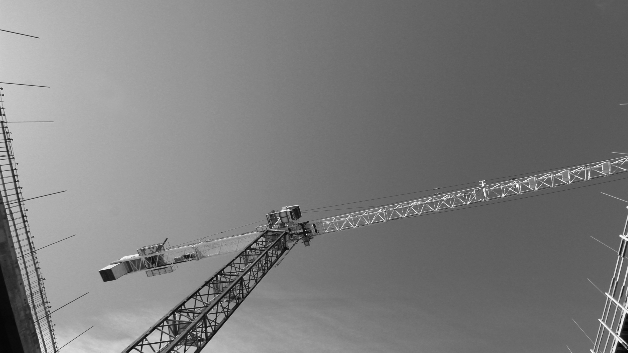

Industry Outlook
Our industry is growing. We continue to need good trade partners.
Finding a new trade partner that is willing to learn how to execute on
higher education projects benefits:
You, the Project, SpawGlass and The University of Texas

Slide 13
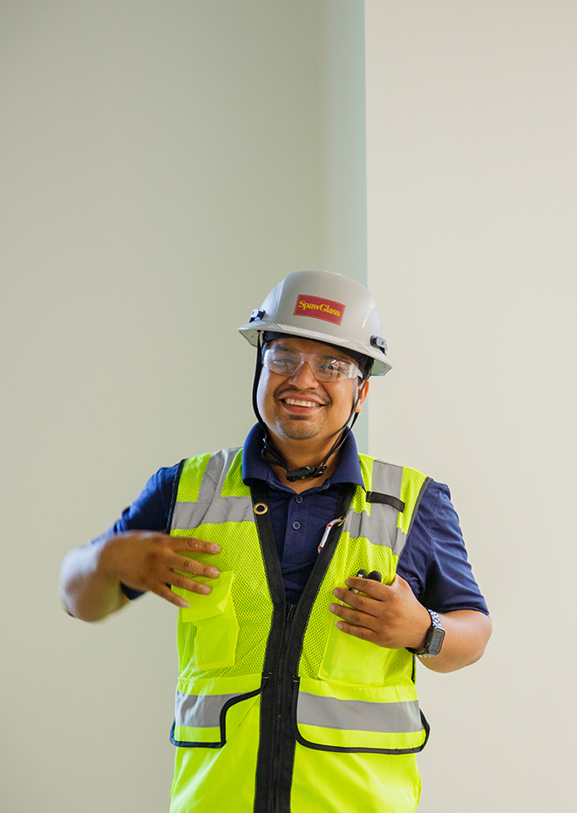

Become a
Trade
Partner

Slide 14

Contract Administration

Slide 15
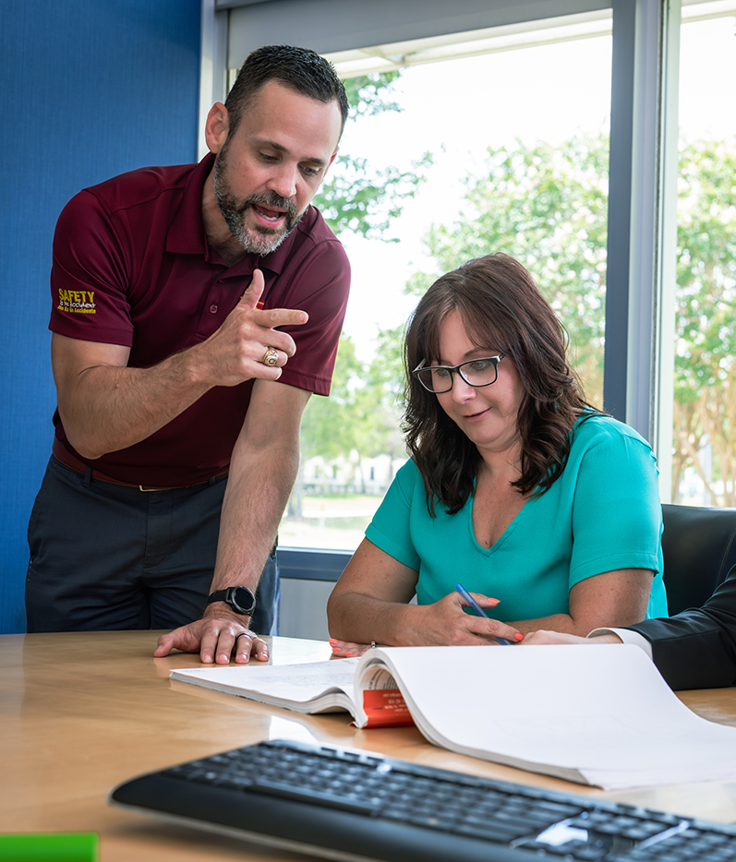
Contracting
Process
Master Subcontract
What is it?
When do we use master subcontracts?
Project-Specific Subcontract
What is it?
When do we use project-specific subcontracts?

Slide 16
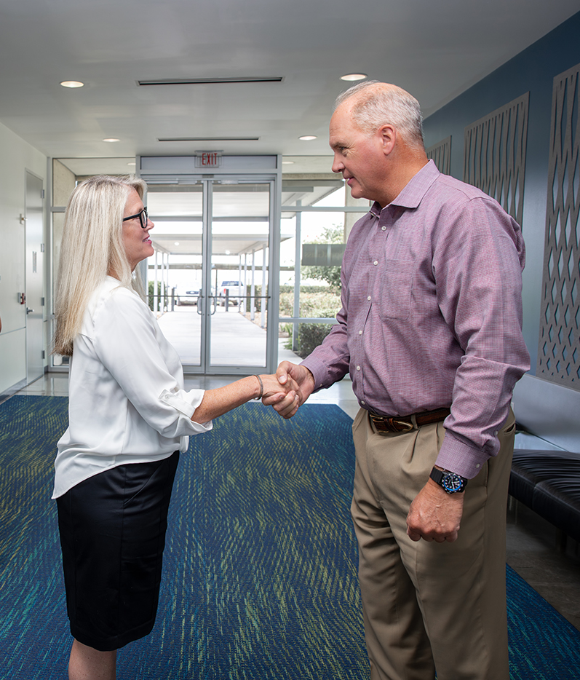
Project-Specific Subcontract
Flowdown Provisions
Order of precedence
Time is of the essence
Liquidated damages
Common Points of Further Discussion
Indemnity
Payment terms
Dispute resolution
Project Schedule is Exhibit G

Slide 17
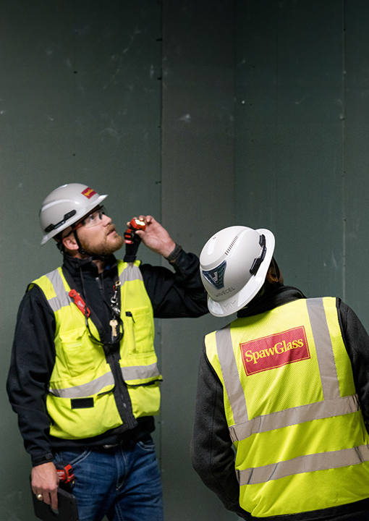




SpawGlass
Uniques
Lean Scheduling
Pull plan and daily huddles required
Material expediting log required
Quality Management
Compliance with Zero-Defect Process
Site-specific quality control plan
Safety Requirements
OSHA 30 certified competent person
Fall protection
Site-specific safety plan and JSAs

Slide 18
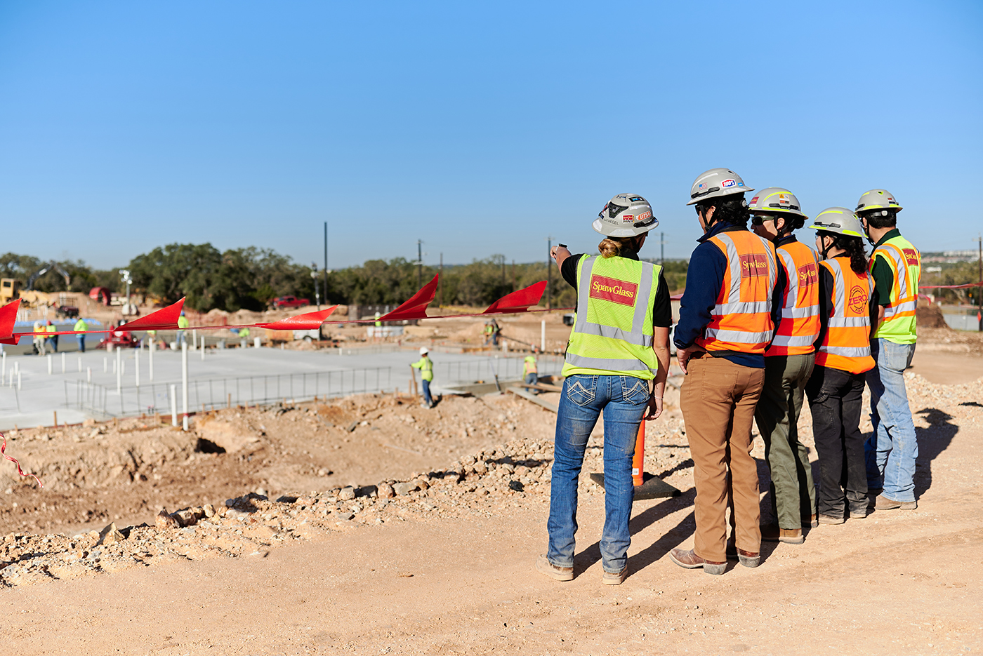
  Bonding &
  Insurance
Bonding
All subcontracts over $250,000
require a bond
Must be completed on our forms
Non-reimbursable per owner’s contract
Insurance
Bid the insurance requirements
Coverage requirements are non-negotiable
ROCIP enrollment is required

Slide 19

Major Take Aways
Major Takeaways
Read the
Entire Subcontract
Read the
Owner Contract
Bid the Insurance, Bond and Project Requirements
If not, be very clear on exclusions
If you have questions,
PLEASE ASK!
Contract terms do affect our recommendations for
best value trade partner

Slide 20

Project
Administration

Slide 21

    Know the
    Contract Documents
Exhibit A – Scope of Work
Exhibit B – Application for Payment
Exhibit C – Insurance Requirements (ROCIP)
Exhibit D – Bonds (Contracts over $250,000)
Exhibit E – List of Drawings and Specifications
  Contract Between UT System and SpawGlass
  Uniform General Conditions
  UT System Division 01 Specifications
Exhibit F – Contract Modifications
Exhibit G – Schedule
Notes:
What Does it Take to Be Successful

Slide 22

    Before you
    Start Onsite
  Executed contract in place
    Enroll in ROCIP
    Submit site-specific safety plan
    Confirm background checks and drug testing
  Submit Schedule of Values
  Submit scope items
    Samples
    Product Data
    Shop Drawings
    Mockup Requirements
  Know the schedule – participate in pull planning
  Attend pre-construction meeting
Notes:
Getting Started

Slide 23

    Checking all
    the Boxes
Review scope
  Clarify all questions
  Identify handoffs with other trades
  Understand administrative requirements
Enroll in ROCIP
Submit Bonds (if required)
  Contract Administrators, Project Managers and
  Project Safety Coordinators are all here to help!
Notes:
Executed Contract

Slide 24

    Getting Paid
Submit Schedule of Values (SOV) breakdown per 01 31 00
Include on Exhibit B sample pay application
Complete HUB payments on The University of Texas System portal
Notes:
Schedule of Values

Slide 25

    Don’t Delay
Get submittals in as soon as possible 01 31 00
Clarify any proposed substitutions up front 01 31 00 & UGC’s 8.3
Notes:
Submittals

Slide 26

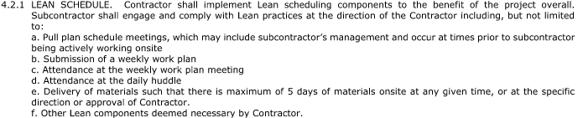
    Time is of the Essence
UGC’s Article 9
Participation in pull plans per SpawGlass contract
Notes:
Schedule

Slide 27
    Starting off on the Right Foot
Take the preconstruction meeting seriously!
Notes:
Pre-Construction Meeting

Slide 28
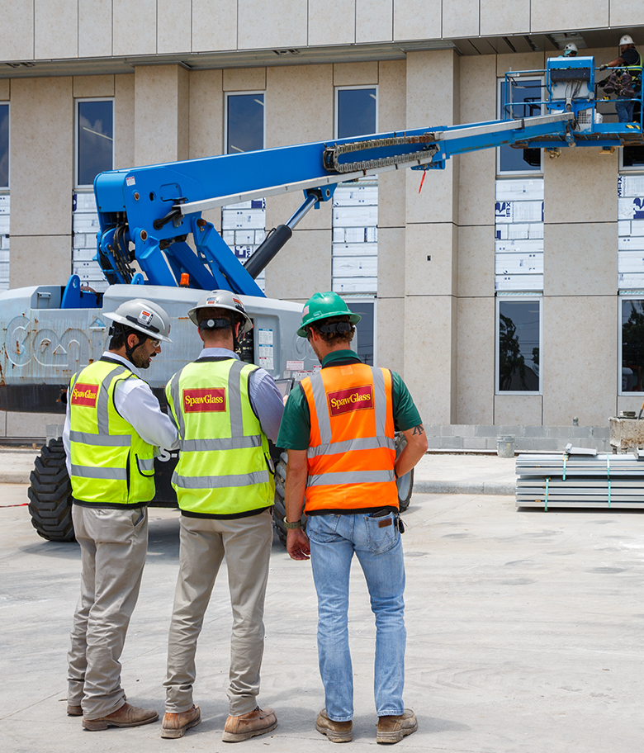
  Working on Site
Job Site Orientation and Badging
Weekly Safety Meetings
Weekly Foreman’s Meetings
Daily Huddles
Monthly Project Manager Meetings
Quality Assurance/Quality Control (QA/QC) Meetings
Weekly Subcontractor Safety Representative (SSR) Meetings
Weekly Commissioning Meetings

Slide 29
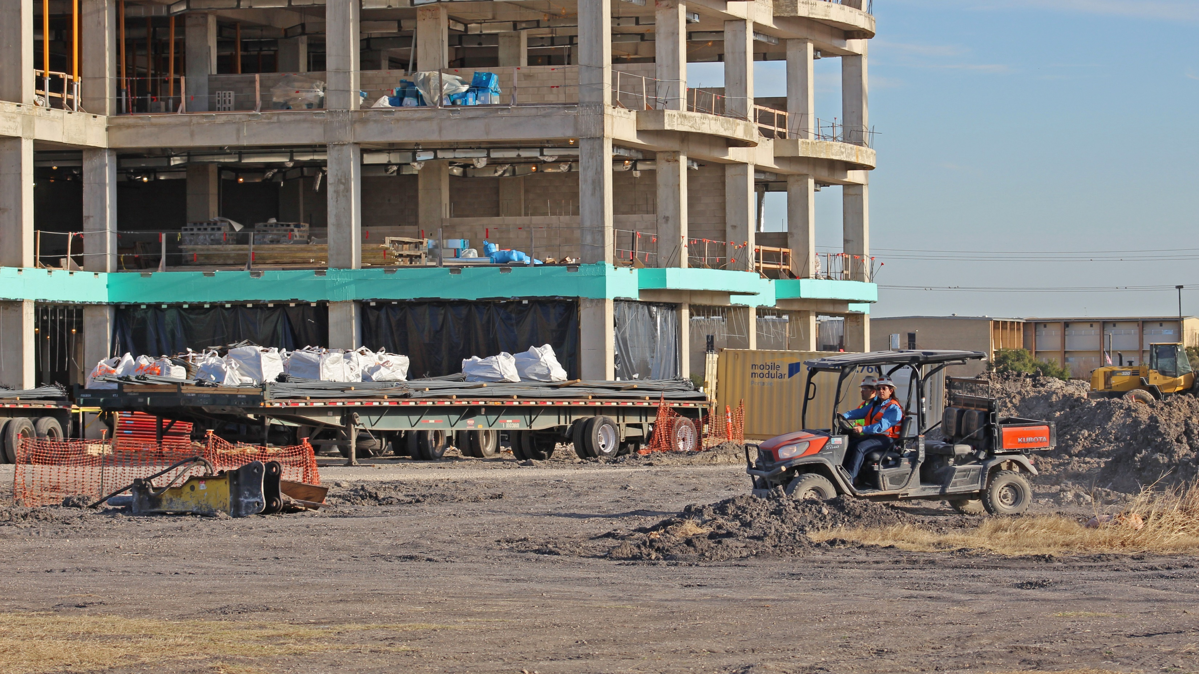
Understand the UGCs and
Div 01 Specifications.
We can only be successful if our trade partners are successful.
If you have questions, ASK!
We are here to help!
  Key Takeaways
  “A goal without a plan
  is just a wish.”
  - Antoine de Saint-Exupéry

Slide 30
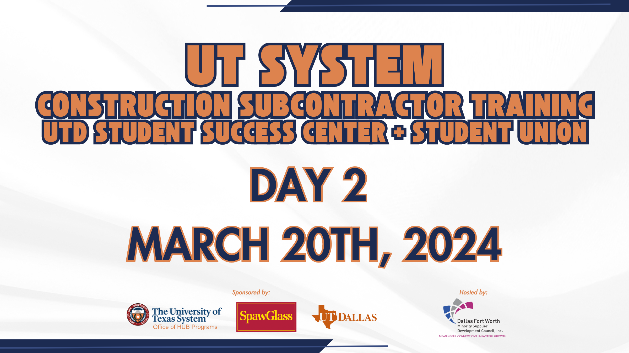

Slide 31
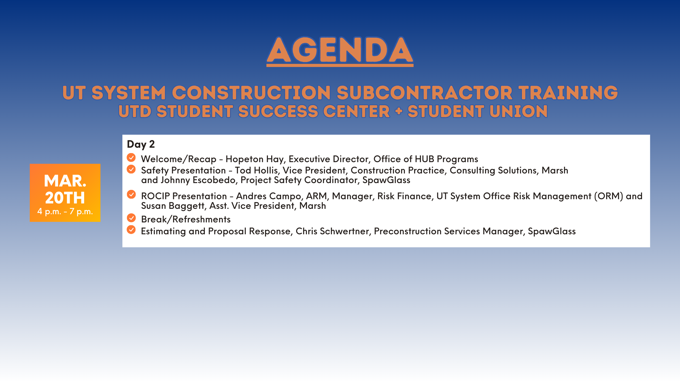

Slide 32

Safety

Slide 33
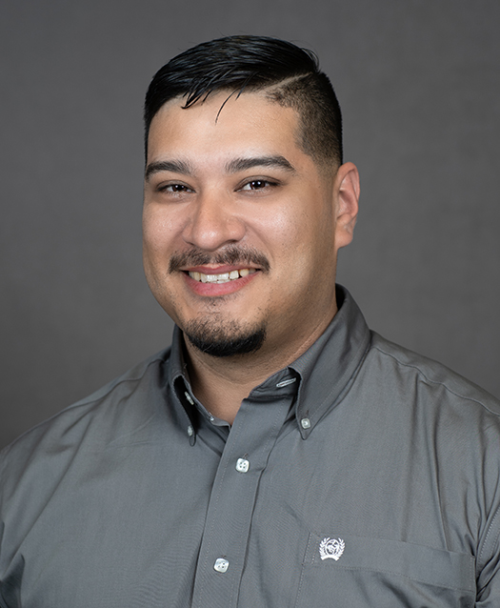


Safety
Johnny Escobedo
Project Safety Manager
512-845-5834
Juan.Escobedo@SpawGlass.com
15 years with SpawGlass
Certified Safety and Health Official from The University of Texas at Arlington
Local to Dallas-Fort Worth area (Plano)

Slide 34
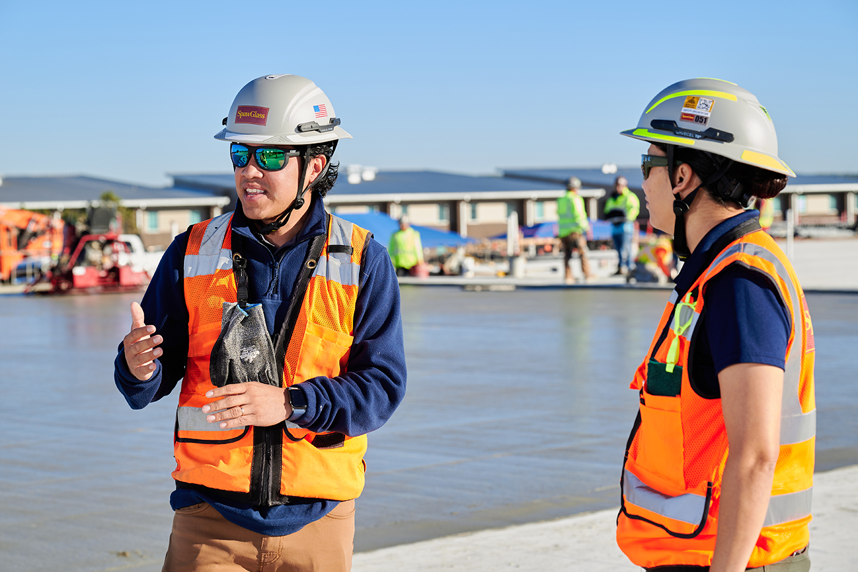
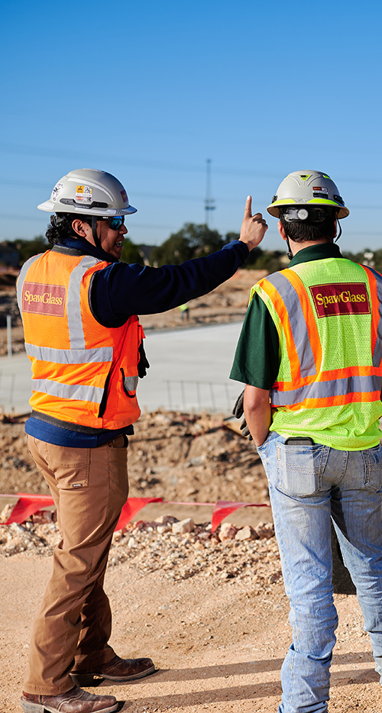

Safety Is Our
First Priority.
Sub Zero - mitigation plan
OSHA 30-hour employee
Site-Specific safety plan
Site-Specific SDS

Slide 35
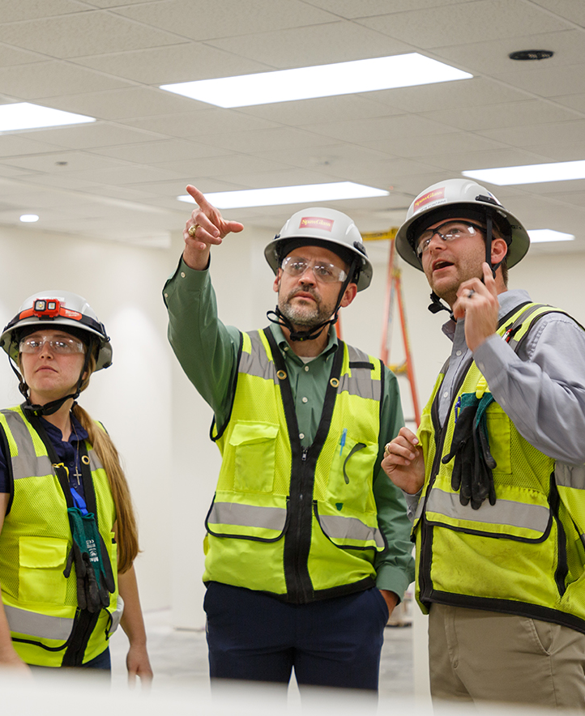
  Commitment over
  Compliance
Leading edge and steel cable Self-Retracting Lifelines (SRLs)
Tie-off in scissor lifts
100% fall protection over six feet
NO safety monitors
Gloves on your person always!

Slide 36
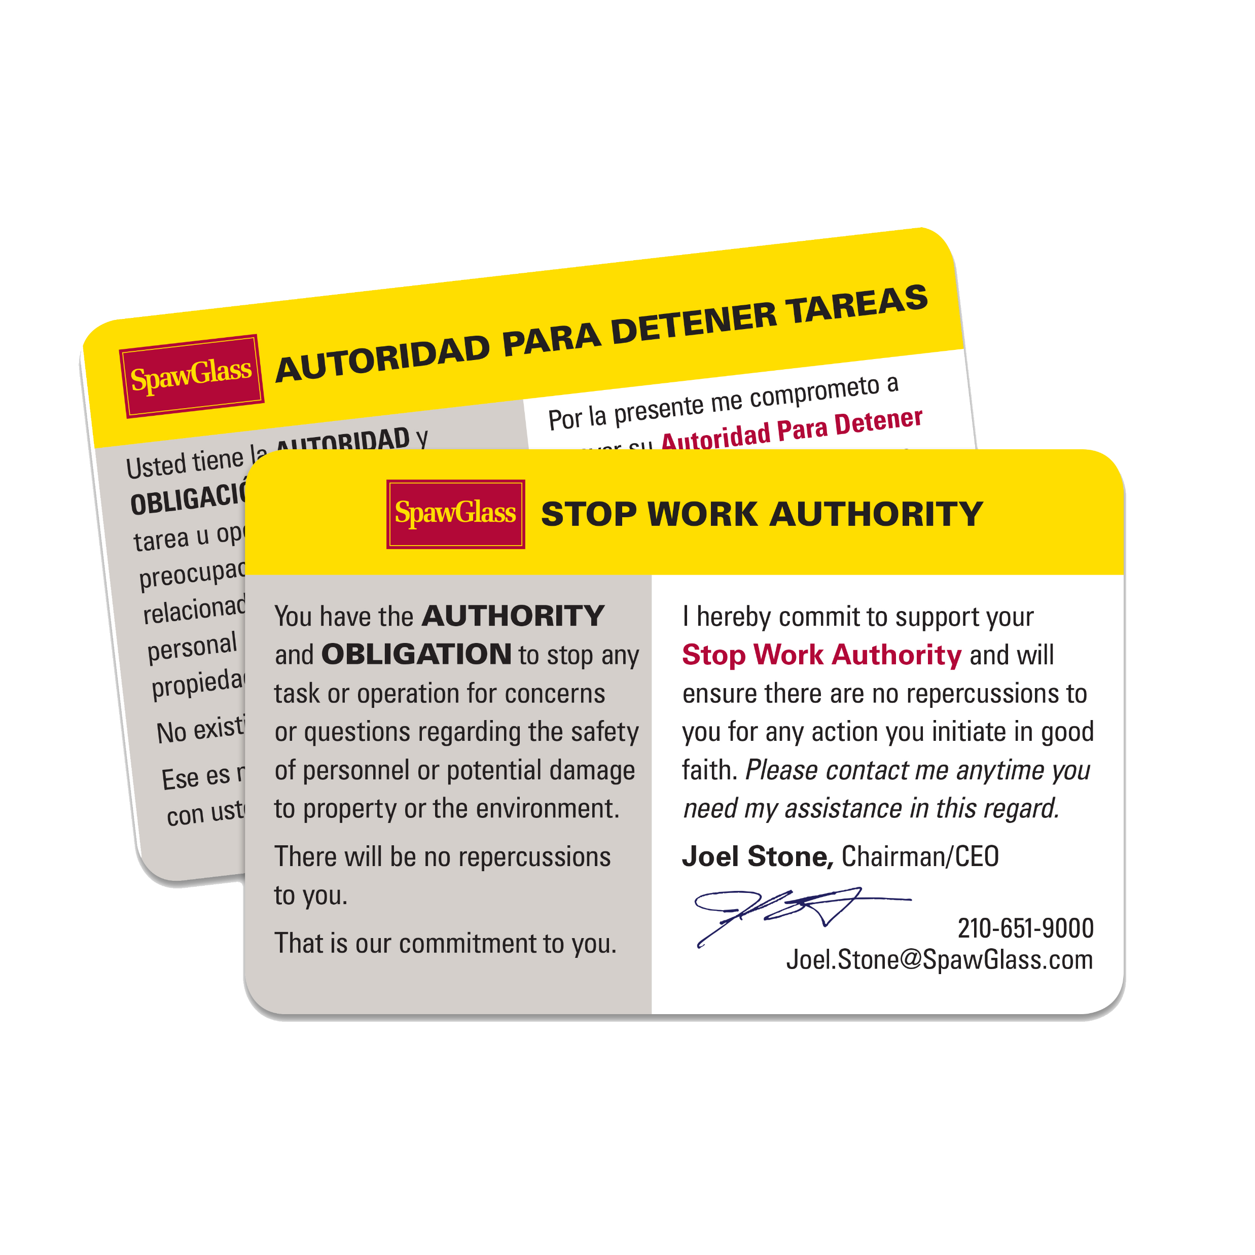
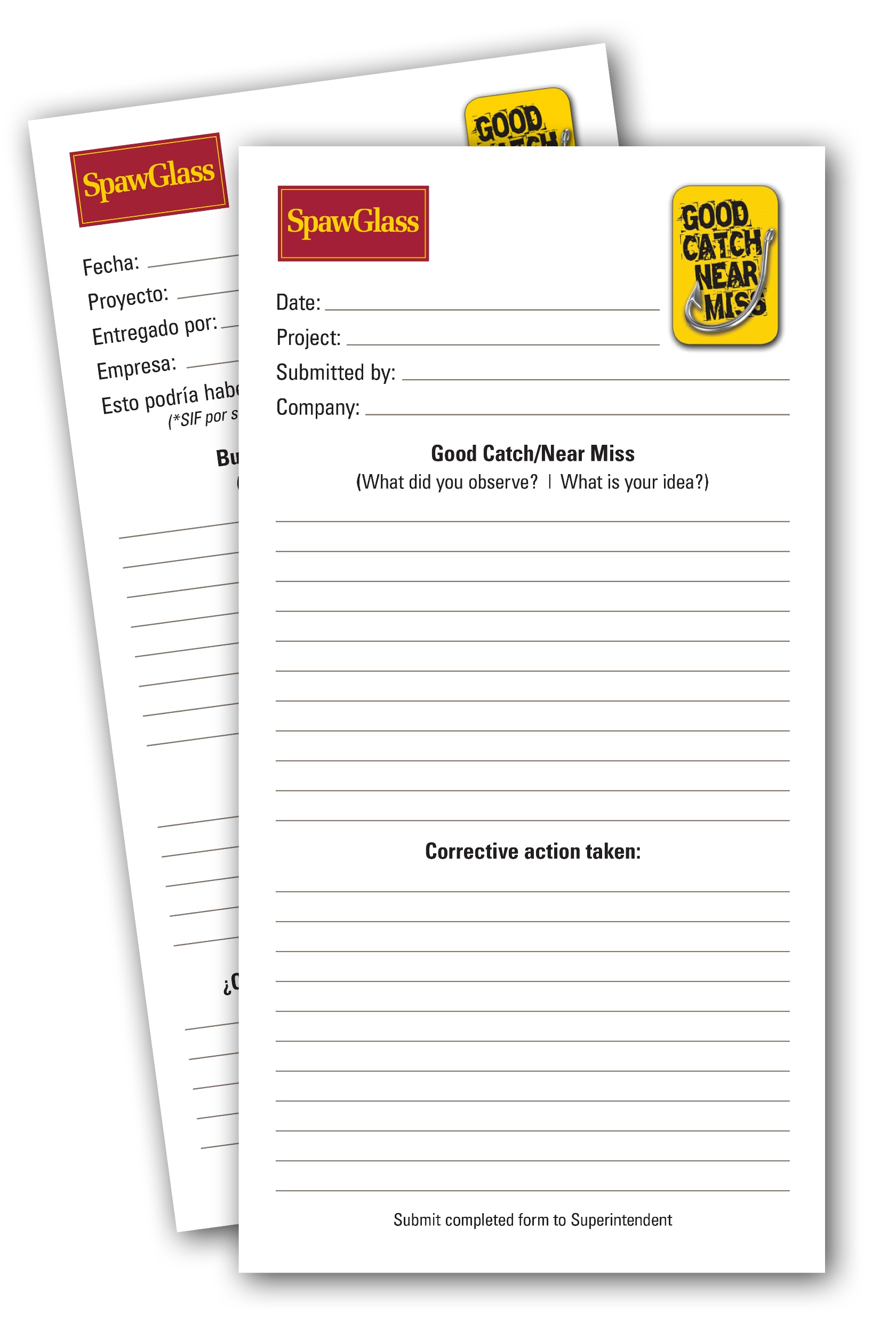

Safety Initiatives
Also available digitally

Slide 37






Safety Resources

Slide 38
The University of Texas System
Rolling Owner Controlled Insurance Program
An Overview
Susan Baggett
Vice President/CIP Project Manager
Marsh, ROCIP Administrator
Andres Campo
Assistant Director, Risk Finance
U. T. System Office of Risk Management
UT Model Contractor Development Program
March 20, 2024

Slide 39
U.T. System Overview
The University of Texas System
9 Academic Institutions
5 Health Institutions
Notes:
As you know, the U. T. System is composed of nine academic institutions and six health institutions. Throughout today’s discussion you’ll notice the high degree of geographic and programmatic diversity inherent in the System.
U.T. Austin is the flagship university with an enrollment of approximately 48,000 students. Most of our growth is occurring in the Dallas Metroplex, in San Antonio, and in the booming South Texas border region.

Slide 40
ROCIP History
1994 - OCIP on MDACC Bertner Project
1997 - ROCIP I covered 19 projects
1999 - ROCIP II covered 23 projects
2000 - ROCIP III covered 28 projects
2003 - ROCIP IV covered 59 projects with $2.1B TCV
2008 – ROCIP V covered 129 projects with $4.2B TCV
2013 – ROCIP VI covered 90 projects with $3.4B TCV
2017 – ROCIP VII currently covers 47 projects with TCV at $2.7B;
  Phase VII Program Expiration Date: 8-1-2025
2022 – ROCIP VIII Program bound 12-15-2022 currently covering 22 projects CV $1.9B; Estimated TCV $4-5B.
  Phase VIII Program Expiration Date: 12-15-2028

Slide 41
ROCIP Collaboration Teams
Manages Work / Performs Site Safety Assessments
Contractor
UT System OCP/
Project Control
Institution
Includes Facilities
& EH&S
Performs Work / Responsible for Safety
Program
Administrator
UT System
ORM
Safety Specialists
Subcontractors
Enrolls Contractors / Performs Site Safety Assessments
Manages Program
Performs Work / Responsible for Safety
Construction
Collaboration

Slide 42
ROCIP VIII Insurance Structure
Excess Liability
$200m per occurrence
$200m annual aggregate
Workers’
Compensation
Statutory Limits
General
Liability
$2m per occurrence
$5m annual aggregate
$5m completed ops aggregate
Employer’s
Liability
$1m limit

Slide 43
ROCIP – How Does it Work?
  Contractors remove insurance costs from bids
  UT purchases certain insurance for each contractor
    GC provides detailed explanation of OCIP coverages at least 10 days before signing the contract
    Each contractor and subcontractor is enrolled
  UT, administrator, and insurance company provide safety oversight and (incident) claims management assistance
  UT achieves cost savings through bulk purchasing of insurance, high deductibles and cash flow benefits

Slide 44
ROCIP VIII Minimum Insurance Requirements
Workers Compensation with waiver of subrogation (for work not covered by the OCIP program)
    Employer’s Liability Insurance: $1,000,000 limits for each accident, disease each employee, and disease policy limit
General Liability with additional insured and waiver of subrogation (offsite only)
    $1,000,000 per occurrence, $2,000,000 annual aggregate
Auto Liability with additional insured and waiver of subrogation
  Combined Single Limit $1,000,000 per occurrence
  Must be with carrier who is A- VII or better by AM Best

Slide 45
ROCIP VIII Administration
ROCIP administered by Marsh
ALL Contractors of EVERY tier are expected to enroll
    Exemptions granted on case-by-case basis, subject to exposure limits and approval by UT System Office of Risk Management
All Insurance Requirements must be met and maintained in order to qualify for enrollment
All Claims are administered by Marsh and are to be reported to the Marsh claims contact as well as Zurich (insurance carrier)
    Contractors must have a Return to Work Plan as outlined in the specs

Slide 46
ROCIP VIII Administration
Contractors cannot enter the jobsite or commence work until the following enrollment procedures have occurred:
    Enrollment has been completed via the Marsh Mwrap Portal.
    All Required Insurance Documents have been uploaded to the Marsh Mwrap Portal by the contractor for review and approval by Marsh
    Certificates of Insurance have been provided and determined to meet minimum requirements
    A ROCIP Certificate has been issued to Contractor by Marsh
    Marsh will supply the PSC (Project Safety Coordinator) with an enrollment log and pending enrollment log indicating awarded contracts that have completed the enrollment process or that are pending approval

Slide 47
ROCIP Process Flow Chart
Online Enrollment Process
General and/or Awarding Contractor
completes a Notice of Subcontract
Award to Marsh. ROCIP Manual to be
Provided to Subcontractor
by Awarding Contractor
Marsh sends enrollment
request and Contractor Portal
login info to subcontractor
Marsh receives enrollment
forms and insurance
documents from subcontractor
Marsh follows up
with subcontractor
for any missing enrollment
info and insurance
documents submitted online
Marsh will enroll subcontractor
by notifying carrier and
assigning policy number
Marsh will verify WC
class code & EMR for each
contractor/subcontractor’s
during the enrollment process
and return to subcontractor
for approval before enrollment
If any revisions are
necessary Marsh will follow up
with subcontractor
until revisions are received
Marsh will issue
Certificate of Insurance
to evidence
contractor/subcontractor
enrollment
Marsh will send copy of
Certificate of Insurance
to enrolled subcontractor
Marsh will receive
subcontractor’s WC
policy, check it,
request any necessary
revisions, e-mail out policy
to subcontractor
Subcontractors to
provide notification to General
Contractor of change order
when change order is received
Payroll Process
All Contractors to report their
payroll to Marsh by the 10th of
each month by submitting a
online Payroll Report
via Contractor Portal
Marsh sends Payroll Delinquency
Report to the General Contractor
by the 15th of the month
UT’s expectation is that no
contractor have a payroll report
more than 30 days delinquent
General Contractor uses
Marsh status report
on a monthly basis to
ensure all contractors on
their jobsite are compliant
Close-Out Process
Marsh receives online close-out
Form from each subcontractor
and Marsh reconciles contract
value and payroll with
subcontractor as needed.
Each contractor/subcontractor
will be closed out as they
complete their on-site work
Marsh notifies Subcontractor
when close-out is complete
Marsh provides
close-out Information
to insurance carrier
47

Slide 48
ROCIP - What Are The Benefits?
Increased Historically Underutilized Business (HUB/MBE) participation
Uniform and enhanced insurance coverages and limits
Standardized & improved claim and safety management programs across all projects
Eliminates cross claims among Contractors (mutual waiver of subrogation)
Significant cost savings to the Owner

Slide 49

Estimating &
Proposal Response

Slide 50
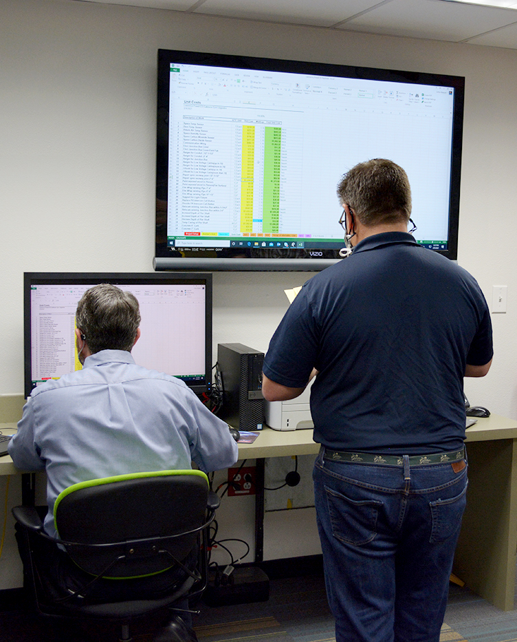
  Preconstruction &
  Estimating
15 Estimators across nine offices
164 projects in progress statewide
Contract values from $1,000,000
to $160,000,000

Slide 51
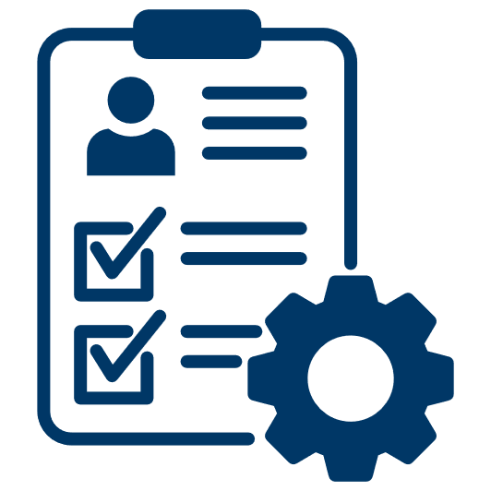







Pursue The Right Projects.
Owner and Project Requirements
Location and
Timing
Relationships with
Designer and Contractor
Corporate
Strategy
Competition
Size, Scope
and Type
Financial
Capacity

Slide 52
  Competitive Sealed Proposal (Hard Bid)
Owner
A/E
Contractor
Owner solicits proposals from multiple general contractors
Each general contractor solicits proposals from multiple subcontractors for each trade
Design is complete
Subcontracts are usually awarded
based on cost
Subcontractors

Slide 53
  Construction
  Manager At Risk (CMAR)
Owner
A/E
Contractor
Owner awards Construction Manager early in design, based on qualifications
Construction Manager provides budget updates as design develops
Construction Manager provides constructability feedback
Subcontracts awarded based on best value
Subcontractors

Slide 54
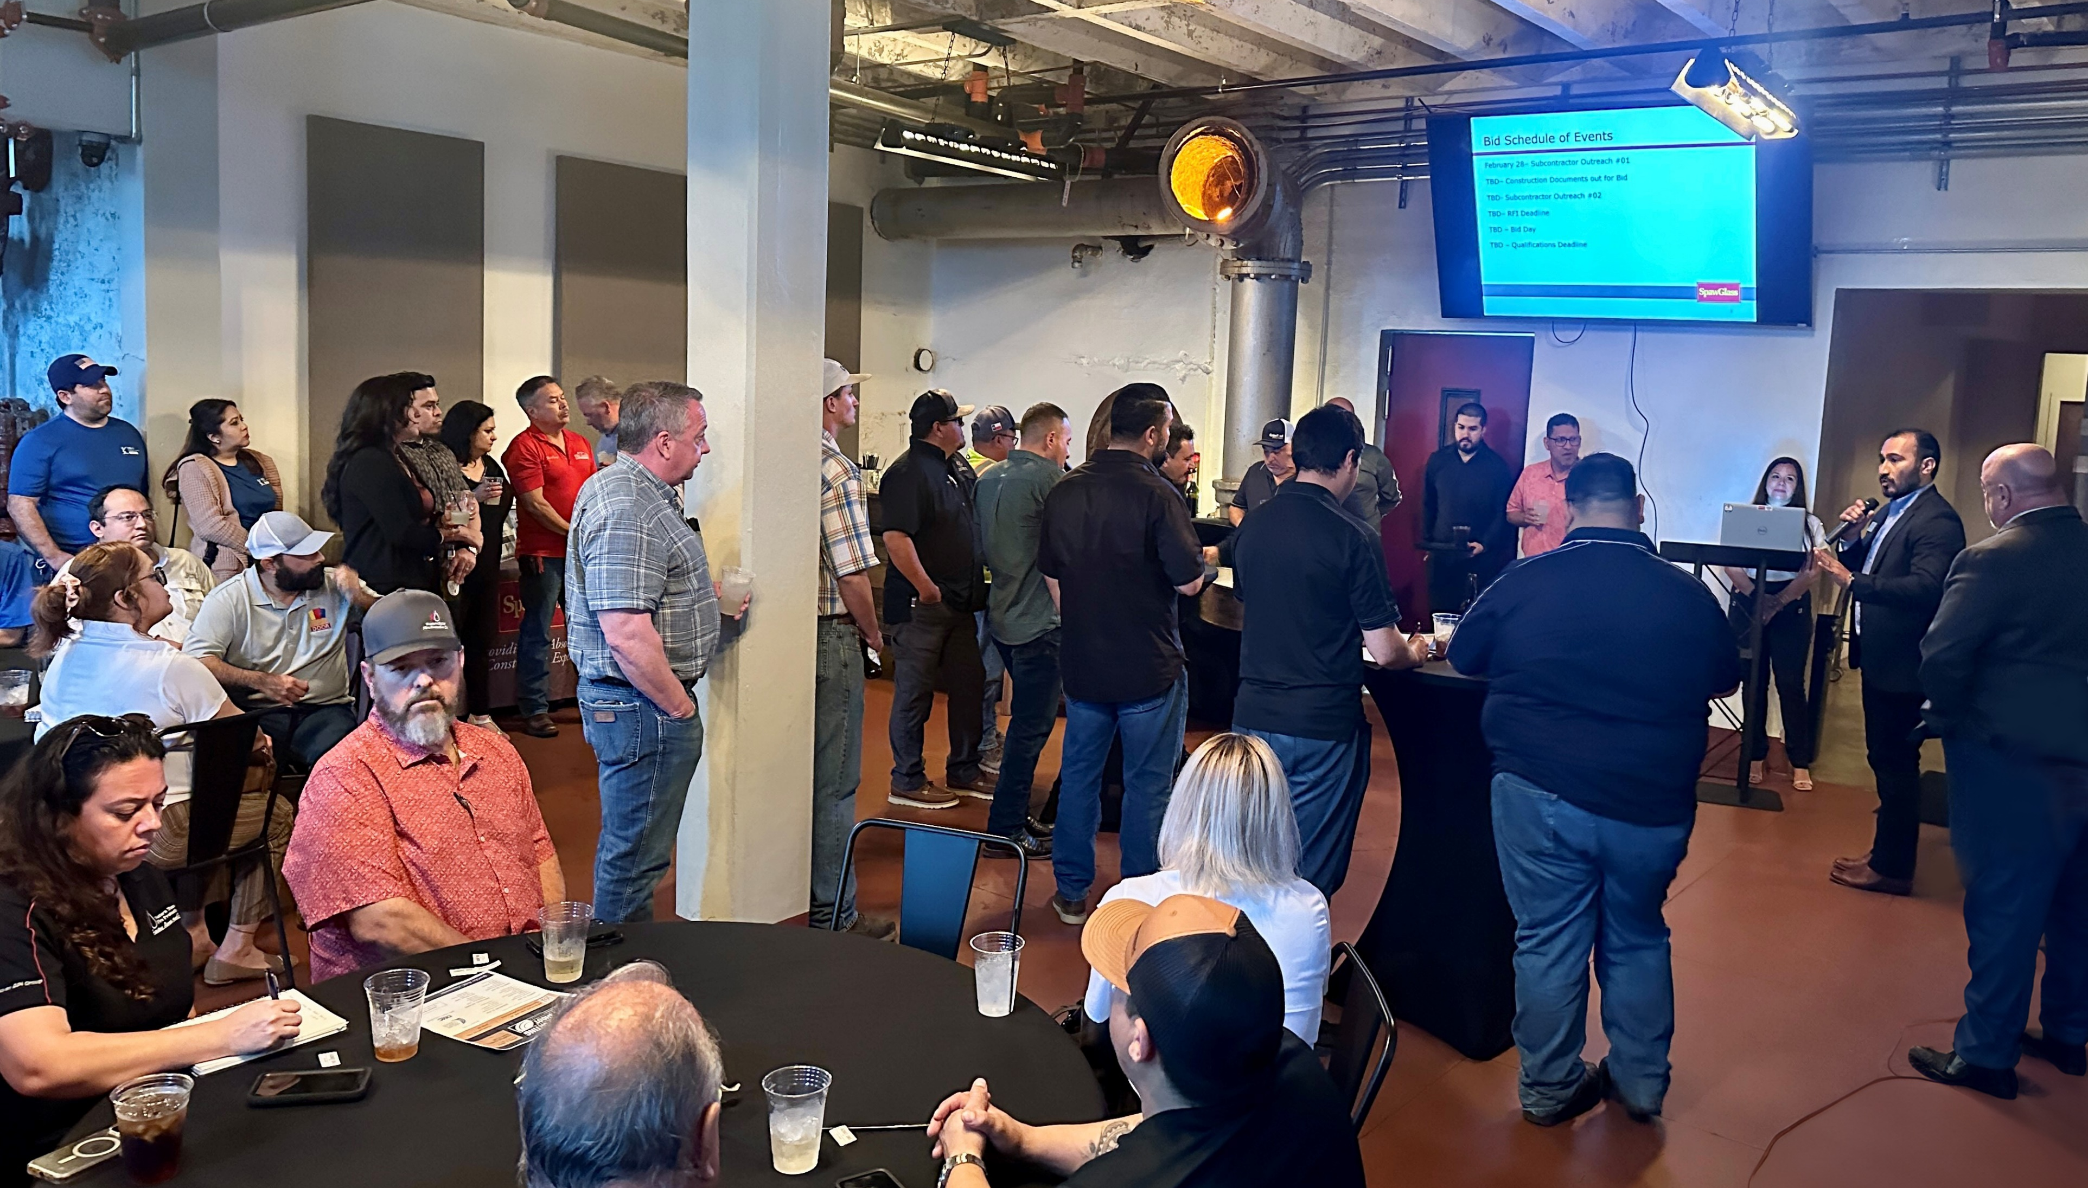
Even the Playing Field!
Ask questions at pre-bid
Identify cost drivers
Identify “buried costs” and “gotchas”
Gain the general contractor/construction manager’s confidence
  Outmaneuver your Competition
Sell Your Competitive Advantage!
Services performed
Relevant experience
Availability of scarce resources
Beneficial relationships

Slide 55
Bid the
Owner and Project Requirements
Bid
Tabs
Bid
Results
Site administration requirements
Construction standards
General Conditions
Quality control and inspections
Substitutions
Payment terms
Bid evaluation method
Compare scope
Compare bid dollars
Evaluate estimate and project risk
How did your bid look?
How many bidders?
Establish rapport with general contractor/
construction manager
Get feedback

Slide 56
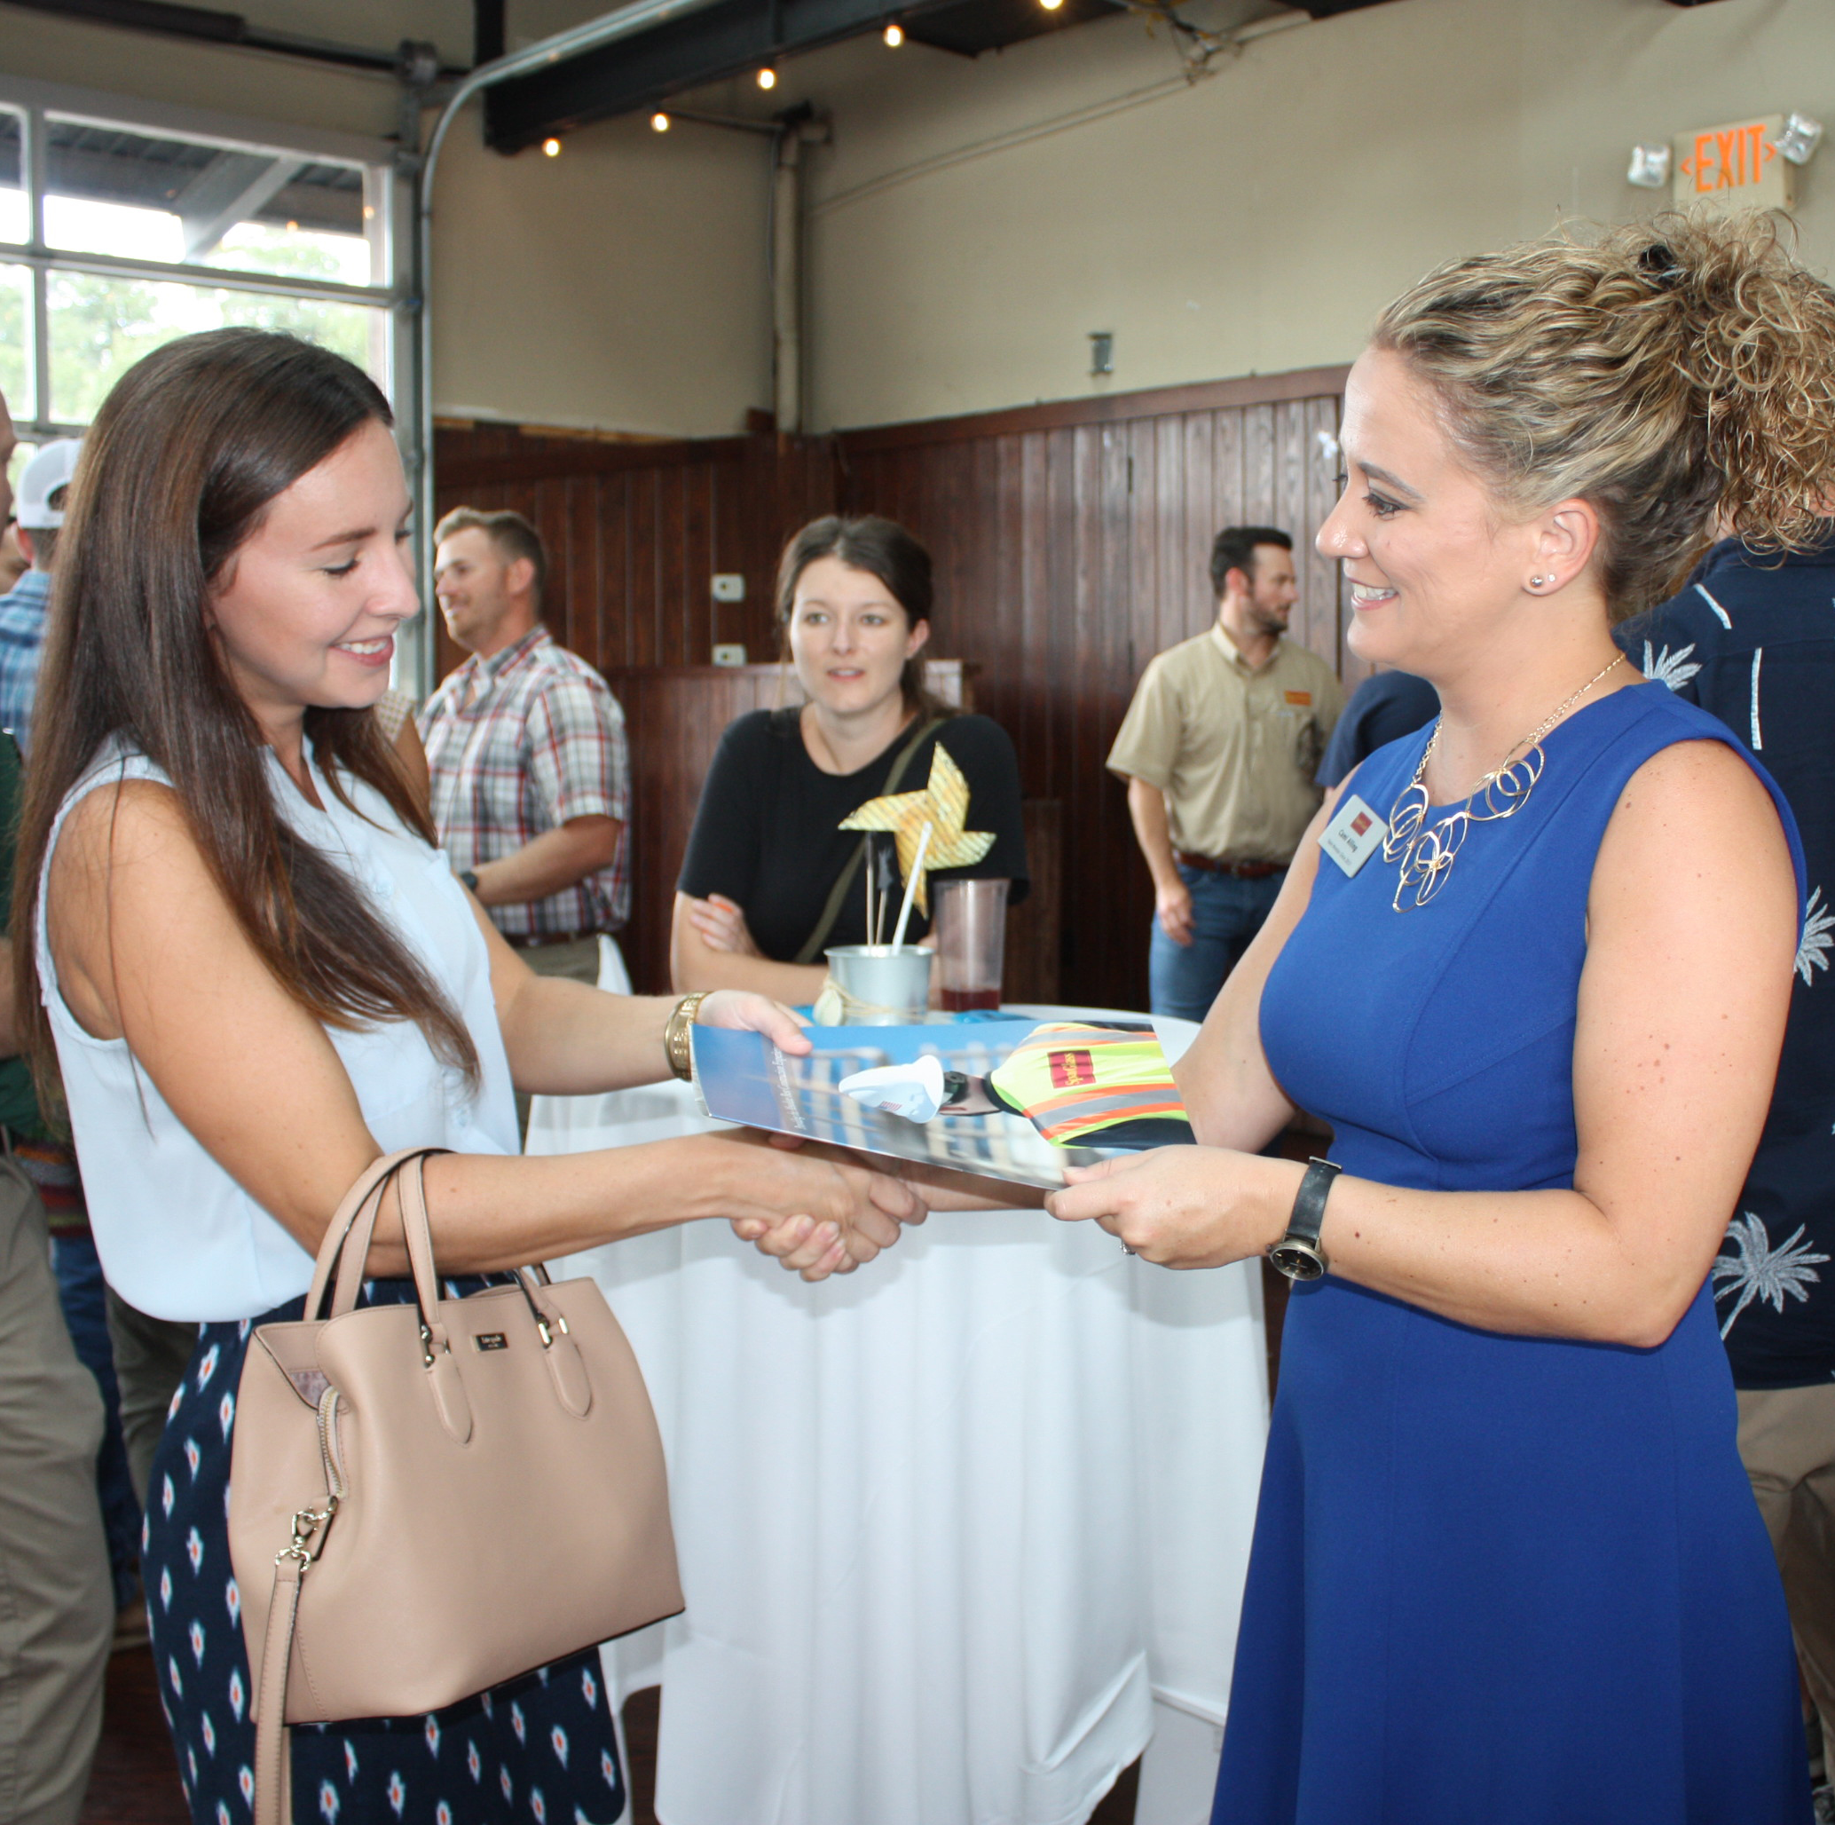
  Grow Your
  Business &
  Market Share
Relationships
  Contractor
  Owner
  Design Team
Opportunities that align with
growth goals
Mentorship

Slide 57
  Subcontractor
  Qualifications
Technical expertise
Organization
Workforce
Financial fitness
Ability to meet insurance requirements
Schedule
Safety Record
Quality management
Plan to execute scope of work
Strong Estimating Team
Knowledge of the trade
Experience in the field
Field collaboration
Historical cost data
Training
Process refinement

Slide 58
Build a Complete Estimate
Scope
Project Administration
Insurances
Drawings
Specifications
Addenda
Appendix (Geotech/physicist reports)
Insurances
Certified payroll
Prevailing wages
General Conditions
Supplementary Conditions (GC)
Bonding requirements
Contractor Controlled Insurance Program (CCIP)
Owner-Controlled Insurance Program (OCIP)

Slide 59
Build a Complete Estimate
Site Investigation
Logistics
Building Information Modeling (BIM)
Existing conditions
Challenges not identified in documents
  Scope
  Access
  Encumbrances
Work hours
Deliveries/Access
Materials staging
  Laydown/Storage
Overhead and profit
Contractor site logistics plan
Software costs
Coordination time
Designer availability/costs

Slide 60
Build a Complete Estimate
Escalation
Safety Requirements
Taxes
Project schedule
When does project subcontract?
When can materials be released?
Contractor strategy
Identify escalation on bid
Personal Protective Equipment (PPE)
Supervision requirements
Training
Orientation
Background checks
Testing
Tax Status
  Exempt New
  Exempt Remodel
  Taxable New
  Taxable Remodel
When in doubt, ask contractor

Slide 61

Build a Complete Estimate
  Common
  Bid Day Errors
  Formula and math errors
  Quantities
  Late bids
  Missed scope
Fees and Permits
Warranties
Utility company and
impact fees
Rentals
Parking
Trade permits
A-typical product warranties
Commencement date

Slide 62
  Prevent Errors - Be Prepared!
Spreadsheets ready to
go with formulas checked
Don’t forget alternates!
Pre-populate bid forms
Review scope with contractor early
Know the documents
Plan the work
Visit the site
Get a quality control check
Submit early for contractor scoping

Slide 63
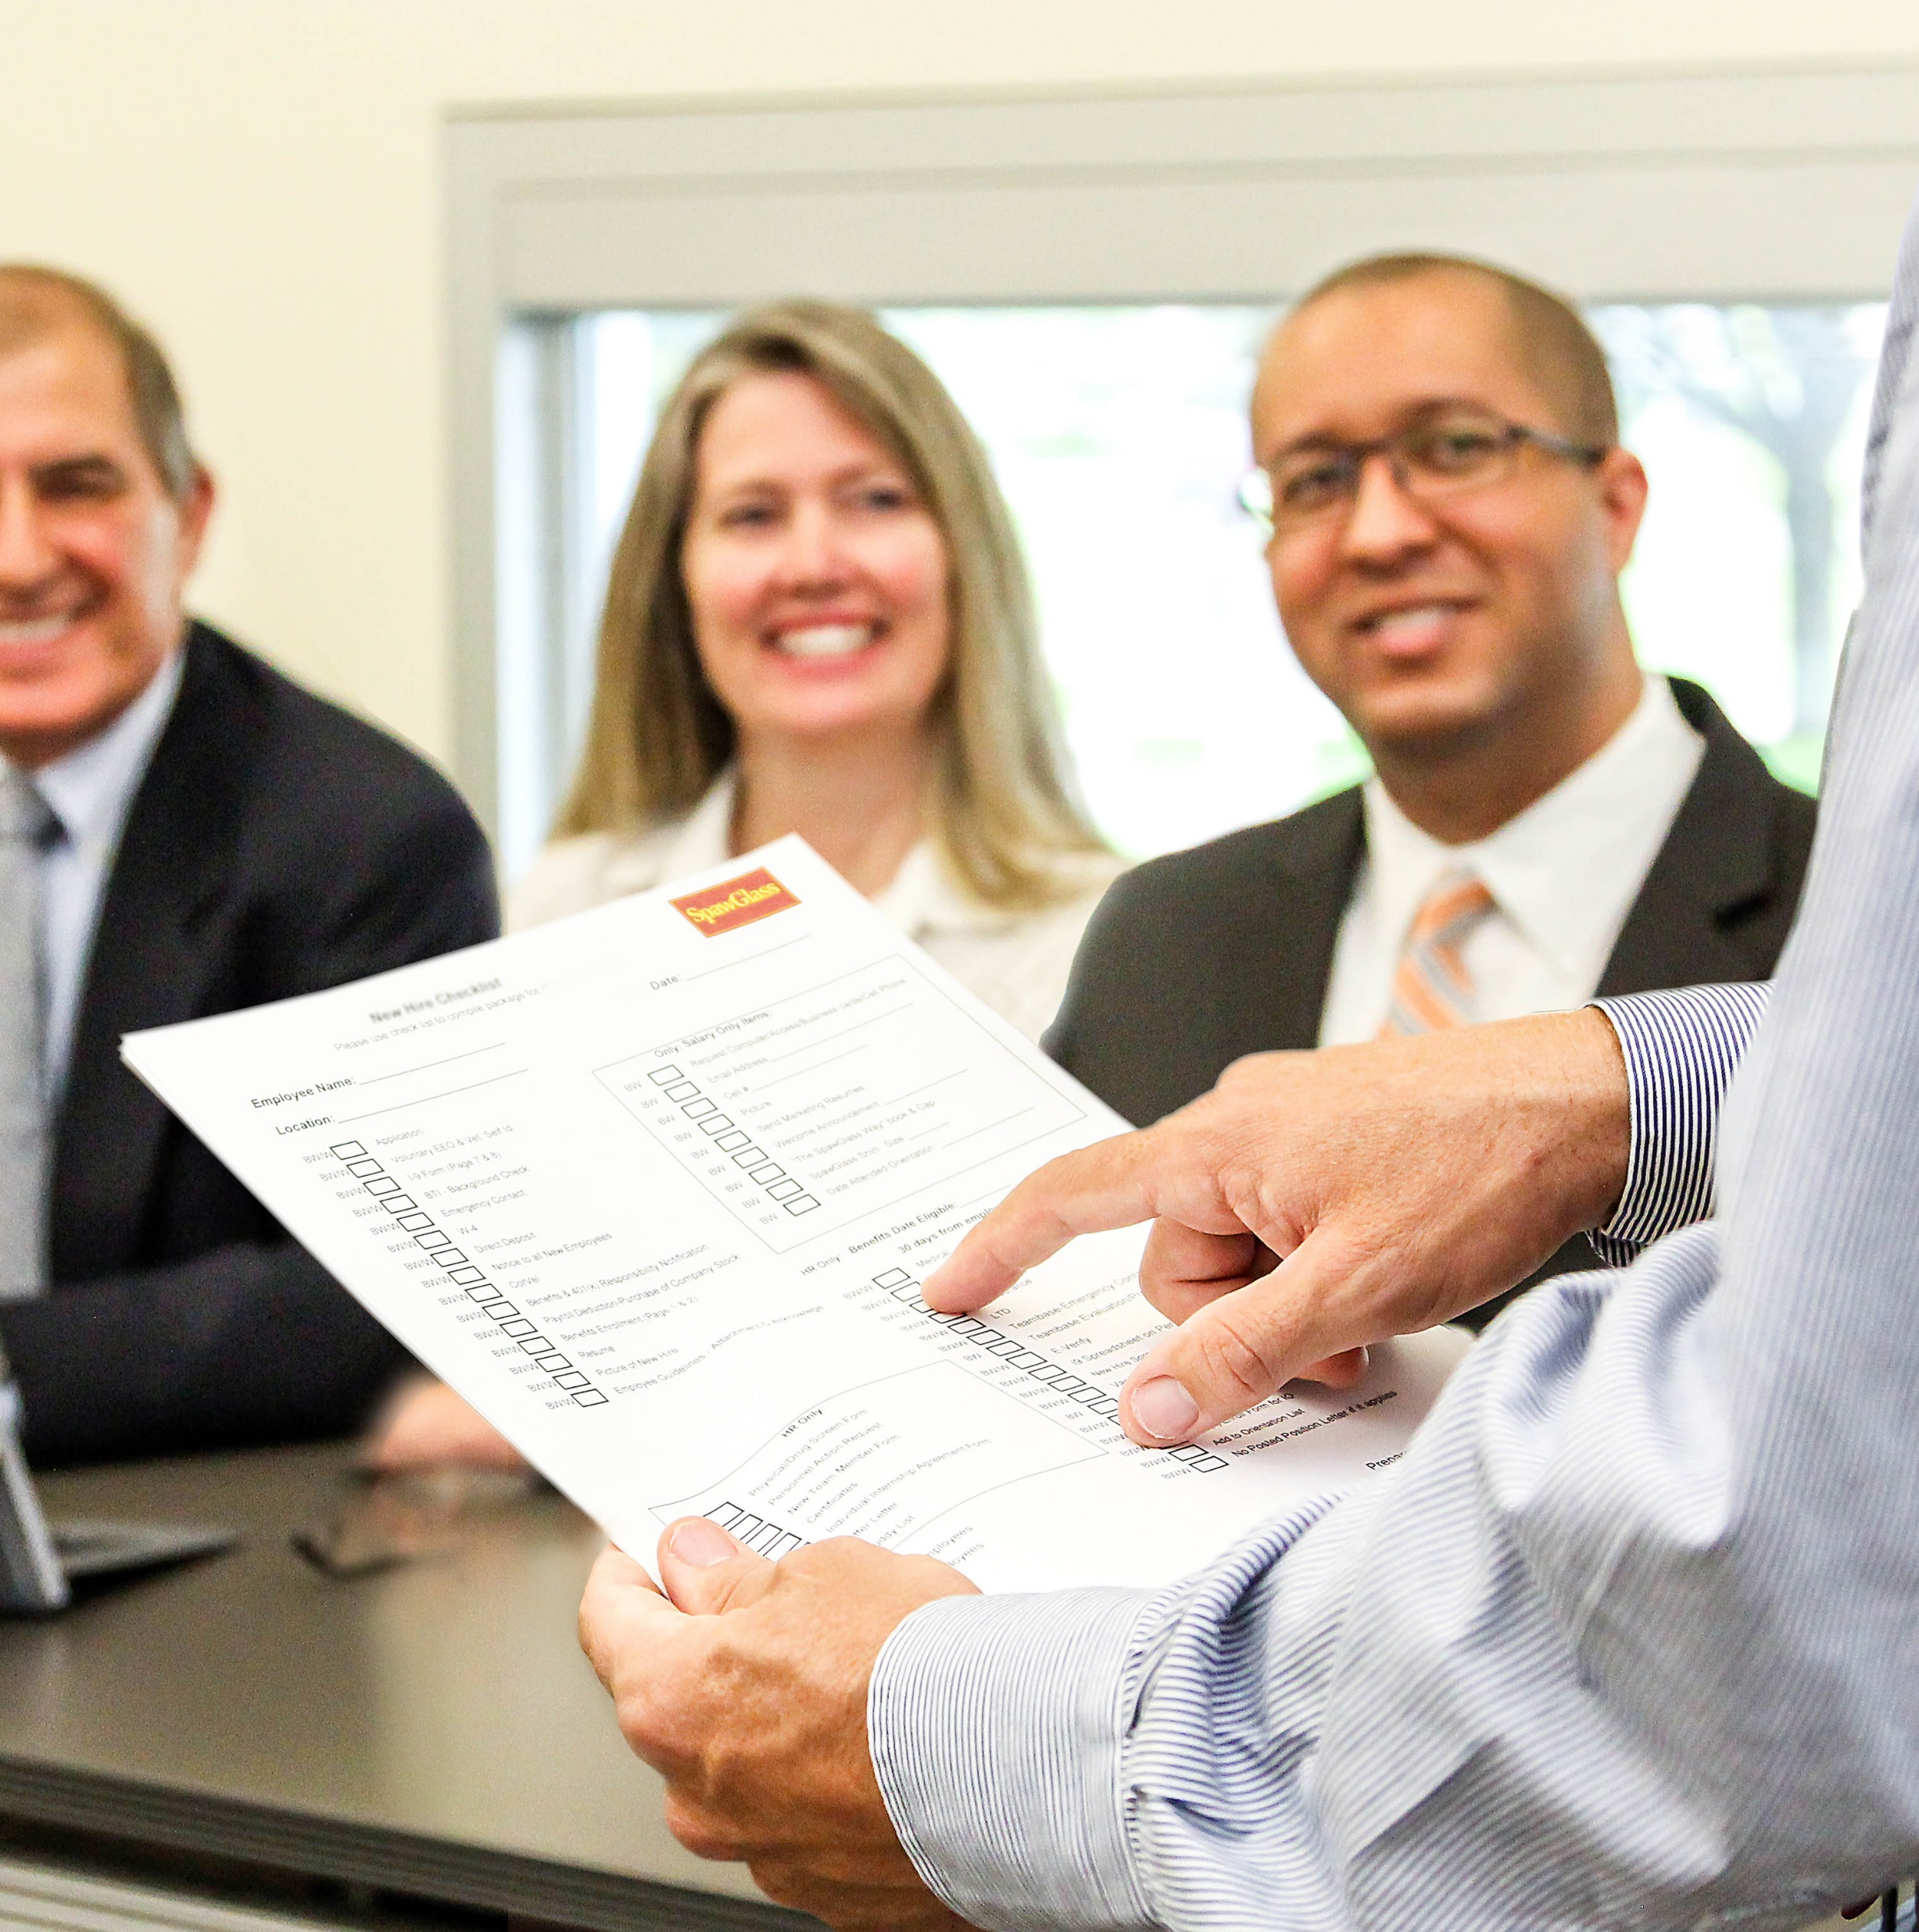
  As-Bid
Document contractor conversations
Added or deleted scope
Price adjustments
Clarifications and inclusions
Vendor post-bid adjustments
Estimate vulnerabilities
Errors and busts

Slide 64
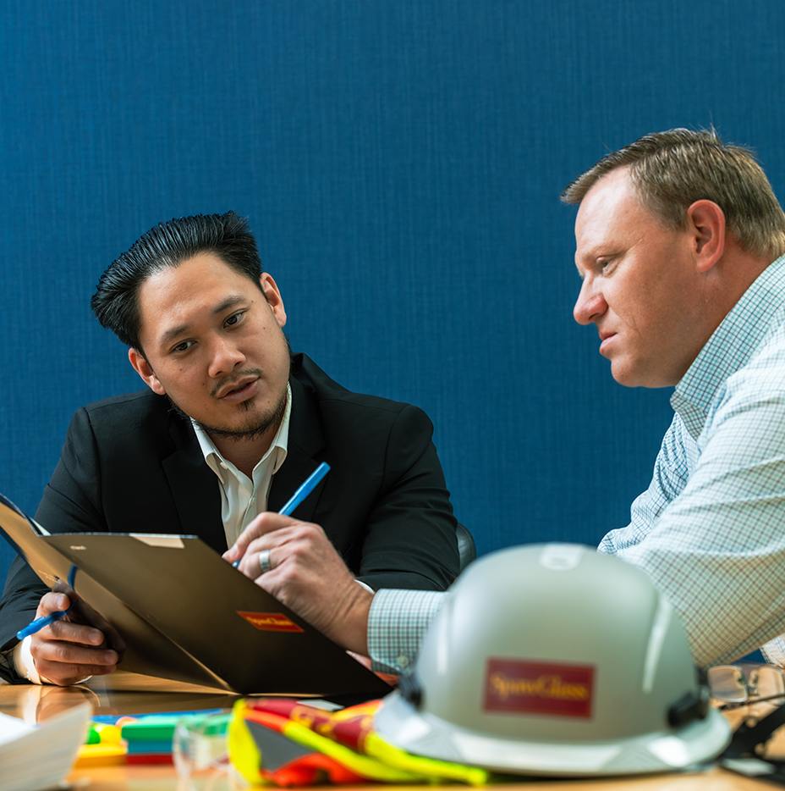
  Lessons
  Learned
What went well?
What could have gone better?
What went poorly?
What can be improved?

Slide 65
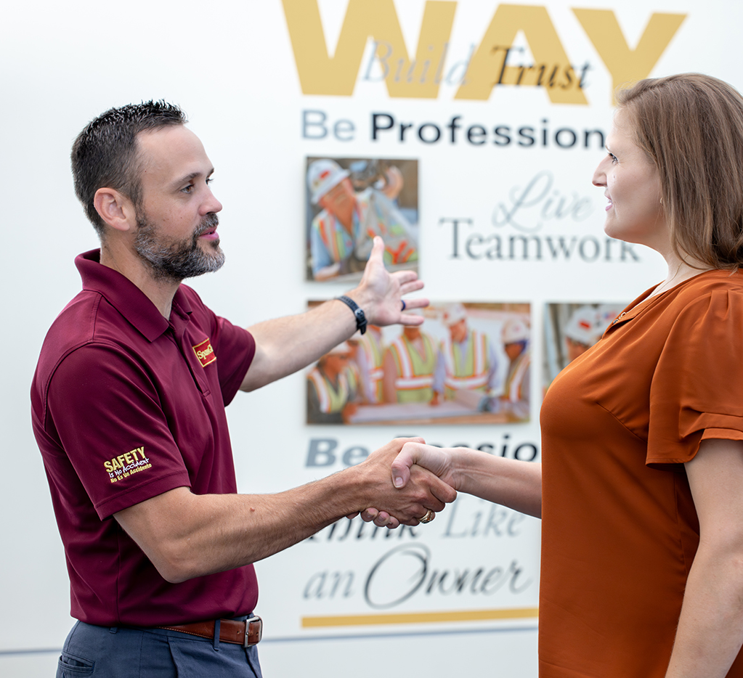
  Project Award
Double/Triple check
Review As-Bid
Review contracts and terms
  Payments
  Retainage
  Safety requirements

Slide 66
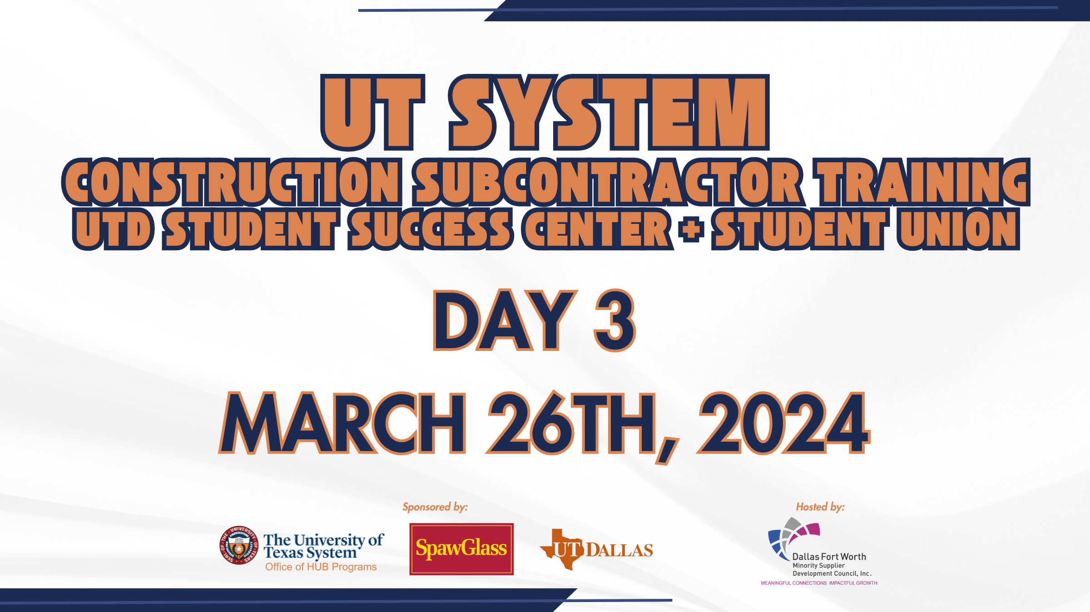

Slide 67
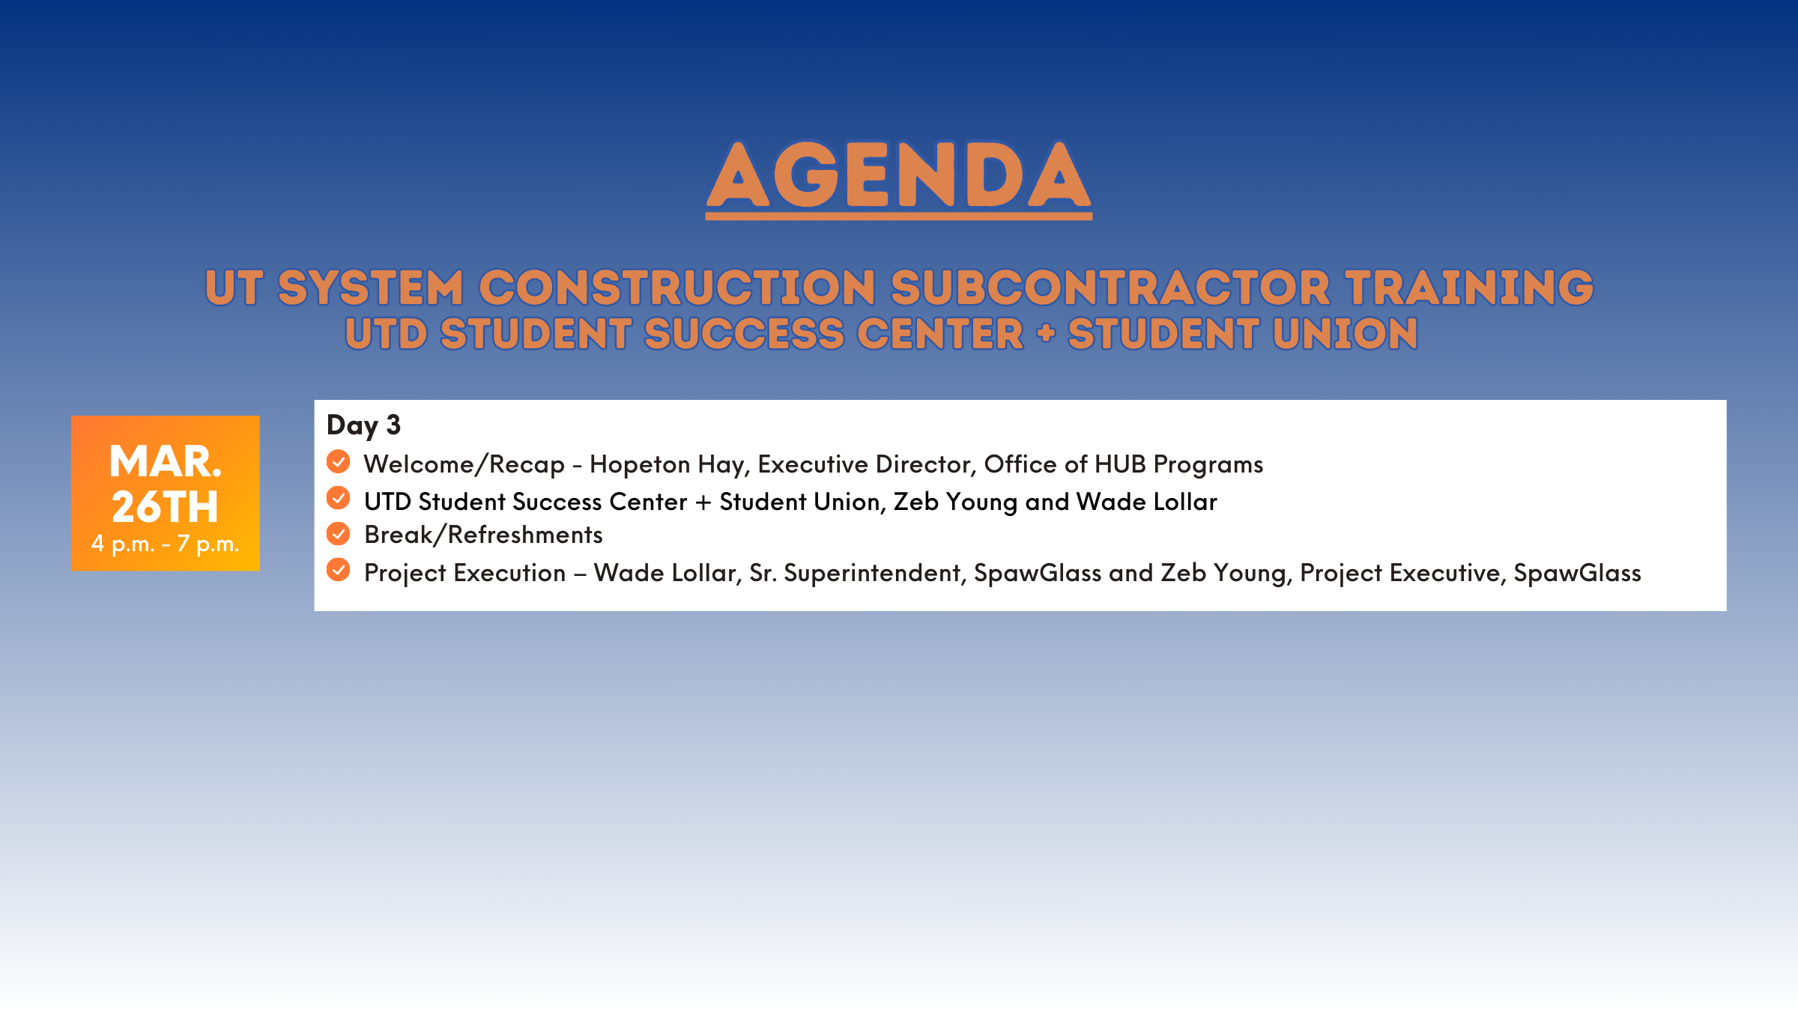

Slide 68

Student Success Center & Student Union
Notes:
Project Execution

Slide 69
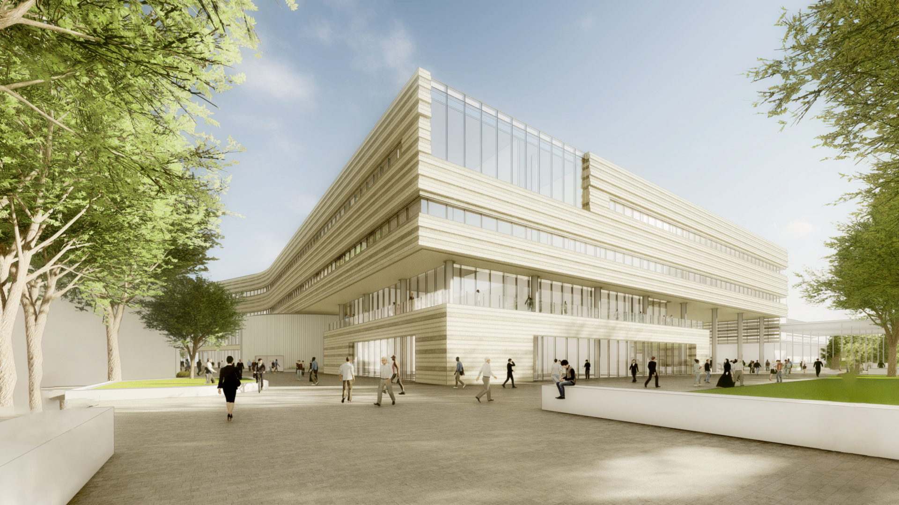
  Project
  Overview
360K
Gross square feet
4
Level cast-in-place structure with basement
10/2026
Substantial completion
Project Architect:
Perkins and Will

Slide 70
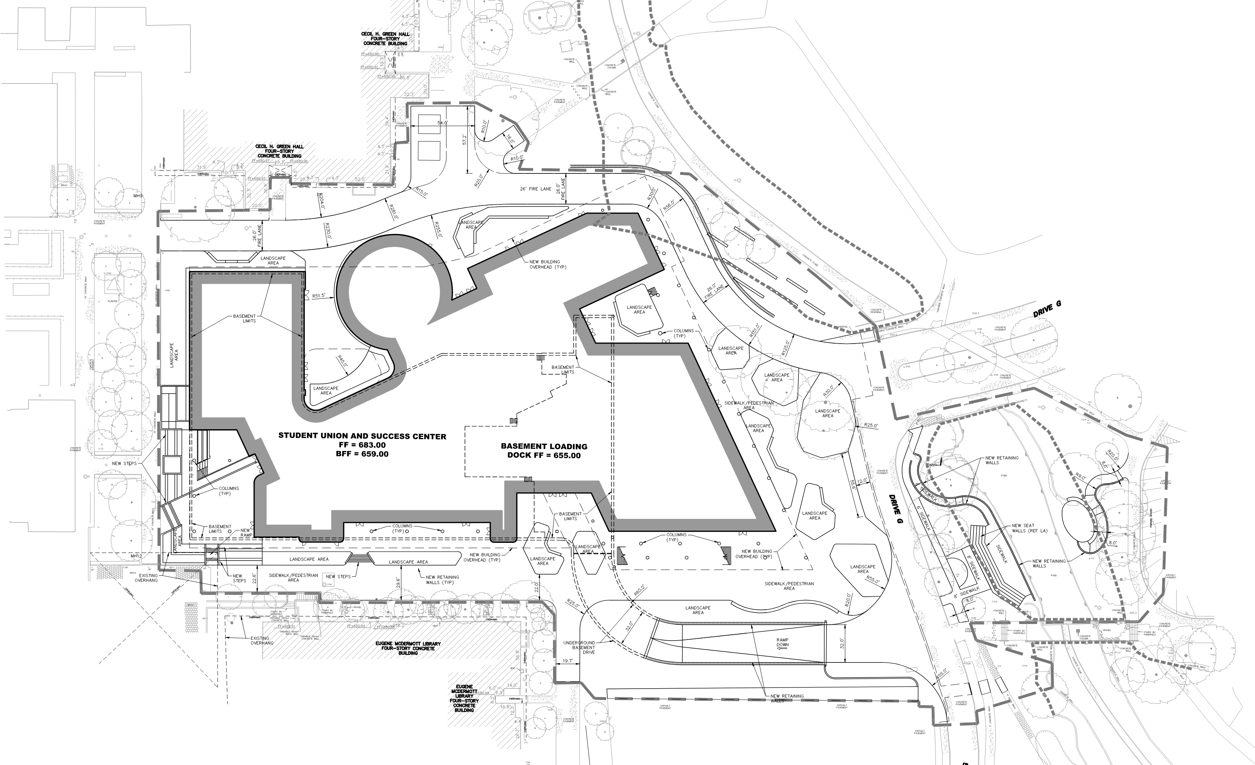
UTD Student Success Center & Student Union

Slide 71
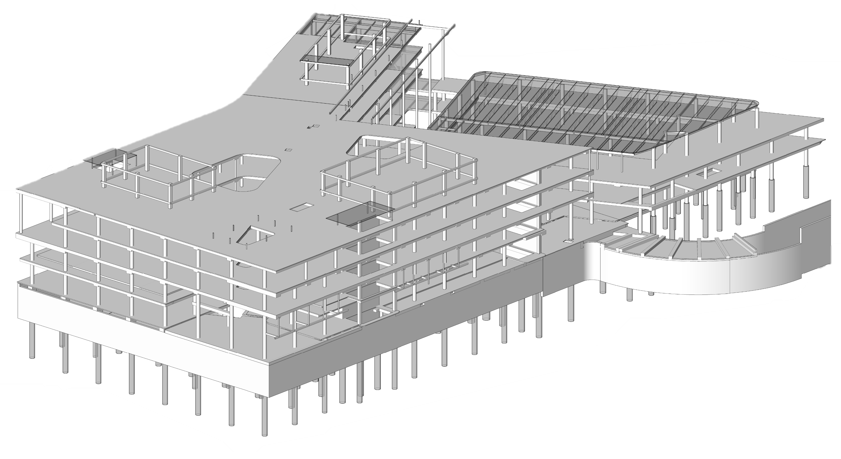
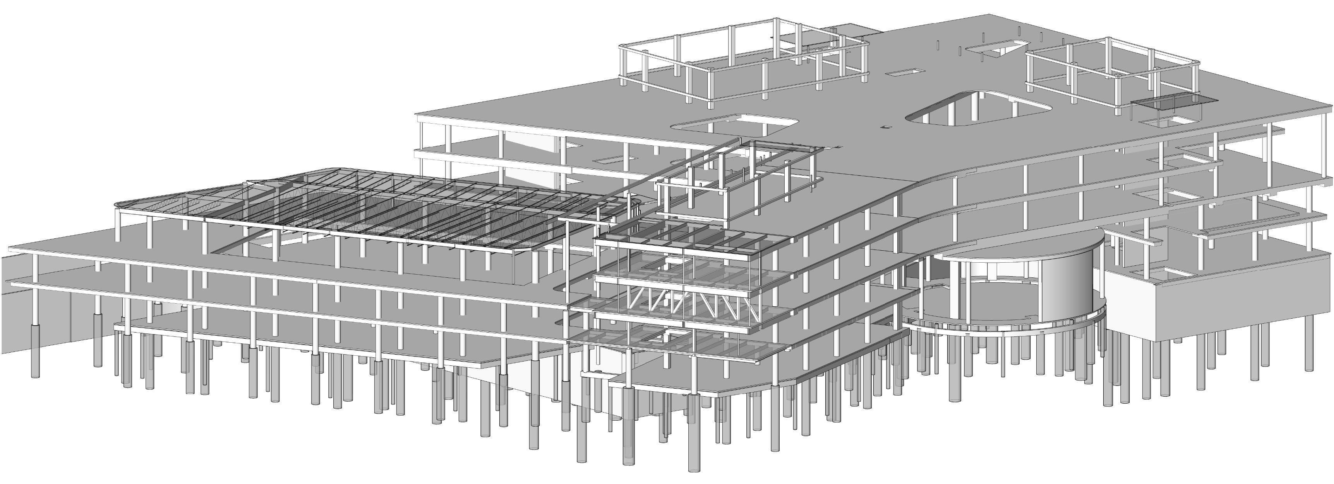

Slide 72
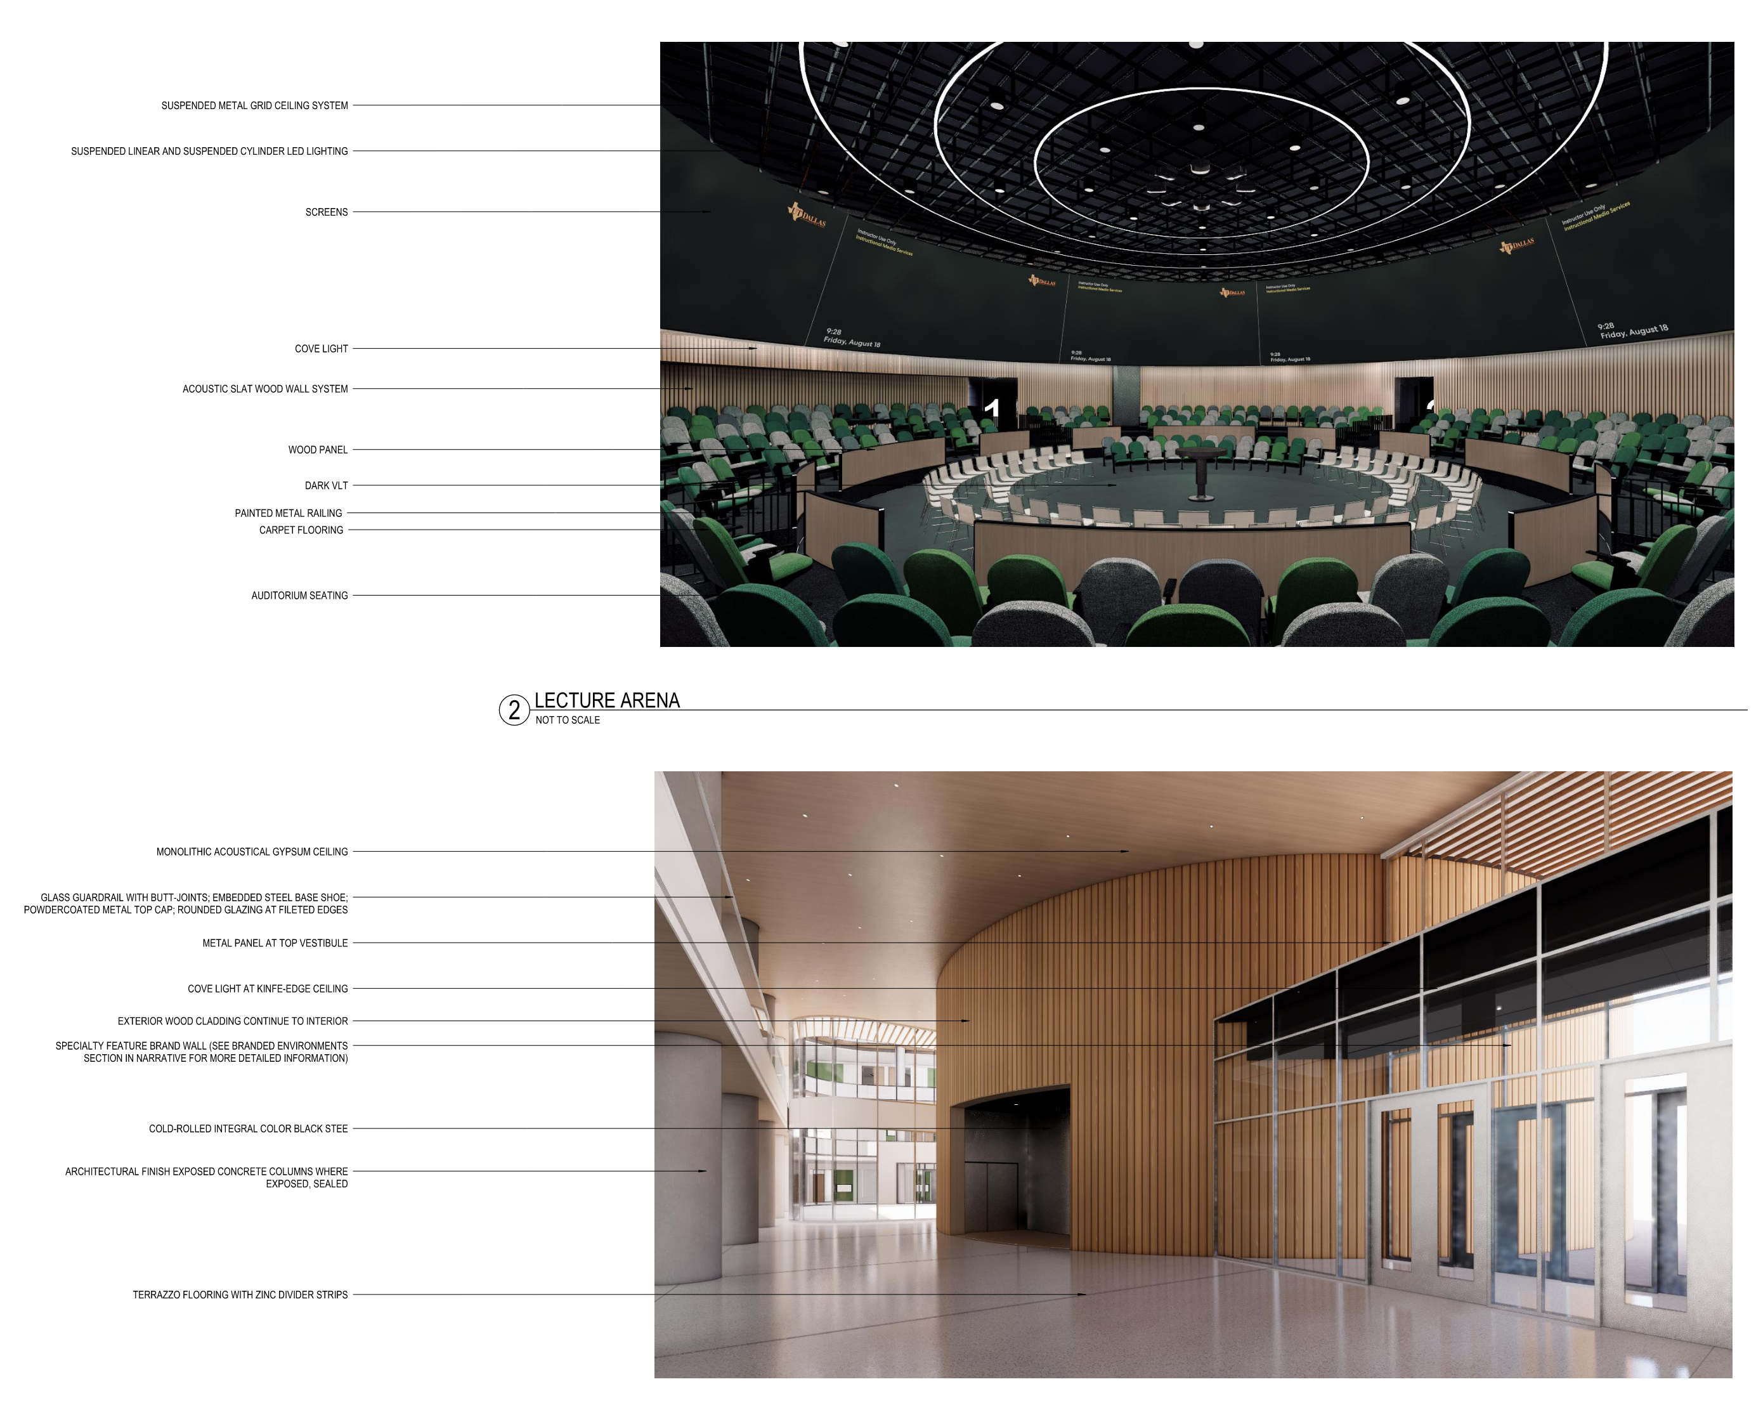
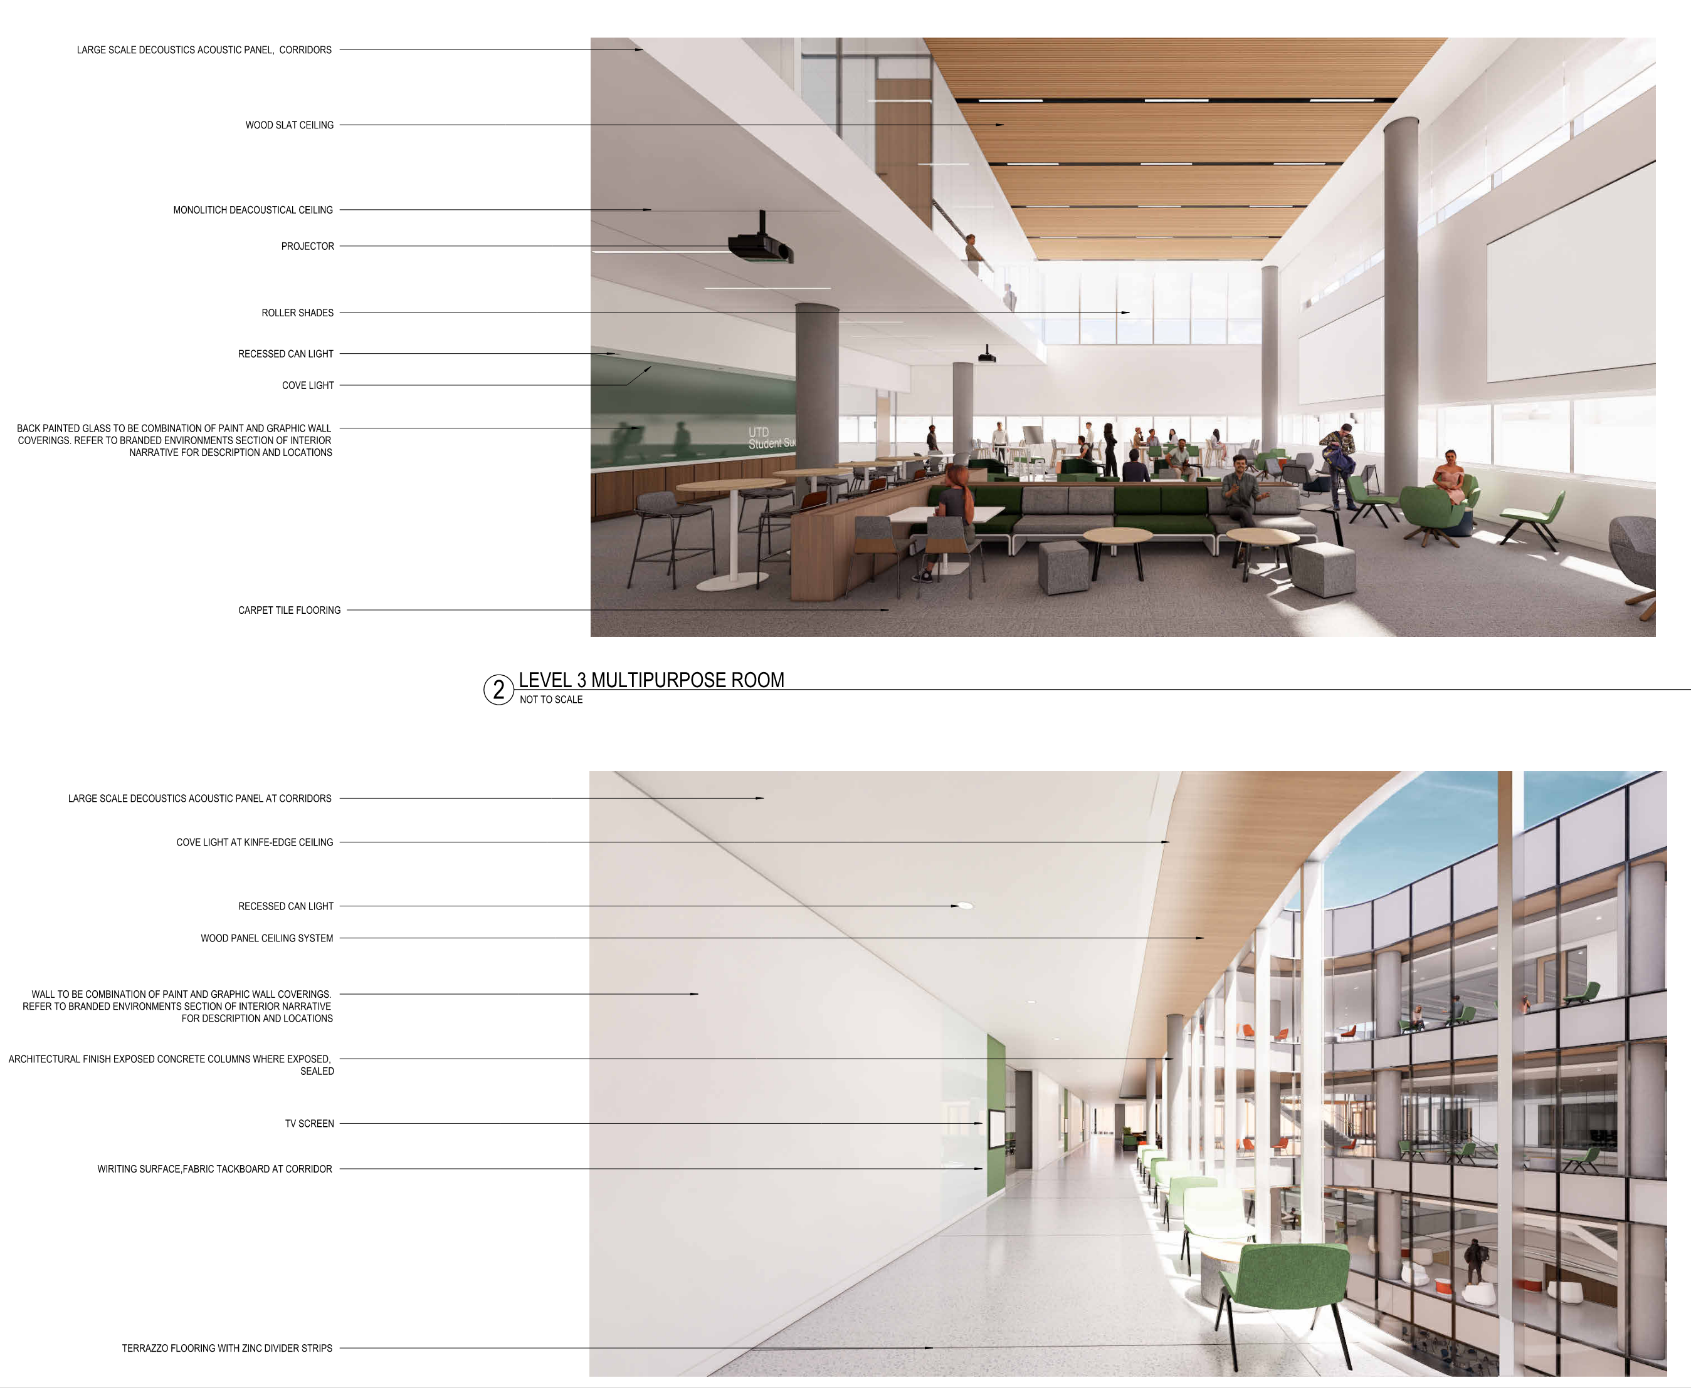

Slide 73
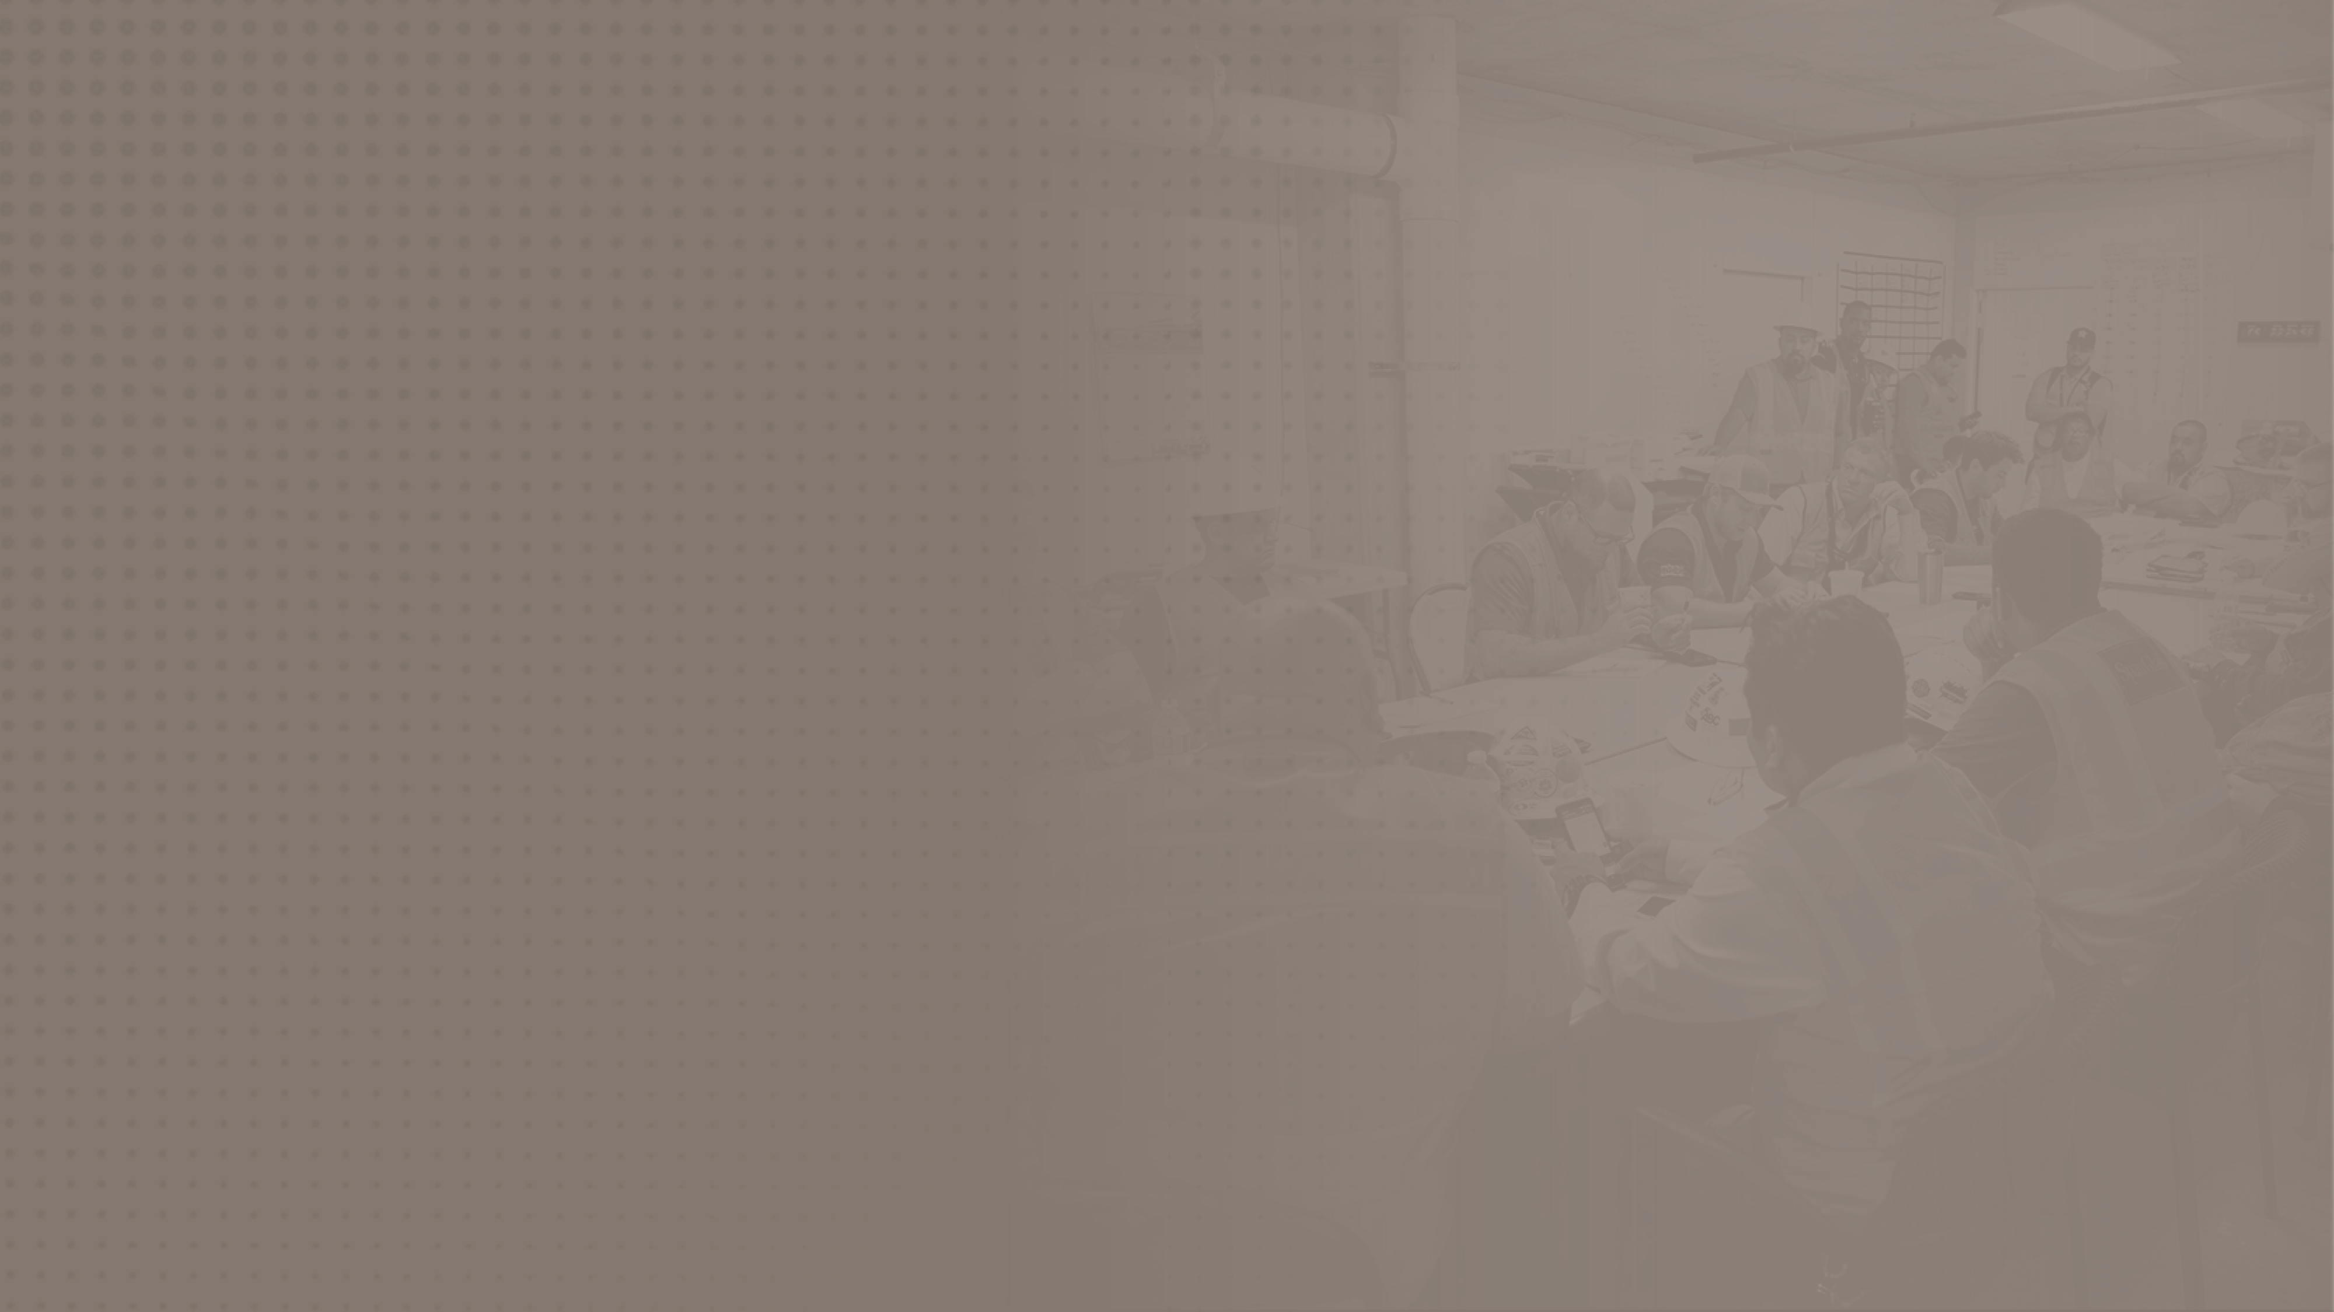
Project
Execution
Notes:
Project Execution

Slide 74
  First Day On Site
Workers will report
to safety office for
jobsite orientation
Workers will be confirmed to have successfully passed background and drug tests
Workers must complete Worker Wage Rate Forms
Workers must submit
current training
Workers will have their picture taken and
receive a badge
Workers will be introduced to Good Catch Near Miss (GCNM) program and encouraged to participate

Slide 75

  Safety
  Meetings
Safety on Site
Mandatory weekly safety meetings
Engagement and interaction encouraged
Prizes for GCNM participation
Topics pertinent to week’s work

Slide 76

  Subcontractor Safety Representative (SSR) Meetings
Safety Leaders
Weekly SSR Meetings are mandatory for all SSRs working on site
Purpose of the meetings is to discuss safety related issues
Identify potential upcoming hazards and how to best mitigate
Review sanitation and housekeeping on site
Discuss topics for weekly safety meetings
Identify any trends in incidents or inspections being observed

Slide 77


  Foreman’s Meeting
Staying on the Same Page
  Mandatory weekly foreman’s meetings
  Weekly Work Plans (WWPs) submitted every Tuesday
  WWPs will be consolidated and reviewed at foreman’s meeting on Thursday
  Schedule status will be reviewed against WWP and Six-Week Look Ahead
  Discuss / identify constraints
  Discuss coordination items for upcoming week
  Review planned percent complete for the week
  Discuss RFIs, ASIs, changes, etc.

Slide 78

  Daily Huddles
Building Efficiency
  Daily Huddles are 15 to 20-minute meetings on site
  Day’s progress is reviewed against WWP
  Potential constraints are identified
  Deliveries and any changes to WWP are discussed

Slide 79

  Project Manager Meetings
Managing Change and Getting Paid
  Mandatory project managers meeting
  Meetings held monthly (at a minimum)
  Project Managers are required to attend even if crews are not currently working on site
  Items of Discussion:
  Overall project schedule
  Material procurement
  Changes in the work
RFIs, ASIs, PCIs, etc.
Submittals
Pay Applications

Slide 80

  Quality Control
Getting it Right
  Meetings will start with preinstallation
  Trade contractor may have multiple meetings for various scopes of work
  Focus on coordinating mockups and first installations
  Involvement from the University’s
  Construction Inspectors
  Project Manager and foreman for each trade contractor required
High-quality projects do not happen by accident. They are the result of focused planning and effort.

Slide 81

  Commissioning
Proving it’s Right
  Reference 01 91 00 for full commissioning requirements
  Commissioning (CX) meetings will include owner’s TAB firm, owner’s Construction Inspectors and all involved Trade Contractors
  CX meetings will occur monthly
    Switch to weekly later in the construction process
  First meeting is within 120 days of Notice to Proceed
  Tracks equipment from submittal to delivery, installation, startup and functional testing

Slide 82


  Key Takeaways
  Successful project execution is dependent upon all parties understanding their project role.
  Trade contractors need to have adequate, qualified supervision to attend required meetings.
  “If you don’t know where you are going, you’ll end up someplace else.” - Yogi Berra

Slide 83

Lean
Process
Notes:
Lean Process

Slide 84







Reduction of Waste
Increased
Value
What Is
Lean?
Increased
Productivity
Respect for People and Teamwork
Smooth
Workflow
Continuous
Improvement
Notes:
Lean IS the reduction of waste – ALL kinds of waste
Lean IS increased productivity
Lean IS smooth workflo
Lean IS increased value
Lean IS respect for people and teamwork
Lean IS continuous improvement

Slide 85

  Lean Results
More Reliable Scheduling
Better Quality
Improved Safety
Reduced Cost / Increased profit!
Less ‘Firefighting’ / Less stress
Increased morale and
worker value

Slide 86
Last Planner System
Weekly Work Planner
Six-Week
Look Ahead
Pull Planning
Milestone Schedule
Learning/
Daily Stand-Up Meetings
Continuous
Weekly
Weekly
As-Needed
Pre-Set

Slide 87


  Pull Planning
Work backwards on a linked group of activities
Forces detailed planning into small batches
Key decision makers must be present
Commit to the work!
Typical Phases:
Underground utilities
Overhead rough-in
Foundation
Systems
Structure
Building Envelope
MEPF
Mechanical
Sitework

Slide 88
  Weekly
  Work Plan
Weekday | Task
Monday | Superintendent issues Six-Week Look Ahead
Tuesday | Submit WWP to superintendent
Wednesday | Superintendent assembles WWP and verifies compliance with Six-Week Look Ahead
Thursday | WWP meeting to review and adjust WWP
Friday | Superintendent issues revised, final WWP for the next week
Detailed list of every task that
supports the
Six-Week Look Ahead
Identifies handoff points
Identifies manpower requirements
  The WWP is the most critical
  lean component!

Slide 89

  Daily
  Huddles
Consistency
Timing
Weekly Work Plan Check

Slide 90

  Constraints
Any task, activity or outstanding item that prevents scheduled work from starting or continuing
Identify early
Assign a champion
Know the impact date
Keep it visual

Slide 91

Discipline of Learning and Continuous Improvement
  Continuous
  Learning
Predict
Study Results
Take Action

Slide 92


Slide 93


Slide 94

Construction Technologies & Methodologies
Notes:
Construction Technologies and Methodologies Utilized in the Field

Slide 95




Construction Technologies & Methodologies Utilized

Slide 96

Document Control and Punchlist
Minimizes quality issues
Minimizes delay/work suspensions
Minimizes change claims

Slide 97



Slide 98


Project Management and Financials
Contracts
Cost management (subcontractor change orders, owner change orders, billings)
Submittals
RFIs
Historical data and document storage

Slide 99

Zero-Defect Process (Quality Control)
Inspections
Observations
Commissioning
Work to complete
Daily Log
Photos
Commissioning
Non-Conformance
SWPPP repairs

Slide 100

Safety Management
Job Safety Analysis
Safety Walks
Mock OSHA Inspections
Positive Recognition
Corrective Action
Good Catch
Near Miss
Analytics
Equipment Checklist

Slide 101



  Other
  Construction Technologies
Building Information Modeling/
Virtual Design & Construction (VDC)
Time-Lapse Cameras
Drones
3D Laser Scanning

Slide 102



Audit Process Overview
Rachel Smith
Debbie Townsend

Slide 103


R. L. Townsend & Associates:
35 years assisting owners in controlling construction costs
Rachel Smith, Senior Construction Auditor
Education: BS in Mechanical Engineering
Certifications: PE, CCA (Certified Construction Auditor)
Experience: 10+ years
214-727-8670
rltownsend.smith@rltownsend.com
Debbie Townsend, President
Education: BA in Accounting
Certifications: CPA, CIA, CFE, CCA (Certified Construction Auditor)
Experience: 25+ years
972 523.3115
datownsend@rltownsend.com

Slide 104


Topics to be Discussed
What we do
Audit process
Subcontractor Costs
Audit process overview

Slide 105

Our job:
Ensure the owner is billed in accordance with the contract terms
The “Rules”:
The contract determines what we review.
What we do
Audit process overview

Slide 106


The Audit Process
Audit process overview

Slide 107


What We Review
Audit process overview

Slide 108

Subcontractor Costs

Slide 109


What We Review
Base subcontracts
  Competitively bid
  Relatively low audit risk
Change Orders
  Audit risk varies
Audit process overview

Slide 110
Contract Terms to Know

Slide 111

The contract determines what we review
Contract Terms to Know
Recommendations:
- Know your contract
- Understand the prime contract & how it relates to your subcontract cost and change orders
- Price the change orders based on the contract
Examples:
- Flow down clause
- Allowances
- Labor rates
- Material costs
- Equipment pricing
- Backup documentation
- OH&P structure
Audit process overview

Slide 112


Contract Terms to Know – Change Order Pricing
UGCs
Estimated “actual” cost
Allowed costs: Actual labor, materials, etc.
Specifies OH&P %
Specifies non-reimbursable items
Gray areas
Audit process overview

Slide 113

Contract Terms to Know – Change Order Pricing
Typical Gray areas:
Large scope changes
BIM
Safety*
Consumables
Foreman vs. working foreman
Automobiles
Per Diem
Audit process overview

Slide 114

Contract Terms to Know – Flow Down Clause
Flow Down Clause:
Trucks
Per diem
Etc.
Audit process overview

Slide 115
What does Audit Look at?

Slide 116

Anything that impacts:
- Contract scope
- Contract time
- Contract cost for the prime contractor or subcontractors
What is a Change Order?
Audit process overview

Slide 117


CO Format & Support – Cost Analysis Form
Example of standard CAF
Challenge:
Not all subcontractor costs break down into these categories
Audit process overview

Slide 118

Based on the UT UGCs :
- Labor rates (base rate/ labor burden)
- Labor hours
- Material cost
- Equipment pricing
- OH&P
What Does Audit Look At?
The contract determines what we review
Audit process overview

Slide 119
Subcontractor Allowances

Slide 120

- Not very common
- Must be reconciled – even within a LS subcontract
- Summary of all costs
Subcontractor Allowances
Audit process overview

Slide 121
GMP Subcontractors

Slide 122

- Submit a GMP with GCs & Fee
- Follow the same rules as the CM
- Backup documentation in Pay Apps
- Reconciliation of job costs
GMP Subcontractors
Audit process overview

Slide 123
UPCOMING CONSTRUCTION PROJECTS WITH THE UNIVERSITY OF TEXAS AT DALLAS

Slide 124
Construction Projects
Minor Construction, Repair and Rehabilitation Projects
New building construction and road, paving, repair and rehabilitation projects with a total project cost of less than $ 10 million
Advertised through the following:
  Electronic State Business Daily
  Posted on UTD Bonfire
HUB Goals
  Construction – 11.2%
  Building Construction – 21.1%
  Special Trades – 32.9%

Slide 125
Construction Opportunities
UTD MINOR CONSTRUCTION OPPORTUNITIES
PROJECT DESCRIPTION | ESTIMATED DATE RELEASE | ESTIMATED PROJECT BUDGET
Solar Panel Installation | Spring 2024 | N/A
Laboratory Renovation Project, Phase II | Qtr. 3, 2024 | N/A
Laboratory Renovations (Battery Research) – Research & Operations Center | Qtr. 4, 2024 | N/A
IDIQ Contractors
Lee Construction & Maintenance Co. (LMC) - SDB Contracting Services
Nouveau Construction & Technology Srvcs. - Turner Construction
SpawGlass

Slide 126
Construction Projects (continued)
Capital Construction Projects
New building construction and road, paving, repair and rehabilitation projects with a total project cost of $ 10 million or more
Managed through University of Texas Systems, Office of Capital Projects
  Current Opportunities (utsystem.edu)
Contact: Stephanie Park, Associate Director (spark@utsystem.edu)

Slide 127
Construction Opportunities
UTD Capital Construction Opportunities (greater than $ 10 million)
PROJECT DESCRIPTION | ESTIMATED DATE RELEASE
Lot M South (temporary parking expansion) | Summer, 2024
Renovation of Founder’s 3rd Floor West | 2nd Qtr., 2025
Build out of Science Building, 3rd Floor Labs | 4th Qtr., 2025
Dallas Area Rapid Transit, Silver Line Intermodal HUB | 4th Qtr., 2025

Slide 128
Questions
Contact our office at hub@utdallas.edu
Reginald Cleveland
Director, Supplier Diversity Programs
Phone #: 972-883-4850

