Slide 1
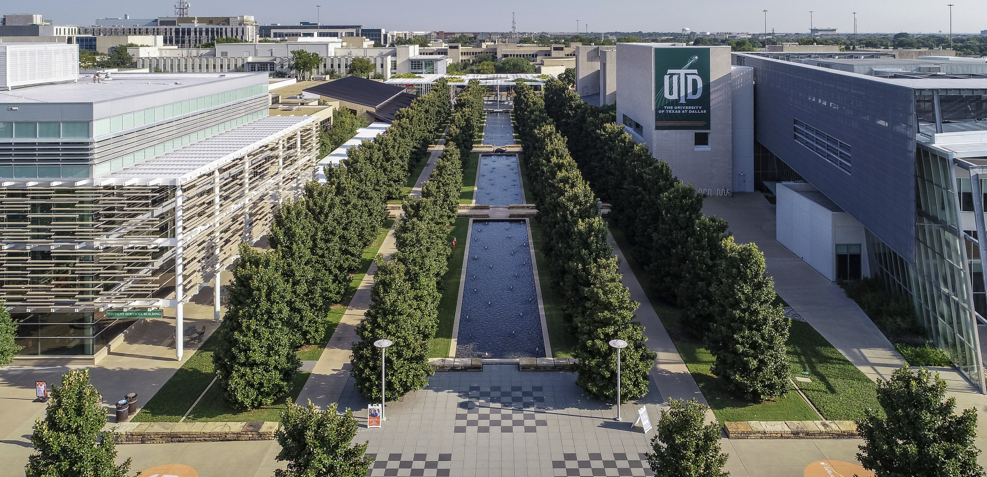
Using P3 (Public-Private-Partnerships) to Build a College Town
Dr. Calvin D. Jamison
Vice President for Facilities & Economic Development
The University of Texas at Dallas
2020 UT System Real Estate Conference – Austin, Texas

Slide 2
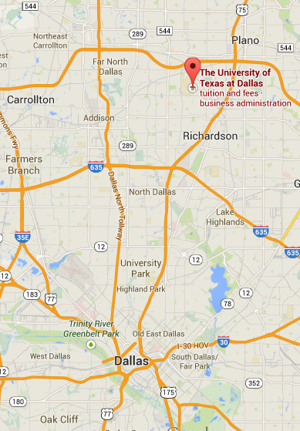
About UT Dallas
Based in Richardson, Texas, with additional land in Plano and Dallas
Located in both Collin and Dallas counties

Slide 3
In the Beginning, Founders Building, 1964
The Founding of UT Dallas
Founded in 1969 by Erik Jonsson, Cecil Green and Eugene McDermott, TI executives who envisioned UT Dallas as the “MIT of the South.”
UT Dallas offered only graduate degrees until 1975, when juniors and seniors were added.
In 1990, the University admitted its first freshman class of 100 students.
Texas Instruments Plaza, Today

Slide 4
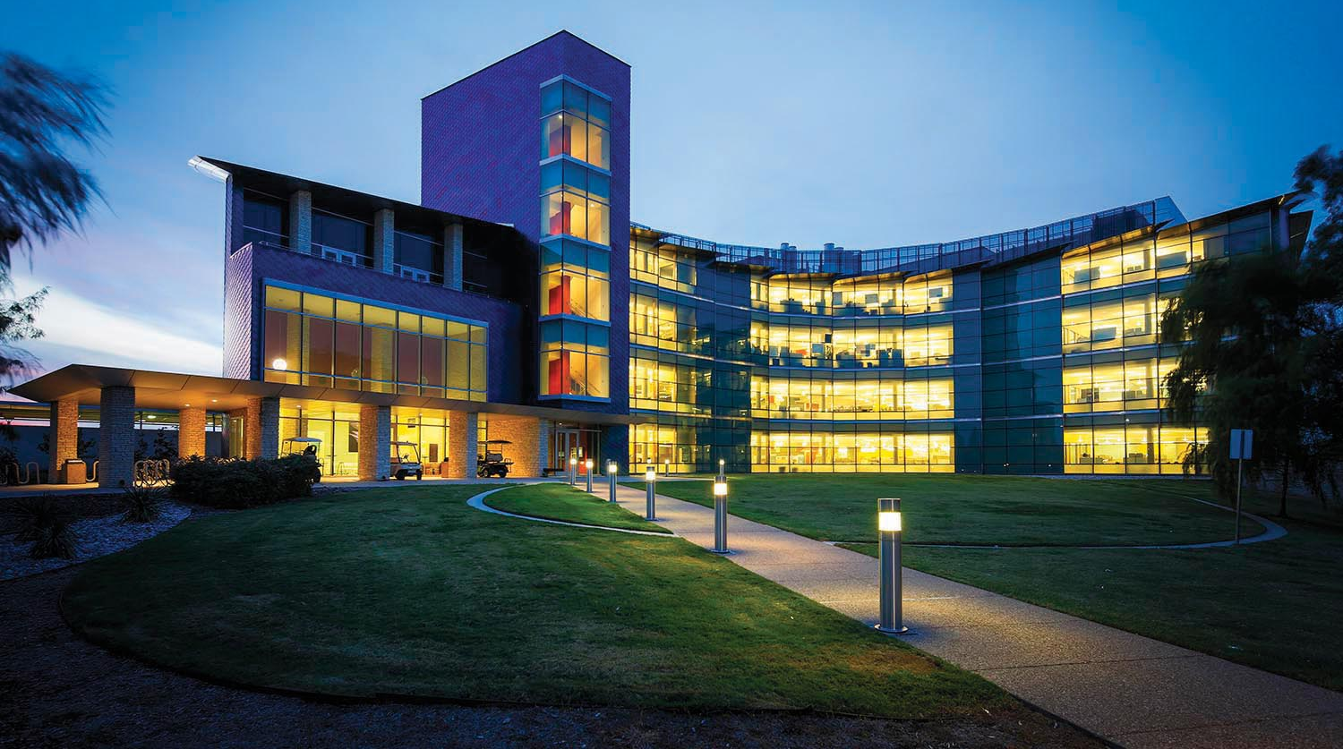
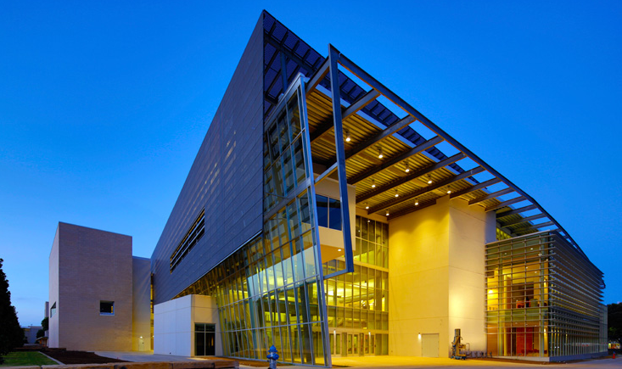
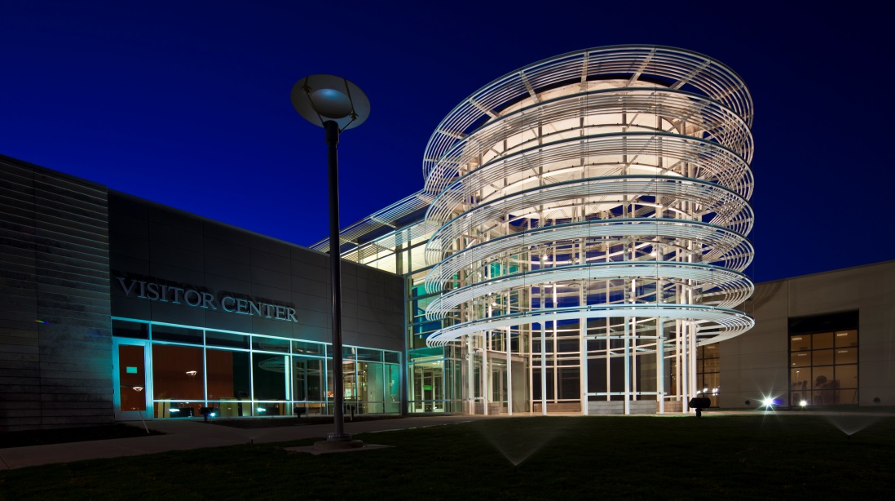
About UT Dallas
More than 29,500 students enrolled; more than 7,000 live on (or adjacent to) campus in residence halls or apartments
Over 4,000 faculty and staff members
142 academic programs across eight schools offering top-ranked programs in science, technology, engineering, arts and management

Slide 5
UT Dallas Stats and Facts
Celebrating 50 years this year; UT Dallas was the top university under the age of 50 in the nation.
#2 Fastest Growing Public Doctoral University in the Country- The Chronicle of Higher Education (2019)
Best Value Public University in Texas- Forbes (2019)
#1 Top MBA Programs Where Grads Make More Than They Owe- U.S. News & World Report (2018)

Slide 6
Rapid Growth of Student Body
UT Dallas was the 2nd-fastest growing public doctoral university in the country from AY07 to AY17, according to The Chronicle of Higher Education.
29,543
40,000
35,000
30,000
25,000
20,000
15,000
10,000
5,000
0
35,000
33,525
31,320
28,757
27,642
23,595
26,793
23,595
24,544
21,193
18,864
15,783
14,523
14,944
14,556
AY07 AY08 AY09 AY10 AY11 AY12 AY13 AY14 AY15 AY16 AY17 AY18 AY19 AY20 AY21 AY22

Slide 7
2019 Student Profile
Top States
Texas (22,950)
California (202)
Illinois (70)
Louisiana (67)
Oklahoma (65)
Florida (53)
Top Texas Counties
Collin (6,830)
Dallas (6,454)
Denton (2,087)
Tarrant (1,364)
Graduate
8,549
Undergraduate
20,994
Full time
23,709
Oldest student: 85 years Youngest Student: 15 years
Notes:
“We are all owners. We have a vested interest.”

Slide 8
Freshman Profile
 | 2013 | 2014 | 2015 | 2016 | 2017 | 2018 | 2019
Freshman Class (Fall) | 2,233 | 2,520 | 2,728 | 3,229 | 3,182 | 3,866 | 4,073
Average SAT | 1261 | 1256 | 1257 | 1261 | 1323 | 1324 | 1344
Average ACT | 28 | 28 | 28 | 28 | 29 | 28 | 29
National Merit Scholars | 89 | 104 | 101 | 119 | 157 | 172 | 195

Slide 9
Top Majors for Incoming Students
Behavioral and Brain Sciences
#4 Neuroscience
#9 Psychology
Engineering and Computer Science
#1 Computer Science
#3 Mechanical Engineering
#5 Biomedical Engineering
Management
#6 Finance
All Other Schools
#7 Healthcare Studies
#8 Arts, Technology, and
Emerging Communication
Natural Sciences and Mathematics
#2 Biology
#10 Biochemistry

Slide 10
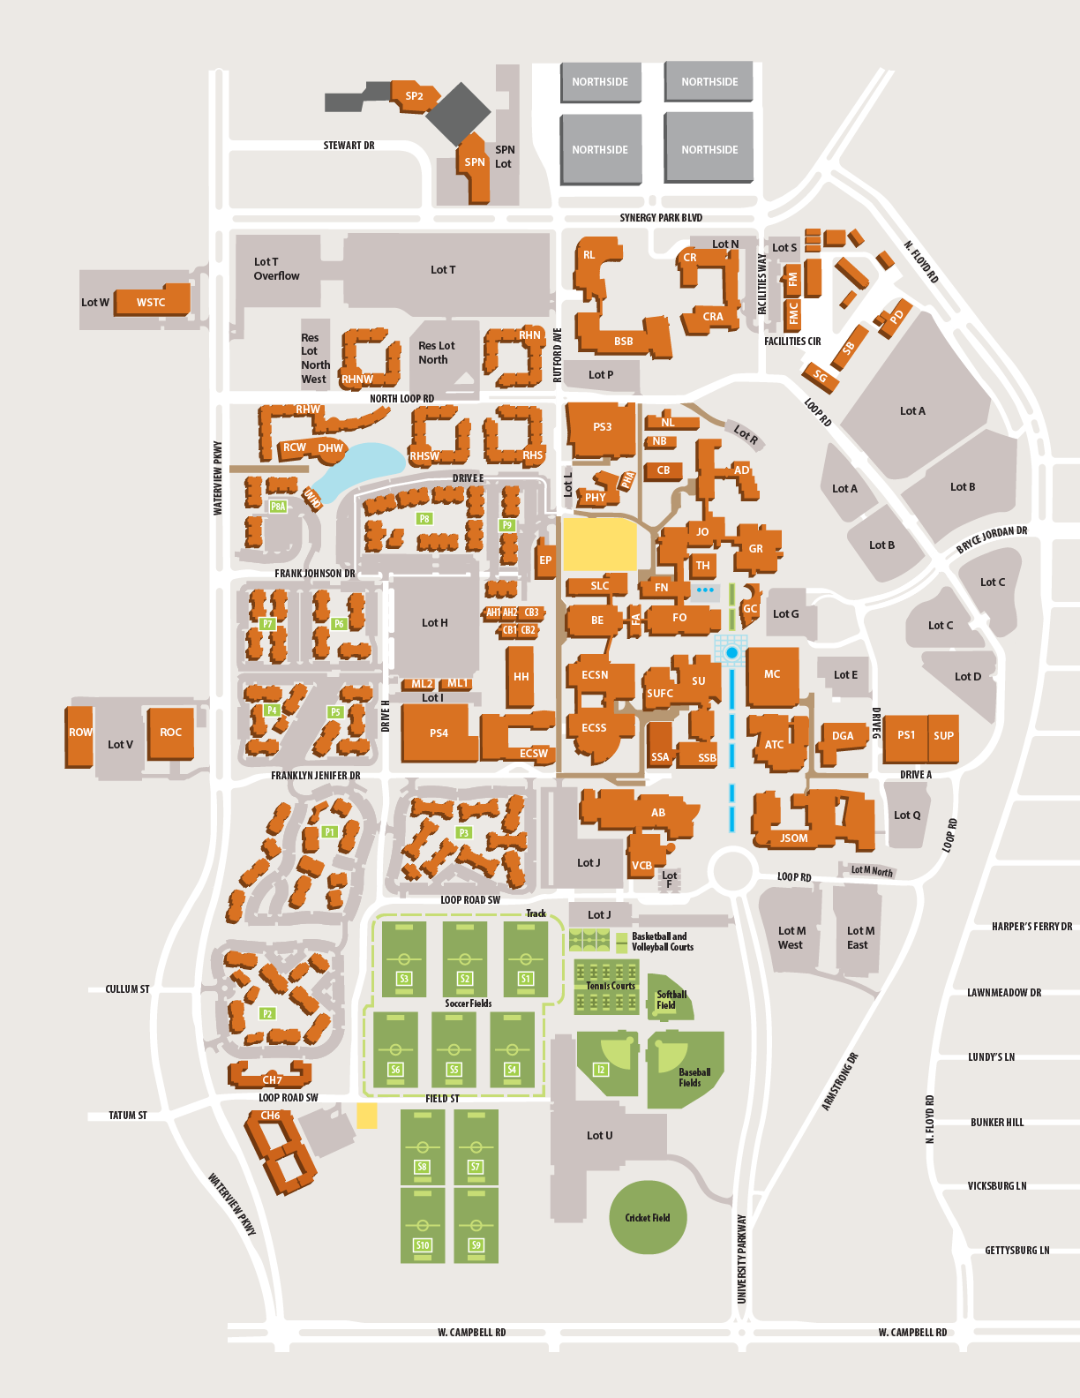
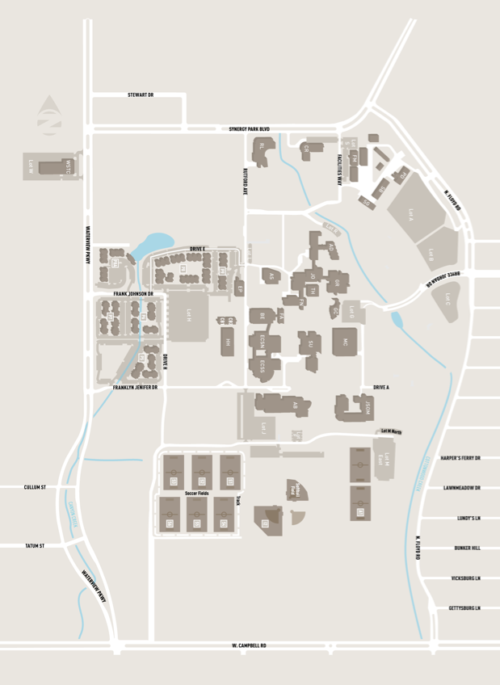
2007
2020
City of UT Dallas
Home of the Comets
(Daytime) Population: 33,000
102nd most populous city in Texas
(out of 1,435 cities)
83 | 2.7M | $46.5M | $264M
BUILDINGS | SQUARE FEET | RESEARCH | ENDOWMENT
160 | 7.04M | $126.6M | $540M
BUILDINGS | SQUARE FEET | RESEARCH | ENDOWMENT
Notes:
“I’ve often thought about how astounded — and how proud — our founders would be with UT Dallas and the City of Richardson.”

Slide 11
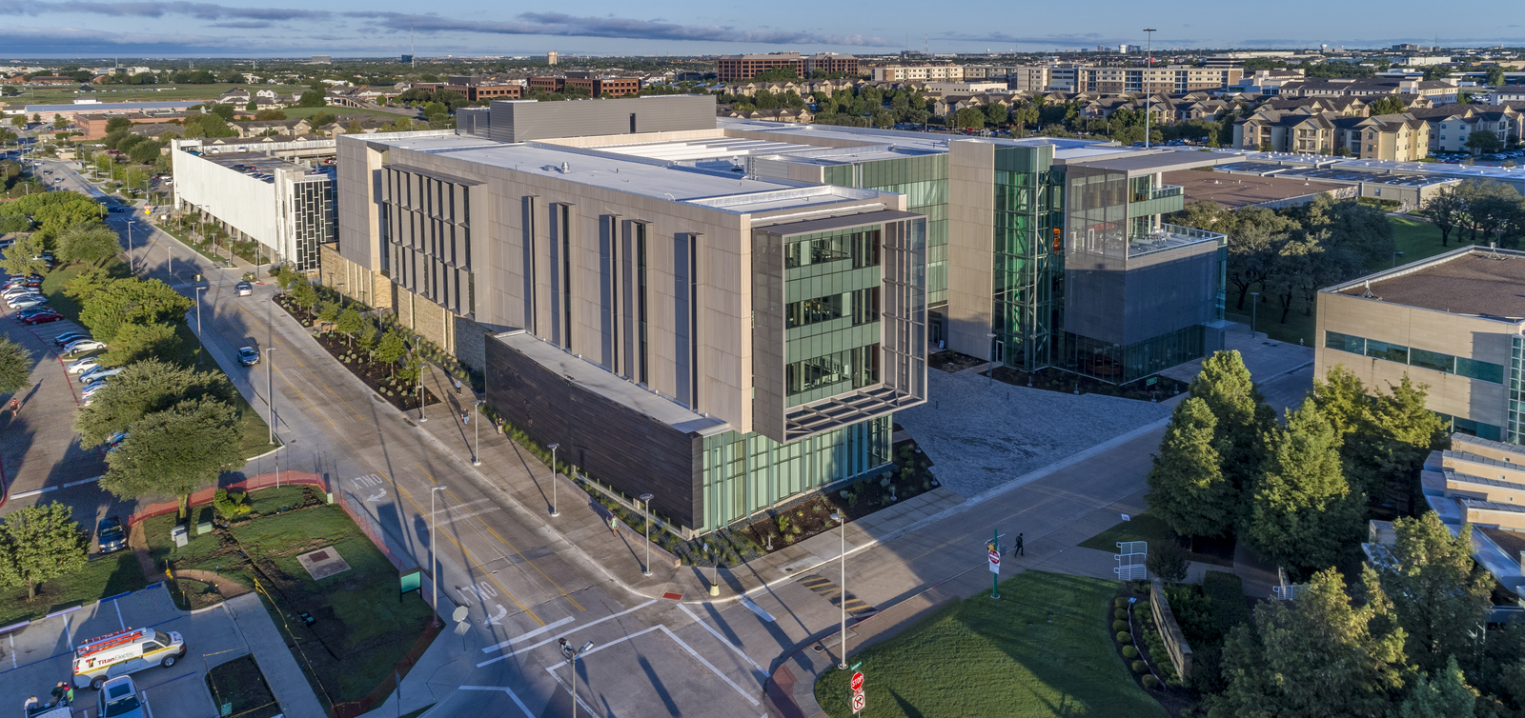
Expanding Infrastructure for Faculty, Staff & Students
UTD has added more than 11.5 million sq. ft. of construction and infrastructure, and more than $1.7 billion in development
Floyd

Slide 12
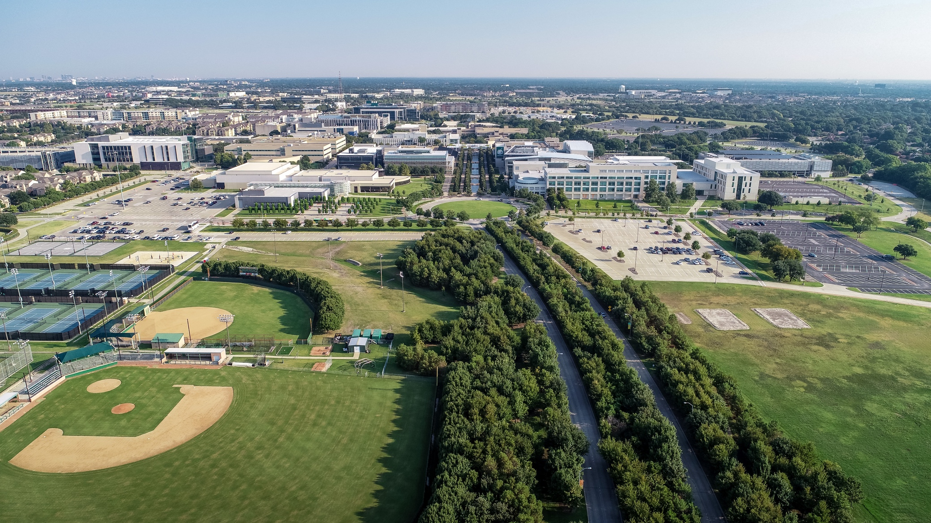
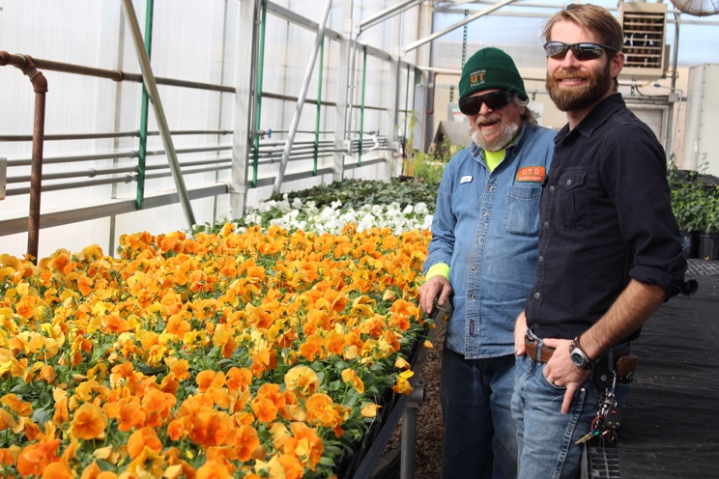
Continual Greening, Coloring of Campus
Planted almost 7,000 trees
All campus color grown in UT Dallas greenhouse from seed

Slide 13
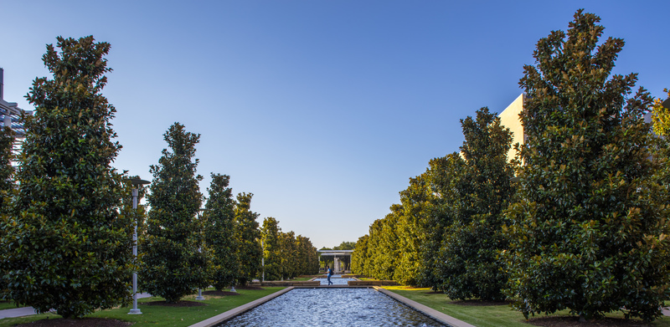
Continual Greening, Coloring of Campus
Continual Greening, Coloring of Campus
Planted almost 7,000 trees
All campus color grown in UT Dallas greenhouse from seed

Slide 14
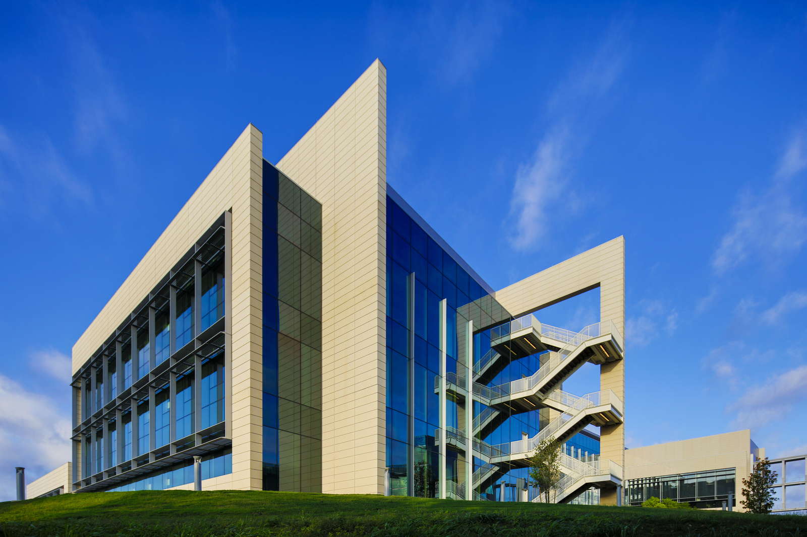
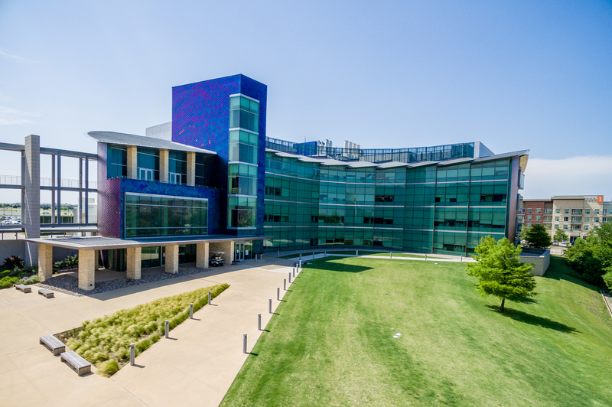
Research Facilities
Bioengineering Sciences Building Natural Sciences & Engineering Research Laboratory

Slide 15
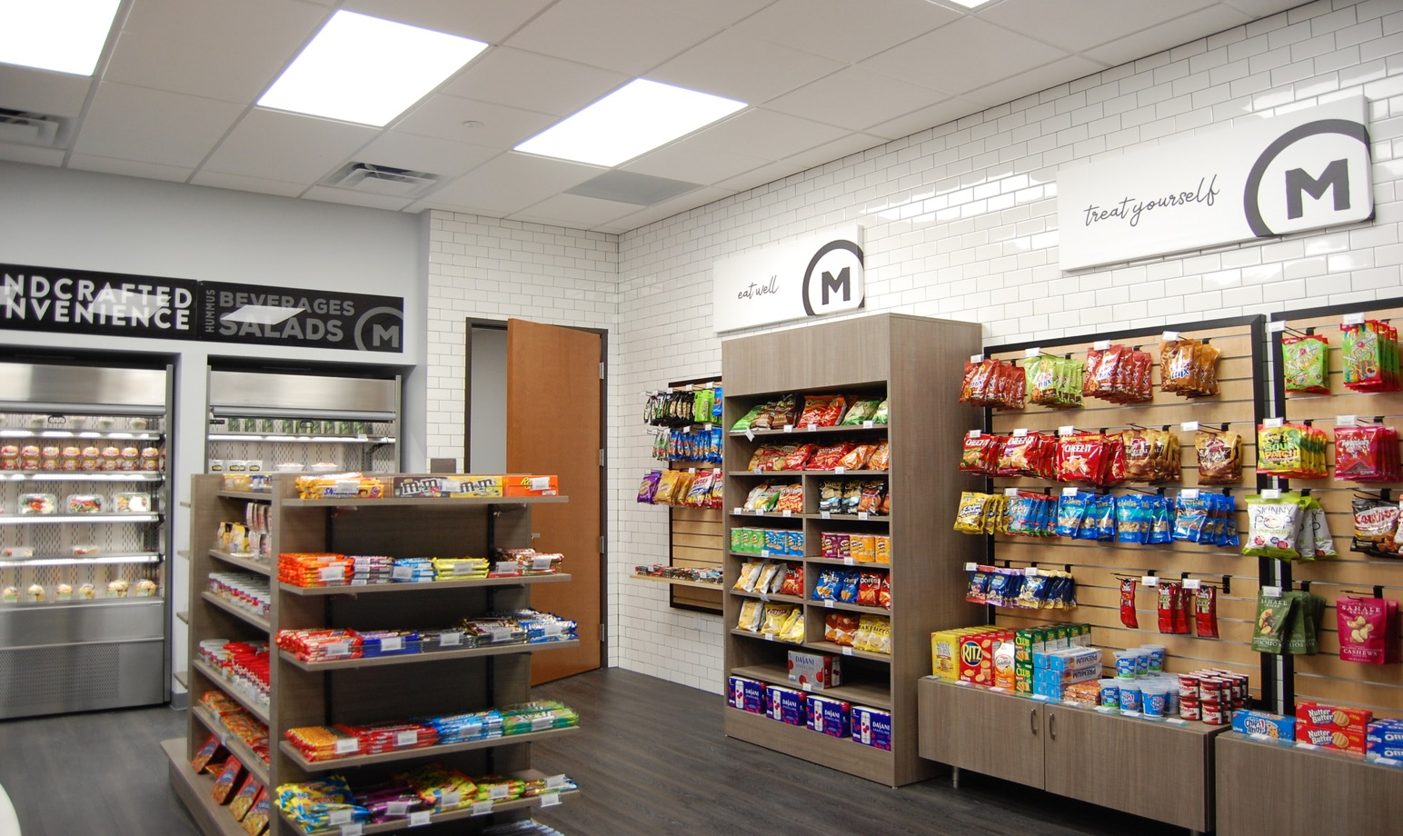
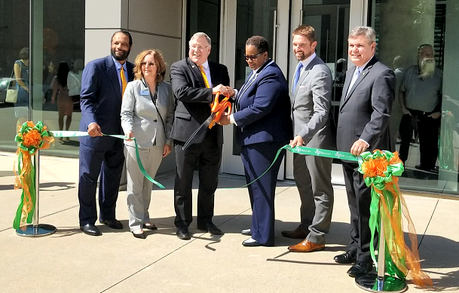
Engineering & Computer Science West
Dedicated Sep 26, 2019
Certified LEED Gold 2019
2019 Lab of the Year – Special Mention, R&D Magazine
“The Market” – Convenient Retail Option

Slide 16
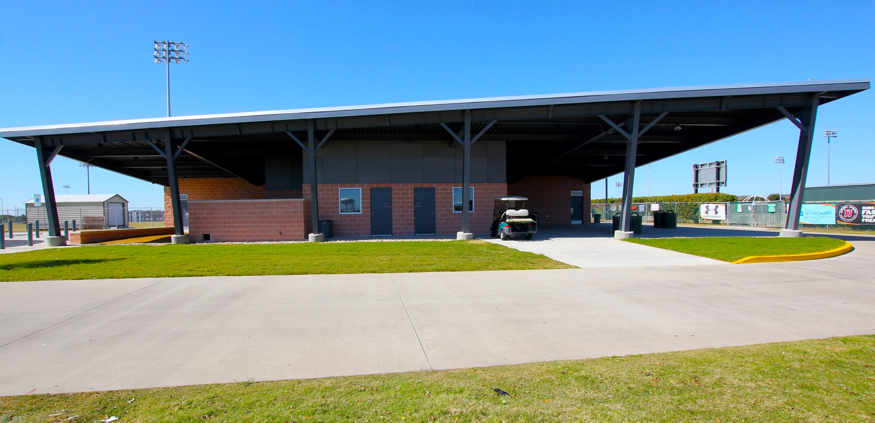
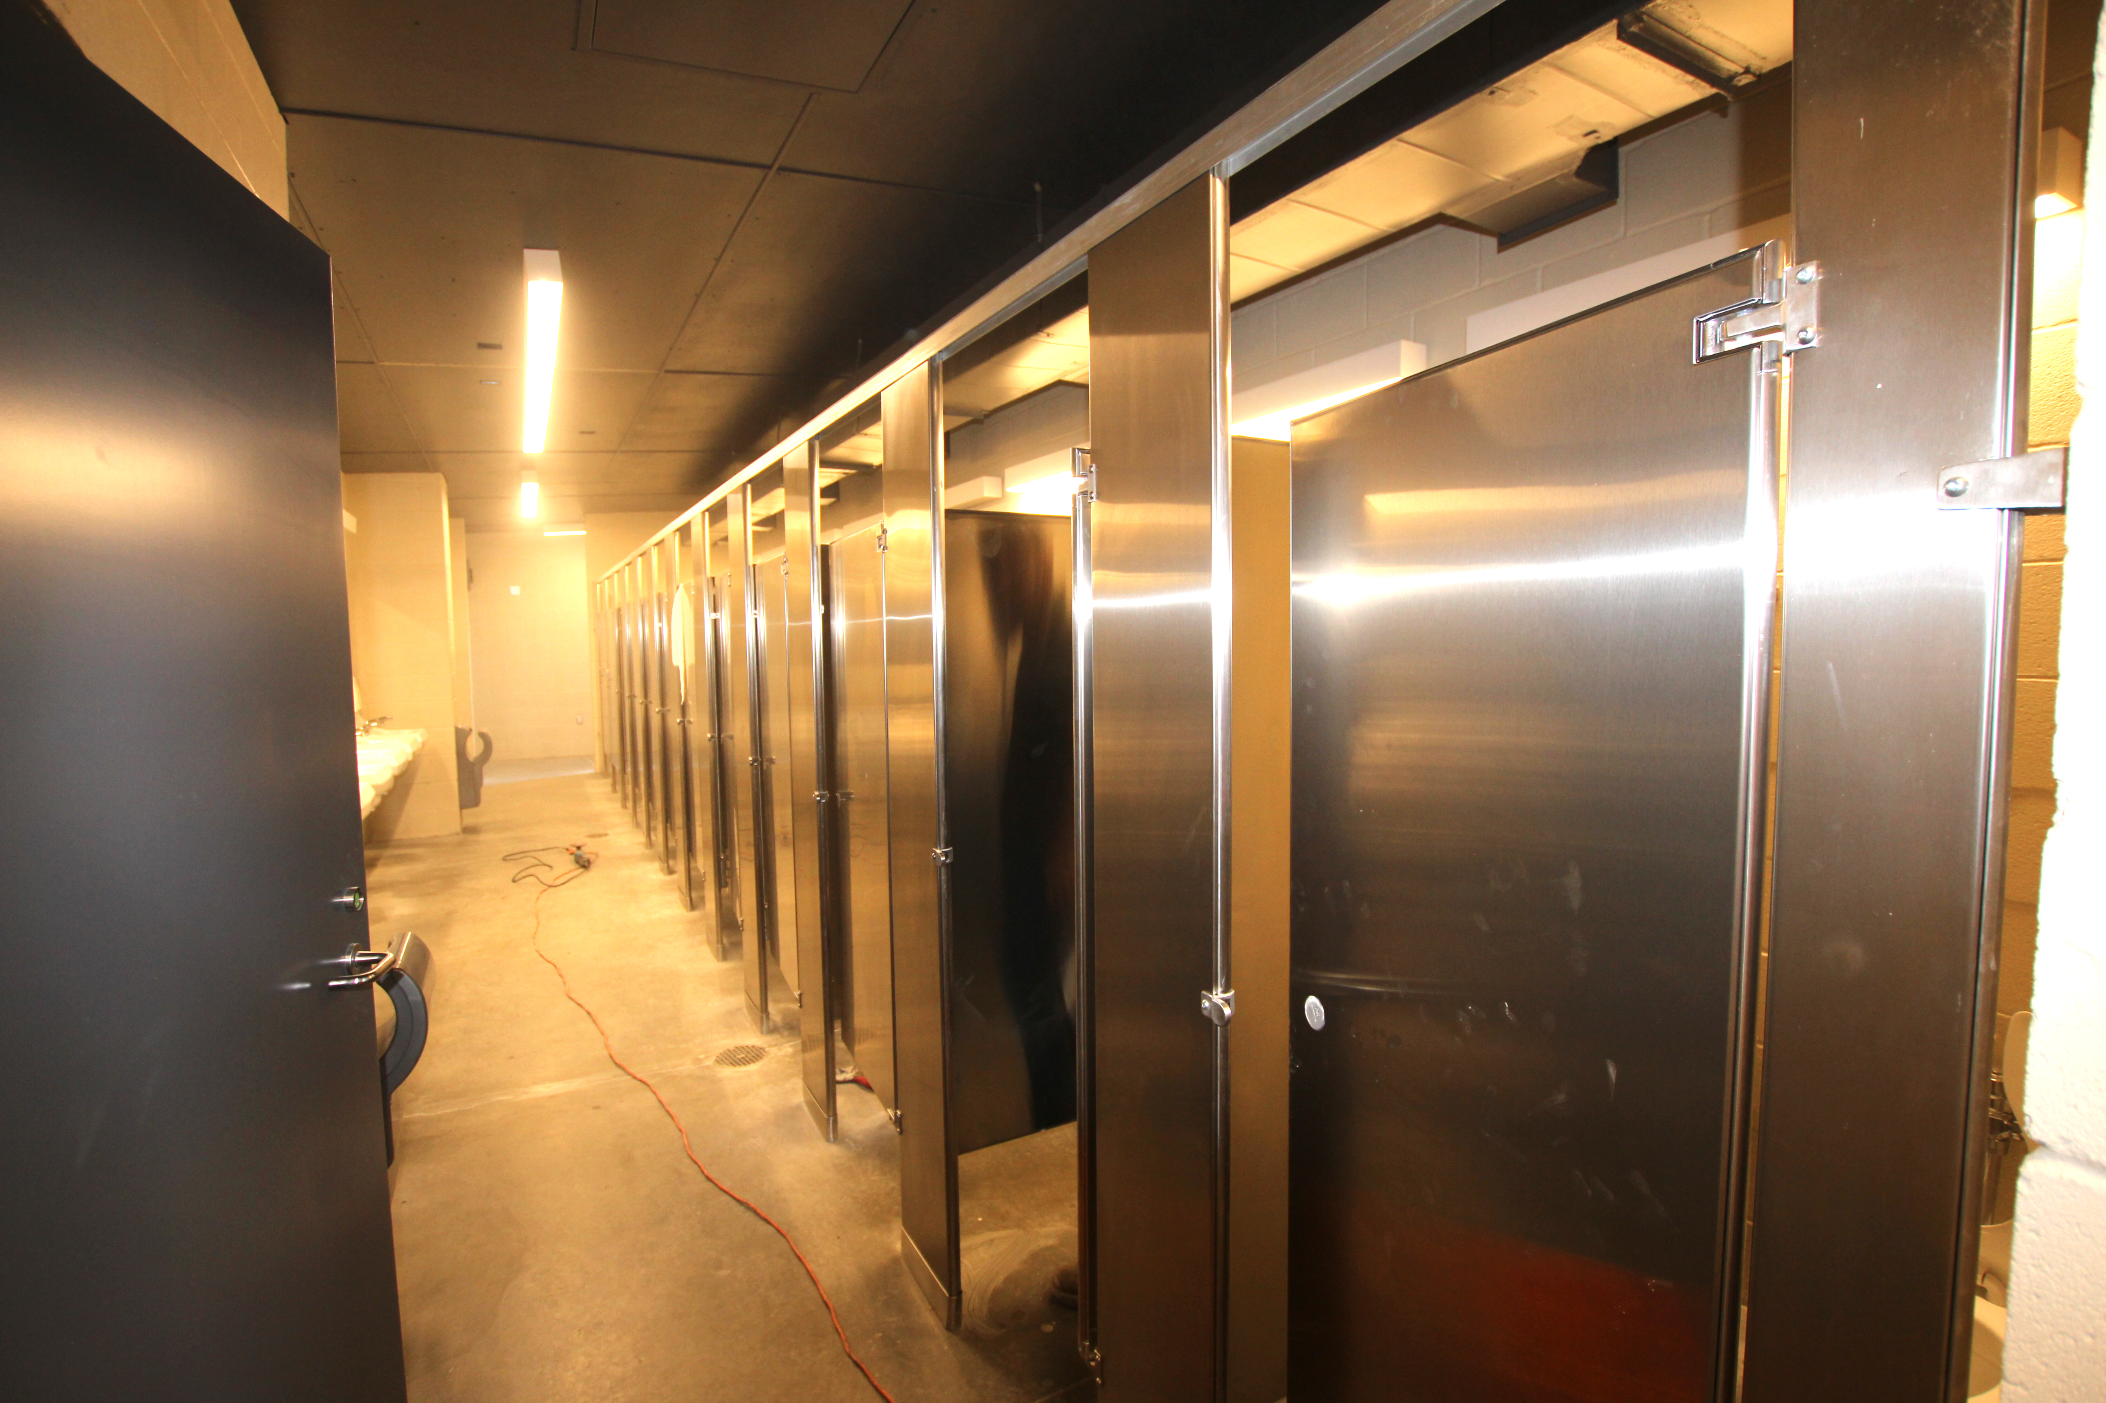
Athletics Concessions Stand & Restrooms
Broke ground Dec 2018
Set to open Fall 2019
Adds roughly 3,000 sq. ft. of concessions & restroom space, including a dozen stalls each for the men’s and women’s restrooms

Slide 17
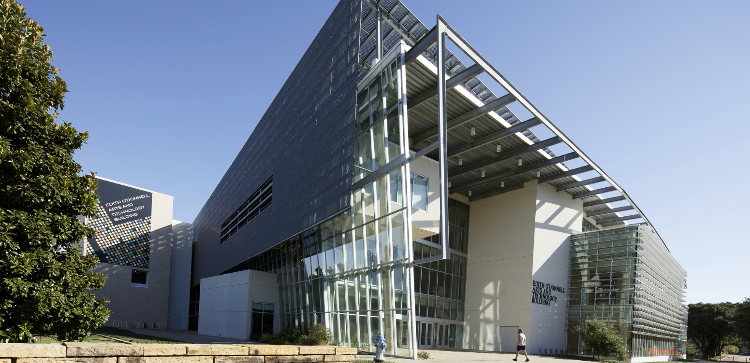
Edith O’Donnell Arts & Technology Building
$60 million, 155,000 square foot structure
LEED Silver designation
Approximately 20% of the building materials are recycled content
Features a motion capture lab, 2D and 3D art studios, soundproof chambers, recording studio and photography labs

Slide 18
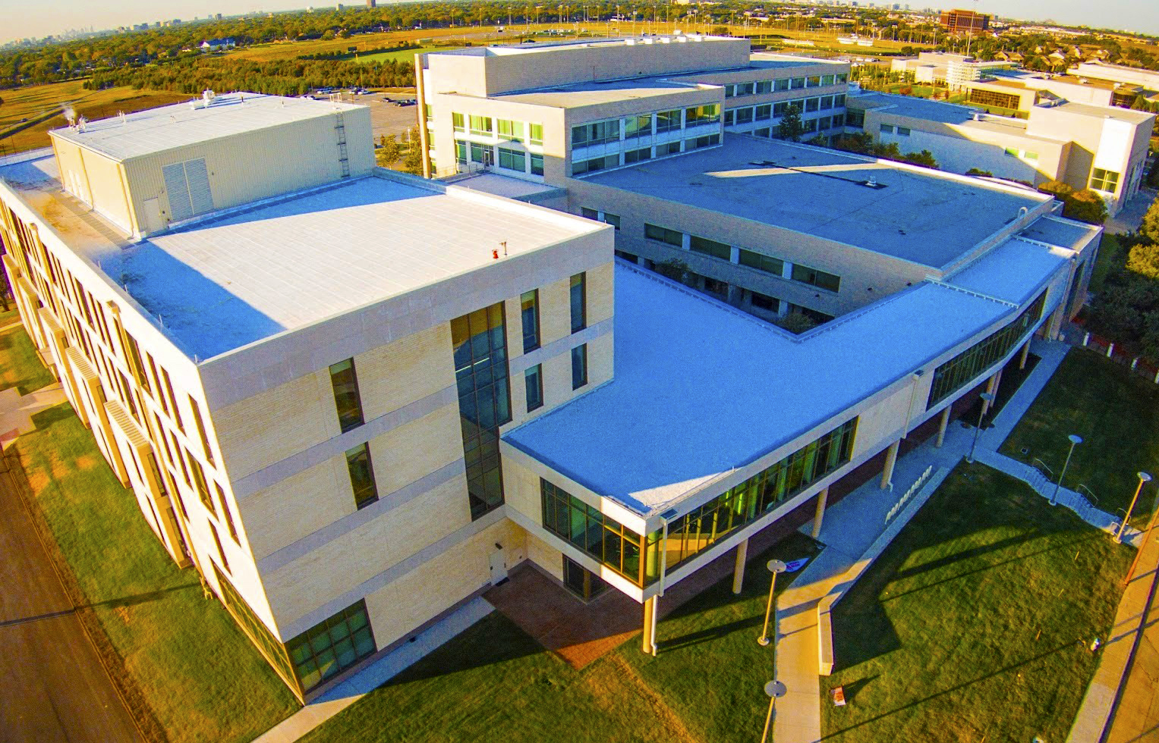
Naveen Jindal School of Management- Addition
107,445 square foot structure
LEED Silver designation
Provides the school with additional classrooms, offices, computer labs as well as a financial trading lab.

Slide 19
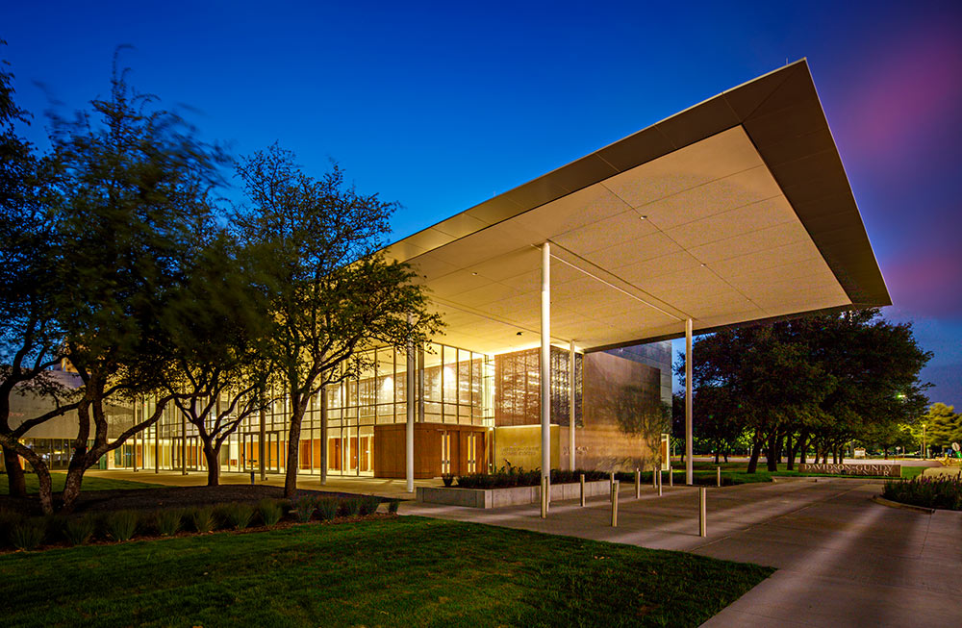
Davidson-Gundy Alumni Center
Constructed in 2017; earned LEED Gold Designation
30,246 square-foot facility named after alumni Nancy Gundy Davidson and Charles Davidson, in recognition of their $15 million gift.
More than 3,000 square of space available for meetings, events and weddings.

Slide 20
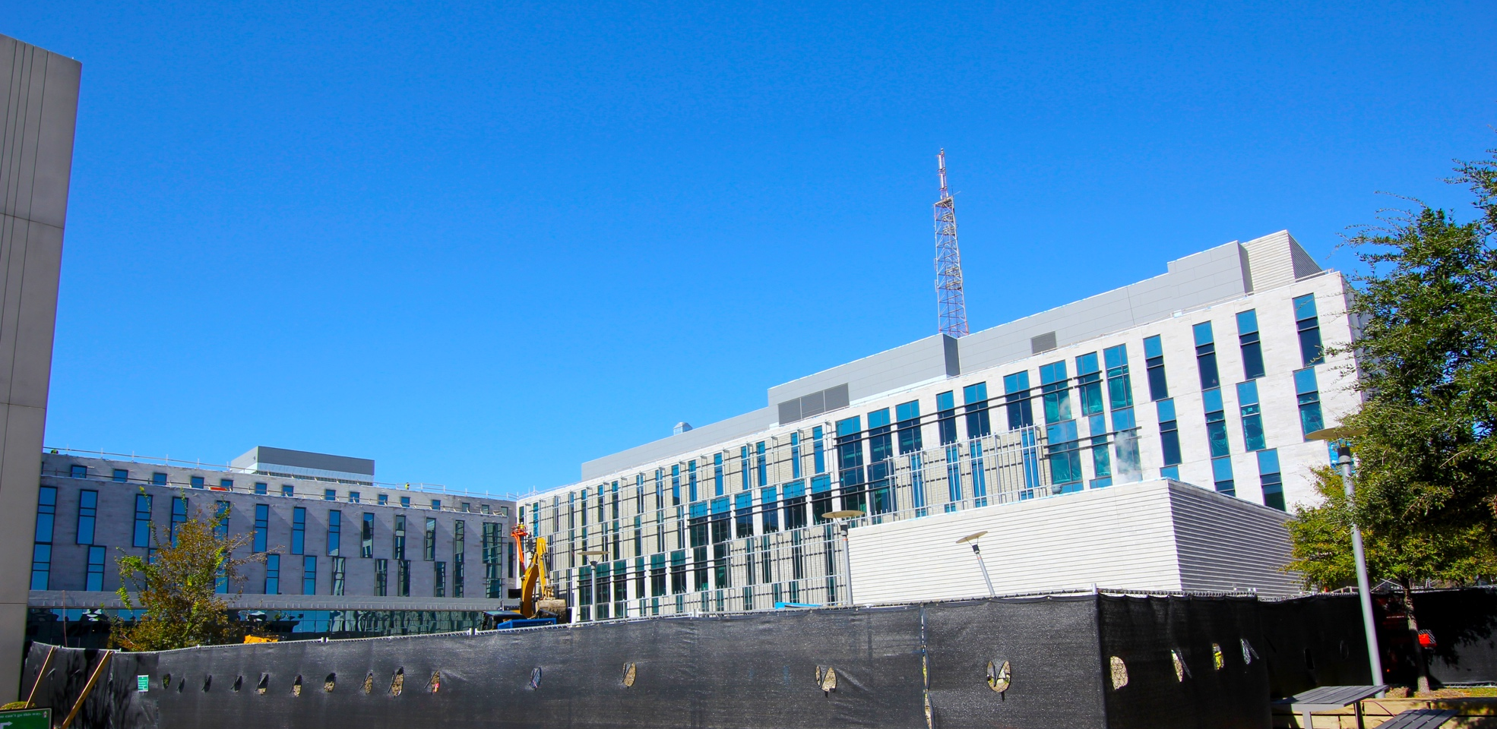
Science Building (Coming Soon- Fall 2020)
Opening fall 2020
Feb 2018 groundbreaking
$101M
Will house Department of Physics, UTeach
2 lecture halls (150 seats and 300 seats)
Labs for cryogenics, optics, magnetism, electricity

Slide 21
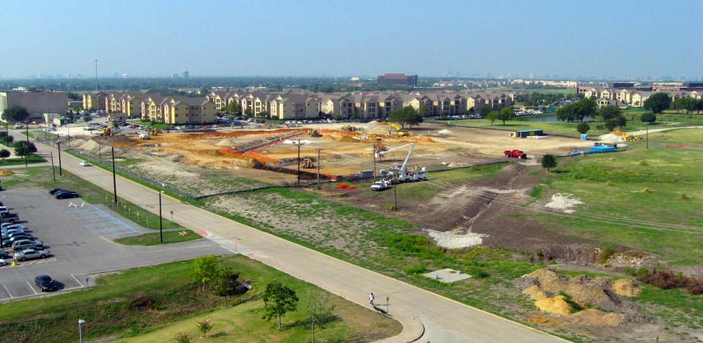
Housing at UT Dallas: Before Residence Halls
Notes:
USE AS EXAMPLE OF GROWTH ---- Notes: Purchased apartments pictured in 2008; prior to that, there was no true on-campus living

Slide 22
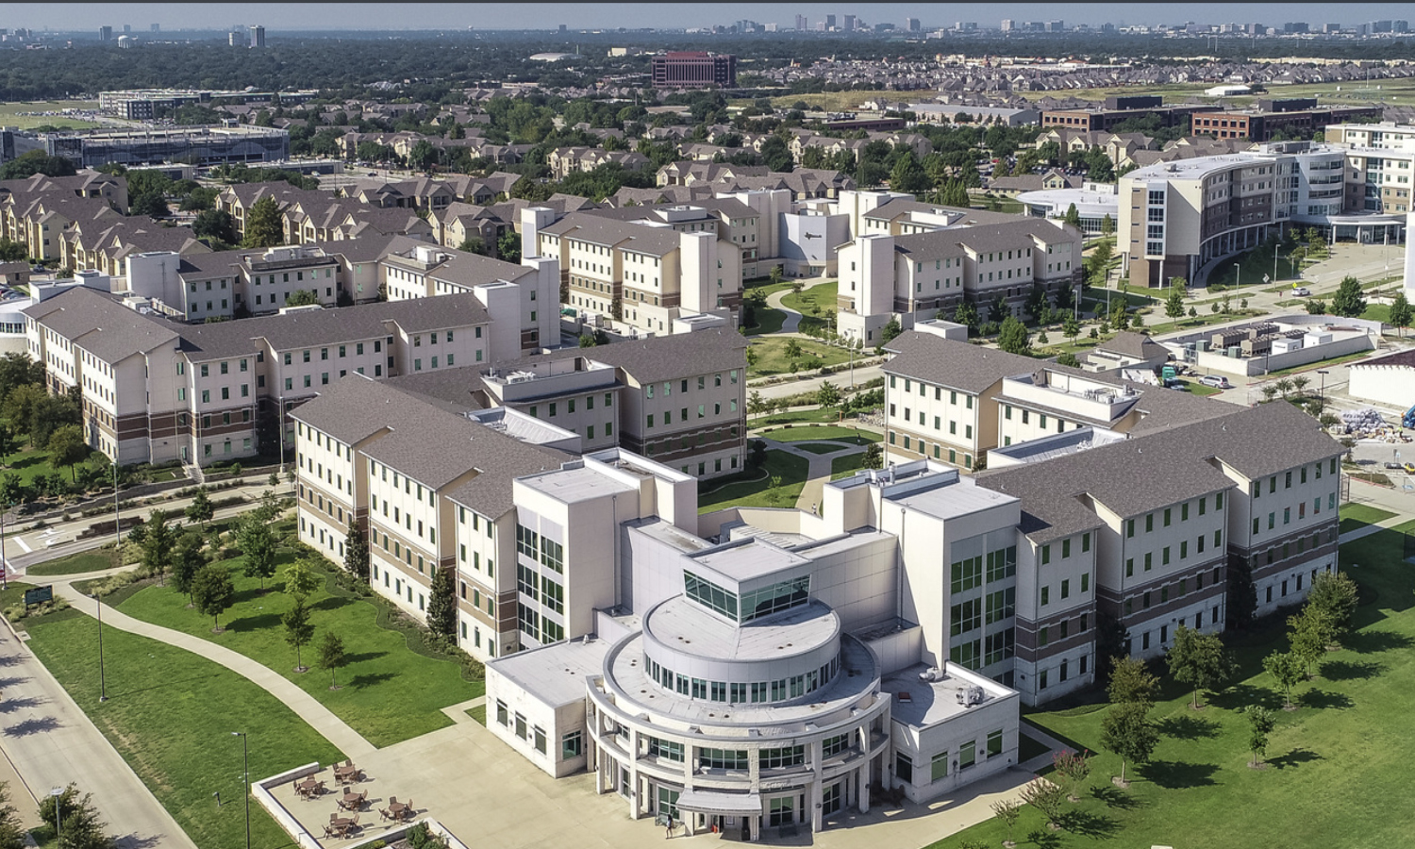
Housing at UT Dallas: Now
On Campus
5 Residence Halls
Canyon Creek Heights North and South (total of 3,500 beds added)
University Village Apartments
* Gender Inclusive Option

Slide 23
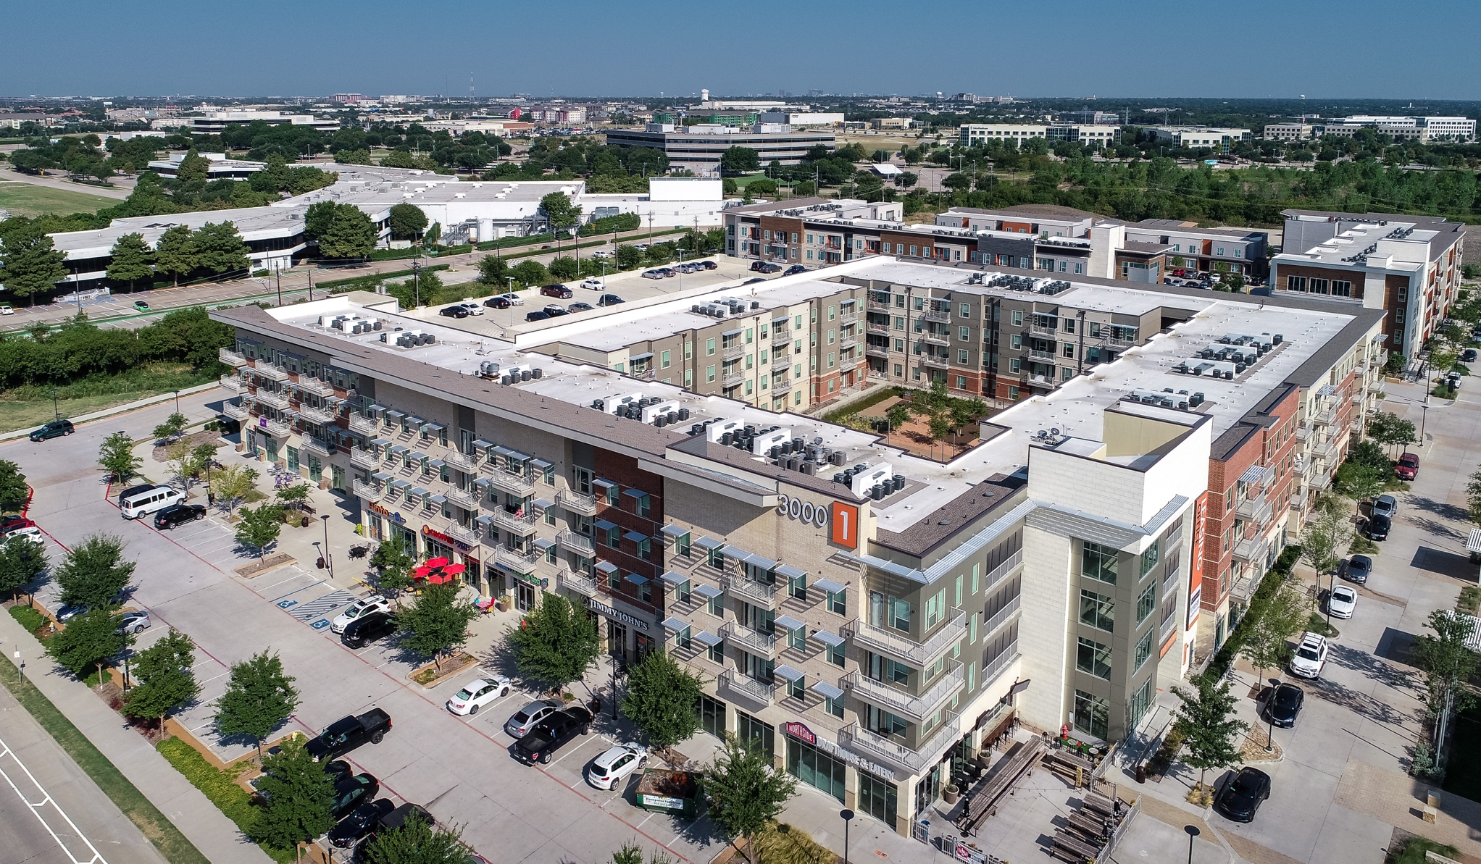
Northside Phases 1, 2
Partnered with Kirk Tames, executive director for UT System Real Estate, to refine concept and RFP
Broke ground in spring 2015; fall 2016 completion
Located adjacent to the UT Dallas campus, Northside offers studio, one-, two-, three- and four-bedroom luxury apartments, along with a mix of campus-oriented and mainstream retail, restaurants and entertainment for the ultimate off-campus living experience
Northside 1- 600 beds Northside 2- 900 beds Retail- 20,000 sq. ft of space

Slide 24
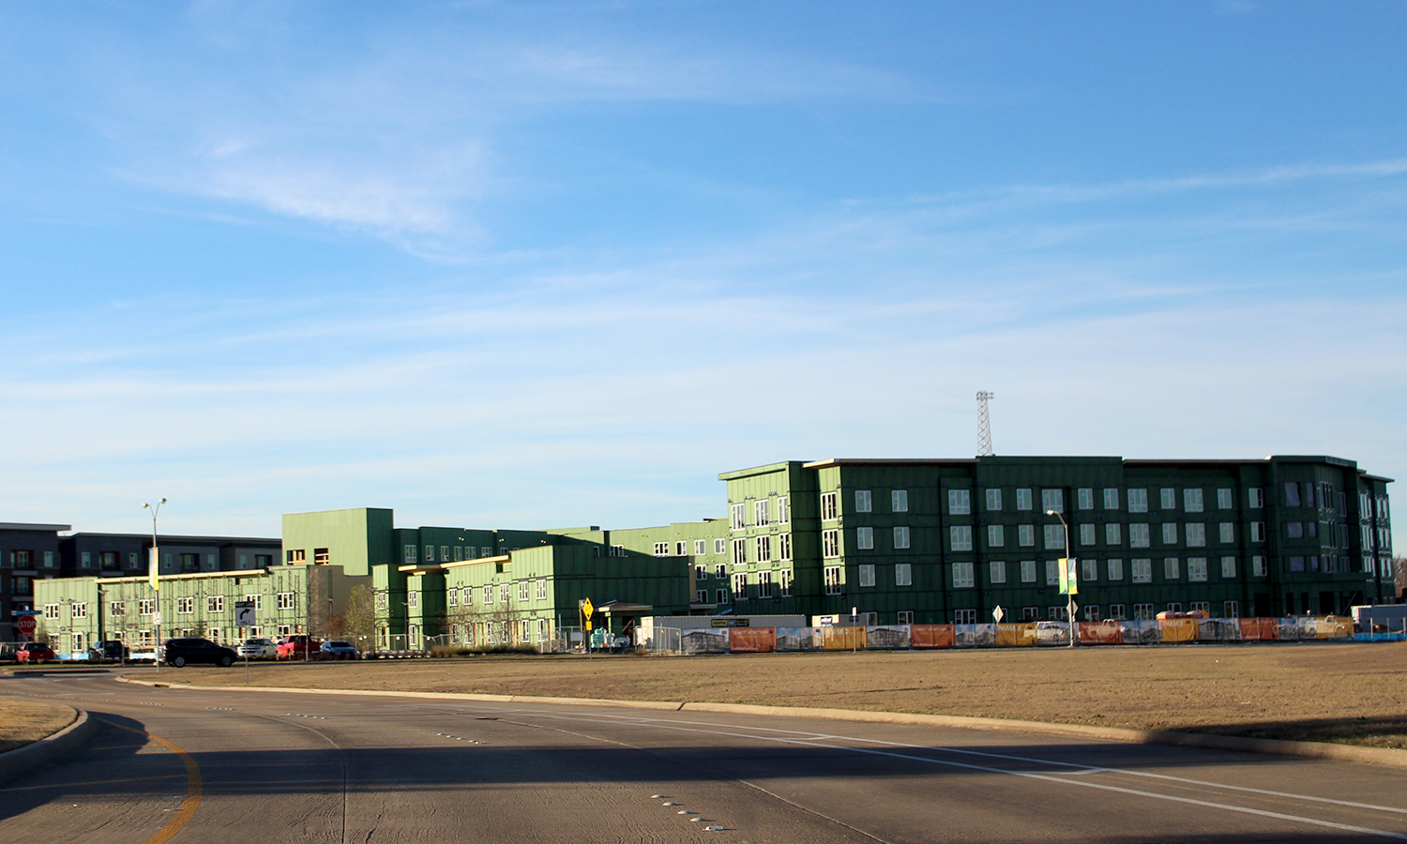
Northside, Phase 3, 4
Fall 2020 Adds 370 beds
246 living units
Mix of furnished one- and two-bedroom apartments
Unfurnished three- bedroom townhomes
Northside 4
Recently approved
Construction underway
Will add 670 beds

Slide 25
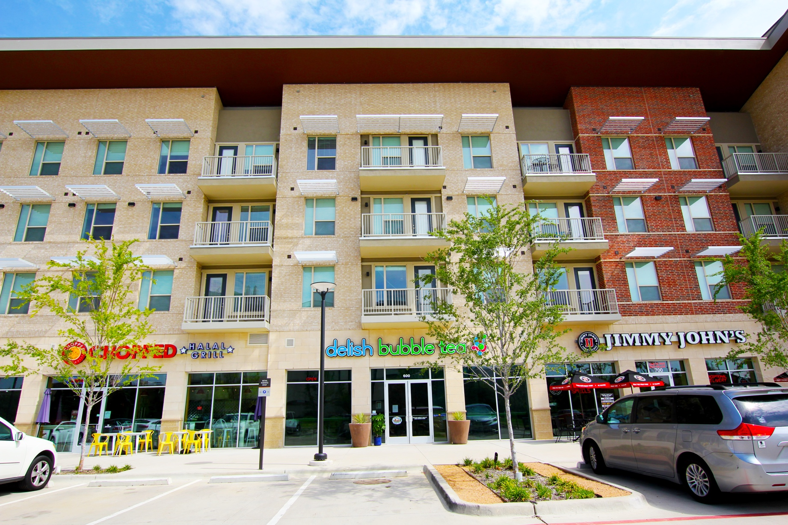
Northside Retail
Many Options
Jimmy John’s
Delish Bubble Tea
Chopped Halal Grill
Northside DraftHouse
American Tap Room
7-Eleven

Slide 26
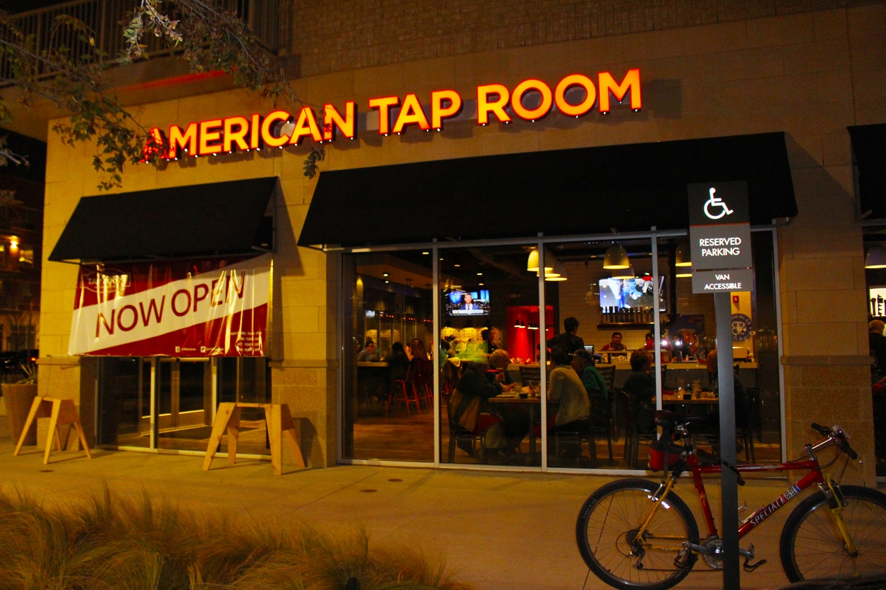
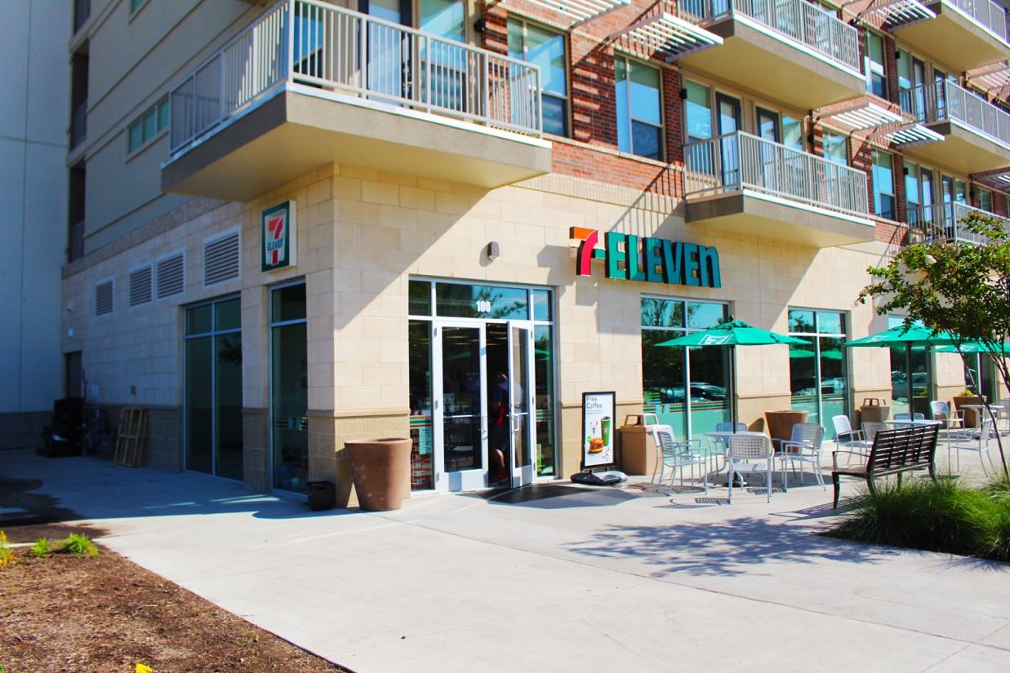
More Northside Retail
Night Life & Convenience
American Tap Room and Northside Draft House both offer food and adult beverages daily
7-Eleven open from 7 am to 11 pm, seven days a week

Slide 27
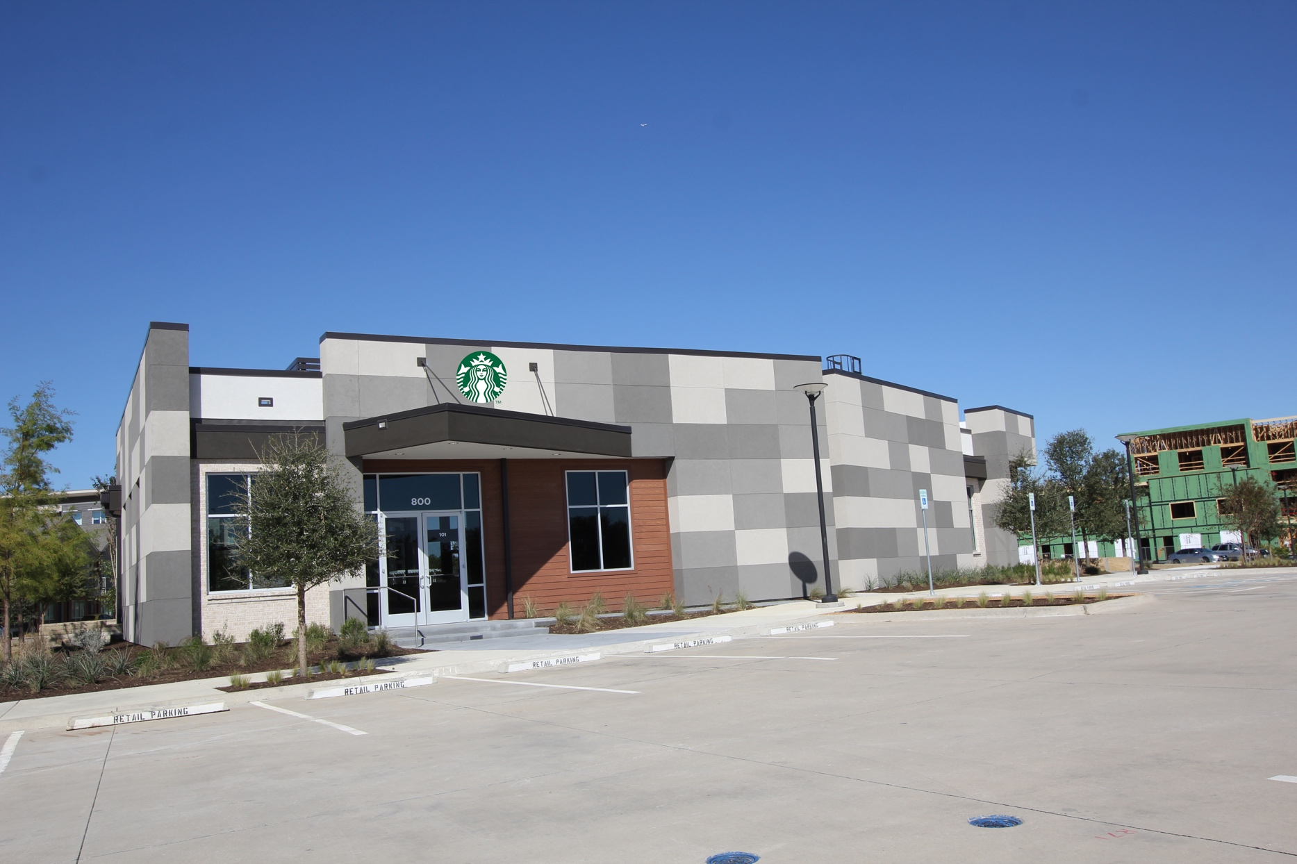
Northside Starbucks
Coming Soon!
A stand-alone, 1,700-square-foot Starbucks nears completion at Floyd Road and Synergy Park Boulevard
Estimated completion: March 2020

Slide 28
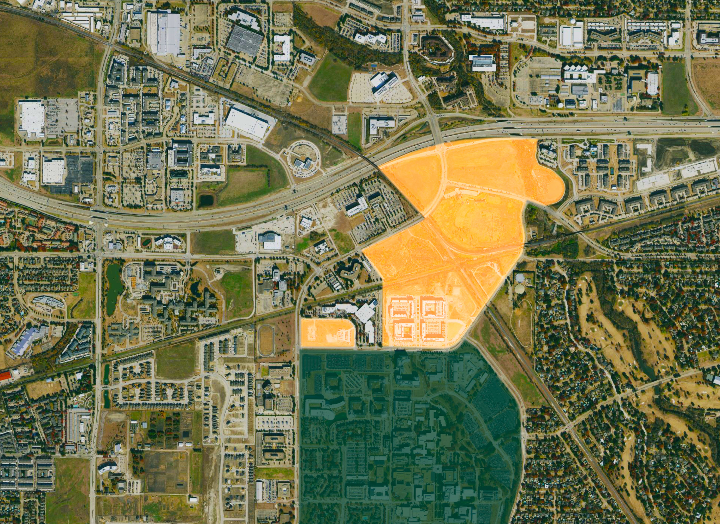
Real Estate North of Campus
Northside
UT Dallas
Campus

Slide 29
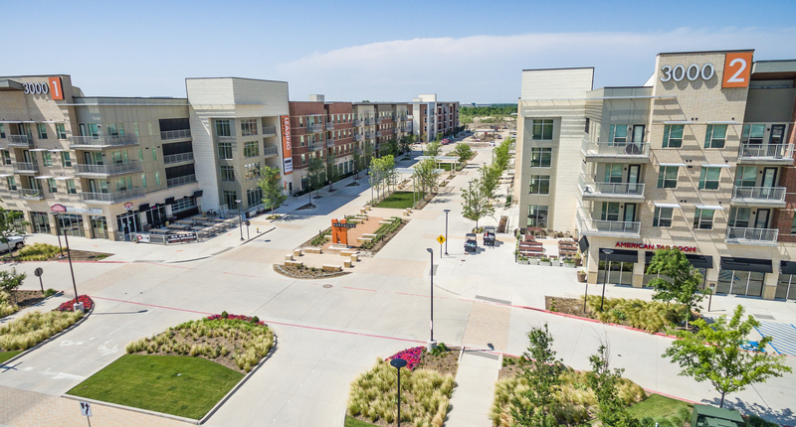
Northside “Comet Town”
DART Station
UTD Campus

Slide 30
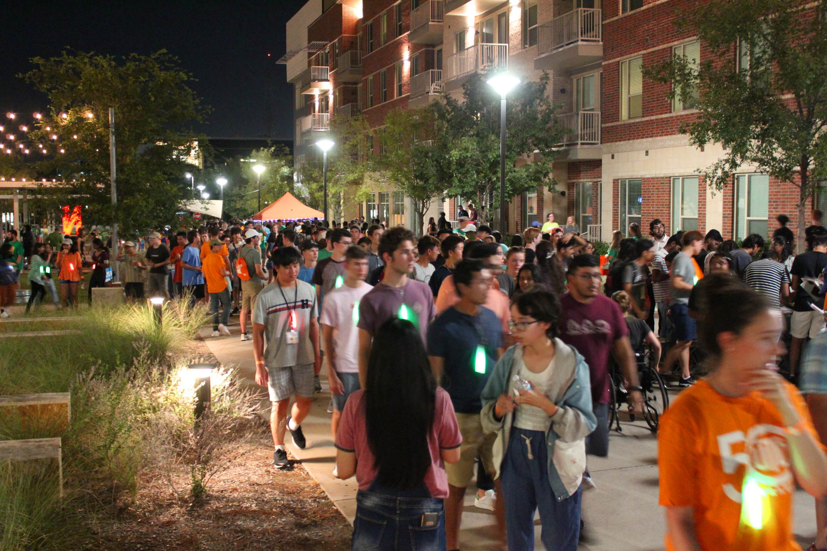
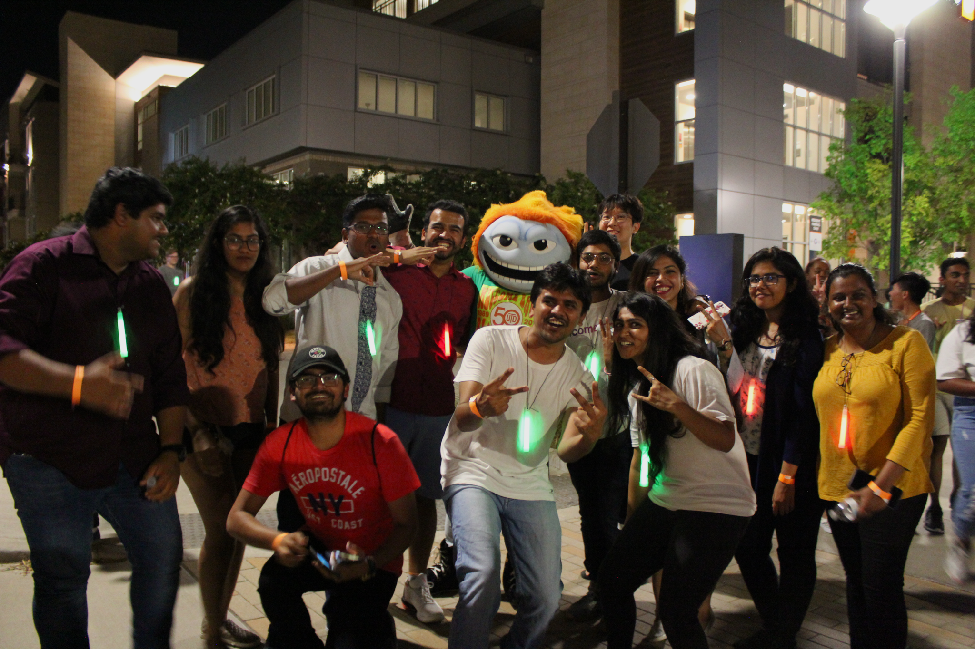
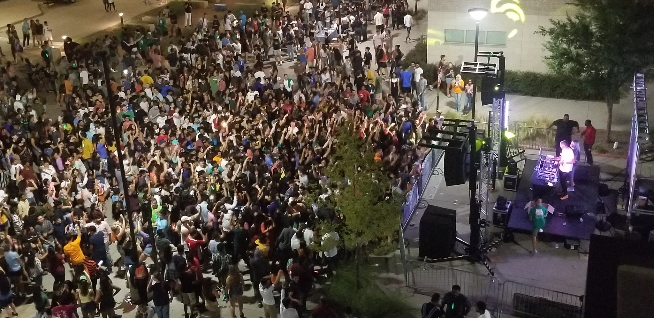
Northside Live!
Welcome Back Block Party- August 2019

Slide 31
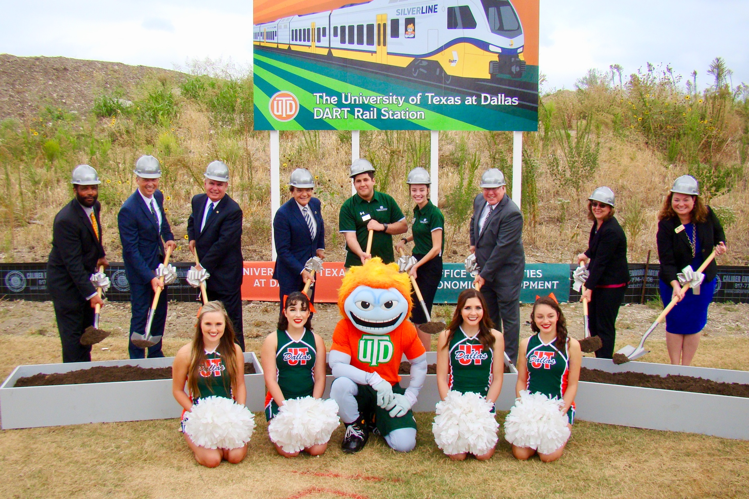
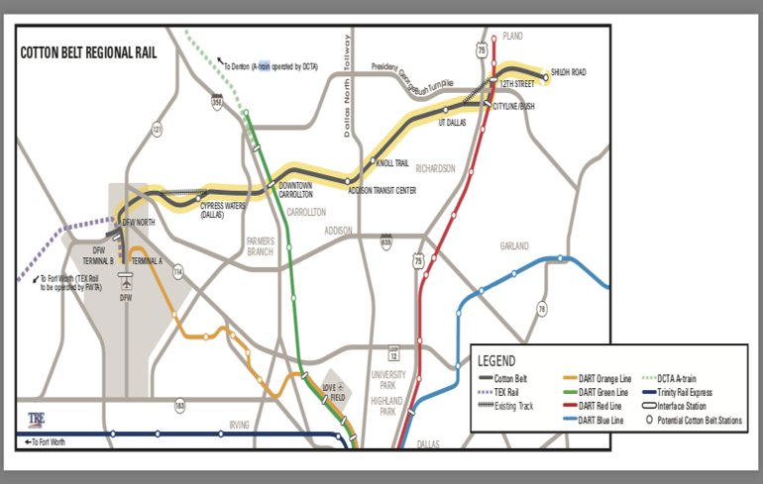
DART Silver Line UT Dallas Rail Station
Groundbreaking Ceremony held Sep 19, 2019
Slated for completion Dec. 2022; station to be located behind Northside Phase 2
Silver Line expected to carry 7,000 riders daily

Slide 32
DART Silver Line UT Dallas Rail Station
UTD will be one of 10 stops on the DART Silver Line
Runs 26 miles from Shiloh Road to Terminal B at DFW Airport
Crosses seven North Texas cities:
Grapevine
Coppell
Dallas
Carrollton
Addison
Richardson
Plano
Connects with four light rail lines – Red, Orange, Blue and Green

Slide 33
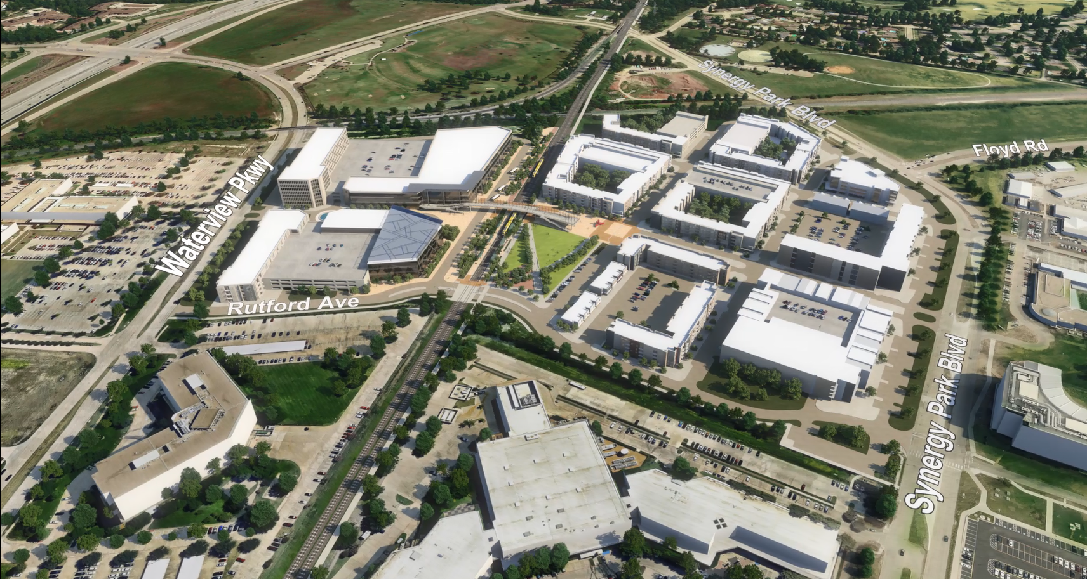
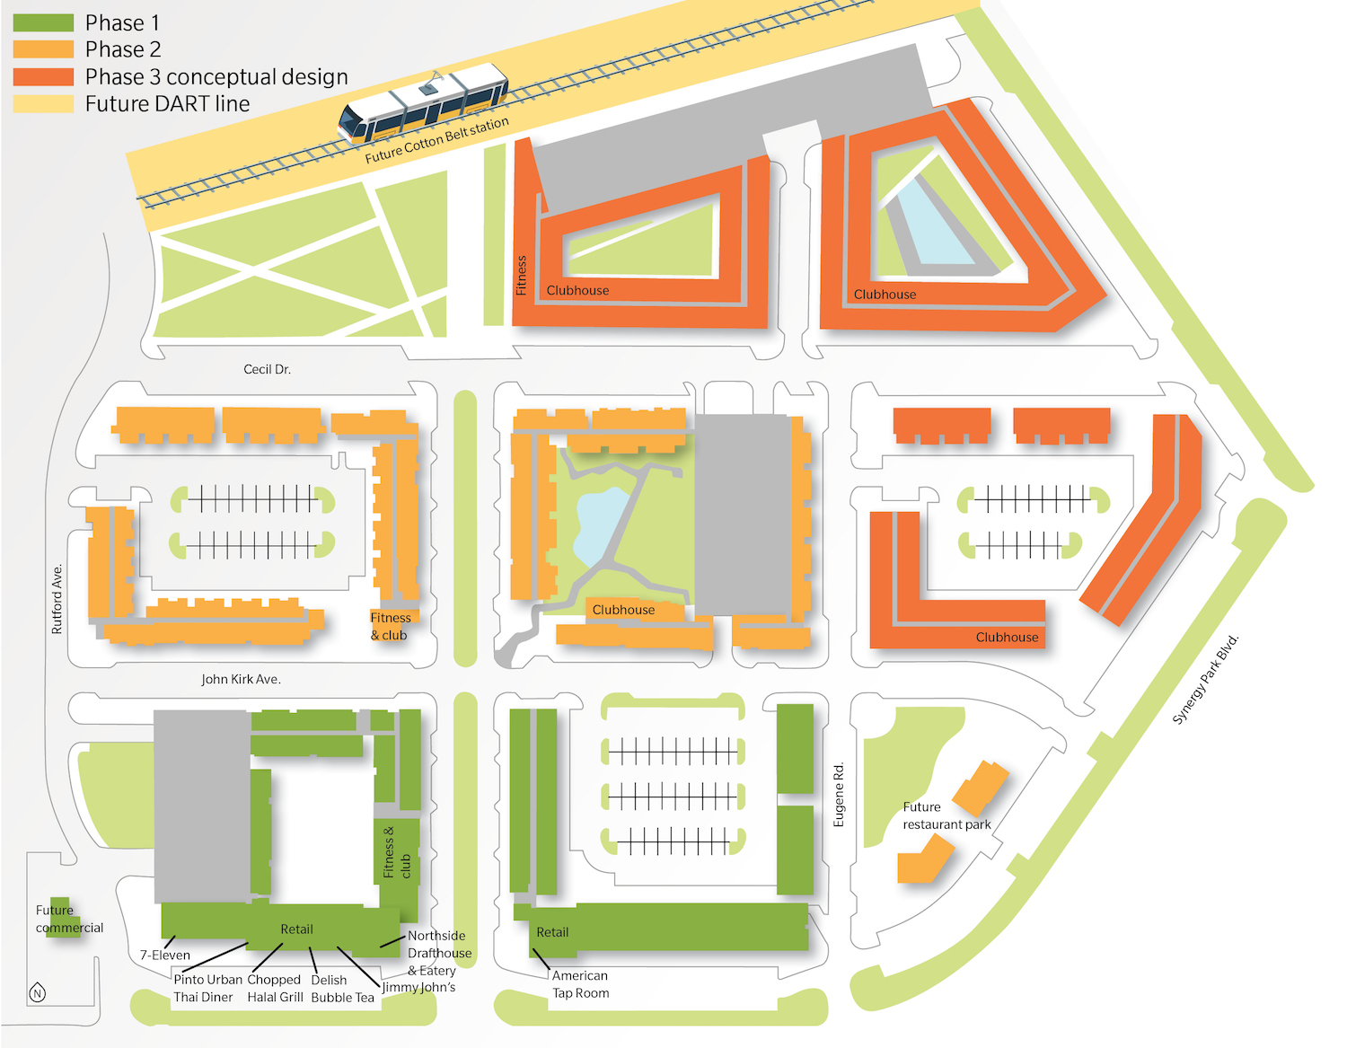
Future Plans- Northside & DART

Slide 34
The Process
Determine the objective or vision
What are we trying to create?
Establish the mechanics
Do you own the land?
What type of mix-use development? (Public, Private with local agency, etc.)
Initiate a market study
Housing – Who do you want your tenants to be?
Retail – must be able to sustain itself year-round

Slide 35
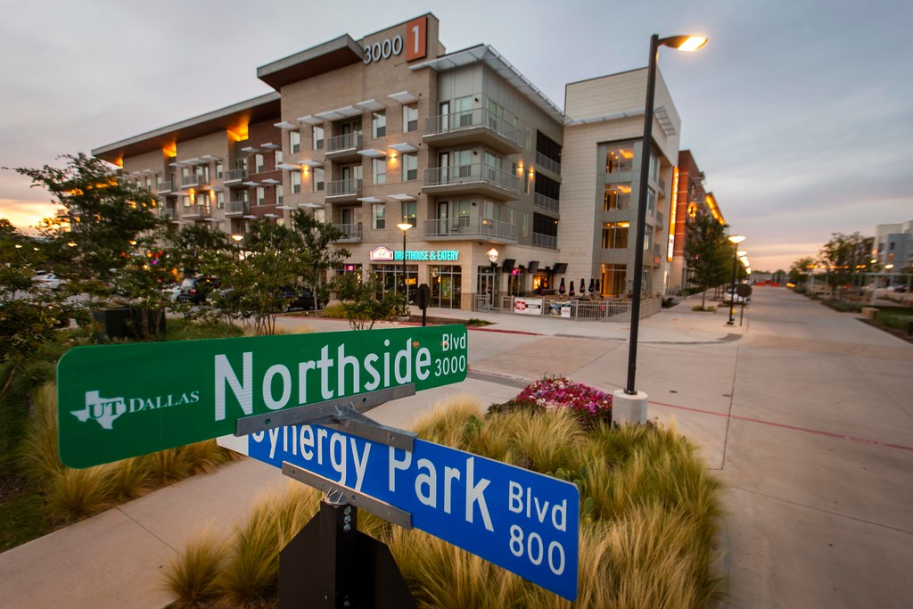
The Process
Determine how to get infrastructure support
Are there any TIFs, CDAs, tax credits?
Establish business and legal terms
Establish operational terms
Develop a periodic review process

Slide 36
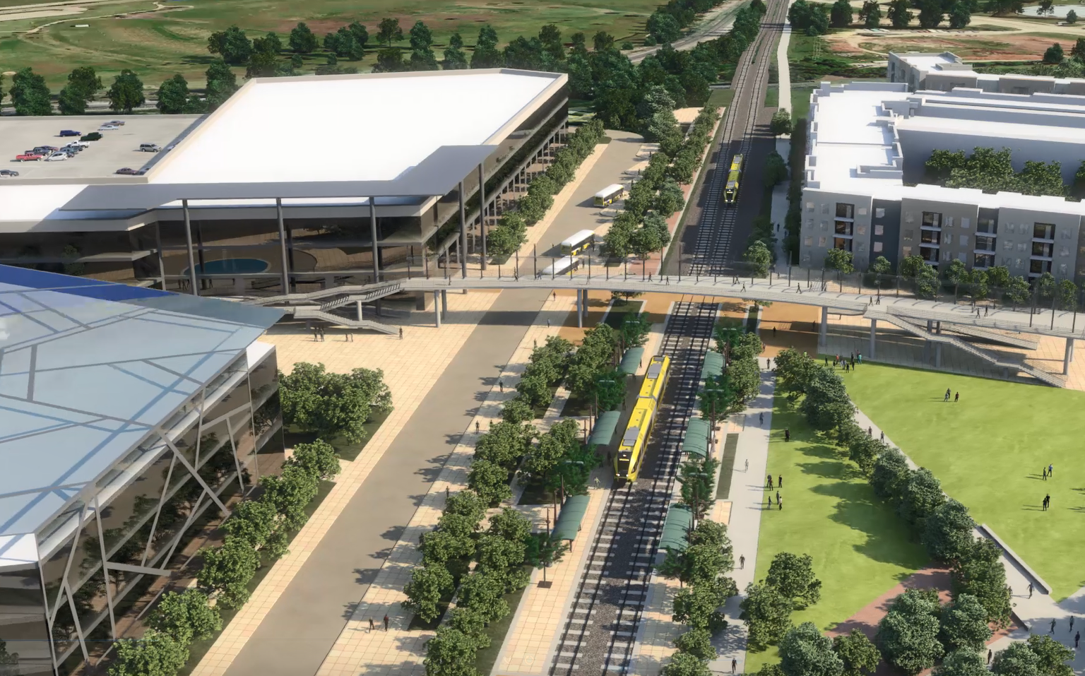
Keep in Mind
Must make business sense
Needs to be part of a master plan
A strong, dedicated project manager is required
Consider management issues, such as traffic, safety and security
Think long-term and protect yourself in your contract (i.e. rent reset)

Slide 37
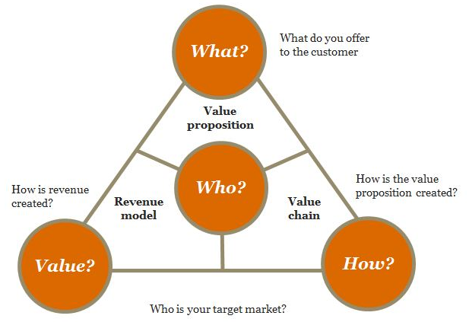
Developing Your Business Model
Land Lease
Term
Mixed use
Shared Revenue

Slide 38
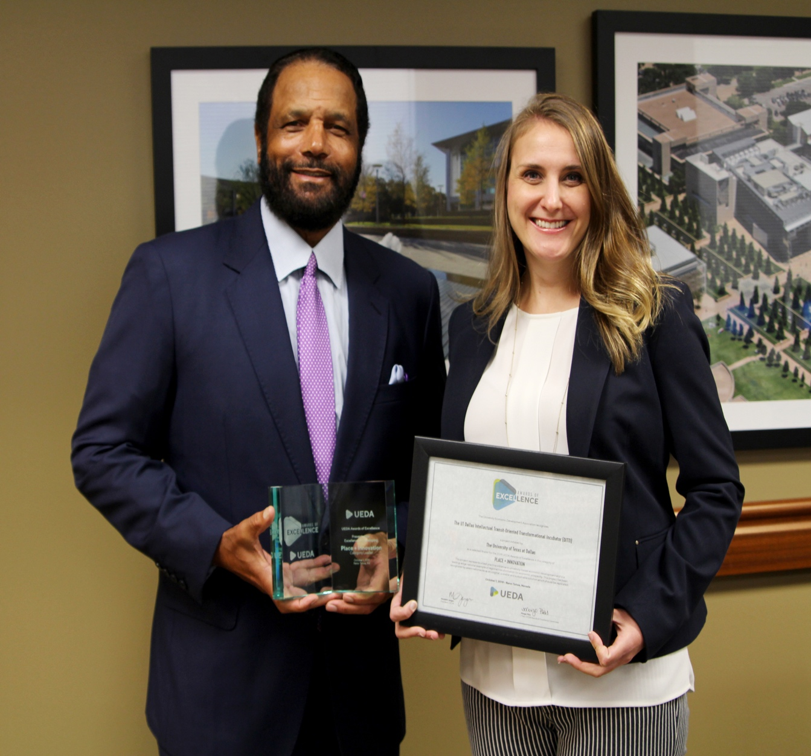
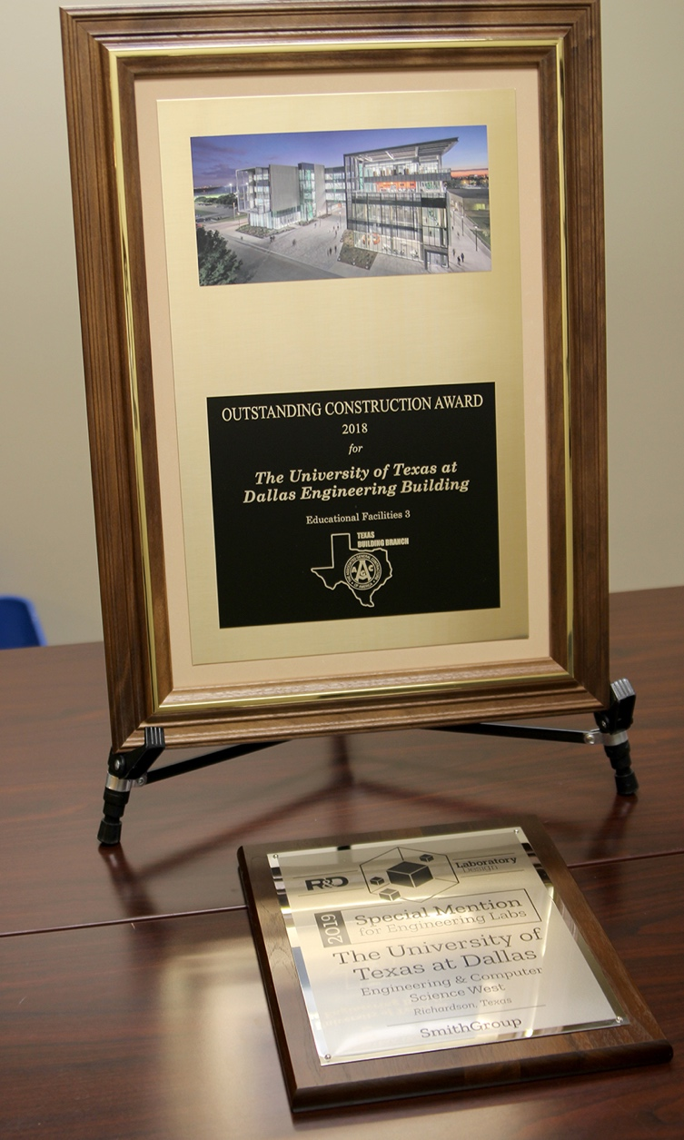
Awards for Economic Development, ECSW
UT Dallas Intellectual Transit-Oriented Transformational Incubator (DITTI)
UEDA Award of Excellence in Place & Innovation
ECSW receives outstanding construction award from Association of General Contractors

Slide 39
Barrett Swiss Art Collection
Major Acquisition
The collection features more than 400 works of Swiss art. The gift was single-largest donation ever made to UTD or UT System school
Collection pieces date from late 14th through mid-20th century
Swiss-born artists like Caspar Wolf (first to ever paint Swiss Alps) and Curio Amiet (inset) are featured

Slide 40
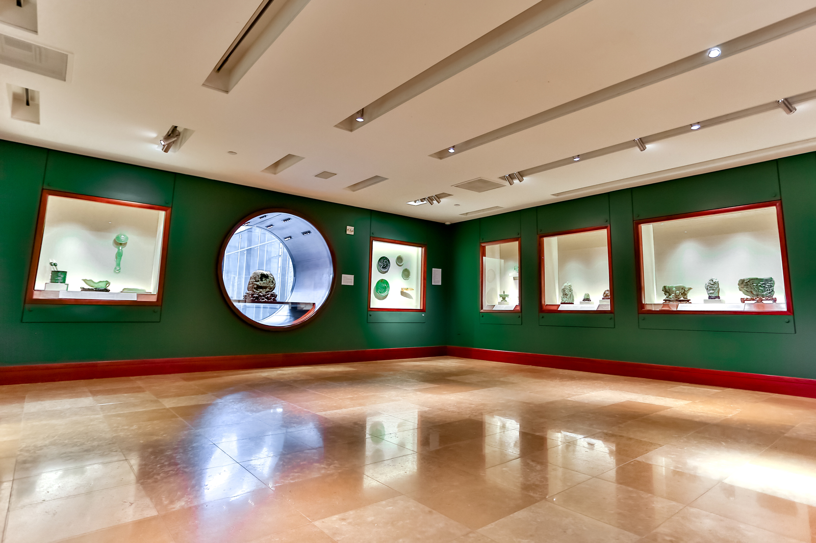
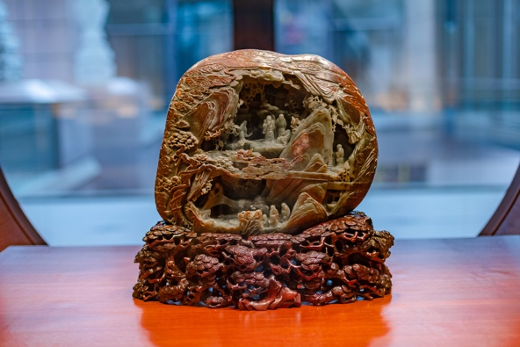
Crow Museum of Asian Art
World-Class Collection Coming to Campus Soon
Trammell and Margaret Crow donated museum collection of Asian art to UT Dallas in 2019
More than 1,000 works, plus a library of more than 12,000 catalogs, journals & books gifted
Gift also includes $23M in funding to help construct an arts & performance complex at UT Dallas

Slide 41
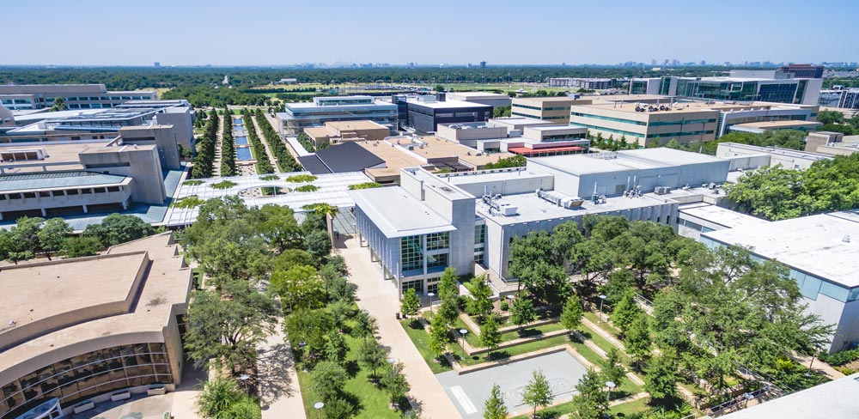
Q&A
Dr. Calvin Jamison
Vice President for Facilities & Economic Development
The University of Texas at Dallas
fed@utdallas.edu

