Slide 1
Best Practices for a Successful Contract Management of Systemwide Agreements
Frank Reighard, Director, Contracts & Procurement
Darya Vienne, Assistant Director, Contracts & Procurement
January 2020

Slide 2
UT System Contracts & Procurement (CnP)
Mission
Our mission is to effectively support the procurement and contracting processes for goods and services that sustain, foster and support the educational, research and health care missions of The University of Texas System. We strive to maintain the most efficient operations while adhering to the requirements of university, state, and federal laws, rules and procedures. It is our goal to serve our customers in the most timely, efficient and transparent means possible.

Slide 3
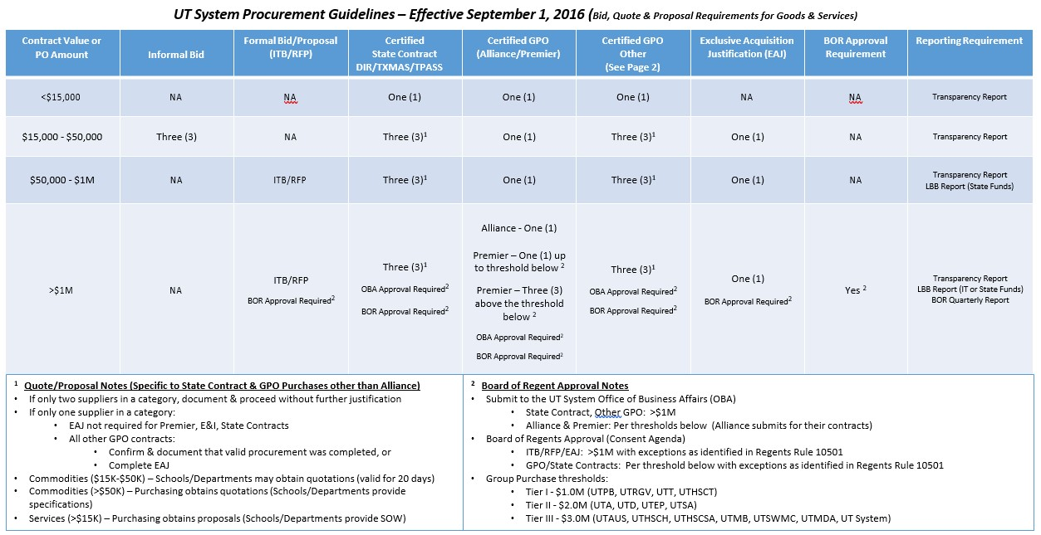
UT System Procurement Matrix

Slide 4
List of State Contracts and Accredited GPOs
Certified State Contracts:
Texas Comptroller of Public Accounts (Statewide Procurement Division)
Texas Multiple Award Schedule (TXMASS)
Texas Procurement and Support Services (TPASS)
Texas Department of Information Resources (DIR)
Accredited GPOs:
E&I Cooperative Services, Inc.
Education Service Center - Region 19 (Allied States Cooperative)
The Local Government Purchasing Cooperative d/b/a BuyBoard
National Cooperative Purchasing Alliance (NCPA)
Sourcewell, formerly National Joint Powers Alliance (NJPA)
Premier Health Alliance, LP
The University of Texas Supply Chain Alliance (UTSSCA)
The UT System utilizes an Accreditation Committee that includes a variety of UT Institutions to review and accredit GPOs each year. All current accreditations will expire August 31, 2021, unless terminated earlier under UT System procedures.

Slide 5
Master Agreements for Use by Other UT Institutions
UT System Administration departments, through the Office of Contracts and Procurement, may initiate contracts that are intended for use by UT institutions. The contracts result from a Request for Proposal (RFP) process that typically includes subject matter experts from the institutions in developing the Scope of Work, evaluating proposals and recommending contract awards. The contracts include a “Project Addendum/Order Form” intended for execution by the contracting/procurement office at the institution. Many of these contracts are awarded to multiple contractor providing the institutions with a variety of options for provision of the services.
Current System-wide agreements include:
Executive Search Firms
Athletic Position Recruiting
Audit Services
Healthcare Consulting Services
Environmental Services
Media Monitoring Services
Real Estate Brokerage Services

Slide 6
Access to Contract Information
UT staff can access contracts, contract launch briefs and contractor contact information at: https://department.utsystem.edu/bus/contracts/default.aspx
Sponsoring Department Responsibilities (UT System)
Provide a Contract Manager as a primary point of contact with the contractor
Communicate and promote the contract with the staff at the UT institutions
Coordinate a contract kick-off meeting with CNP to include key functional staff and procurement staff at the UT institutions
Develop a contract monitoring plan which includes periodic written status reports, including dollars spent by institution, to CNP
Contact CNP to report any significant issues that would require notification of executive management
UT Institution Responsibilities
Obtain proposals from a minimum of three of the awarded contractors if no specific costs for services are outlined in the contract
If only two or one contract exists, all awarded contractors must be asked to submit proposals
Selection should be based upon use of best value criteria
Execute the Project Addendum/Order Form with signature by authorized signor with delegated authority to sign contracts
UT institutions should not change any language in the Project Addendum or Order Form
Include detailed Exhibits to address Scope of Work, Project Schedule and Project Cost
Execute any Exhibits as may be required to comply with FERPA and HIPPA requirements if required

Slide 7
Office of Contracts and Procurement Responsibilities (UT System CnP)
Manage the RFP process and approve the contract award
Assist the department in negotiating agreements with each of the awarded contractors
Obtain assistance from the Office of General Counsel as required
Participate in contract award conferences and periodic contract reviews
Provide UT institution contracting offices with access to contract documents and advice on how to execute project addenda
Report any significant contract disputes or issues to the Executive Vice Chancellor for Business Affairs
Link to Delegations for UT Institutions
https://www.utsystem.edu/documents/docs/general-counsel-documents/2016/delegation-of-authority-charts

Slide 8
Open Discussion
and/or Questions

