Slide 1
Evaluating Public-Private Partnerships
For Texas Universities
University of Texas System Real Estate Conference
January 22, 2020
Jeff Nydegger
Winstead PC
jnydegger@winstead.com
512.370.2836

Slide 2
Understanding Public-Private Partnerships
DESIGN
CONSTRUCTION
“A public-private partnership is a procurement model that uses an integrated approach to deliver infrastructure, incorporating design, construction, financing, operations and maintenance functions into the contract.”
- The Association for the Improvement of American Infrastructure (AIAI)
(https://aiai-infra.Info/resource-center)
FINANCING
MAINTENANCE
OPERATION

Slide 3
The Theory of P3
DESIGN
CONSTRUCTION
A P3 is an alternative procurement model designed to effectively manage risk, promote innovation, reduce costs, and accelerate delivery.
FINANCING
MAINTENANCE
OPERATION

Slide 4
The Theory of P3

Slide 5
The Theory of P3

Slide 6
The P3 Roadmap
Identify Objectives
Engage Advisors
Develop Concept
Solicitation (RFQ/P)
Finalize Scope
Refine and Clarify
Feasibility
Binding Agreement
Evaluate Responses
Shortlist & Selection
Exclusive Negotiations

Slide 7
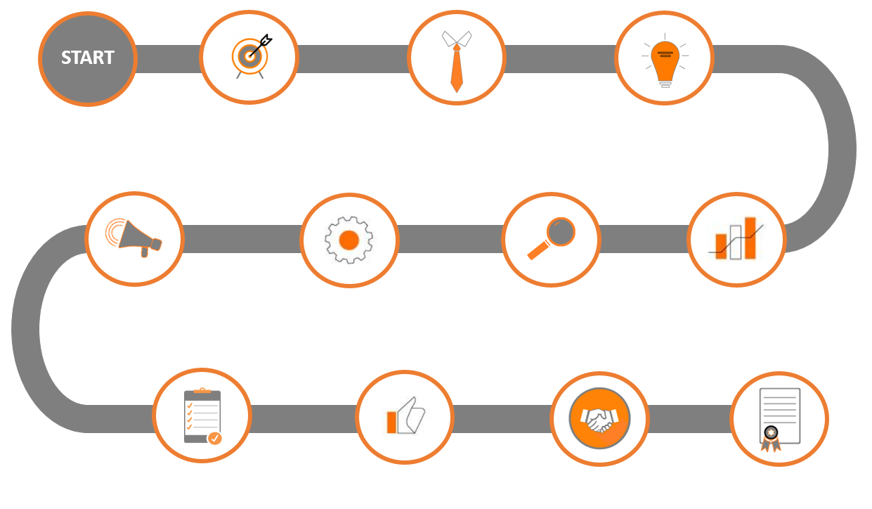
The P3 Roadmap
Identify Objectives
Preparing the Solicitation
Selection & Negotiation

Slide 8
Identify Objectives
Private funding
Expedited delivery
Risk allocation & cost certainty
Efficiency & life-cycle management
Mixed use; revenue generation

Slide 9
Preparing the Solicitation
Preliminary feasibility analysis
Engage with private sector
Refined scope
Realistic timelines
Objective evaluation criteria
Allow for creativity and innovation

Slide 10
Evaluation, Selection & Negotiation
Transparency and communication
Best value selection
Recognize your partner’s role
Be mindful of key milestones
Don’t lose sight of objectives

Slide 11
The P3 Landscape in Texas
State Procurement Laws applicable to Universities
Chapter 2269 – Design-Build, CMR
Chapter 2254 – Professional & Consulting Services
Chapter 2267, 2268 – Pub. & Priv. Facilities & Infrastructure Act

Slide 12
The P3 Landscape in Texas
Public & Private Facilities & Infrastructure Act (2267, 2268)
No unsolicited proposals
Requires public hearings
Must adopt guidelines
Cumbersome “comprehensive agreement” requirements

Slide 13
The P3 Landscape in Texas
Constitutional Limitations: Art. 3, Sec. 52(a)
No political subdivision of the State may lend its credit or grant public money or give any thing of value to any individual, association, or corporation whatsoever.
The action must be within the agency’s powers, not merely to benefit the public in general. Tex. Att’y Gen. Op. No. KP-0035 (2015).
An action may incidentally benefit a private interest and also serve a constitutional public purpose. Edgewood Indep. Sch. Dist. v. Meno, 917 S.W.2d 717, 750 (Tex. 1995).
Whether an action serves a public purpose is for the governing body to decide, subject to judicial review for abuse of discretion (very low standard).

Slide 14
The P3 Landscape in Texas
Ground lease model considerations
Procurement requirements
Ad valorem taxation – public ownership & public benefit
Sales and use tax – primary use & benefit
“Public works” contracts

Slide 15
Discussion
University of Texas System Real Estate Conference
January 22, 2020
Jeff Nydegger
Winstead PC
jnydegger@winstead.com
512.370.2836

