Slide 1
(Making) Shared Decision Making
Part of “Usual Care”
University of Texas System, Clinical Safety and Effectiveness Conference
Building the Bridge: Maintaining Quality in the Face of Change
September 20-21, 2012
San Antonio, Texas
David Wennberg, MD, MPH

Slide 2
Disclosure
Health Dialog sells population health management products and services, including those to support shared decision making. I receive royalties from Health Dialog. This presentation includes data from a peer reviewed RCT that Health Dialog supported.

Slide 3
What we will cover
Profile of the issue
Are physicians and patients on the same page?
Is there evidence that doing the right thing can result in doing well?
Making shared decision making part of usual care

Slide 4

Providers’ Perspective
(or at least it should be…)
“healthcare that establishes a partnership among practitioners, patients and their families (when appropriate) to ensure that decisions reflect patients’ wants, needs and preferences and that patients have the education and support they need to make decisions and participate in their own care.”

Slide 5
Profile of the issue…
Preference Sensitive Care
  Care for conditions where treatment options exist
  Where the treatment options involve significant tradeoffs in the patient’s quality or length of life
  The choice of treatment should be decided upon by the fully informed patient in partnership with their physician (shared decision making)
Source: A.M. O’Connor et al. Modifying Unwarranted Variations in Health Care: Shared Decision Making Using Patient Decision Aids.
Health Affairs, Vol. 7, October 2004.

Slide 6
Profile of the Issue…
Preference Sensitive Care Conditions (PSC) include:
  Herniated disc (meds, PT, surgery)
  Osteoarthritis (meds, surgery)
  Coronary artery disease (meds, angioplasty/stenting, CABG)
  Prostate cancer (active surveillance, radiation, surgery)
  Early-stage breast cancer treatment (lumpectomy/radiation, mastectomy +/- reconstruction)
  Benign uterine conditions (meds, D&C, ablation, hysterectomy)
  Obesity (behavior change, meds, bariatric surgery)
  End of life care (‘curative/futile’, palliative, hospice, etc)
  Depression (meds, psychotherapy, watchful waiting)
  Etc.

Slide 7
Principal assumptions
Patients want to be fully informed
Informed patients will participate in shared decision making
Fully informed physicians will honor patients’ values and preferences
Patients are more risk averse than are their physicians

Slide 8
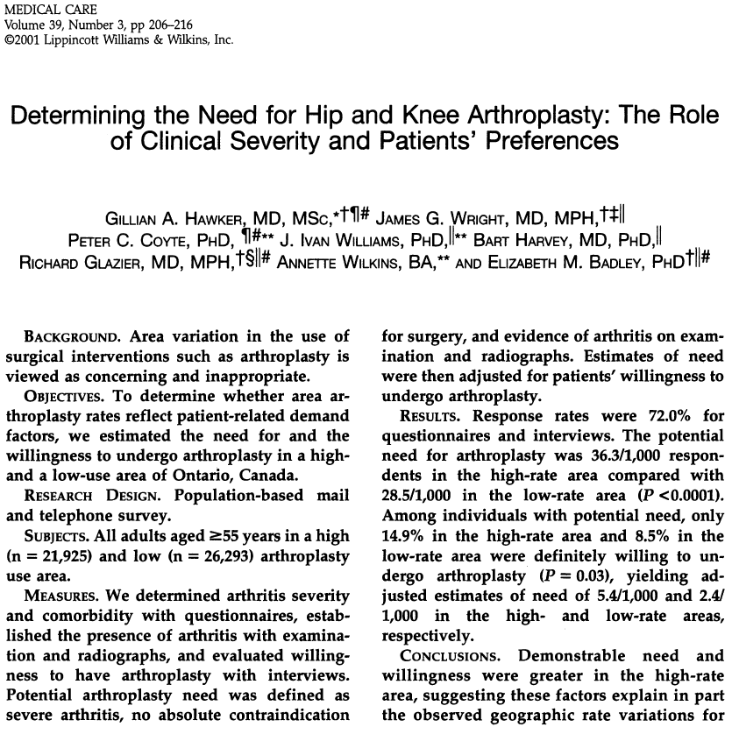
Profile of the issue…
“…Among those with severe arthritis, no more than 15% were definitely willing to undergo (joint replacement), emphasizing the importance of considering both patients’ preference and surgical indications in evaluating need and appropriateness of rates of surgery”
Source: Hawker, G.A., et al. Determining the Need for Hip and Knee Arthroplasty: The Role of Clinical Severity and Patients’ Preference.
Medical Care. Vol 39(3), 206-16.

Slide 9
physician’s Decision-Making Role Preferences
Preferences | Number of Providers (n=1050)
Preferred to share decision-making with their patients | 780 (75%)
Preferred paternalism | 142 (14%)
Preferred consumerism | 118 (11%)
Perceived themselves as practicing their preferred style | 87%
Source: Murray E, Pollack L, White M, Lo B. Clinical decision-making: physicians’ preferences and experiences. BMC Family Practice. 2007. 8:10

Slide 10
patient’s Decision-Making Role Preferences
Preferences | Number of Patients (n=914)
“I prefer to leave all the decisions regarding my treatment to my doctor.” | 102 (11.1%)
“I prefer that my doctor make the final decision about which treatment will be used, but seriously consider my opinion.” | 225 (24.6%)
“I prefer that my doctor and I share responsibility for deciding which treatment is best for me.” | 400 (43.7%)
“I prefer to make the final selection of my treatments after seriously considering my doctor’s opinion.” | 167 (18.2%)
“I prefer to make the final decision about the treatment I will receive.” | 20 (2.1%)
Source: Shields CG, et al. Decision-Making Role Preferences of Patients Receiving Adjuvant Cancer Treatment: A University of Rochester Cancer Center Community Clinical Oncology Program. Supportive Cancer Therapy. Jan 2004. Vol 1. No 2. 119-126.

Slide 11
Profile of the issue…
21.0
18.0
15.0
Cardiac Revascularization
12.0
9.0
6.0
Ontario Benchmark
3.0

Slide 12
“Informed” Consent?
In a survey of consecutive patients scheduled for an elective coronary revascularization procedure at Yale New Haven Hospital in 1997-1998
  75% believed PCI would help improve an MI
  71% believed PCI would help them live longer
  <50% could name 1 possible complication of PCI
  85% were “consented” just before the procedure (by a fellow or an NP)
Source: Holmboe ES. JGIM 2000; 15:632.

Slide 13
Patients’ and Cardiologists’ perceptions of PCI benefits
Anticipated Benefit
Source: Rothberg MB, et al. Patients’ and cardiologists’ perceptions of the benefits of percutaneous coronary intervention for stable coronary disease. Ann Intern Med. 2010; 153:307-313.

Slide 14
Profile of the issue…
Reliance on delegated decision making
  Presumes physicians adequately assesses patient’s values and preferences
Failure to adequately inform patients of their treatment options
  Options have varied risks and benefits that only the patient can experience
Failure to adequately engage patients in informed choice
  Leads to interventions (and costs) that fully informed patients would choose not to have

Slide 15
Profile of the issue…
Estimated proportion of health care spend by category of care
Effective Care
Preference Sensitive Care
Supply Sensitive Care
Source: Dartmouth Atlas

Slide 16
What we will cover
Profile of the issue
Are physicians and patients on the same page?
Is there evidence that doing the right thing can result in doing well?
Making shared decision making part of usual care

Slide 17

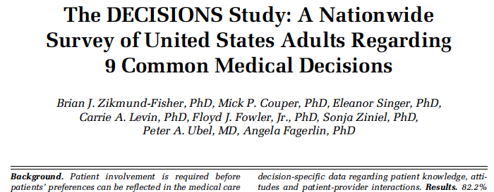
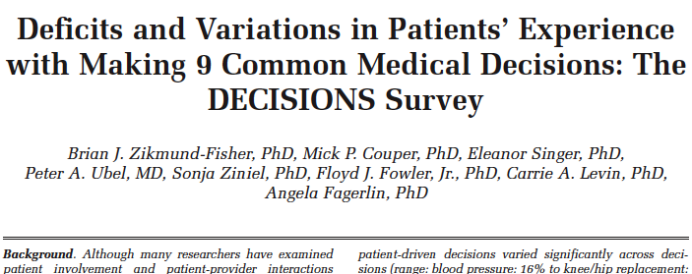
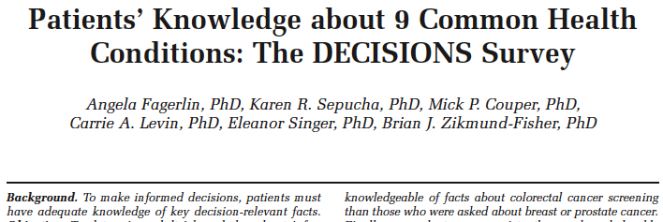
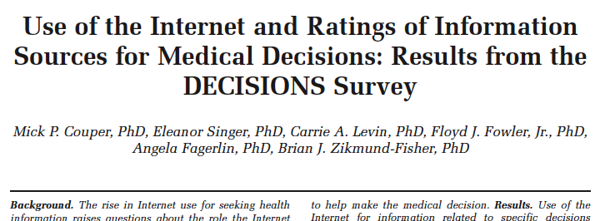
Decisions study papers

Slide 18
The national Survey of Medical Decisions (a.k.a. decisions Study)
Telephone survey 3,010 Americans > 40 years old
  National, representative sample
  Asked about 9 common medical decisions
Defined a medical decision as
  Having taken a medical action (such as screened for cancer, initiated medication, had surgery) within 2 years
  Or having discussed taking such action with a health care provider in the last 2 years

Slide 19
Decisions study
Prevalence of Medical Decisions in Past Two Years
Medication Initiation
Cancer Screening
Elective Surgery

Slide 20
Decisions study
“Some” or “A Lot” of Discussion of Pros and Cons
Medication Initiation
Cancer Screening
Elective Surgery

Slide 21
Decisions study
Physician Offered an Opinion, Asked Patient’s Opinion
Medication Initiation
Cancer Screening
Elective Surgery

Slide 22
Decisions study
Mean proportion of knowledge items answered correctly
Medication Initiation
Cancer Screening
Elective Surgery

Slide 23
How do Informed Patients Feel?
On a scale of 0-10, where 0 is not at all informed and 10 is extremely well-informed, how informed do you feel about your decision about (screening, medication, surgery)?
22%
41%
Not at all
informed
Extremely
well informed

Slide 24
Decisions study
Importance of Information Sources
* 0 rating assigned to non-users

Slide 25
Decision Quality Instruments
Preference Sensitive Decisions
  What is the core sent of information relevant for each decision?
  What are the most salient goals and concerns upon which patients select treatments?
Mailed survey to determine accuracy, importance and completeness of items
  How important was each item?
  Pick top three
Patient responses (n=324; 72-85% by site)
Provider responses (n=266; 76% response rate)
Source: Lee C, Barry M, Cosenza C, Dominik R, Mulley A, O'Connor A and Sepucha K. Development of instruments to measure the quality of breast cancer
Treatment decisions. Health Expectations 2010 Sep;13(3):258-72 [Epub 2010 Jun 9].
Lee C, Hultman S, Sepucha K. Do patients and providers agree about the most important facts and goals for breast reconstruction decisions?" Annals of
Plastic Surgery 2010 May; 64(5):563-6.

Slide 26

Bridging perspectives: what are the key facts?
SURVIVAL:
COSMETICS:
RECURRENCE:
RADIATION:
ADD. SURGERY:
Mastectomy
Same
Lose breast
Low (1-5%)
Not Common
Rare
Lumpectomy
Same
Keep breast
Slightly higher(5-15%)
6+ weeks
Common (20-50%)
Source: Lee C, Barry M, Cosenza C, Dominik R, Mulley A, O'Connor A and Sepucha K. Development of instruments to measure the quality of breast cancer
Treatment decisions. Health Expectations 2010 Sep;13(3):258-72 [Epub 2010 Jun 9].
Lee C, Hultman S, Sepucha K. Do patients and providers agree about the most important facts and goals for breast reconstruction decisions?" Annals of
Plastic Surgery 2010 May; 64(5):563-6.

Slide 27
Top 3 Things Patients should know
Benefits and harms from the survey about chemo and hormone therapy for breast cancer
Fact
Chemotherapy reduces recurrence, increases survival
Hormone therapy reduces recurrence, increases survival
Chemotherapy common side effects
Chemotherapy serious side effects
Hormone therapy common side effects
Hormone therapy serious side effects
Fact | % top 3 Patients
Chemotherapy reduces recurrence, increases survival | 12%
Hormone therapy reduces recurrence, increases survival | 12%
Chemotherapy common side effects | 12%
Chemotherapy serious side effects | 24%
Hormone therapy common side effects | 6%
Hormone therapy serious side effects | 6%
Fact | % top 3 Patients | % top 3 Providers
Chemotherapy reduces recurrence, increases survival | 12% | 38%
Hormone therapy reduces recurrence, increases survival | 12% | 33%
Chemotherapy common side effects | 12% | 0%
Chemotherapy serious side effects | 24% | 0%
Hormone therapy common side effects | 6% | 0%
Hormone therapy serious side effects | 6% | 0%
Source: Lee C, Barry M, Cosenza C, Dominik R, Mulley A, O'Connor A and Sepucha K. Development of instruments to measure the quality of breast cancer Treatment decisions. Health Expectations 2010 Sep;13(3):258-72 [Epub 2010 Jun 9].
Lee C, Hultman S, Sepucha K. Do patients and providers agree about the most important facts and goals for breast reconstruction decisions?" Annals of Plastic Surgery 2010 May; 64(5):563-6.

Slide 28
Top 3 Goals and Concerns for Breast Cancer Decisions
Fact
Surgery: Keep your breast
Reconstruction: Look natural without clothes
Chemotherapy: Live as long as possible
Reconstruction: Avoid using prosthesis
Fact | % top 3 Patients
Surgery: Keep your breast | 7%
Reconstruction: Look natural without clothes | 59%
Chemotherapy: Live as long as possible | 33%
Reconstruction: Avoid using prosthesis | 33%
Goal/Concern | % top 3 Patients | % top 3 Providers | p
Surgery: Keep your breast | 7% | 71% | <0.01
Reconstruction: Look natural without clothes | 59% | 80% | 0.05
Chemotherapy: Live as long as possible | 33% | 96% | 0.01
Reconstruction: Avoid using prosthesis | 33% | 0% | <0.01
Source: Lee C, Barry M, Cosenza C, Dominik R, Mulley A, O'Connor A and Sepucha K. Development of instruments to measure the quality of breast cancer Treatment decisions. Health Expectations 2010 Sep;13(3):258-72 [Epub 2010 Jun 9].
Lee C, Hultman S, Sepucha K. Do patients and providers agree about the most important facts and goals for breast reconstruction decisions?" Annals of Plastic Surgery 2010 May; 64(5):563-6.

Slide 29
Is Doing what the Doctor Thinks is best a top priority?
Decision
BCA surgery
Hip placement
Knee replacement
Menopause
PSA
Spinal Stenosis
Decision | % top 3 Patients
BCA surgery | 86%
Hip placement | 84%
Knee replacement | 78%
Menopause | 60%
PSA | 59%
Spinal Stenosis | 46%
Decision | % top 3 Patients | % top 3 Providers | p
BCA surgery | 86% | 14% | <0.01
Hip placement | 84% | 40% | <0.01
Knee replacement | 78% | 35% | <0.01
Menopause | 60% | 21% | 0.02
PSA | 59% | 21% | 0.03
Spinal Stenosis | 46% | 5% | <0.01
Source: Lee C, Barry M, Cosenza C, Dominik R, Mulley A, O'Connor A and Sepucha K. Development of instruments to measure the quality of breast cancer Treatment decisions. Health Expectations 2010 Sep;13(3):258-72 [Epub 2010 Jun 9].
Lee C, Hultman S, Sepucha K. Do patients and providers agree about the most important facts and goals for breast reconstruction decisions?" Annals of Plastic Surgery 2010 May; 64(5):563-6.

Slide 30
KEY DIFFERENCES AND CONCLUSIONS
Patients feel it is critical to do whatever the doctor thinks is best
Patients and providers focus on different issues
Delegation of information provision and decision making to providers is problematic
  Likely to not get information want and need
  Likely to not get treatments that best match their individual goals and concerns
Source: Lee C, Barry M, Cosenza C, Dominik R, Mulley A, O'Connor A and Sepucha K. Development of instruments to measure the quality of breast cancer
Treatment decisions. Health Expectations 2010 Sep;13(3):258-72 [Epub 2010 Jun 9].
Lee C, Hultman S, Sepucha K. Do patients and providers agree about the most important facts and goals for breast reconstruction decisions?" Annals of
Plastic Surgery 2010 May; 64(5):563-6.

Slide 31
What we will cover
Profile of the issue
Are physicians and patients on the same page?
Is there evidence that doing the right thing can result in doing well?
Making shared decision making part of usual care

Slide 32
Shared Decision-Making (SDM)
Definition:
Integrative process between patient and clinician that
  Engages the patient in decision-making
  Provides patient with information about alternative treatments (often includes a decision aid)
  Facilities the incorporation of patient preferences and values into the medical plan
Source: Charles C, Soc Sci Med 1997; 44:681

Slide 33
SDM: can it effect choice?
Use of decision aids show that fully informed patients choose differently than non-informed patients
21.0
18.0
15.0
Cardiac Revascularization (1994-95)
12.0
9.0
6.0
Ontario Benchmark
3.0

Slide 34
SDM: can it effect choice?
Revascularization Decision in Ontario
*
Controls
Stable Angina
SDM Video
*RR=0.77, p=0.01
Source: Morgan MW, et al., JGIM. 2000; 15:685-93

Slide 35
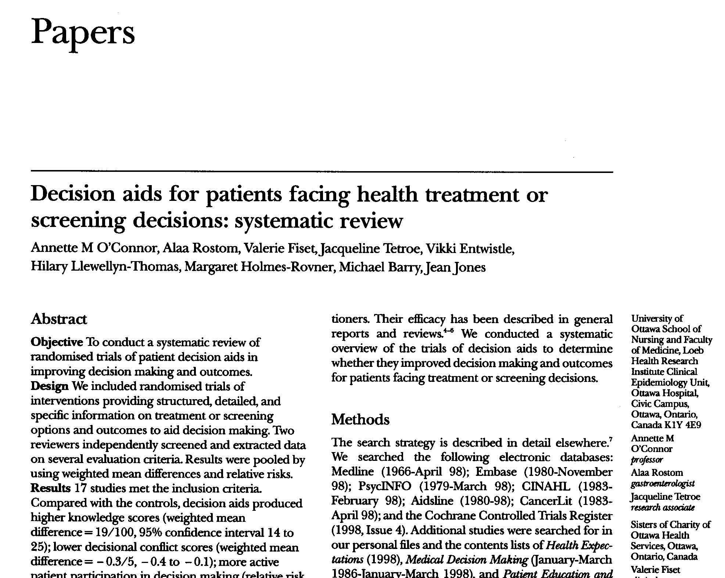
SDM: can it effect choice?
Summary measure of surgery versus medical management across the 8 trials
RR (95% CI) = 0.75 (0.60-0.94)
Source: O’Connor AM., et al. Decision aids for people facing health treatment or screening decisions. Cochrane Database of Systemic Reviews
(updated 2010)

Slide 36
SDM: can it effect choice?
Review of 86 RCTs in use of decision aids
  Greater knowledge of options, benefits and harms
  More realistic expectations
  Lower decisional conflict related to feeling uninformed
  Less uncertainty related to lack of clarity on personal values
  40% fewer people who were passive in decision
Decisions differ from usual care
  25% reduction in elective invasive surgery
  30% reduction in use of menopausal hormones
  20% reduction in PSA testing for prostate cancer
  14% increase in screening for colon cancer
Source: O’Connor, Cochrane Review, 2006.

Slide 37
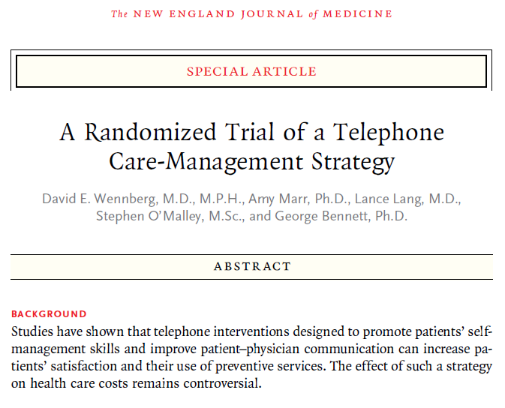
SDM: Can it also reduce costs?
RCT of over 174,000 people
Identify individuals at risk for unwarranted utilization
Navigation and Shared Decision-Making support
Outcomes: cost and utilization at 1 year
Source: Wennberg DE, Marr A, Lang L, O’Malley S, Bennett GB.
A Randomized Trial of a Telephone Care-Management Strategy
N Eng J Med 2010; 363:1245-55

Slide 38
SDM: Can it also reduce costs?
Medical cost differences by service category
Source: Wennberg DE, Marr A, Lang L, O’Malley S, Bennett GB. A Randomized Trial of a Telephone Care-Management Strategy. N Eng J Med 2010; 363:1245-55

Slide 39
SDM: Can it also reduce costs?
Medical cost differences by service category
Most of the cost reduction was due to
reduced inpatient and outpatient hospital costs
13.3% reduction in high variation medical admissions
11.5% reduction in preference-sensitive admissions
Source: Wennberg DE, Marr A, Lang L, O’Malley S, Bennett GB. A Randomized Trial of a Telephone Care-Management Strategy. N Eng J Med 2010; 363:1245-55

Slide 40
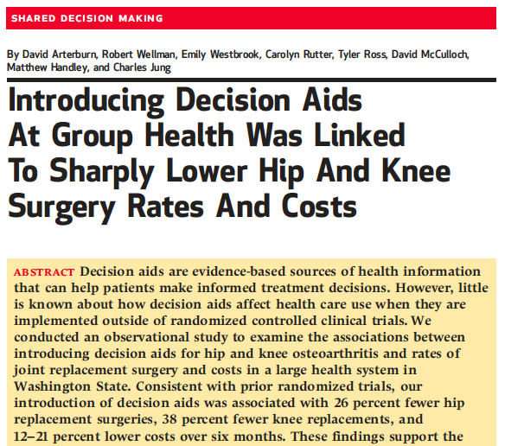
SDM: Can it also reduce costs?
Observational study to examine association between introducing decision aids for hip and knee osteoarthritis and rates of joint replacement surgery and costs in a large health system
Source: Arterburn, Wellman, Westbrook, et al. Introducing Decision Aids at Group Health was Linked to Sharply Lower Hip and Knee Surgery Rates and Costs. Health Affairs, 31. no. 9 (2012):2094-2104

Slide 41
Association between decision Aids and surgery
26% reduction in 180-day rate of hip replacement surgery
38% reduction in 180-day rate of knee replacement surgery
26%
38%
Source: Arterburn, Wellman, Westbrook, et al. Introducing Decision Aids at Group Health was Linked to Sharply Lower Hip and Knee Surgery Rates and Costs. Health Affairs, 31. no. 9 (2012):2094-2104

Slide 42
Association between decision Aids and Costs
21% reduction in costs in the hip replacement cohort
12% reduction in costs in the knee replacement cohort
21%
12%
Source: Arterburn, Wellman, Westbrook, et al. Introducing Decision Aids at Group Health was Linked to Sharply Lower Hip and Knee Surgery Rates and Costs. Health Affairs, 31. no. 9 (2012):2094-2104

Slide 43
What we will cover
Profile of the issue
Are physicians and patients on the same page?
Is there evidence that doing the right thing can result in doing well?
Making shared decision making part of usual care

Slide 44
Adoption of Shared Decision-Making on a Large Scale
Reasons:
  Ethical imperative to do the “right thing”
  Move from (flawed) informed consent to informed choice
    Aligning preferences and values with an individual’s clinical decision
  Bridge health disparities
  Conservative utilization of surgical interventions

Slide 45

Rhode Island Hospital Performed Surgery on Wrong Part for 5th Time
The Rhode Island Department of Health is investigating Rhode Island Hospital in Providence after the hospital admitted to operating on the wrong body part for another patient, marking at least the fifth wrong-site surgery at the hospital since 2007.
Source: AboutLawSuits.com, Oct 30, 2009.

Slide 46

Patient Safety
How do we describe operating on a patient who
would say NO to surgery if alternatives, risks
and benefits were well understood?
Wrong
Patient
Surgery
Wrong
Site
Surgery

Slide 47
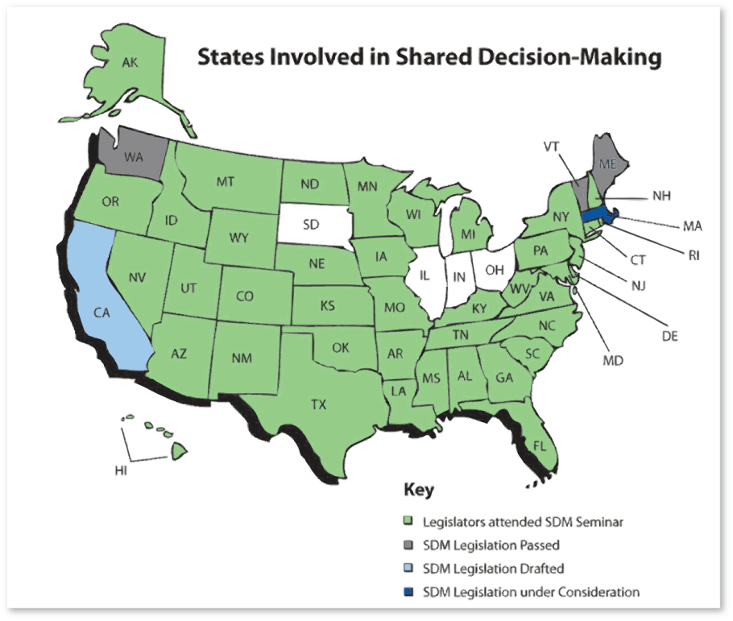
Legislative push for shared decision-making
Source: Kuehn BM. States Explore Shared Decision Making. (Reprinted) JAMA 24, 2002. Vol 301. No 24, p 2539.

Slide 48

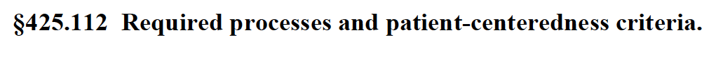
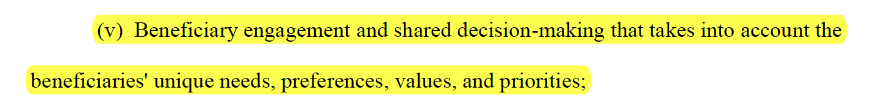
Payment reform for shared decision-making
Medicare Program; Medicare Shared Savings Program: Accountable Care Organization

Slide 49
Who’s doing SDM as part of usual care?
Not too many places….
Dartmouth-Hitchcock Health
FIMDM demonstrations
Group Health

Slide 50
4 Step Process of Shared Decision- Making
Define the population
Engage the patient (include a decision aid if available)
Provide support
  Patient understands treatment options
  Patient has thought about options within context of preferences and values
Clinical discussion

Slide 51
SDM Process
PSC Elective Surgery
Patient identified via diagnosis or at time of referral
Patient Decision
No: Do not refer; explore non-surgical options
Engage: appropriate for surgery?
Patient not interested in surgery; inform PCP
Patient leaning towards surgery
Patient undecided
Yes, or unknown: Prior to specialist visit, send decision aid to patient
CONSULT: Patient and surgeon review DA info and make decision
1 week before visit, confirm that DA was used; offer decision support

Slide 52
Geographic approach
Mission:
Provide products and services that enable members to deliver high quality, efficient care and to support them in delivering outcomes of care based on the Triple-Aim as they move from fee for service reimbursement and volume based care to care financed by global budgets and full capitation
Guiding Principles:
  Patient-centered care
  Transition to capitation
  Common measures
  Learning & innovation
  Public-private partnerships
  Transparency
  Separate risk arrangements
  Stewardship

Slide 53
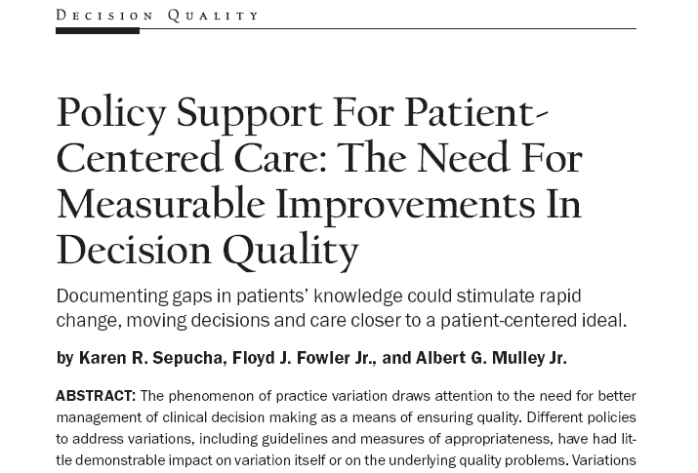
BEYOND THE USUAL SUSPECTS: NEW QUALITY MEASURES
Decision
Quality
Did the patient know a decision was being made?
Did the patient know the pros and cons of the treatment options?
Did the provider elicit the patient’s preferences?
Did the patient know what (s)he needed to know?
Did the decision reflect the patient’s goals and concerns?
Values Concordance
Involvement
Knowledge
Source: Sepucha KR, et al. Policy support for patient-centered care: the need for measurable improvements in decision quality. Health Affairs (Millwood). 2004; Suppl Web Exclusives: VAR54-62.

Slide 54
Lining up all of the levers
Establish informed patient choice as the standard of care
  Ethically required
  Replace informed consent with informed patient choice
    Legal structures that mirror clinical model
Reimbursement changes
  Support infrastructures to systemically deliver shared decision making
  Pay for achieving high quality patient decision making
Benefit changes
  Incentives to participate in shared decision making
  Cost sharing for more expensive intervention?

Slide 55
What we will cover
Profile of the issue
Are physicians and patients on the same page?
Is there evidence that doing the right thing can result in doing well?
Making shared decision making part of usual care

