Slide 1
Pediatric Hospitalists Collaborate to Improve Discharge Communication
Mark Shen, MD
UT Southwestern Austin Pediatrics
Dell Children’s Medical Center
Julia Shelburne, MD
UT Medical School at Houston
Children’s Memorial Hermann Hospital
Notes:
Added a title slide, dbl check your info

Slide 2
Background: PHM
Pediatric Hospital Medicine tri-sponsorship
  American Academy of Pediatrics (AAP)
  Academic Pediatric Association (APA)
  Society of Hospital Medicine (SHM)
2009 PHM Roundtable
  Strategic Planning
  Commissioned 3 Quality Improvement Collaboratives with mentorship from national leaders in pediatric QI
Notes:
Added a background slide
Mention that this was an exploratory project by PHM with little road map…
Describe VIP

Slide 3
Background
Co-Chairs of Transitions of Care Collaborative
  Mark Shen, MD, enrolled in the CS&E course
  Julia Shelburne, MD, a graduate of the UT Houston Physician Quality and Safety Academy
Elected to focus on Hospitalist-PCP communication
Representatives from 15 other pediatric hospitalist groups enrolled
Project was time-limited to 9 months
Notes:
Would be good to mention that Shawn Ralston also led a collaborative to show impact of CS&E course on national QI-
Mention the scientific process: beer poolside.

Slide 4
Core Participants
Lora Bergert: Kapi`olani Medical Center, Honolulu
Michael Bryant: USC Keck School of Medicine
David Cooperberg: St. Christopher’s, Philadelphia
Dan Coughlin: Hasbro Children’s, Providence
Leah Mallory: Barbara Bush Children’s Hospital at Maine Medical Center, Portland
Beth Robbins: Anne Arundel Medical Center, Annapolis
Julia Shelburne: UT-Houston Medical School/Children’s Memorial Hermann Hospital
Mark Shen and Don Williams: UT-Southwestern, Austin/Dell Children’s Medical Center, Austin
Ann Vanden Belt: St. Joseph Mercy Hospital, Ypsilanti, MI
Joyce Yang, Dan Hershey, and Erin Stucky: Rady Children’s Hospital, San Diego
Notes:
Mention that these were the groups that stayed to the end

Slide 5
Hospitalist-PCP Communication: A High-Risk Handoff
In studies of adult patients, approximately 20% of hospitalized patients experience an adverse event after discharge
Many (1/2 to 2/3) are preventable or ameliorable
Most common type: adverse drug events
Forster AJ, et al. The incidence and severity of adverse events affecting patients after discharge from the hospital. Ann Intern Med. 2003;138(3)161-7.
Forster AJ et al. Adverse events among medical patients after discharge from hospital. CMAJ 2004; 170(3):345-9.

Slide 6
Hospitalist-PCP Communication: A High-Risk Handoff
Poor communication between hospitalists and outpatient providers:
Only 17% to 20% of PCPs always notified of discharge
Only 3% of PCPs reported being involved in communication regarding discharge
11% of discharge letters and 25% of discharge summaries never reached the PCP
Kripalani, S et al. Deficits in communication and information transfer between hospital-based and primary care physicians: implications for patient safety and continuity of care. JAMA. 2007;297:831-841.
Notes:
Mention that this was a systemativc review

Slide 7
Hospitalist-PCP Communication: A High-Risk Handoff
Communication rarely timely
PCPs and patients often made contact before discharge information arrived (16%-88%)
Delayed or absent discharge communication was estimated to adversely affect management in 24% of cases
  In one study, only 24.5% of discharge summaries were available for at least 1 follow-up visit.
Trend towards decreased risk of readmission for patients seen for follow-up by a physician that had received a discharge summary
Kripalani, S et al. Deficits in communication and information transfer between hospital-based and primary
care physicians: implications for patient safety and continuity of care. JAMA. 2007;297:831-841.
Van Walraven C, Seth R, Austin PC, Laupacis A. Effect of discharge summary availability during post-discahrge visits on hospital readmission. J Gen Intern Med 2002;17:186-192.
Notes:
Maybe add: and missing critical elements (from slide that got mangled when reformatted- see Marks original slides)

Slide 8
Collaborative Needs Assessment
Survey of referral community:
Highly variable preferences on method:
  50% email
  50% telephone
  50% fax
Timeliness of discharge communication was desired:
  56.3% Same day
  23.9% Prior to recommended follow-up appointment
  14.1% Within 72 hours
Notes:
Segue: because there was little literature re: what do PCP’s want we did our own…

Slide 9
Collaborative Diversity
Broad scope of potential projects
Wide range of experience with QI
Varying degrees of institutional support
Spectrum of EMR implementation and technical/systems sophistication
→Focus on timeliness and reliability

Slide 10
Collaborative Aim Statements
Global Aim: We will create a discharge infrastructure within our hospitals to achieve measurable improvements in the handoff of patient care at discharge from the hospitalist to the primary care provider.
Specific Aim: Over the next 6 months, we will lead a quality improvement collaborative and achieve measureable improvement in the frequency AND timeliness of communication of patient information to the PCPs at discharge.
Goal: 90% of hospitalist discharges at each participating hospital will have documentation of communication with a PCP within 2 calendar days of actual discharge.
Notes:
Mention that we chose frequency and timeliness because of time frame.

Slide 11
Collaborative: Process
Monthly conference calls
  Scheduled topics
    Standardized data collection and reporting
    QI didactics
    Use of QI tools
    Individual site presentations
  Open discussion of lessons learned
  Positive reinforcement!
Quarterly collaborative leadership calls
  Co-chairs of 3 collaboratives & national mentors
Notes:
I think for this audience we should stress process as much as results, esp given groups are meeting the next day to discuss forming collaboratives
Need more details…

Slide 12
Step 1 - Measurement
Weekly sampling
Minimum 12 charts
2 weekdays + 1 weekend day
Documentation of communication (email, phone, fax)
Simple process for ease of data reporting and viewing
Plotted on a collaborative run chart

Slide 13
(Sample Slide from Conference Call)
“I’m Measuring, but still confused…“
Process Maps, Key Drivers, Pareto Charts, Fishbone Diagrams are all:
Diagnostic Tools
to help you PLAN your CHANGE (intervention)
Step 2: Do you understand your process?

Slide 14
Collaborative Process
Common feedback from the group:
“I don’t understand Key Drivers or Process Maps but I can clearly see 15 barriers in my way….”
Collaborators had a wide range of QI skills
A major part of conference calls was devoted to Quality Improvement basics
Notes:
More details

Slide 15
Patient is Ready for Discharge or has been discharged (same day). Algorithm followed whether PCP known or if only clinic name (distinct) known
RCHSD Discharge
Communication
Process Map
YES
Do patient
YES
needs warrant
Place call to PCP
a personal
call
by end of day
?
NO
Document call in
:
1
)
patient chart on ward or
Does PCP
2
)
field in billing program
have
communication
preference
?
YES
Does PCP have secure email?
Communication by
Communication by
Communication by
fax
phone
email
?
?
Complete discharge fax on
Place call to PCP by end
ward or in office by end of
of day
Email PCP by end of day
day
OR
1) Fax on ward
2) Document date/time.
3) Place fax in chart
4) Document in progress note
5) Document in billing field
Document call in
:
Document email by
1. Patient chart
progress note
2. Field in billing
1
)
Patient chart on ward
:
2
)
Field in billing program
1. Give fax to admin
2. Admin faxes notice
3. Record date/time of fax
4. Submit to Chartmaxx for scanning into chart.
5. Notify attending/record faxes not sent in log.
Notes:
Format needs to be cleaned up

Slide 16
Key Drivers Diagram
AIM KEY DRIVERS INTERVENTIONS
Faculty, resident, and NP awareness of expectation
Education ongoing of faculty and residents (monthly )
90% of general pediatric discharges will have instructions,
summary or short stay form faxed to PCP within 48 hours
IT support to help pull QI data
Availability of name of PCP and contact info in EMR
IT initiative to enhance PCP information tab in EMR
Educate residents to ask/document PCP information in eH&P
IT support of initiative
Ongoing Ad Hoc multidisciplinary meetings
Working with IT to find automated solutions (modify discharge template, automated fax from EMR, etc)
Personnel assigned to efax info—residents, NPs
Working with team to efax until auto-fax process in place

Slide 17
Collaborative Outcomes

Slide 18
Results
Percent of discharges with documented communication with PCP within 2 calendar days of discharge, by month since “go-live"
Notes:
Mentioned staggered by start date

Slide 19
Sustainability: Groups entering Phase 2
Notes:
There are not enough lines to account for the key on the R

Slide 20
Value of Pediatric Hospitalists:
Referring Physician Satisfaction
Annual Survey of Austin Pediatric Alliance:
  Hospitalists received the highest marks for communication
  “Communication is so much better”
  “Discharge summaries have been received promptly on a consistent basis”
  “I have seen a tremendous improvement with regards to receipt of d/c summaries and faxes regarding admits”
  “In general, i think the pcrs service has improved tremendously in the areas of prompt communication”
  “Wonderful job getting notification of admissions and d/c summaries to me quickly these days”

Slide 21
Change Package
Team buy-in/Leadership engagement
Measure
Standardize and/or automate processes
Provide targeted and timely individualized feedback
Keep measuring
Incentives

Slide 22
Learning Collaborative Factors Contributed to Success
Learned from peers
Received instant feedback
Supported, motivated and pushed by the group
Learned Quality Improvement
  “I learned to fish”
Felt accountable to group deadlines

Slide 23
Collaborative Co-Chairs
Lessons Learned
Plan ahead: timelines, deadlines, conference calls
Administrative support is key to a successful collaborative
While individual input is a strength of collaboratives, it is up to leadership to keep groups positive and moving forward

Slide 24
UT CS&E
Provided Collaborative Co-Chairs with the skills and confidence to lead this collaborative
An effective model for experiential learning
  Combination of didactic theory and practical hands-on learning through projects
Provided networking which allowed co-chairs to further this project at their own institution
Facilitated development of strong regional and national pediatric QI presence
Notes:
Add some generic kudos re: how cs&e prepared us to lead national quality improvement….
I don’t know much about the meeting on Friday that you and Shawn are organizing but would mention it here- how UT system ripe for collaborative because of the breadth and depth of QI expertise thanks to CS&E…yada yada…

Slide 25
Next Steps:
Continued leadership and administrative support
  Value in Inpatient Pediatrics (VIP) Network
  AAP Quality Improvement and Innovation Network (QuIIN)
Phase 2
  National multi-community needs assessment of primary care physicians (underway)
  Improve content of discharge communication
  Apply for Maintenance of Certification (MOC) credit
  Partner with outpatient pediatric providers to improve outcomes
A new Phase 1
  Repeat cycle of improving timeliness and learning QI with a new group of enthusiastic hospitalists

Slide 26
SLIDE GRAVEYARD

Slide 27
Needs Assessment: Pediatric Hospitalist – PCP Communication
Single pediatric medical center
Telephone survey: 10 pediatric hospitalists and 12 referring pediatric primary care providers
Evaluation of Communication issues previously identified in adult literature
  Quality of communication
  Barriers to communication
  Methods of information sharing
  Key data element requirements
  Critical timing
  Perceived benefits
Harlan, G, et.al, Pediatric hospitalists and primary care providers: a communication needs assessment. J Hosp Med 2009 Mar;4(3):187-93.

Slide 28
Needs Assessment: Pediatric Hospitalist – PCP Communication
Important Elements:
  Diagnoses
  Medications
  Follow-up needs
  Pending laboratory test results
Critical Times for communication
  Discharge
  Admission
  Major clinical changes
Harlan, G, et.al, Pediatric hospitalists and primary care providers: a communication needs assessment. J Hosp Med 2009 Mar;4(3):187-93.

Slide 29
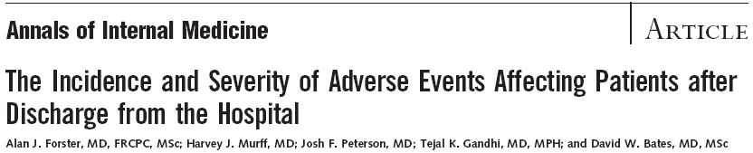
19% of patients experienced an adverse event after discharge
  1/3 were preventable, 1/3 were ameliorable
Adverse drug events were most common
Forster AJ, Murff HJ, et al. The incident and severity of adverse events affecting patients after discharge from the hospital. Ann Intern Med. 2003l 138(3):161-7.

Slide 30
23% of patients experienced an adverse event after discharge
  ½ were preventable or ameliorable
Adverse drug events were most common
Forster AJ, Clark HD et al. Adverse events among medical patients after discharge from hospital. CMAJ 2004;170(3):345-9.

Slide 31
Characterize types and prevalence of deficits
Determine efficacy of interventions
Most studies were performed outside of the United States
Systematic review of literature
Kripalani, S et al. Deficits in communication and information transfer between hospital-based and primary care physicians: implications for patient safety and continuity of care. JAMA. 2007;297:831-841.
Notes:
What is the point of this one? Just to show there are known deficits? What were the findings?
This is also an incomplete citation

Slide 32
Failure to Make Contact
Only 17% to 20% of PCPs were always notified of discharge
Only 3% of PCPs reported being involved in communication regarding discharge
11% of discharge letters and 25% of discharge summaries never reached the PCP
Kripalani, S et al. Deficits in communication and information transfer between hospital-based and primary care physicians. JAMA. 2007;297:831-841.
.
Notes:
I would combine this slide and the previous one into one slide

Slide 33
Missing From Discharge Summary
Notes:
May want to leave this one out since we did not focus on conten0t
Also, format screwed up when converting into new pp format- may need to pull from marks original slides

Slide 34
Poor Timeliness of Discharge Communication
PCPs and patients often made contact before discharge information arrived (16%-88%)
Delayed or absent discharge communication was estimated to adversely affect management in 24% of cases
Kripalani, S et al. Deficits in communication and information transfer between hospital-based and primary care physicians. JAMA. 2007;297:831-841.
Notes:
Complete citation

Slide 35
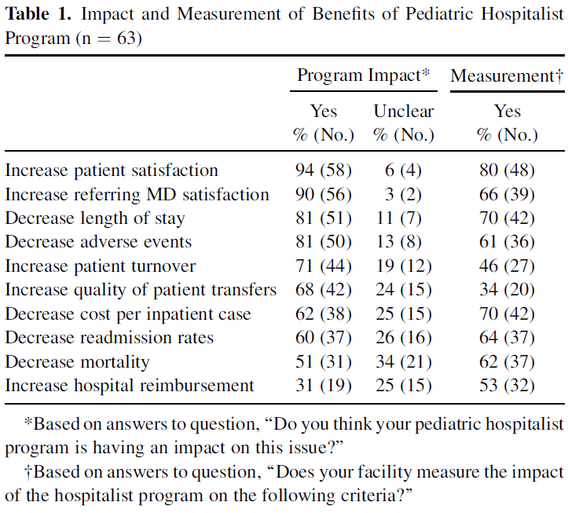
Hospital’s Perspectives on the Value of Pediatric Hospitalist Programs
Freed GL, Dunham KM, Switalski KE, et. al. Assessing the value of pediatric hospitalist programs: the perspective of hospital leaders. Academic Pediatrics 2009;9(3):192-6.
Notes:
Could we somehow highlight “increase referring MD satisfaction” and “decrease length of stay” and “increase quality of transfers”?

Slide 36
AAP Policy Statement
Guiding Principles for Pediatric Hospitalist Programs
  5. Pediatric hospitalist programs should provide for timely and complete communication between the hospitalist and the physicians responsible for a patient’s outpatient management, including the primary care physician and all involved subspecialists.
Perclay JM, Strong GB, American Academy of Pediatrics Section on Hospital Medicine. Guiding Principles for Pediatric Hospitalist Programs. Pediatrics 2005;115(4): 1101-1102.
Notes:
Is this a complete citation?

Slide 37

Trend towards decreased risk of readmission for patients seen for follow-up by a physician that had received a discharge summary
  Only 24.5% of summaries were available for at least 1 follow-up visit
Van Walraven C, Seth R, Austin PC, Laupacis A. Effect of discharge summary availability during post-discahrge visits on hospital readmission. J Gen Intern Med 2002;17:186-192.

Slide 38
PHM – VIP Discharge Handoff Collaborative Phase 1
Notes:
Is mentioning VIP just distracting for this audience? An offshoot of an offshoot?

Slide 39
PHM-VIP Discharge Handoff Collaborative Phase 1 Needs Assessment
When would you prefer to be notified about your patient’s admission to the hospital?
  68.8% During business hours but soon after admission
  38.6% At discharge
  32.9 % Periodically throughout admission
  20.0 % Immediately upon admission

Slide 40
PHM-VIP Discharge Handoff Collaborative Phase 1 Needs Assessment
How would you prefer to be notified regarding discharge of your patient from the hospital?
  47.9 % Electronically (email)
  46.5% Telephone
  46.5 % By mail or fax

Slide 41
PHM-VIP Discharge Handoff Collaborative Phase 1 Needs Assessment
When would you prefer that the discharge communication (whether verbal or written) occur?
  56.3% Same day
  23.9% Prior to recommended follow-up appointment
  14.1% Within 72 hours

Slide 42
PHM-VIP Discharge Handoff Collaborative Phase 1 Needs Assessment
If your patient is discharged when you are not personally available (holiday, weekends, evenings), then how should you be notified?
  42.3% Electronically (email)
  36.6% Fax to the office
  28.2% Contact on-call physician
  22.5% Leave message with office or answering service
Notes:
I would cut these slides down somewhat- stress that there was a very wide range of PCP preferences for how and when they would be notified of patient information but cut this info down to 2 slides

Slide 43
PHM-VIP Discharge Handoff Collaborative Phase 1 Needs Assessment
If your patient is discharged when you are not personally available (holiday, weekends, evenings), then how should you be notified?
  42.3% Electronically (email)
  36.6% Fax to the office
  28.2% Contact on-call physician
  22.5% Leave message with office or answering service

Slide 44
PHM-VIP Discharge Handoff Collaborative Phase 1 Needs Assessment
What would you consider critical information to include in the initial discharge communication? (Assuming that this is a timely version later followed by a complete, detailed discharge summary).
  98.6% Diagnoses
  97.2% Brief summary of hospital course
  95.8 % Follow-up plans
  93.0% Discharge medications
  67.6% Referrals that need to be processed
  64.8% Pending laboratory results
  39.4% Imaging procedures and results
  39.4% Laboratory results
  29.6% Hospital medications
Notes:
I would shorten the phase 1 needs assessment to a few slides and THEN mention our global/specific aims.

Slide 45
PHM – VIP
Transitions of Care Collaborative Phase 2 next steps: improve content, outcomes, QuIIN (MOC)
Join us to find out more!
David.Cooperberg@DrexelMed.edu
mshen@seton.org

