Slide 1



Clinical Safety & Effectiveness
Cohort # 8
Overdue Results at Westover Hills
DATE
Educating for Quality Improvement & Patient Safety

Slide 2

Team Makeup
Stella Koretsky, MD, Medical Director - Westover Hills
Jeanette Hernandez, Clinic Manager - Westover Hills
Valerie Works-Gomez - Director, HIM - UT Medicine
John Cange - Director, EpicCare - UT Medicine
  Extended Team:
  Glen Lam, Reporting Analyst - UT Medicine
  Jarrod Power, EpicCare - UT Medicine
  Tim Davis, HIM Mgr. - UT Medicine
  Eli Mendiola, HIM Supv. - UT Medicine
  Cindy Escalera, MA - Westover Hills
  Efrain Esqueda, LVN - Westover Hills
  Roxanne Gonzales, MA - Westover Hills
  Hope Nora, PhD - CS&E Consultant / Advisor

Slide 3
AIM Statement
Reduce Overdue Results at Westover Hills Family Medicine clinic by 80% by September 30th, 2011

Slide 4
Problem Definition
Overdue Results (ODR) occur when expected date for an ancillary result is exceeded by:
  7 days for a “Future” order
  0 days for a Clinic-performed “Normal” procedure (A1C, UA)
ODR messages are delivered to clinical staff’s Epic (EMR) In Baskets. With nearly 1,900 messages to ‘manage’, staff is overwhelmed; creating a delay in working messages.
ODR negatively impact timeliness of care and potential loss of revenue from cancelled appointments.

Slide 5
Patient Impact of ODR
1. National Committee for Quality Assurance (NCQA)
Track and Coordinate Care Standard (#5)
“Practice has documented process for and demonstrates:
  Tracks lab tests and flags and follows-up on overdue results.”
2. JCAHO
“The JCAHO requires health care organizations to track and improve the timeliness of reporting and receipt of critical test results by the responsible licensed caregiver.”
Analysis of Laboratory Critical Value Reporting at a Large Academic Medical Center. Anand S. Dighe, MD, PhD,1 Arjun Rao, MBBS, MBA,2 Amanda B. Coakley, RN, PhD,3and Kent B. Lewandrowski, MD1 Am J Clin Pathol 2006;125:758-764
3. Lit. Review: no relevant ODR, patient safety studies found in moderate scan of the literature (PubMed, NEJM, Google).
Notes:
1 & 2 show core Governmental and Oversight Quality Measures
Managing ODR is part of our National Standard of Care – part of standards for JCAHO and NCQA
3 – hoped to find Pubmed arcticles on potential risks caused by ODR, but we could find no relevant studies in the literature --- might be a good study for an informaticist or someone like me finishing their MS in Health Informatics

Slide 6
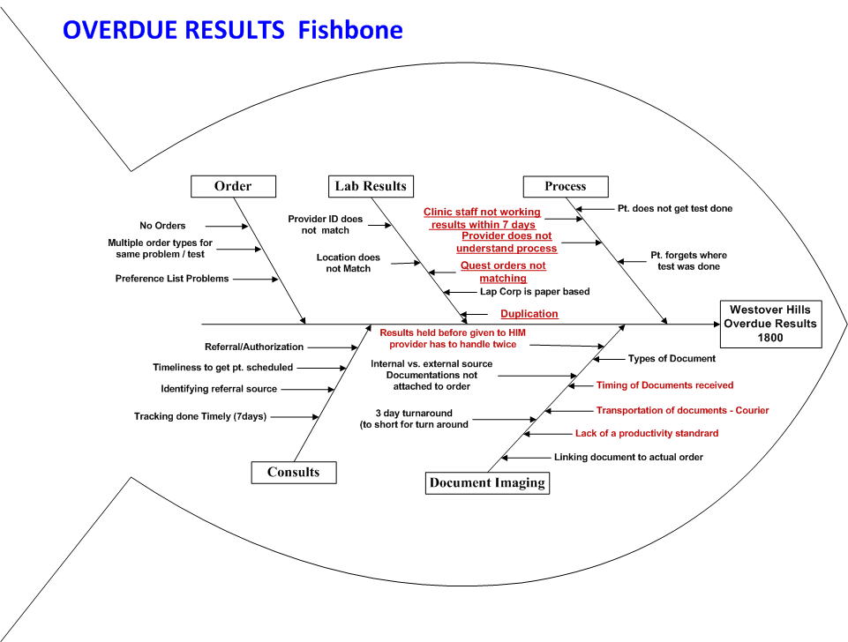
Notes:
NARRATIVE: read reds – mention all – allude to the Provider not understanding the process (were the expected dates the original idea?)

Slide 7
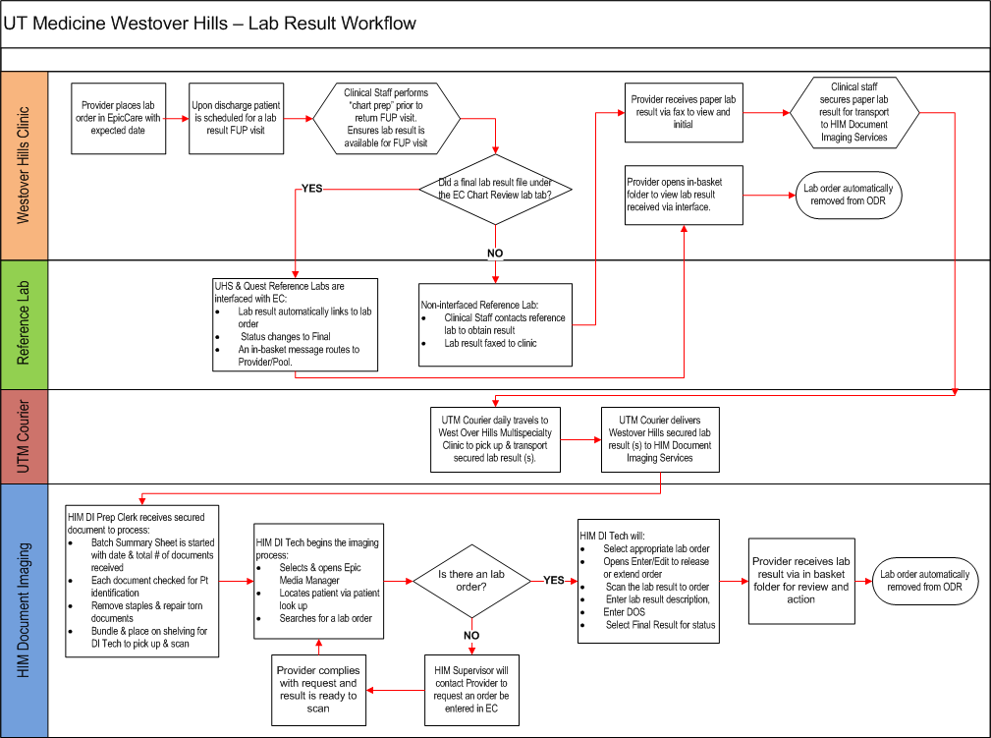

Slide 8
Project Timeline
First Team Meeting & Deliverables 5/18/11
  AIM statement 1
  Cause/Effect (Fish) diagram
  Scope Decision: Labs & Imaging
Document Imaging Analysis: 6/1/11
Discuss Lab Issues – duplicates, panel tests, Quest: 6/15/11
  Re-scope : Labs emphasis
  AIM statement 2
Data Analysis / Research: 6/15/11 – 9/15/11 (ongoing)
ODR Baseline Data Collection: 1,895 Total ODR at WH Hills: 6/24/11
Interventions 1-X – ‘clean’ ODR message queues: 6/25/11 – 8/16/11
Intervention Z – institutionalize process changes, train providers: 9/1/11
Finalize Control Charts for Presentation: 9/7/11
Deliverables & Project Presentation – TODAY!

Slide 9
Quantify the Problem: UT Medicine vs. Westover Hills
Annual # Orders – UT Medicine: 454,984 (projected)
Overdue Results – UT Medicine: 22,528 (projected)
= 4.9% OVERDUE (ALL UT Medicine)
Annual # Orders – Westover Hills: 14,063 (projected)
Overdue Results – Westover Hills: 1,895 (6/24/11 snapshot)
= 13.4% OVERDUE (All Westover Hills)

Slide 10
WH FM
15% of Total Lab ODR Messages
Notes:
1,895 of Labs == 15% of total (12,363)

Slide 11
Quantify the Problem: Westover Hills
Westover Hills makes a good “pilot site” for UT Medicine-wide rollout. WH ODR is nearly 3 times the average for all UT Medicine. Also:
    6.54% of “Normal” orders overdue
    49.55% of “Future” orders overdue
Re-Scope: Focus on Future Lab Orders!

Slide 12

DISCOVERIES – June to September, 2011
H&H vs. CBC issue
BUN vs. Chem confusion
Duplicate tests/results: Quest error, provider error
Physicians not changing Expected Date default (‘today’)
“Result Notes” column header is not about Results – creates confusion
Clinic staff not always resulting same-day POC tests/procedures (causes ODR for same-day tests)
Clinic staff not ‘working’ ODR messages
Postponing ODR messages only delays awareness of scope of problems
Notes:
We sampled 10 ODR messages 3 different weeks – last October, this Spring and this Summer to determine some of the root causes of ODR messages. This served as the basis for many of our discoveries and for our ODR Message Management Guide we’ll discuss later.

Slide 13
DISCOVERIES – June to September, 2011
H&H vs. CBC issue
BUN vs. Chem confusion
Duplicate tests/results: Quest error, provider error
Physicians not changing Expected Date default (‘today’)
“Result Notes” column header is not about Results – creates confusion
Clinic staff not always resulting same-day POC tests/procedures (causes ODR for same-day tests)
Clinic staff not ‘working’ ODR messages
Postponing ODR messages only delays awareness of scope of problems
Notes:
The first issue, for example, was a physician ordering problem…
The physician ordered both an H&H and a CBC. Quest realized that the H&H results were part of the CBC panel, so they only returned the CBC results. The H&H order would never be resulted, so this ODR would persist until the order was cancelled.
The biggest discovery, though, was that the staff just were not working the messages in a timely manner.
The biggest discovery affecting the delivery of Future results was user related. Physicians were not always resetting the Expected Date, which is defaulted to today’s date. Half of Future orders were generating ODR for this reason.

Slide 14
DISCOVERIES – June to September, 2011
H&H vs. CBC issue
BUN vs. Chem confusion
Duplicate tests/results: Quest error, provider error
Physicians not changing Expected Date default (‘today’)
“Result Notes” column header is not about Results – creates confusion
Clinic staff not always resulting same-day POC tests/procedures (causes ODR for same-day tests)
Clinic staff not ‘working’ ODR messages
Postponing ODR messages only delays awareness of scope of problems
Notes:
The biggest discovery affecting the delivery of Future results, though, was user related. Physicians were not always resetting the Expected Date, which is defaulted to today’s date. Half of Future orders were generating ODR for this reason.

Slide 15
DISCOVERIES – June to September, 2011
H&H vs. CBC issue
BUN vs. Chem confusion
Duplicate tests/results: Quest error, provider error
Physicians not changing Expected Date default (‘today’)
“Result Notes” column header is not about Results – creates confusion
Clinic staff not always resulting same-day POC tests/procedures (causes ODR for same-day tests)
Clinic staff not ‘working’ ODR messages
Postponing ODR messages only delays awareness of scope of problems
Notes:
The key reason that so many messages had accumulated to nearly 2,000 overdue results was that the staff just were not working the messages in a timely manner. It got to an overwhelming point. One solution to that problem was to postpone messages. We found 1543 messages had been postponed at the start of the project.

Slide 16
Interventions
Imaging / HIM Interventions: 6/25/11
Establish Productivity Standards for HIM Document Imaging Services
  Scan TAT of 72 hours or less -- 400 clinical documents /8 hr. day to meet required
Improve document delivery: WH Clinics to UT Med HIM via UTM Courier
Reduce Provider-to-HIM handoffs so Provider handles one result via in-basket
  EpicCare Applications: 7 /15/11
  Remove “Results Notes” – is not really about Results
  Increase reliability of ODR data and message delivery by correcting message delivery settings (releasing ~5,000 ODR ‘held’ in error to clinic pools)
Westover Hills Clinical Operations:
Establish ‘cleanup’ process by clinical staff to reduce # ODR. 6/24/11
Institutionalize process, maintain manageable levels of ODR: 9/1/11 →
Train physicians & staff to understand order types, expected dates. 9/1/11 →
Notes:
Intervention 4 – physician training items added to standard EpicCare training curriculum – 10/1/11

Slide 17
WH Staff training and awareness
HIM Productivity Standards Implemented
WH Ops Letters and phone calls to patients – 3 attempts, 3-4 weeks
EpicCare corrections, Improved data/reporting
WH Cleanup efforts: cancelling orders of non-responsive patients, etc.

Slide 18
New Overdue Results by Week
Notes:
Used Control Charts to analyze the date. This data generated by looking at # of specific Orders resulting in individual in ODR messages.
NOTE: Post Intervention, the data shows:
Downward, random trend in historical data (Mar-April red dots)
Downward, and reliable trend during Intervention weeks (June-July red dots)
Spike up at end within LCL and Midpoint, so natural variation.
The Center line reduced by 32 pts
Difference between control limits from (approximately) 180 to 120
Overall tightening of control limits and variability post-intervention – stable going forward? New baseline? Monitor.

Slide 19
Notes:
16-Aug 23-Aug 30-Aug 6-Sep 13-Sep
948 988 1058 1083 1080
Hold 632
New 442

Slide 20

Return On Investment
4 Providers * 1 extra PT/session * 8 sessions/week = 32 extra PTs/week * $100 (avg rev/visit) * 42 weeks =
Gain from Investment = $134,400
($33,600 per provider, annually)
Less Cost of Investment = $40,000
(Team resources @ 400 hrs * $100/hr., incl. benefits)
Net Gain on Investment = $96,000
(4 Providers)
ROI = 2.36
Notes:
1 extra PTN / session rationale:
interpreting lab results are needed for the follow-up visit
if results are unavailable (due to ODR), visits are often cancelled or rescheduled
If PTN seen, E&M coding is lower than w/ lab interp as part of visit note.
Cancelled appointments often leave an opening in the provider’s schedule that goes unfilled.
BOTTOM LINE: 1 PTN/session is estimated to be missing lab results due to ODR
Less Potential Cost = $80,000 === Net Gain: 10M Potential ROI = $?
If other specialties or other locations realize only 10% of this benefit, payback to UT medicine is $1,008,000.

Slide 21
Lessons Learned
ODR can reduce provider productivity 1 PT / session
Prior efforts masked problems:
  “Postponing” results only removes message from InBasket, not ODR Report or work queue
Continuous effort is required to maintain manageable levels
Keep analyzing your data and trying new charting / graphs
Identify the data that is really needed – sooner, rather than later
Get expert help and guidance (fresh eyes), if needed
Define and re-define problem(s) clearly, re-examine assumptions

Slide 22
Project Results
Project Objectives:
  Reduced Total Westover Hills ODR messages by 55% (but not 80%)
  Reduced # of new ODR messages by 63%
  Achieved “Manageable” number of ODR messages (~1,000)
  Operations Improvements:
  Achieved Positive, Meaningful ROI: 2.36 (to 1)
  WH FM cleanup process institutionalized
  Improved Physician understanding of “Setting appropriate Expected Dates” for Normal vs. Future orders
Project Artifacts:
  Developed / Delivered Improvement Recommendations
  Developed Overdue Results “ODR Message Management Guide”
  Developed baseline ODR Dataset (available to future Cohorts)
Notes:
SUCCESS
Less than target 80%, but reached manageable level, reduced ODR by more than half in 2 months.

Slide 23
Project Results
Project Objectives:
  Reduced Total Westover Hills ODR messages by 55% (but not 80%)
  Reduced # of new ODR messages by 63%
  Achieved “Manageable” number of ODR messages (~1,000)
  Operations Improvements:
  Achieved Positive, Meaningful ROI: 2.36 (to 1)
  WH FM cleanup process institutionalized
  Improved Physician understanding of “Setting appropriate Expected Dates” for Normal vs. Future orders
Project Artifacts:
  Developed / Delivered Improvement Recommendations
  Developed Overdue Results “ODR Message Management Guide”
  Developed baseline ODR Dataset (available to future Cohorts)
Notes:
SUCCESS
Less than target 80%, but reached manageable level

Slide 24
Project Results
Project Objectives:
  Reduced Total Westover Hills ODR messages by 55% (but not 80%)
  Reduced # of new ODR messages by 63%
  Achieved “Manageable” number of ODR messages (~1,000)
  Operations Improvements:
  Achieved Positive, Meaningful ROI: 2.36 (to 1)
  WH FM cleanup process institutionalized
  Improved Physician understanding of “Setting appropriate Expected Dates” for Normal vs. Future orders
Project Artifacts:
  Developed / Delivered Improvement Recommendations
  Developed Overdue Results “ODR Message Management Guide” (draft)
  Baseline ODR Dataset (available to future Cohorts)
Notes:
SUCCESS
Less than target 80%, but reached manageable level

Slide 25
Recommendations
UT Medicine Teams:
  EpicCare: “Results Notes” column removal
  HIM: establish QI analysis of “Document Imaging”
  WH Clinic: continue ODR monitoring, report reviews
  Use “ODR Message Management Guide”
Leadership:
  Continue support of QI efforts (like this CS&E project)
Future Cohort(s):
  Establish Project Team to continue data collection and analysis of ODR reasons for continuous improvement
  Rollout ODR cleanup process to all UT Medicine clinics

Slide 26
ODR Message Management Guide (work in progress)
Reason for ODR
                LAB PANEL / COMPONENT
                PATIENT-BASED
                RESEARCH
Staff Action
If test is included in comprehensive panel, Cancel order or enter a result referencing the lab panel
Contact patient, if patient does not intend to get proc/test done, Cancel the order, notify physician, send letter to patient
For non-interfaced results, obtain results, send to HIM for document imaging
DRAFT

Slide 27


Thank you!
Educating for Quality Improvement & Patient Safety

