Slide 1
Imagining Innovation: Role of Creativity in Medical Education
Vineeth John, MD, MBA; John Riggs, MD, MS
Abbey Bachmann, PhD, MEd; Samuel Neher, MS, EdD
Peggy Hsieh, MEd, PhD

Slide 2
Session Learning Objectives
Session attendees will:
Discuss background on the neurobiological underpinnings of creativity
Share personal experiences with creativity
Analyze scenarios to understand factors that promote creative breakthroughs
Evaluate potential creativity solutions that pose as barriers to medical education

Slide 3
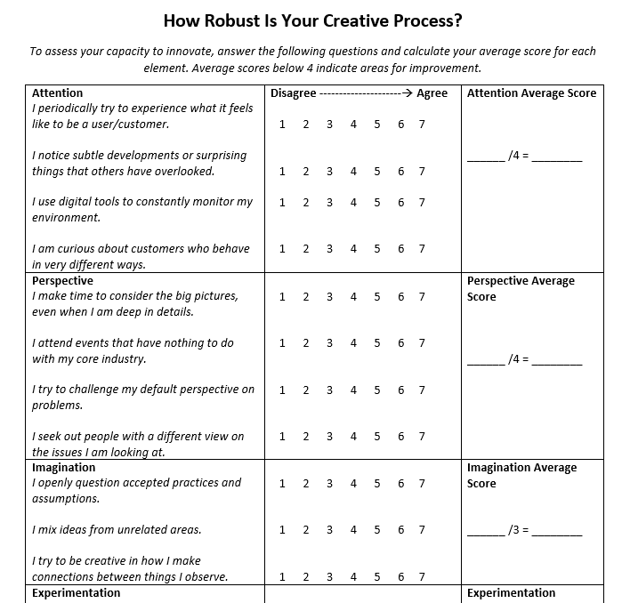
Creativity Quiz

Slide 4
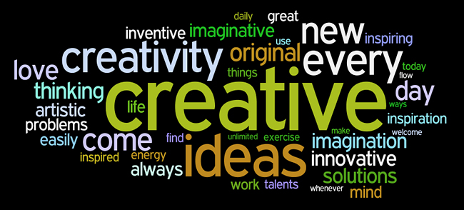
What is Creativity?

Slide 5
Creativity
Creativity ultimately involves the production of original, potentially workable, solutions to novel, ill-defined problems of relatively high complexity.
(Besemer & O’Quin, 1999; Lubart, 2001)

Slide 6
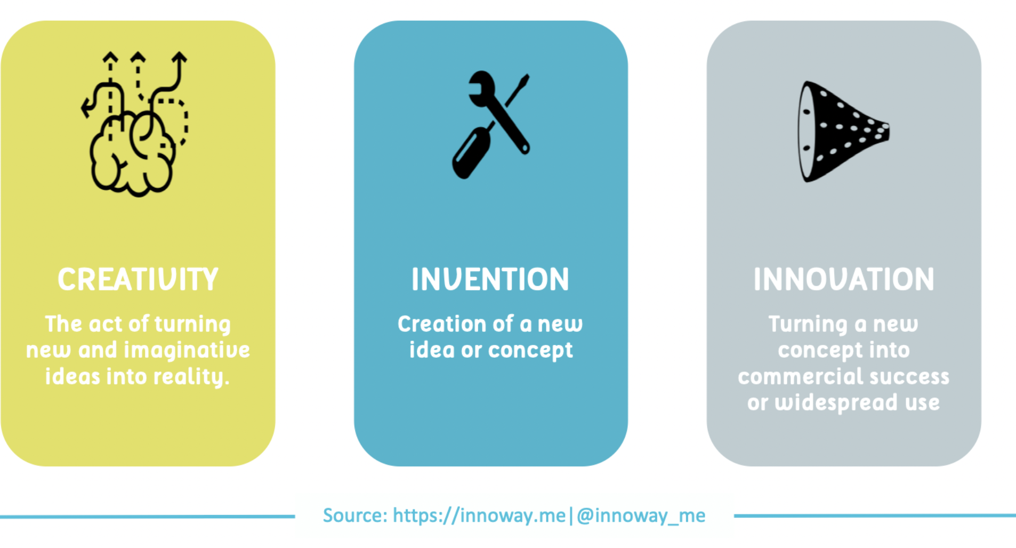

Slide 7
Credit: Dr. Elizabeth Armstrong, Harvard Macy Institute

Slide 8
5 Skills for Creative Individuals:

Slide 9
NEUROSCIENCE OF CREATIVITY

Slide 11
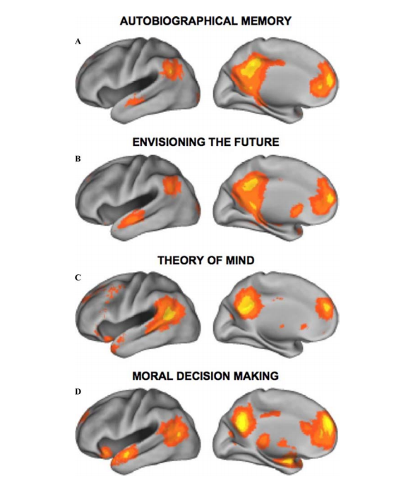
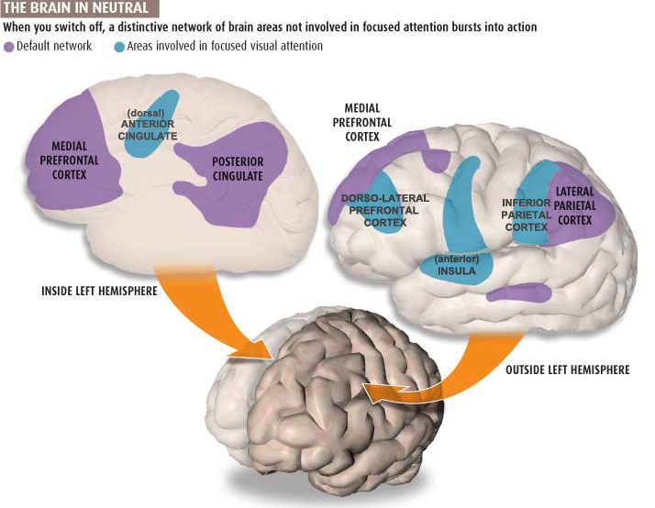
Default Mode Network: The Seat of Creativity

Slide 12
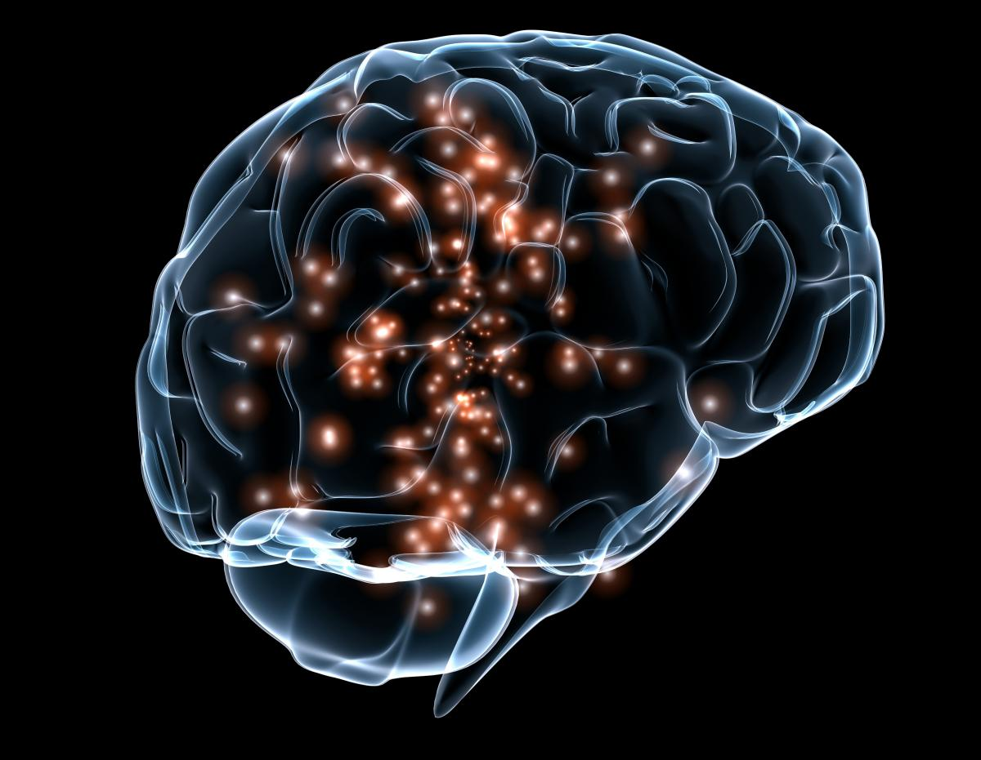
Neuroscience of the “Aha” Moment

Slide 13
Liza Aziz-Zadeh – University of Southern California

Slide 14
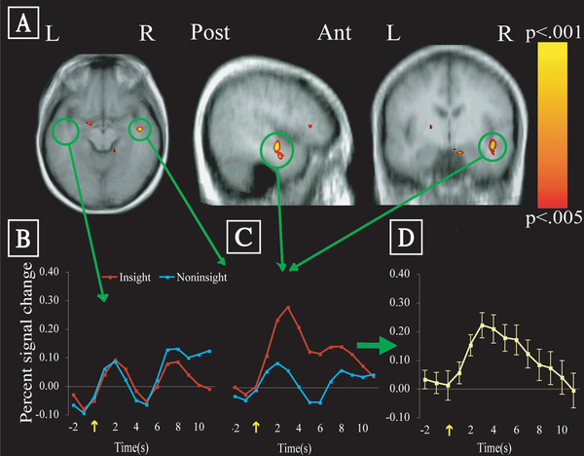
Neural Basis of Insight
Insight culminates with a sharp increase in neural activity in the right anterior temporal lobe at the moment of insight.
(Kounios and Beeman)
L
R

Slide 15
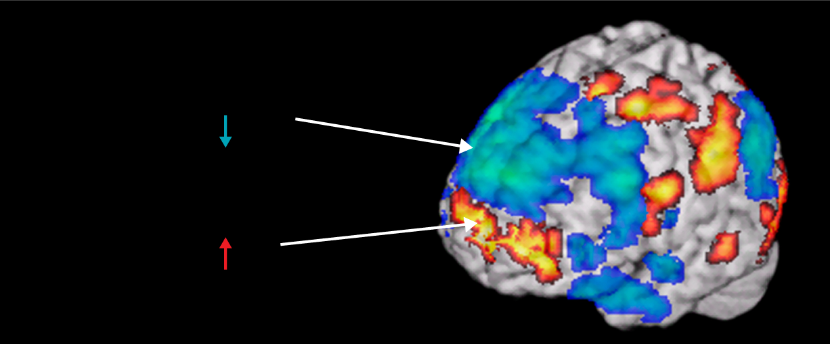
BAIN ON JAZZ
Brain on Jazz
Brain on Jazz
Lateral prefrontal deactivation
Self-monitoring
Medial prefrontal activation
Self-expression
C. Limb

Slide 17
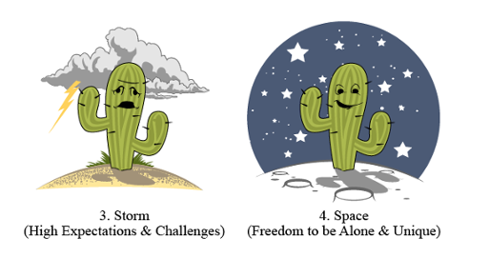
4 S Model of Creativity (K.H. Kim)

Slide 18
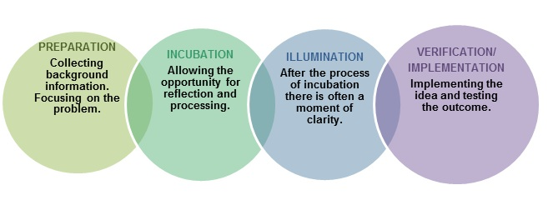
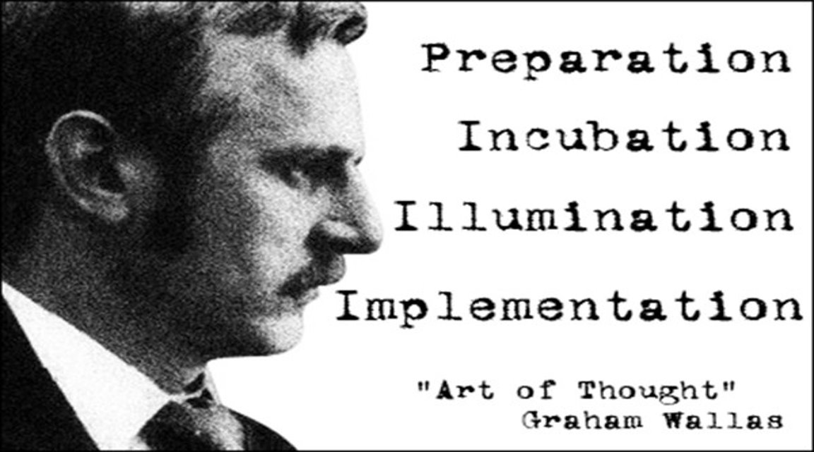
Wallas Model for Creativity

Slide 19
Objectives

Slide 20
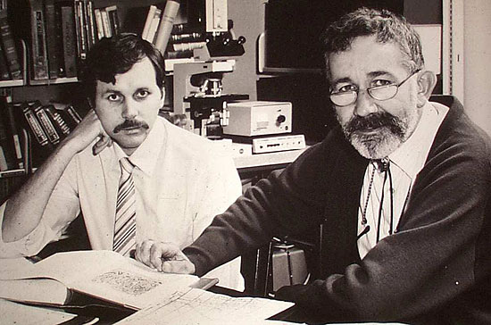

Slide 22
The Discovery of Helicobacter Pylori
“At the time of their discovery, Warren and Marshall were physicians doing their daily jobs. They were not in the laboratory chasing after the Nobel Prize. They had no intention of being in the limelight. They had no research grants for studying ulcer disease. Rather, they happened upon something interesting, and driven by curiosity, they investigated and reported it. They proved again that we, as physicians, can make groundbreaking discoveries in the course of our clinical practices if we attend to our work with open eyes, a sense of curiosity, a desire to understand, and a willingness to pursue ideas to their completion.”
Julie Parsonnet, M.D., NEJM 2005; 353:2421-23

Slide 23
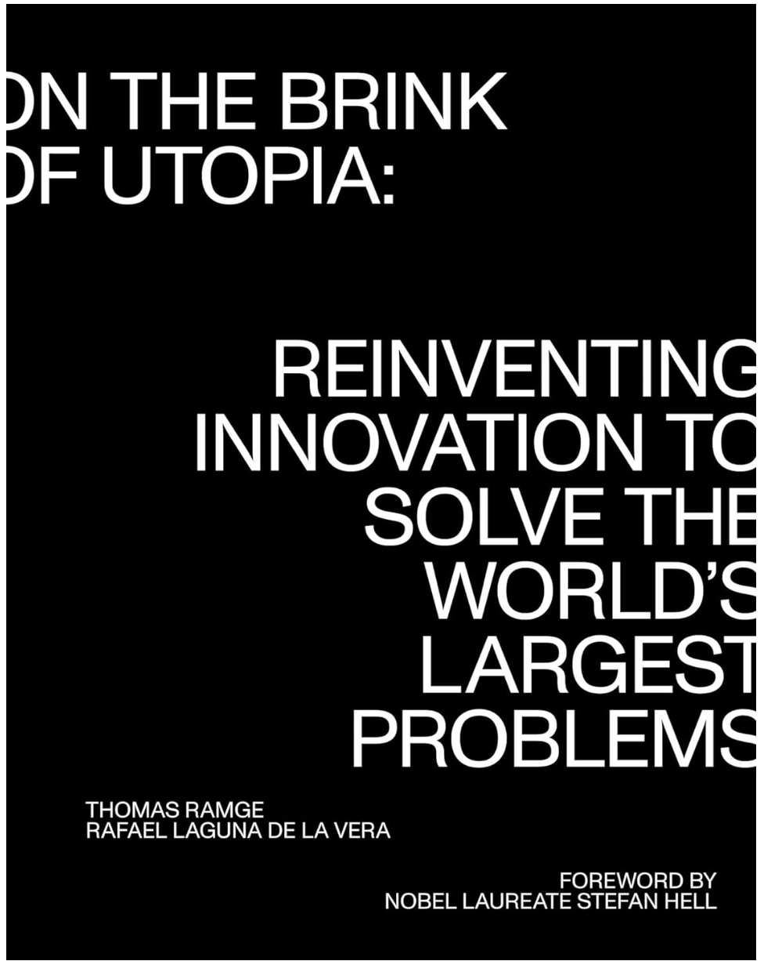
5 Traits of Creative Individuals: Ramge and De La Vera
1.Extreme Interest
2. Grit
3.Openness
4.Empowering and Inspiring Leadership
5. Drive for Impact

Slide 24
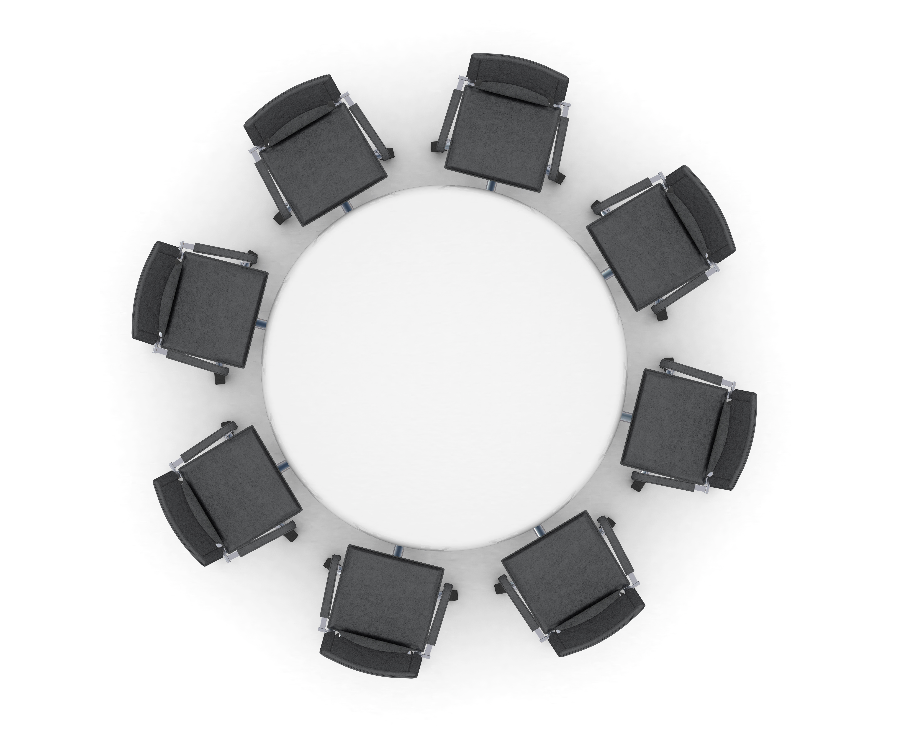
Stop and Discuss
Related to your position(s) in the workplace, what are your creative strengths?
Does this align with the results you saw on your creativity quiz?

Slide 25
5 Forces that Drive Creativity
Chance
Collaboration
Competition
Curiosity
Convergence

Slide 26
Driver #1: Chance

Slide 27
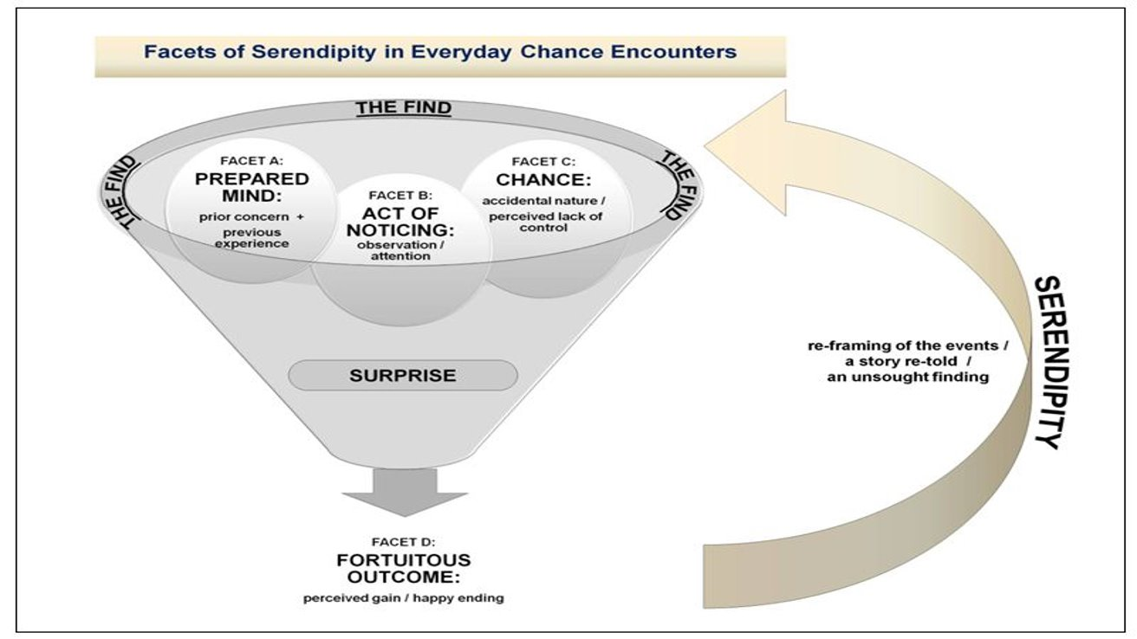
Serendipity
Chance interacting with human action, leading to a usually positive outcome.

Slide 28
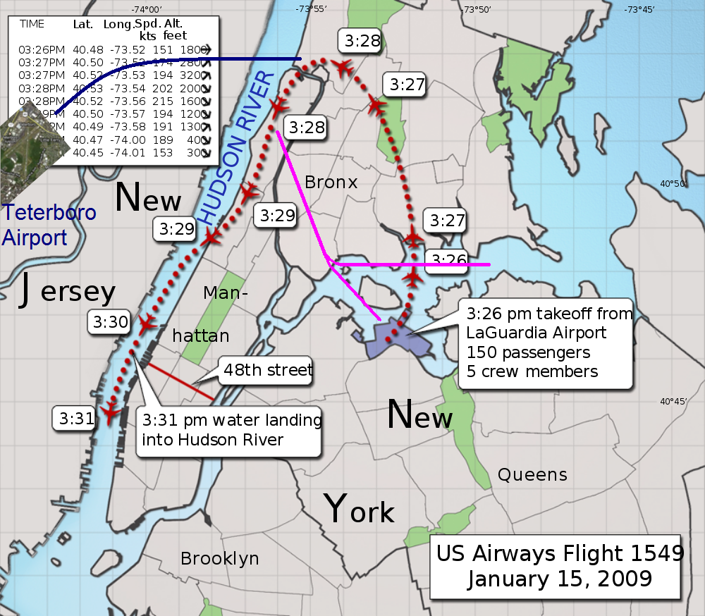
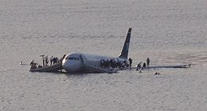

Slide 29
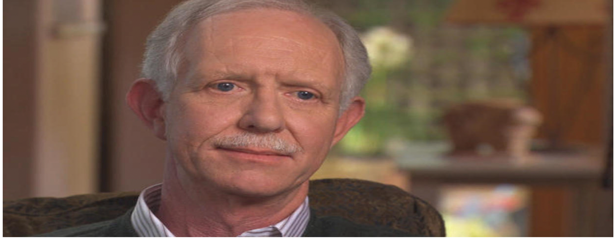
"One way of looking at this might be that for 42 years, I've been making small, regular deposits in this bank of experience, education and training. And on January 15, the balance was sufficient so that I could make a very large withdrawal”
- Chesley B. "Sully" Sullenberger, III

Slide 30
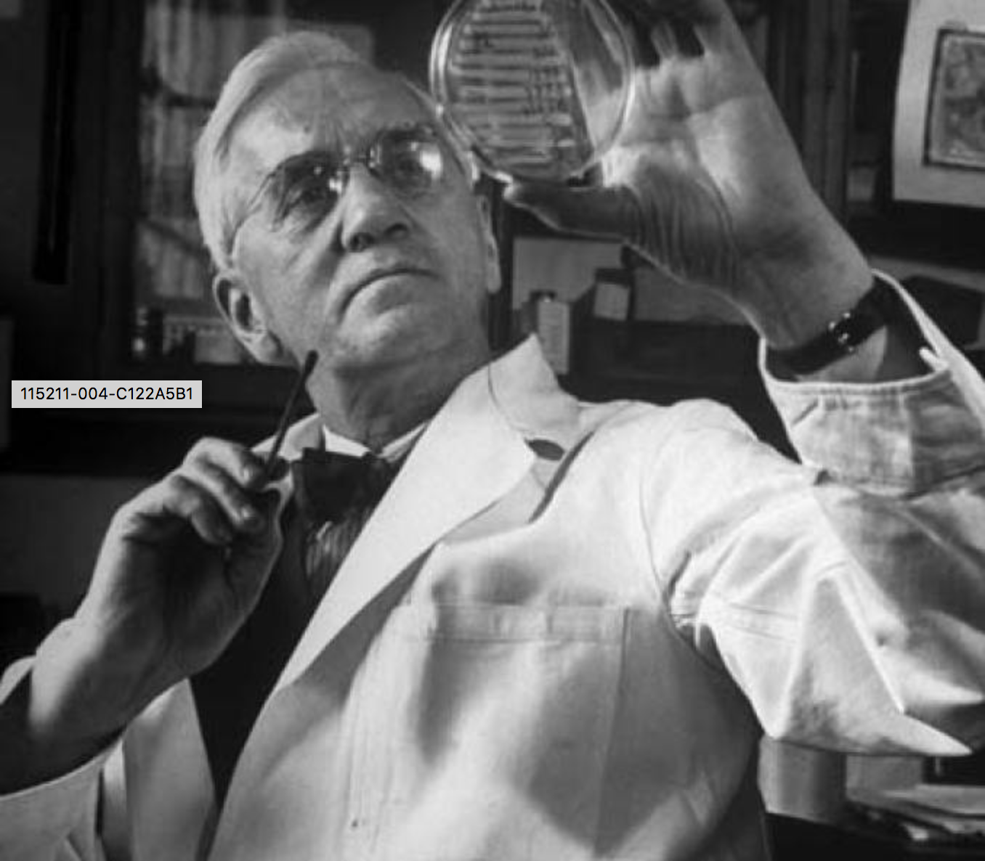

Slide 31
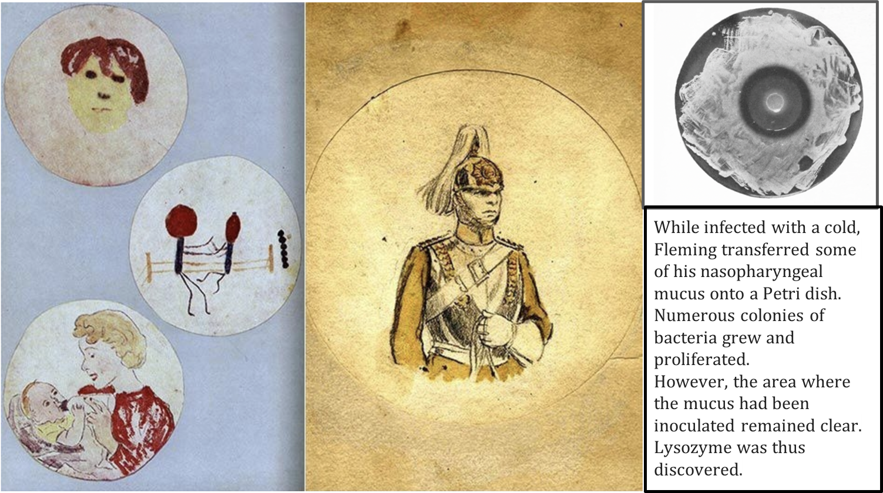

Slide 32
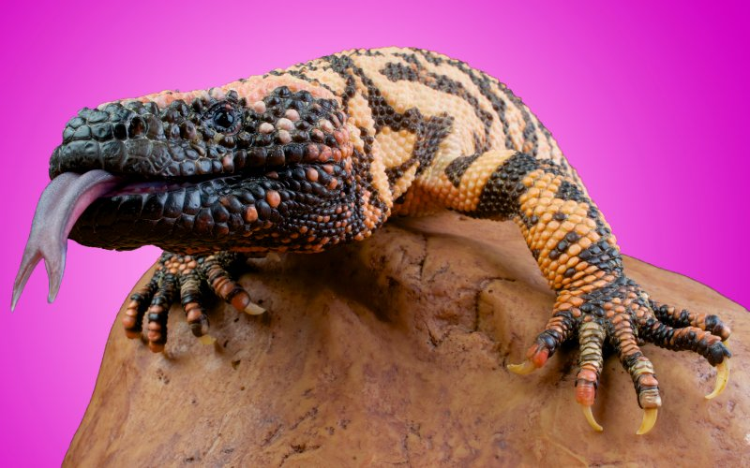

Slide 33
Dr. Eng and the Gila Monster
Amylin Chairman Joseph Cook described Eng as "someone who is unusually capable to see things, particularly patterns, that others don't see when looking at an object, or data set, or event."

Slide 34
C. Busch: The Serendipity Mindset

Slide 35
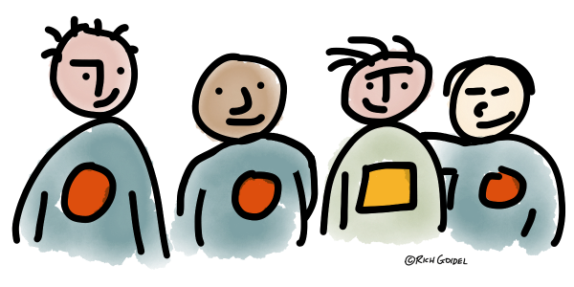
1. Collaboration
Driver #2: Collaboration

Slide 36
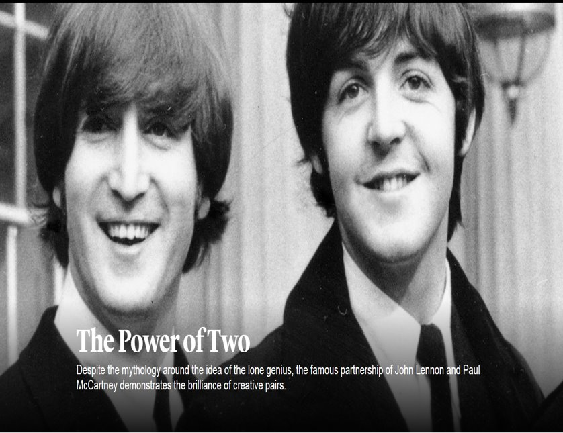
Creativity and the “Power of Twos”
John was the badass older brother Paul never had. Paul was a charming sidekick who could do something rare - keep up with John. - Joshua Shenk
Compensatory Genius:
A brilliant mind makes up for the shortcomings of another brilliant one

Slide 37
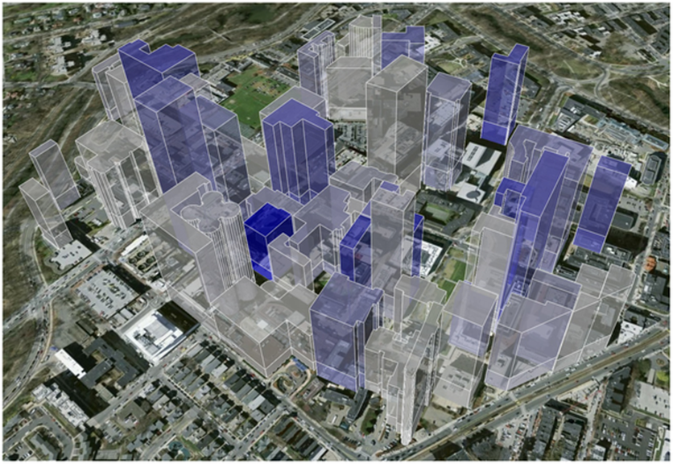

Slide 38
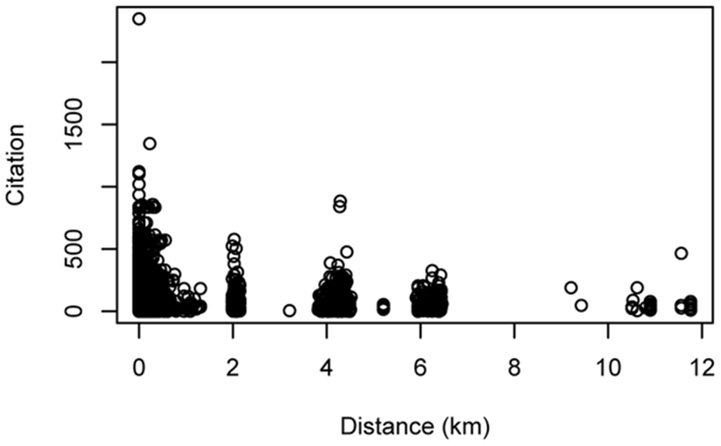

Slide 39
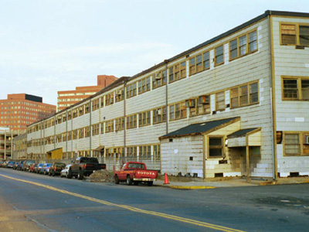
MIT’s Building 20: "The Magical Incubator"
An eccentric amalgam of people who knew little to nothing about each other, suddenly thrust together within the walls of what seemed like an awful building.

Slide 40
Q Factor: Why too much chumminess and too little friction are bad for business
Source: Dangerous Kitchen

Slide 41
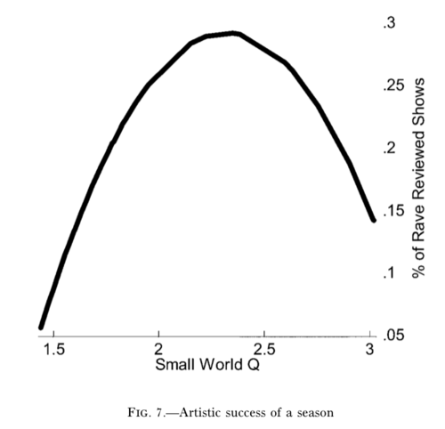
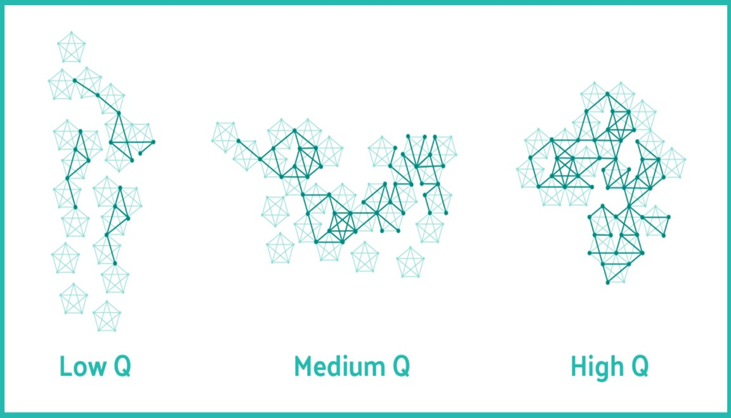
The Power of Q

Slide 42
Driver #3: Competition

Slide 43
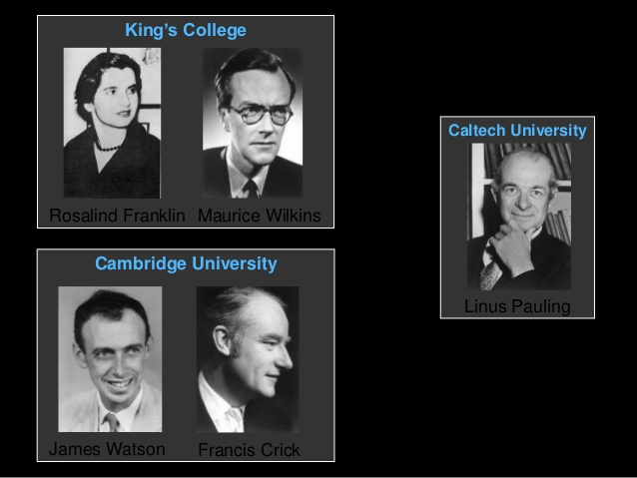

Slide 44
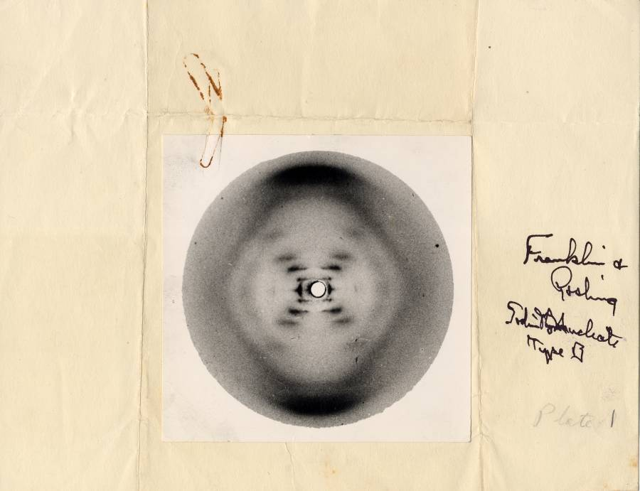

Slide 45
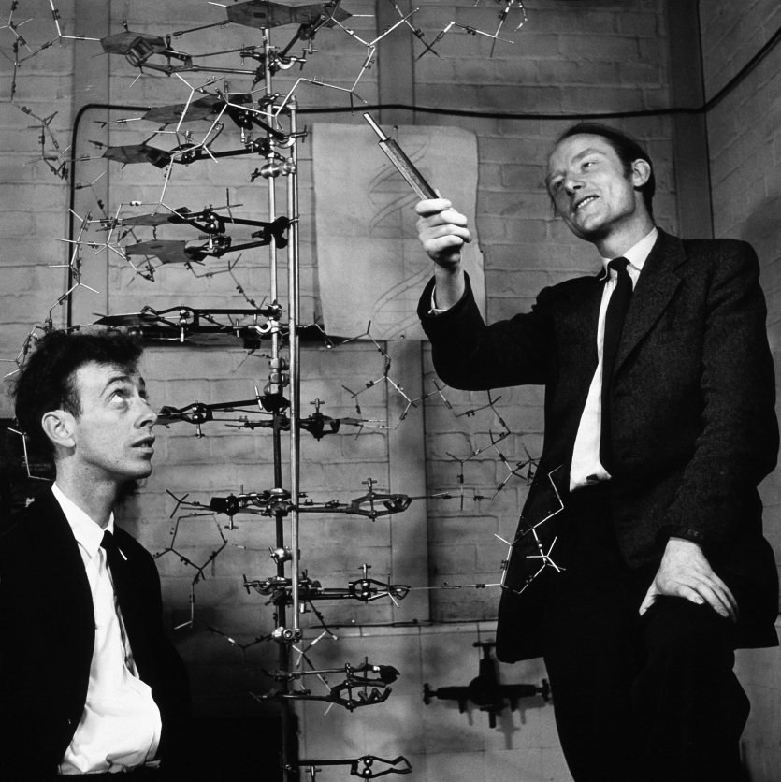
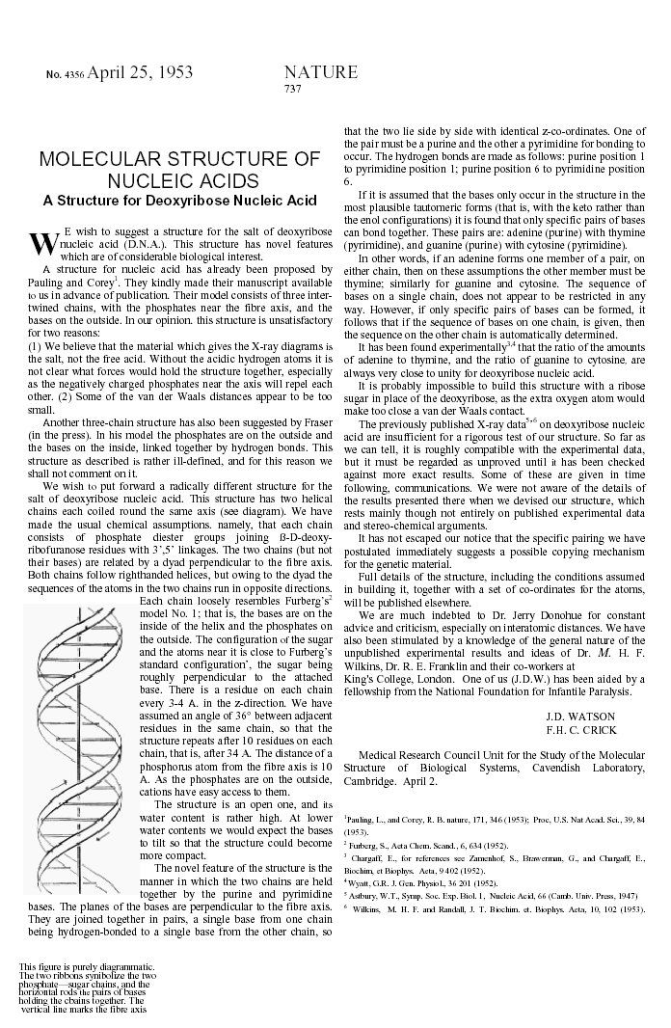

Slide 46
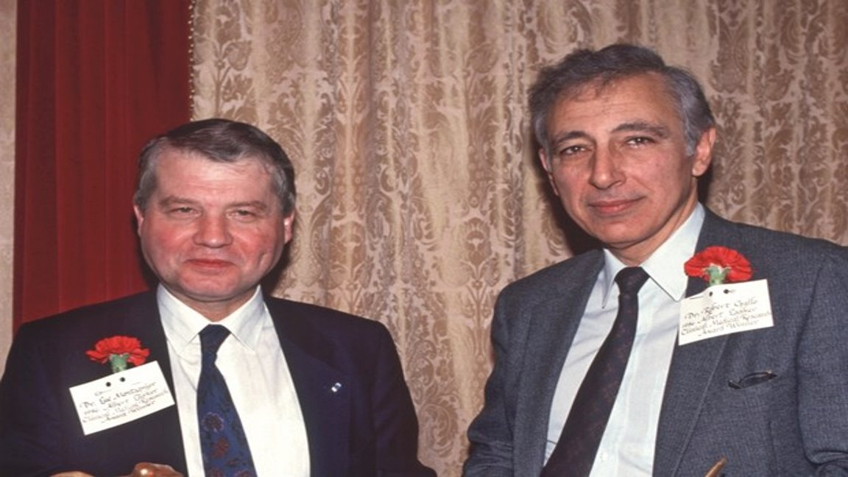

Slide 47
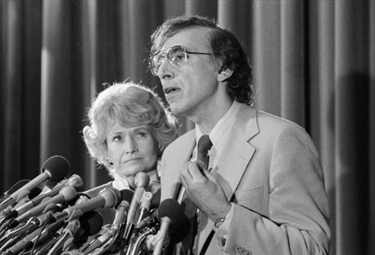

Slide 49
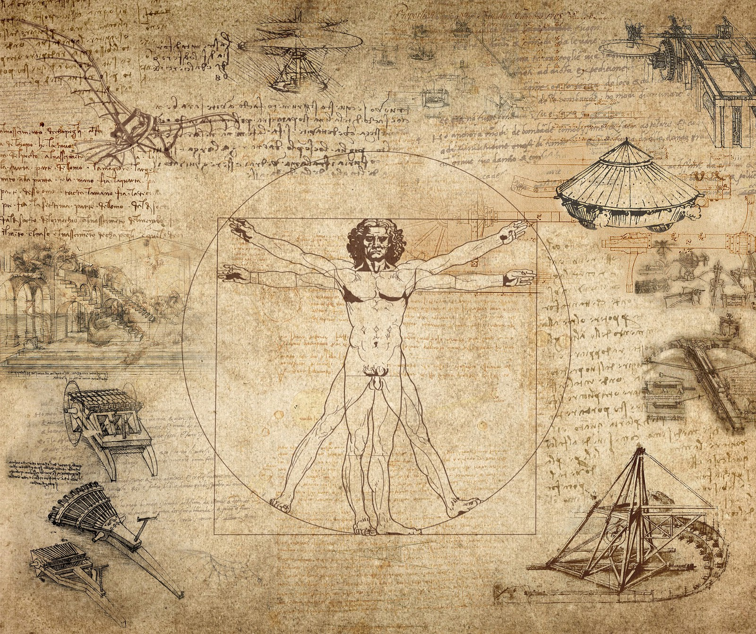
Driver #4: Curiosity

Slide 50
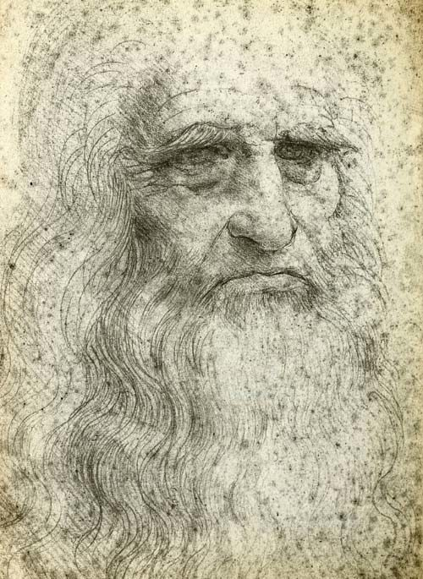
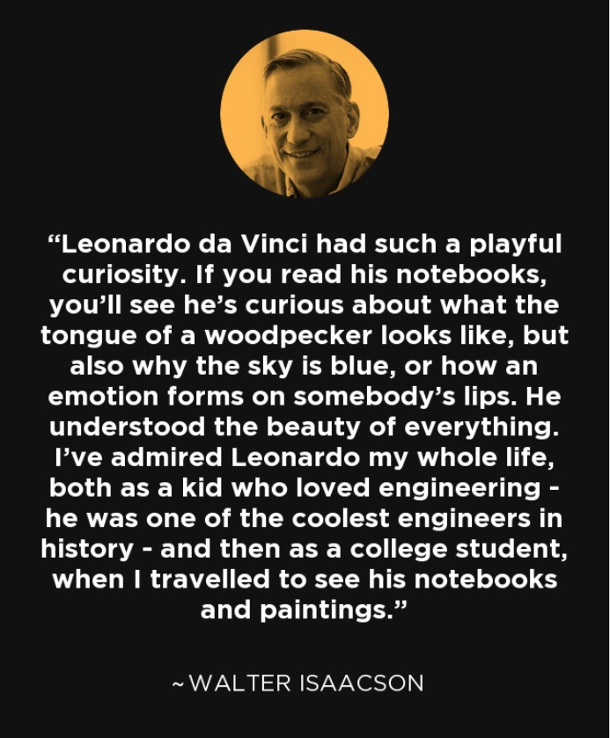

Slide 51
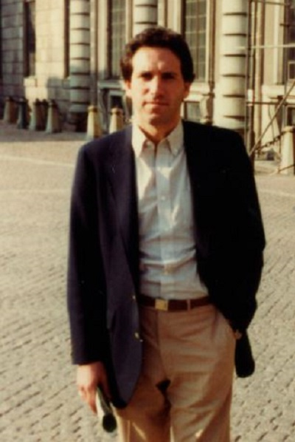
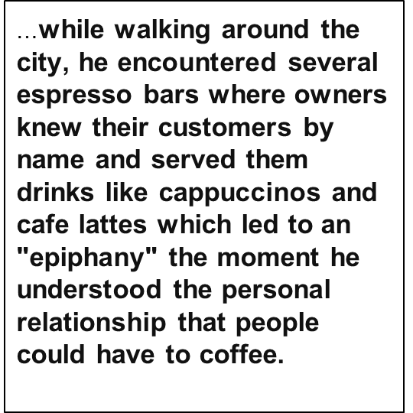

Slide 53
What is Curiosity?
The drive to learn and explore something to attain further knowledge and skill of the subject.
Self-regulates inherent goal effort, grit, personal growth, and creativity (Kashdan & Fincham, 2002).
Notes:
Basis for fostering creativity and industry (Kashdan & Fincham, 2002).
Mutual relationship between curiosity and motivation.

Slide 54
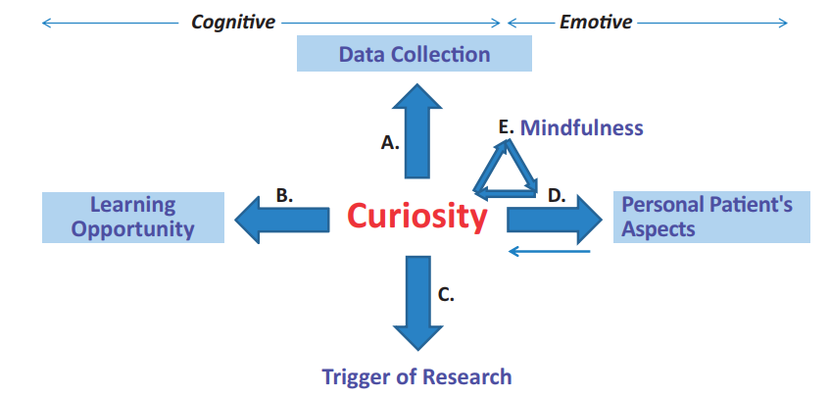

Slide 55
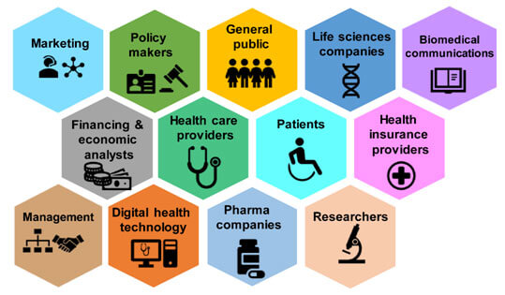
Driver #5: Convergence

Slide 56
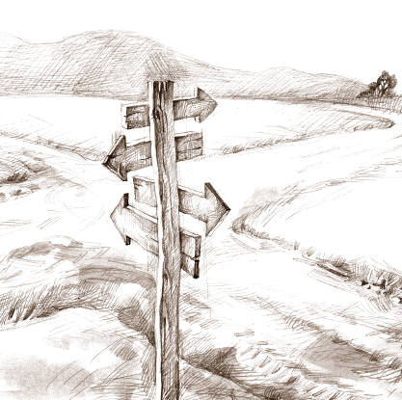
Medici Effect
Where fields meet
Field = culture, domain, discipline
Fields consist of concepts (knowledge, practices)

Slide 57
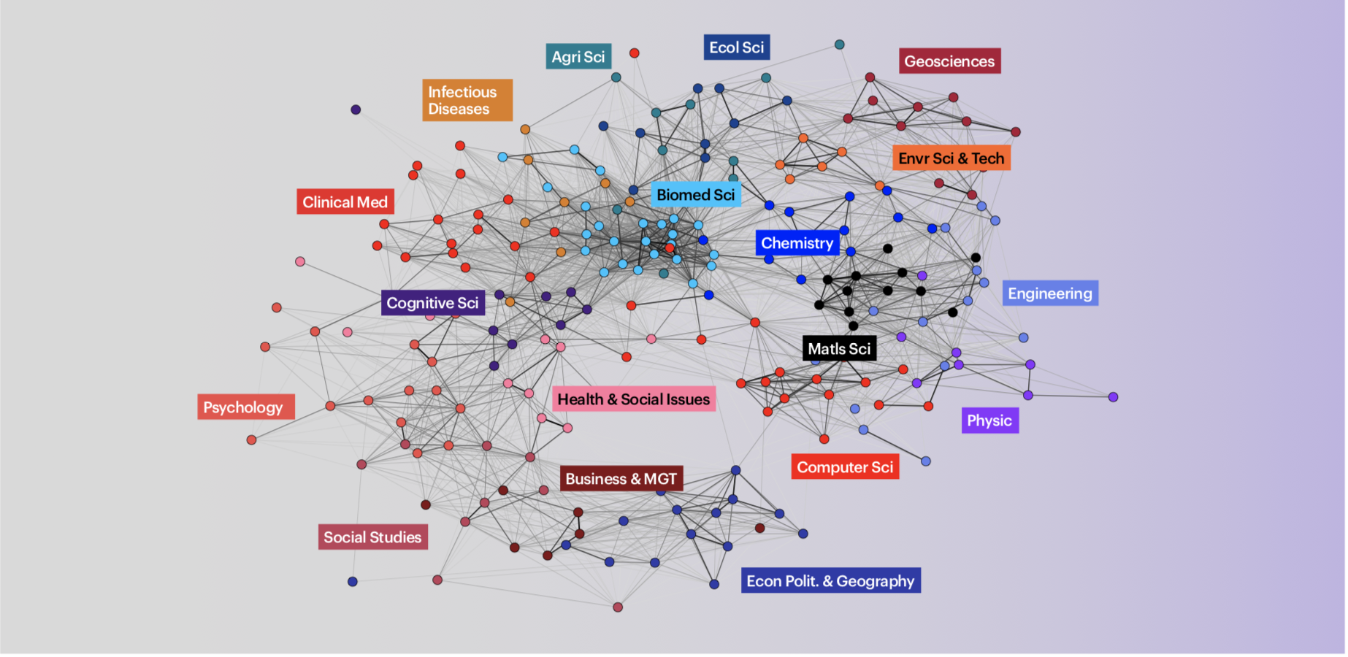
Mapping Convergence

Slide 58
Convergence Medicine Arrives

Slide 59
Stop and Reflect
Which of the 5 forces that drive creativity stand out to you?
How could you see yourself utilizing and leveraging this/these force(s) to promote creativity in academic medicine?

Slide 60
Barriers in Creativity
Time constraints
Emphasis on evidence-based practice
Lack of collaborators
Social comparisons and competition
Obvious rewards tied to routine behaviors
Public evaluations
High standards
Limiting Mindsets
Reluctance to embrace one’s identity as a “Creative” person
This Photo by Unknown author is licensed under CC BY.

Slide 61
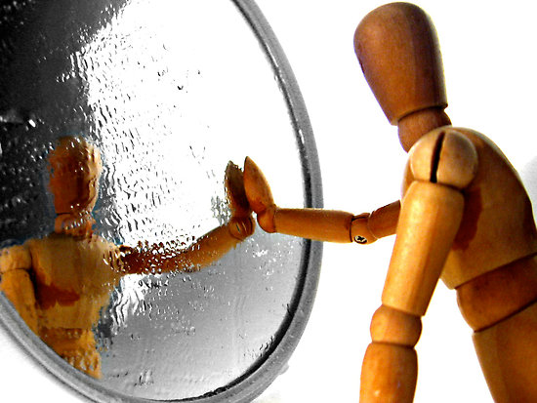
Reflect and Share
Reflecting on your creative strengths, what current barriers prevent you from moving forward with your creativity?
When you return to the workplace, what are you able to do to overcome the identified barriers?
This Photo by Unknown author is licensed under CC BY-NC-ND.

Slide 62
Re-igniting Creativity
•Take control of your schedule
•Connect the dots AND be prepared for serendipity in your life
•Make time for daydreaming
•Shape your space AND find your creative partner
•Find out what you like and what you hate about your life
•Start doing more of what you love and less of what you hate

Slide 63
Questions?
Vineeth John, MD, MBA – vineeth.p.john@uth.tmc.edu
John Riggs, MD, MS- john.w.riggs@uth.tmc.edu
Abbey Bachmann, PhD, MEd – abbey.m.bachmann@uth.tmc.edu
Samuel Neher, MS, EdD - samuel.e.neher@uth.tmc.edu
Peggy Hsieh, MEd, PhD - peggy.h.huang@uth.tmc.edu

